Slide 1
World War II: Overview
AP US History

Slide 2
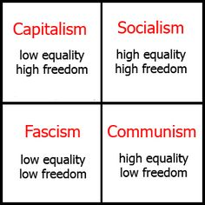

Slide 3
Causes
Treaty of Versailles
War Debt
Emergence of fascism
Lack of power of League of Nations
Appeasement

Slide 4
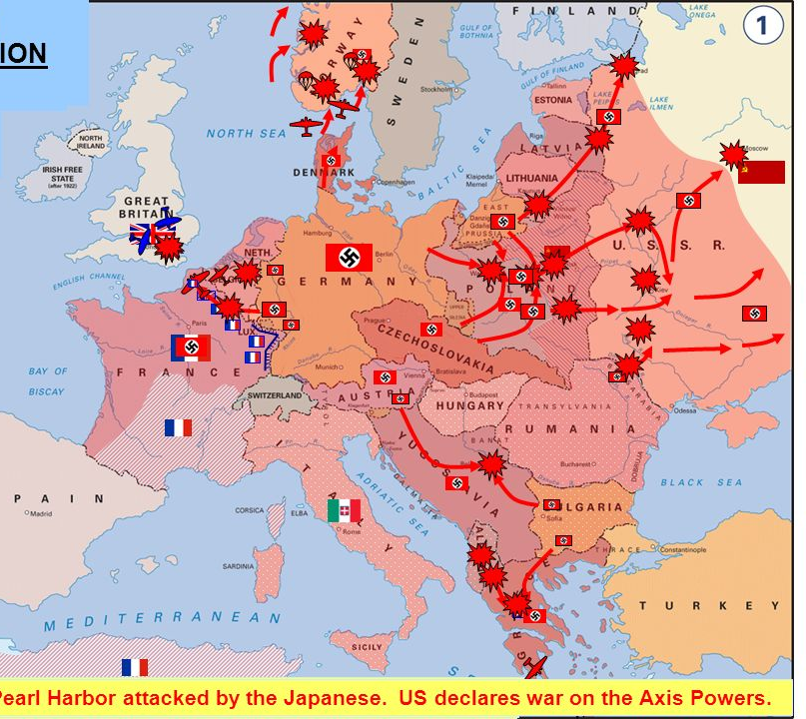
European Theatre (1939 – 1945)
Hitler’s conquests
Battle of Britain
Operation Barbarossa
D-Day
Conquest of Germany
German surrender
Notes:
Key players – Eisenhower, Churchill

Slide 5
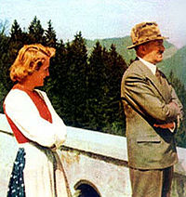
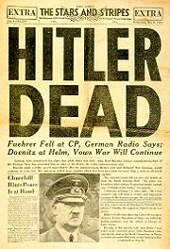
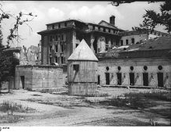

Slide 6
Human Rights Abuses - Europe
Hitler’s Final Solution (Holocaust)
1933 - 1945
Over 11 million killed (over 6 million Jews)
40,000 concentration camps/killing centers/confinement areas – most liberated by US and Soviet soldiers in 1945
Military missions (USSR)
Allied knowledge?
Nuremburg Trials
Notes:
FDR – put economic needs at home over humanitarian efforts abroad
US had no refugee program in the 1930s; hoped European nations would adopt refugees; Quota system of 1924 still in tact
Eleanor Roosevelt openly pledged support for taking in German refugee children but FDR failed to act
Formally condemned Hitler’s atrocities towards Jews (with 11 European nations) in 1942
FDR and Churchill agreed that their priority was defeating Hitler
Formally established a refugee board in 1944 – took in some refugees (about 1,000) and worked with other countries to open their borders to refugees
Nuremburg Trials – US, GB, France, USSR presided over 22 major Nazi criminal trials – 12 put to death; trials of Nazi’s and Nazi conspirators continued in Germany and other countries for nearly 20 years; hundreds of Nazi’s fled Germany after the surrender to other countries, including the US

Slide 7
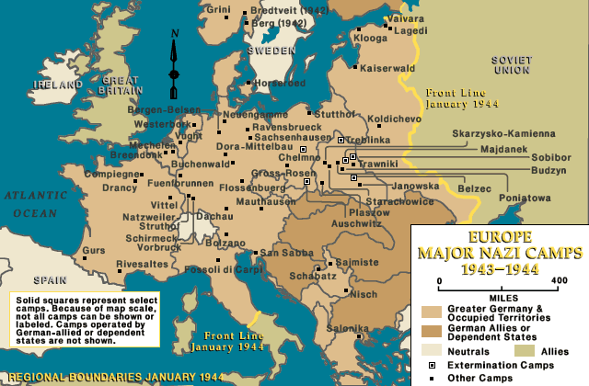

Slide 8
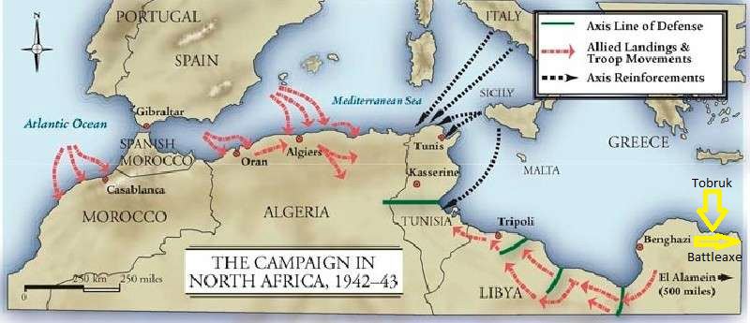
North Africa
Purpose: keep German empire from spreading/save Allied colonial holdings
Morocco to El Alamein (Egypt)
Victory led to the liberation of Italy
Notes:
Key players: Eisenhower, Rommel (Desert Fox) – Africa; Patton - Italy

Slide 9
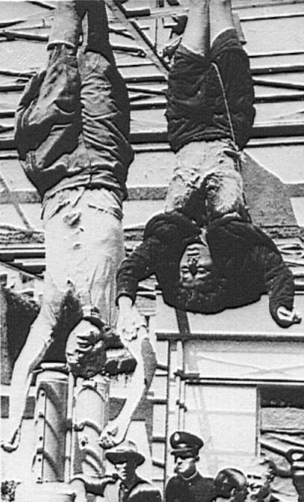
Mussolini & Clara Petacci

Slide 10
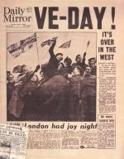
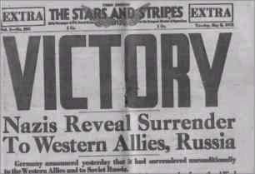
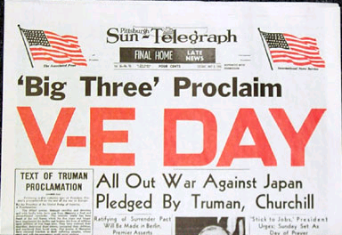
NEWSPAPERS CELEBRATE THE SURRENDER OF GERMANY BUT WARN THERE IS STILL JAPAN TO DEFEAT

Slide 11
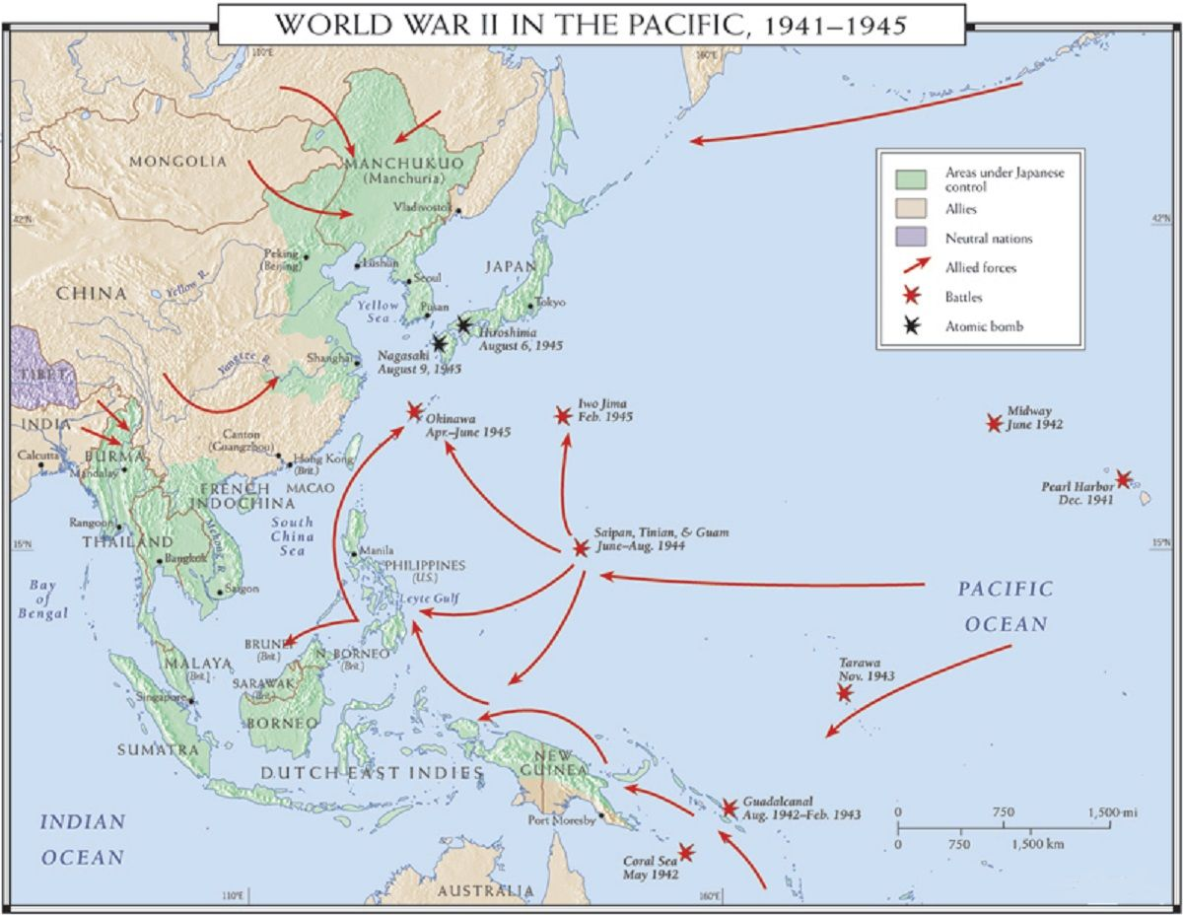
Pacific Theatre (1941 – 1945)
Pearl Harbor
Coral Sea
Midway
Iwo Jima
Okinawa
Operation Downfall
Notes:
Key players: Emperor Hirohito, PM Hideki Tojo, Allied Sup Commander Douglass MacArthur
Reasons for Japanese
Pearl Harbor – 2400 killed; 1200 wounded; over 500 Japanese zeros from 6 aircraft
Allied counter offensive – “island hopping”
Battle of Coral Sea – aircraft carriers engaged (tactical win for Japanese; strategic win for US – we didn’t surrender); disengaged after 2 days
Midway – turning point
Iwo Jima & Okinawa – huge death tolls (esp Japanese civilians); land, sea, air; both attractive to use for fueling/planes taking off
Japanese kamikazes (Japan resorted to consistent use after Midway) – see subsequent slide
Operation Downfall – planned invasion of mainland Japan

Slide 12
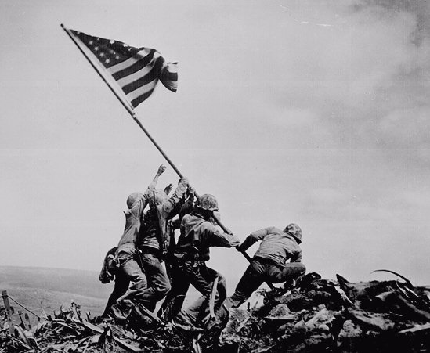
Notes:
Mount Suribachi, Iwo Jima

Slide 13
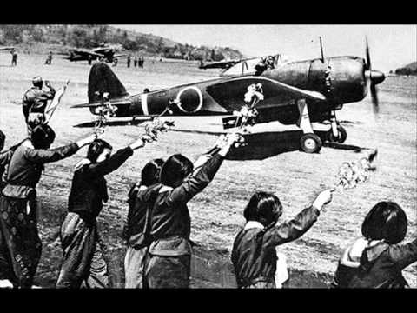
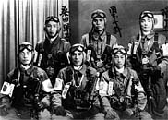
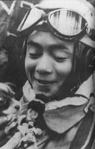
Japanese Kamikaze Pilots
Notes:
Kamikaze means “divine wind”
Most under the age of 25
Most didn’t hit their targets (only 40 hours of training)
Air and sea

Slide 14
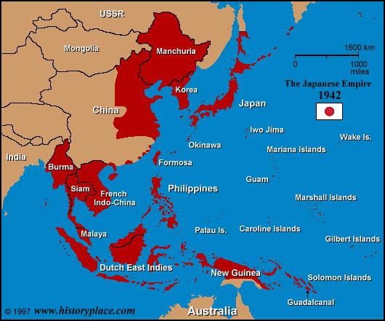
Human Rights Abuses - Asia
Japanese imperialism
Bataan Death March
Camps in China, Korea
Forced labor
Comfort women
Unit 731
Tokyo Trials
Notes:
Japanese army conquered land and killed over 10 million people in China and SE Asia in the 1930s and 40s
Ex. Nanking Massacre – 1937, China – Japanese army murdered 300,000 citizens in one month; also participating in mass rape and looting (contest – 100 civilians by sword in one day) – Japanese nationalists refute
Comfort women – brothels established throughout China, the Koreas, Indochina, and Indonesia – called military comfort stations; over 200,000 women were kidnapped and forced to remain confined in these areas where they were repeatedly raped and beaten
When locals revolted against forced removal of women, Japanese army invoked Three Alls Policy – kill all, burn all, loot all
Unit 731: experiments and warfare in the name of science
Human experiments – vivisections, germ warfare attacks, frost bite testing, syphilis testing (how it spread – forced adults and children to have sex), raped women to get them pregnant and then conduct experiments; animal blood injections; salt water injections, spinning to death, food and water deprivation
Weapons testing – grenades and flamethrowers - distance/impact on humans
Biological warfare – bombed Chinese with bubonic plague, cholera, small pox, anthrax, fleas
Tokyo trials aka International Military Tribunal for the Far East – 28 leaders charged with Class A crimes; 5700 other officials charged in trials worldwide (China held 13 tribunals which resulted in 504 convictions and 149 known executions); Hideki Tojo – hanged 1948

Slide 15
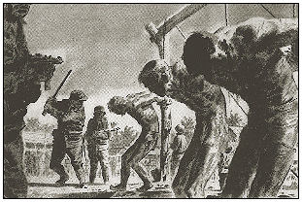
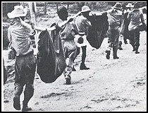
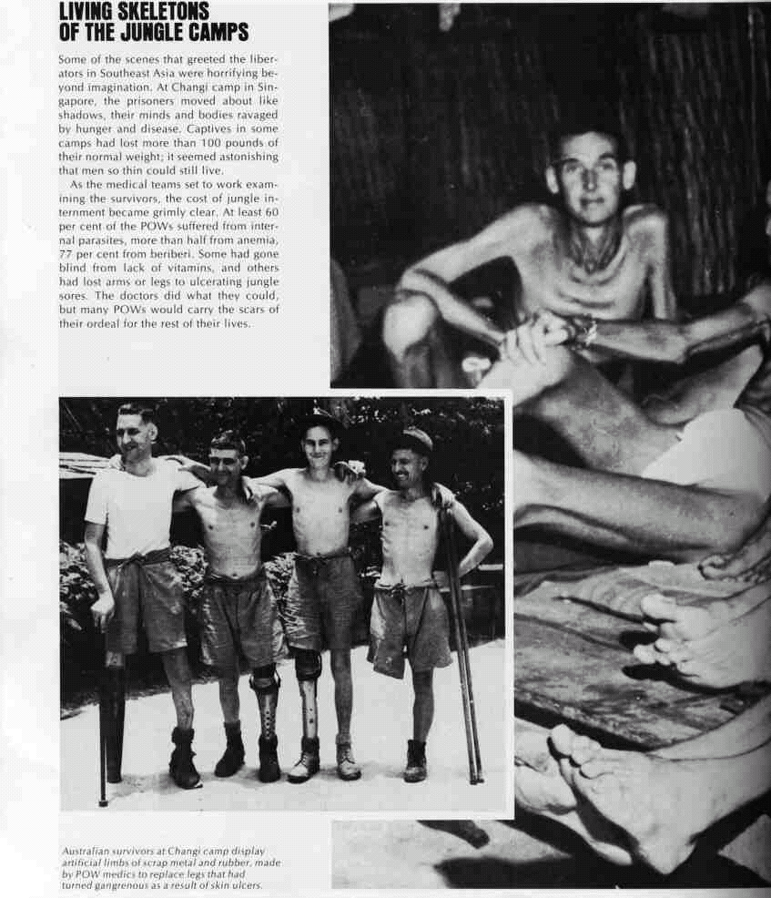
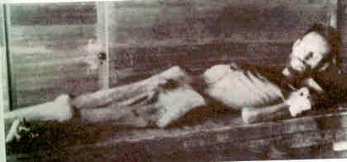
Notes:
Bataan Death March – 70,000 US and Filipino soldiers/civilians (almost 18,000 Filipino deaths; 600 US deaths)

Slide 16
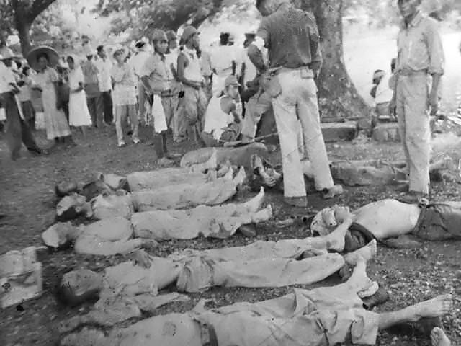

Slide 17
Diplomacy
Big three conferences (UK, US, USSR)
Tehran (Nov – Dec, 1943)
Yalta (Feb 1945)
Potsdam (July – Aug, 1945)
San Francisco (Apr – June, 1945)
Notes:
Tehran – Stalin, Churchill, FDR - Stalin will continue to take on the Germans alone on the Eastern front while Britain and the US will invade France on the western front
Yalta – Stalin, Churchill, FDR - new boundaries for Poland; USSR agrees to enter war against Japan three months after defeating Germany (at strong urging of FDR)
San Francisco – 50 Allied nations agree to form the UN (important that it was on US soil – showed our commitment); sponsoring nations – US, China, Britain, USSR
Potsdam – Stalin, Attlee, Truman – established German occupation zones; Truman told Stalin to allow free elections in Poland

Slide 18
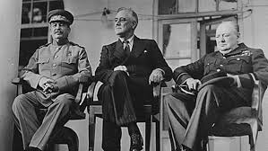
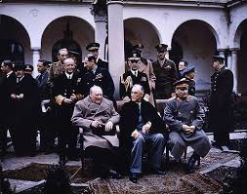
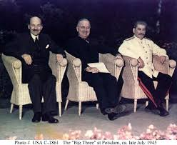
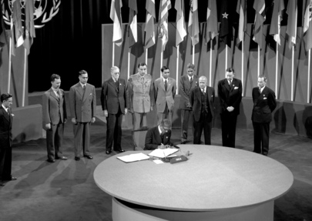

Slide 19
Decision to Drop the Bomb
Manhattan Project (3 bombs)
FDR dies April 1945; Truman to POTUS
Hiroshima (August 6), Nagasaki (August 9)
Stalin
Notes:
A-bombs – killed over 200,000 civilians immediately, potentially millions in aftermath
Stalin – army on its way; no knowledge of atomic bomb; had taken the brunt of of German army and now not considered a partner in victory

Slide 20
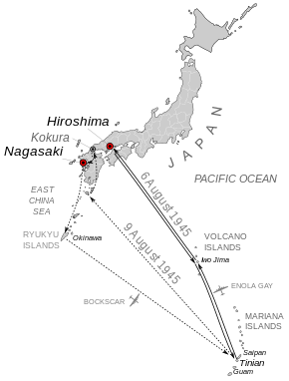
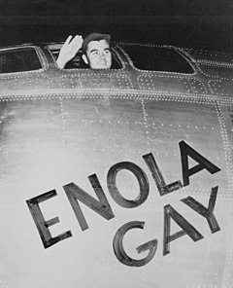

Slide 21
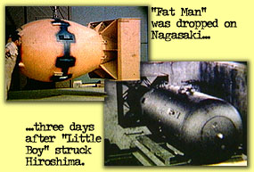

Slide 22
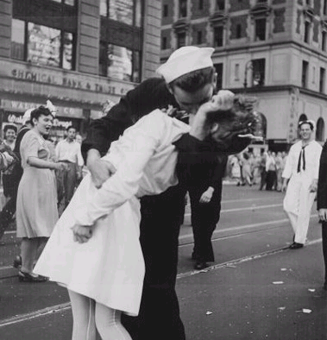
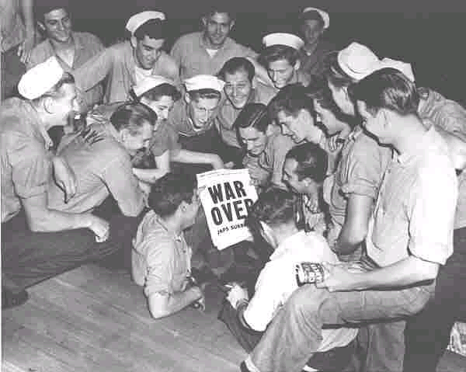
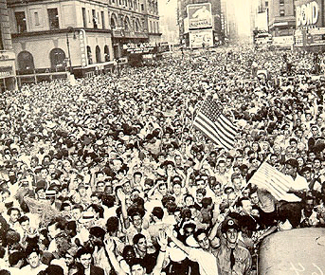
VJ Day: September 2, 1945

Slide 23
Aftermath
Massive human dislocation
Creation of the United Nations
End of US and European economic depression
Emergence of third world nationalist movements & the decolonization of European empires
Division of Germany
Japan occupied by US; independent Korea divides
Chinese Civil War
Bipolarization (US vs. USSR)
Cold War atmosphere of fear
Space race
Arms race
Nuclear age

Slide 24
