Slide 1
War of 1812
AP US History
Mrs. Lacks

Slide 2
“Mr. Madison’s War”
US vs. British
1812 – 1814 (fighting); treaty signed in 1815
Fought in three major areas:
Chesapeake region
Great Lakes/Canada
New Orleans

Slide 3
Causes of War
Chesapeake-Leopard Affair (fight b/w a British & US ship; stalemate)
British Orders of Council of 1807 (Britain would not trade w France)
Embargo Act of 1807 (US embargo against Brit. Or France)
Non-Intercourse Act (trade/land with Natives)
Macon’s Bill No. 2 (asked Britain to stop impressment)
Tecumseh’s War (Natives vs Americans)
Henry Letters (said New England should join Canada)
War Hawks (Calhoun & Clay)
Rule of 1756 (Britain will not trade with those trading with the enemy)
Little Belt Affair (USS President vs. HMS Little Belt off North Carolina coast; US wins)

Slide 4
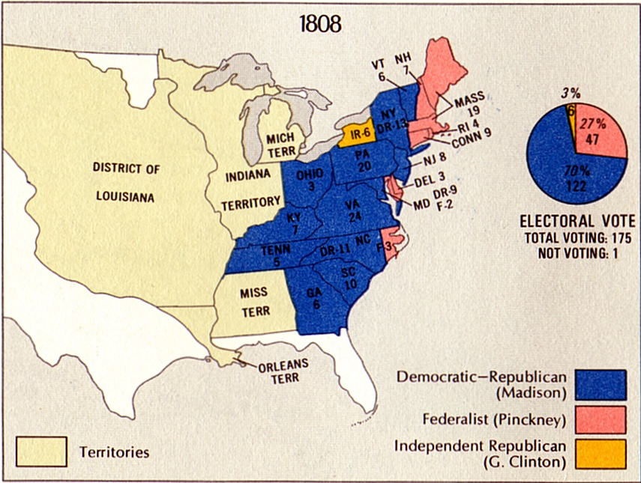
Madison – Re-Elected in 1812

Slide 5
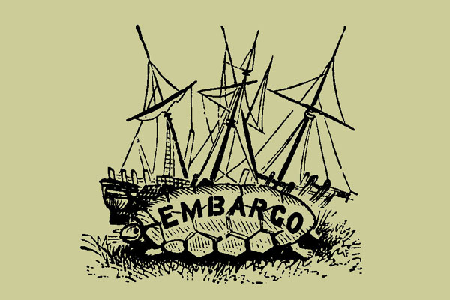
Maritime Issues
Neutral Rights of Shipping
British Seizures of American Merchant Marine Shipping
Impressment

Slide 6
Frontier Issues
Western Land Hunger (Canada & Florida)
Indian problems in west

Slide 7
Economic & Military Issues
Financially unprepared: flood of paper money, revenue from import tariffs declined
Militarily unprepared:
US had a 12 ship navy; Britain had an 800 ship navy
Americans disliked the draft – preferred to enlist from disorganized state militias

Slide 8
Mr. madison’s War
President Madison asked Congress to declare war on June 1, 1812
Vote
House= 79-49
Senate= 19-13
“The suspense was hell!” RM Johnson

Slide 9
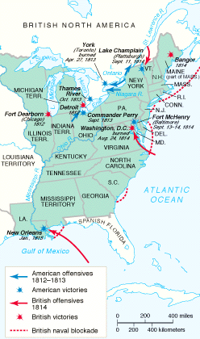
An overview of the War of 1812
US vs. Britain (land and sea)
US vs. Indians (land only – Tippecanoe)
Three theatres
Great Lakes/Canada
Chesapeake
New Orleans

Slide 10
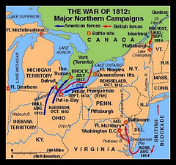
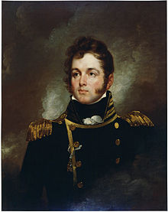
Northern Campaign, 1812 - 1813
Commodore Oliver Hazard Perry, hero of the Battle of Lake Erie

Slide 11
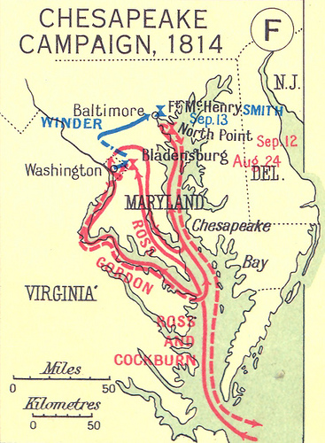

Slide 12
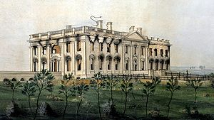
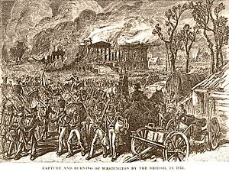
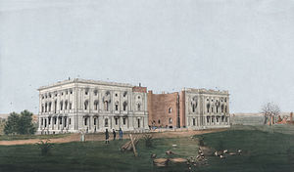
Burning of Washington

Slide 13
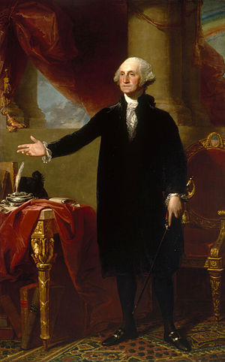
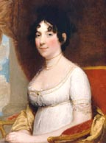
Dolley Madison

Slide 14
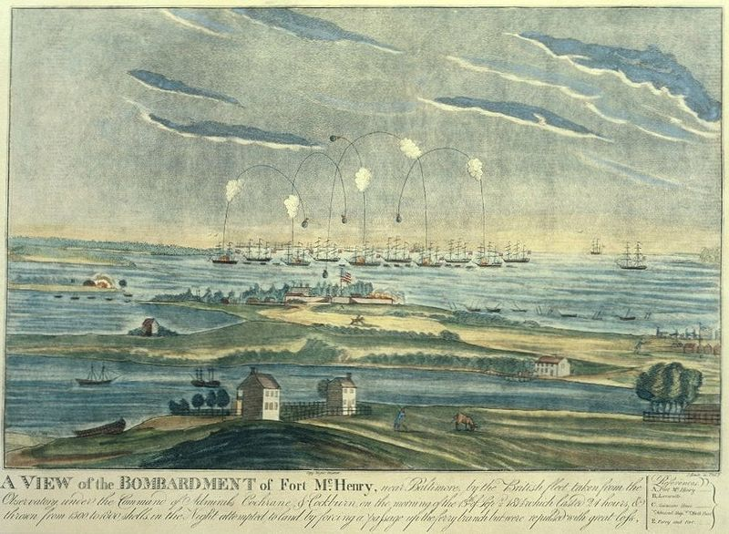
Battle of Fort McHenry
Northern Chesapeake Bay, outside of Baltimore
Naval battle
US wins
Francis Scott Key, witnesses it from ironclad, writes poem describing it

Slide 15
Hartford Convention
December 1814 – January 1815
New England considers secession!
Reaction to Virginia Dynasty and unpopularity of “Mr. Madison’s War
Abolish 3/5s clause for determining House of Representatives
2/3rds vote to declare war or admit new states
No embargoes of more than 60 days
No foreign-born to hold federal offices
1 term presidents
No successive presidents from same state
Officially discredits the Federalist Party; Southerners see northerners as treasonous

Slide 16
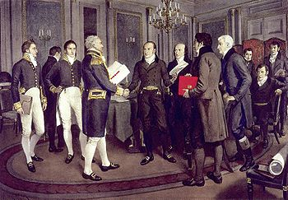
Treaty of Ghent
24 Dec 1814
Belgium
Terms:
Released all prisoners and restored all war lands and boats, resulting in several changes
Returned to the US were approximately 10,000,000 acres of territory, near Lakes Superior and Michigan, in Maine, and on the Pacific coast.
American-held areas of Upper Canada (present-day Ontario) were returned to British control.

Slide 17
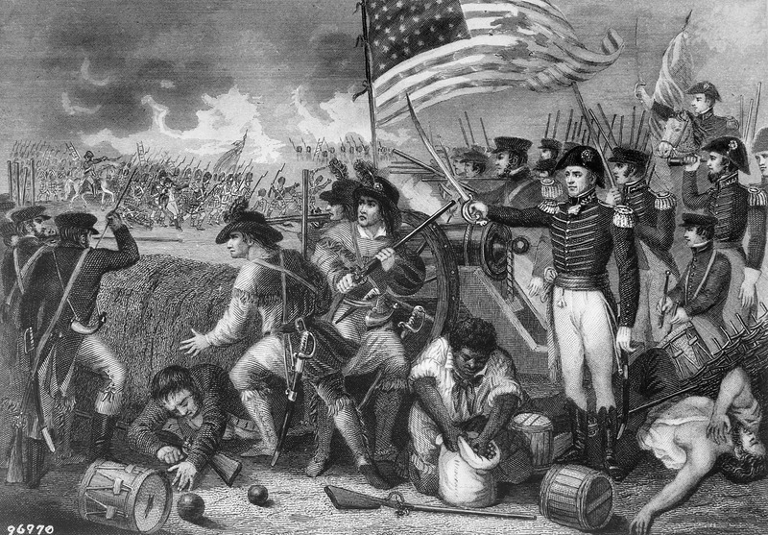
Battle of New Orleans (1815)
http://www.youtube.com/watch?v=SW8Mj0Py7FY

Slide 18
Results of War
National Honor and Pride?
Demise of the Federalist Party
“Second War of Independence?”
National Heroes and Symbols
Andrew Jackson (war hero, New Orleans, becomes POTUS)
W.H. Harrison (war hero, Tippecanoe, later becomes POTUS)
Richard M. Johnson (war hawk, becomes VP)
“Star Spangled Banner “

Slide 19
After war… Era of Good Feelings
Why???

