Slide 1
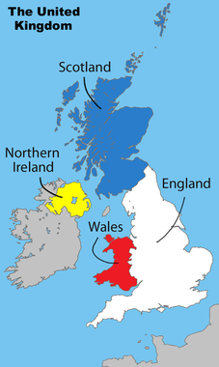
UK: Citizens, Society & the State & Public Policy
Spring 2014

Slide 2
Social Cleavages
For much of British history based on:
Multi-National Identities
England (77%)
Welsh (4.5%)
Scottish (7.9%)
Northern Irish (2.7%)
Social Class Distinctions
Working class vs middle-class
Education
Notes:
Wales
Flag, Welsh Language
Scotland
Strong nat’l identity
National flag, currency, Parliament
Northern Ireland
1949 most of Ireland became a totally independent country and N. Ireland remained under British rule
Protestants/Cathlolics
Good Friday Agreement: April 1998, Britain agreed to give N. Ireland a regional govt in which all parties would be represented on Proportional Basis
Education
Compulsory until age 17 (just raised from 16, will be 18 by 2015), national curriculum
Most important portal to elite classes is through Oxford and Cambridge
Nearly ½ of all Conservative MPs went to Oxbridge, ¼ of Labour MPs
% higher for cabinet positions/PM
More scholarships available for working class BUT Parliament raised min level of tuition to Eng universities from $5,400 to $14, 500 making higher education less accessible to many students

Slide 3
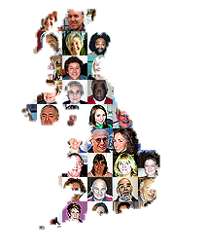
Social Cleavages
More Recently Ethnic Minorities
Only about 7.1% of British pop is of non-European origins:
23% Indian (1.8% of total population)
16% Pakistani (1.3% of total population)
12.2% Afro-Caribbean
10.5% Black
BUT minority ethnic population grew by 53% between 1991 – 2001
Also, immigrants from Eastern European countries (EU) has increased
2nd most spoken language in UK – Polish!
Notes:
Immigrants from Eastern Europe:
About 1 million immigrants from 8 central eastern Eur countries that joined the EU in 2004
Poles, who have made up abt 2/3 of the newcomers, are now the largest group of foreign nationals in Britain
Main draw has been better job opportunities

Slide 4
Social Cleavages – Treatment of Minorities
Minorities have experience some discrimination:
Ethnic minorities disproportionately suffer diminished opportunities
Unequal treatment by police (esp young men)
Physical harassment by citizens
Marginalization in education, job training, housing & labor
But some have also been very successful
Among men of African, Asian, Chinese & Indian descent, the proportional representation in managerial/professional ranks is actually higher than that for white men
British South Asians (esp Indians) have high rate of entrepreneurship
Notes:
Discrimination
More than 1/3 of ethnic minority population is younger than 16, nearly ½ is under 25, 4/5 is under 45

Slide 5
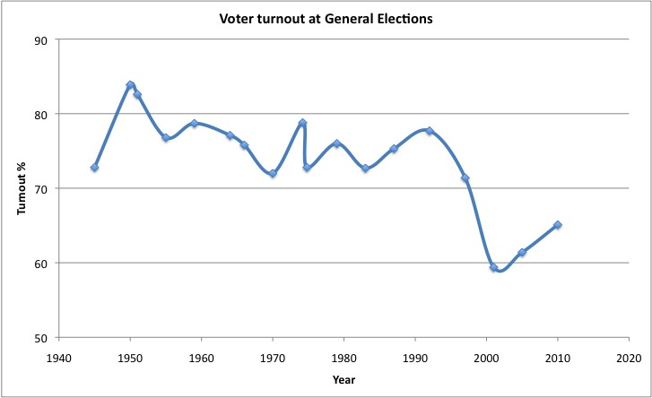
Political Socialization & Participation
Socialization
Family
Schools (civics courses)
Media (BBC)
Participation
Voting – around 70% (down in recent elections)
Voting behavior still tied to social class and region
Social Movements
Not as strong
Centered on issues (Iraq war, environment, etc)
Notes:
Interest in politics is low compared to the U.S., while voting rates are higher (U.S. 2012 58%)
Less than 1/5 of population does anything more than vote
Social Movements:
On local level people are more willing to organize around a specific issues, but participation of the active 20% is sporadic
Historic exceptions – women’s suffrage and nuclear disarmament
More Recent Issues: Women’s mvmt on health and children’s issues; environment; anti-poverty events (Live 8), groups protesting globalization and genetically-modified food products, anti-Iraq war

Slide 6
Linkage Institutions
Political Parties (see student presentations)
Question to consider: To what degree do Political Parties address social cleavages?
Interest Groups
Interest group pluralism
Most influential interest groups are those tied to class and industry
Neo-corporatism: interest groups take the lead and sometimes dominate the state
Notes:
Interest Groups:
Trade Unions Congress (TUC), Confederation of Business Industries (GSI)

Slide 7
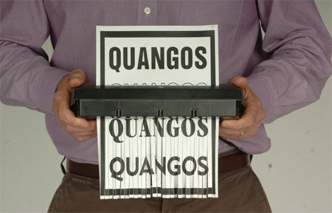
Linkage Institutions
Greatest influence of British interest groups comes through quangos
Quasi-autonomous nongovernmental organizations
Created by Parliament to put govt and private interests together on policymaking board
Recent trend toward eliminating and reforming quangos to save $
Notes:
Quangos:
It is an organization that is funded by taxpayers, but not controlled directly by central government – over 700!
Do things like developing safety regulations for factories, creating proposals to improve race relations, and maintaining railway infrastructure
Civil servants, lobbyists and even members of govt serve on quangos

Slide 8
British Values (according to Ken Wedding)
Devotion to justice and fair play
Human and civil rights for all
Acceptance of class distinctions and social mobility
Equal representation
Civilian government
Pragmatism and cooperation
Tolerance
Both community and individual responsibility
Honesty and transparency in govt and business
Acceptance of activist govt

