Slide 1
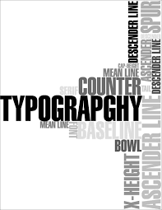
Graphic Design
Mrs. Lacks

Slide 2
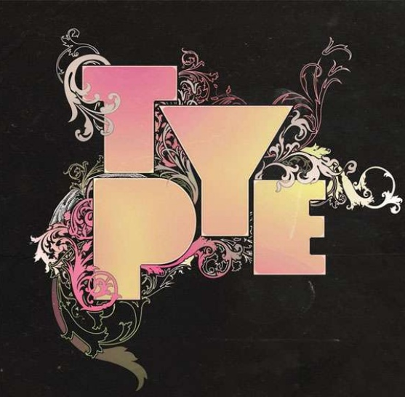
Typography
Is the art and skill of arranging text so that language is visible
Essentially, all forms of writing are typography

Slide 3
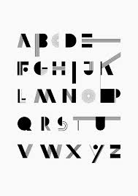
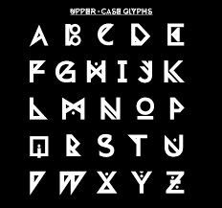
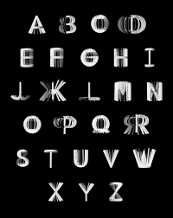
Typefaces, Fonts, and Font Families
Typeface: the set of letters, numbers, & characters that share common design features

Slide 4
Font
A font is a specific size, weight, and style applied to a character (letter, number, symbol)
A font style is a specific slant and weight of a character, such as bold or italics

Slide 5
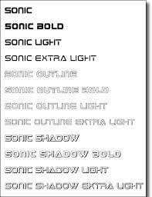
Font Family
A font family is a group of similarly formatted characters

Slide 6
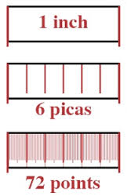
Font Size
We measure the size of type in points and picas, not inches
There are approximately 12 pts to a pica; 6 picas to an inch

Slide 7
Four Families of Fonts
Serif
Sans Serif
Ornamental or Decorative
Script or Cursive

Slide 8
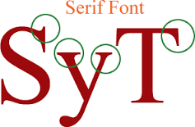
Serif
Contains attributes/strokes at the tips of a letter

Slide 9
Serif
When? Serif fonts are usually easier to read in printed works than sans-serif fonts. The commonly used convention for printed work is to use a serif font for the body of the work.
Why? The serif make the individual letters more distinctive and easier for our brains to recognize quickly. Without the serif, the brain has to spend longer identifying the letter because the shape is less distinctive.

Slide 10
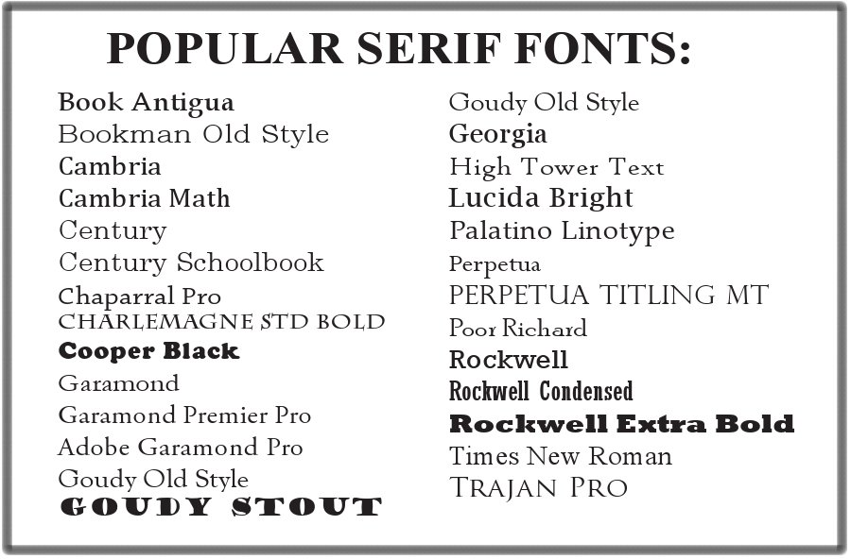

Slide 11
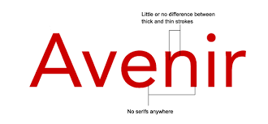
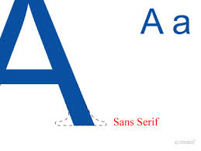
Sans Serif
No attributes (serifs) at the tips of a letter
Mono-weight appearance

Slide 12
Sans Serif
When? Headings and online work
Why headings? Headings are supposed to stand out, or get attention

Slide 13
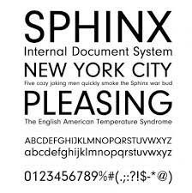
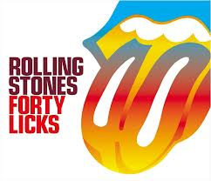

Slide 14
Sans Serif
Why online? An important exception in body text must be made for the web. Printed works generally have a resolution of at least 1,000 dots per inch; whereas, computer monitors are typically around 100 dots per inch. Even Apple's much vaunted retina display is only around 300 dots per inch — much lower than print.
This lower resolution can make small serif characters harder to read than the equivalent sans-serif characters because of their more complex shapes.
It follows that small on-screen text is better in a sans-serif font like Verdana or Arial.

Slide 15
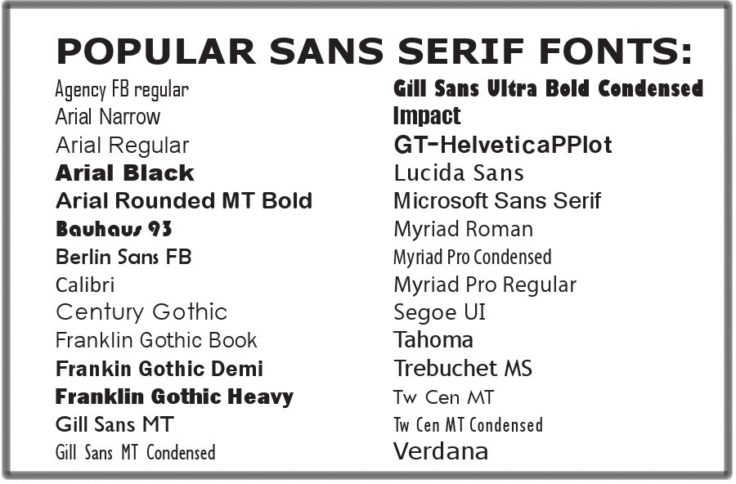

Slide 16
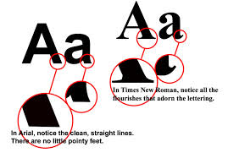
Serif vs. Sans Serif

Slide 17
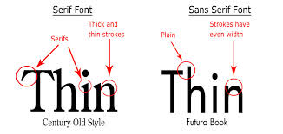
Serif vs. Sans Serif

Slide 18
Ornamental or Decorative
Designed strictly to catch the eye
Should be used sparingly – they are only powerful when their use is limited (if you use them everywhere, the effect is diminished)

Slide 19
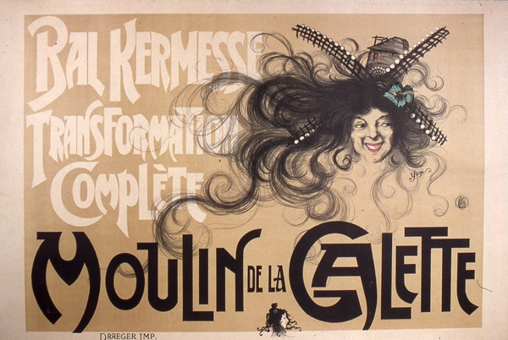
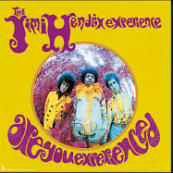
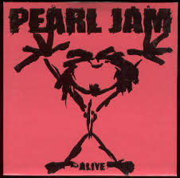

Slide 20
Script or Cursive
The general rule of thumb for script fonts is just don’t
Acceptable times to use them: formal invitations, greeting cards, or designs with short titles that could use a visual boost
If you do use them, keep it simple, and use only one at a time

Slide 21
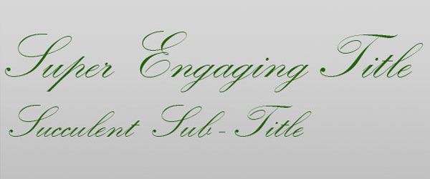
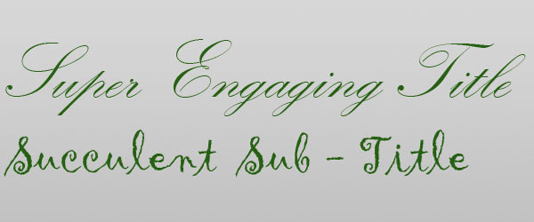

Slide 22
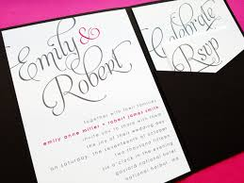
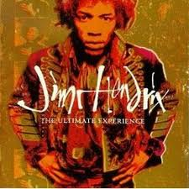
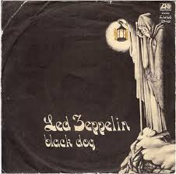
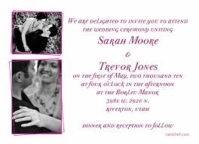

Slide 23
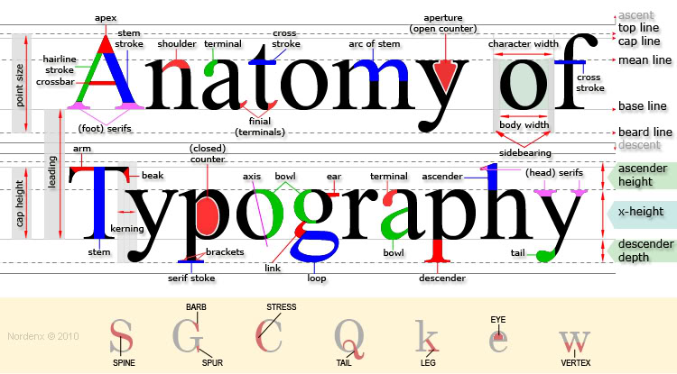

Slide 24
Anatomy
Ascender: The part of lowercase letters (such as k, b, and d) that rise above the x-height of the other lowercase letters.
Baseline: The imaginary line on which the majority of the characters in a typeface rest.
Counter: The white space enclosed by a letterform, whether wholly enclosed (as in "d" or "o") or partially (as in "c" or "m").

Slide 25
Anatomy
Descender: The part of lowercase letters (such as y, p, and q) that descends below the baseline of the other lowercase letters in a font face. In some typefaces, the uppercase 3 and Q also descend below the baseline.
X-height: Traditionally, x-height is the height of the lowercase letter x. It is also the height of the body of lowercase letters in a font, excluding the ascenders and descenders. Some lower-case letters that do not have ascenders or descenders still extend a little bit above or below the x-height as part of their design. The x-height can vary greatly from typeface to typeface at the same point size.

Slide 26
HEADLINE
Subhead
Paragraphs of type are referred to as body copy. Paragraphs of type are referred to as body copy. Paragraphs of type are referred to as body copy. Paragraphs of type are referred to as body copy. Paragraphs of type are referred to as body copy. Paragraphs of type are referred to as body copy.

Slide 27
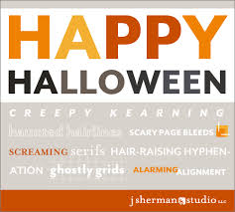
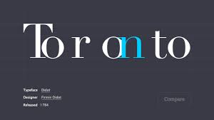
Type Traits
Kearning: space between characters

Slide 28
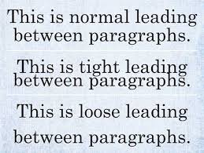
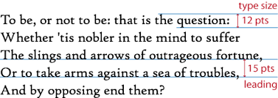
Type Traits
Leading: space between lines of type

Slide 29
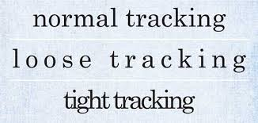
Type Traits
Tracking: space between words + characters

Slide 30
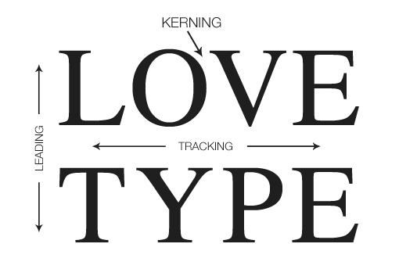

Slide 31
Typography Part II
Typography is visual, but it can also provoke emotion.

Slide 32
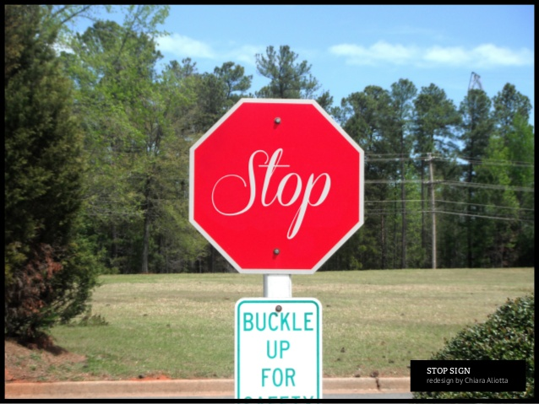

Slide 34
Through text you can…
Engage your audience
Draw attention: organize information in memory
Add character and personality
Tell a story

Slide 35
Draw attention
A well-designed layout encourages associations, and reduces distraction

Slide 36
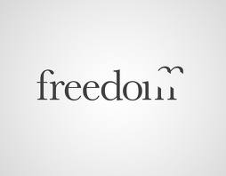

Slide 37
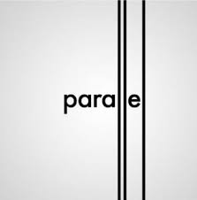
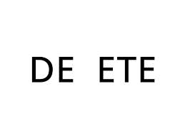
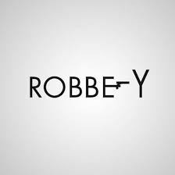
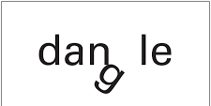

Slide 38
Add character & personality
By evoking emotions that suit the context, we are able to communicate a personality that establishes connection and trust

Slide 39
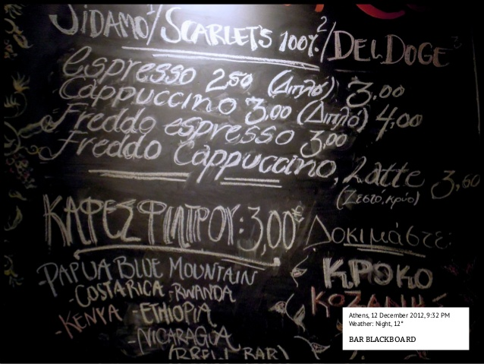
Personal/Human

Slide 40
Fun!

Slide 41
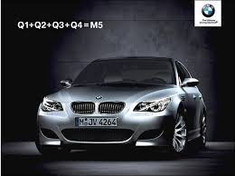
Trustworthy/Grounded

Slide 42
Create memories
Typography can tell a story, helping people process information, enhance memories, and share experiences

Slide 44
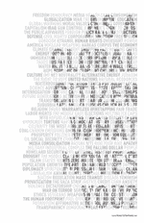

Slide 45
Typography Part III
Yes, typography is the art of arranging text…

Slide 46
But…
Typography can also use text to create written images using language

Slide 47
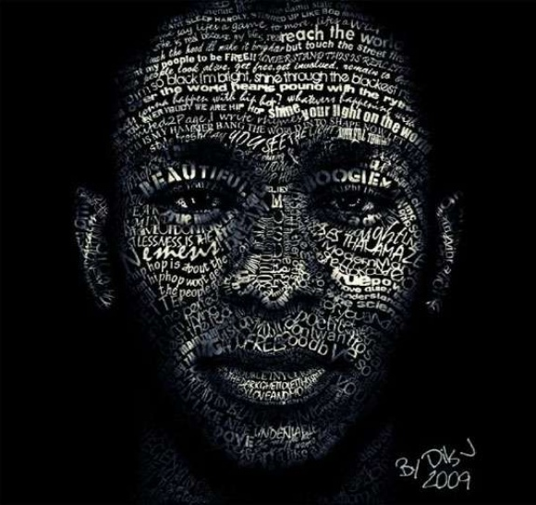

Slide 48
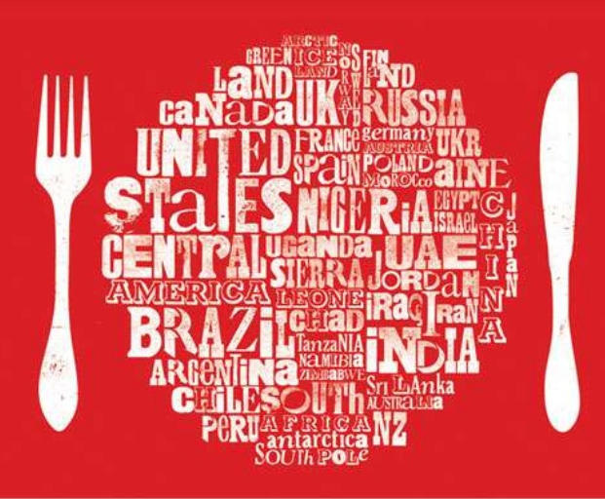

Slide 49
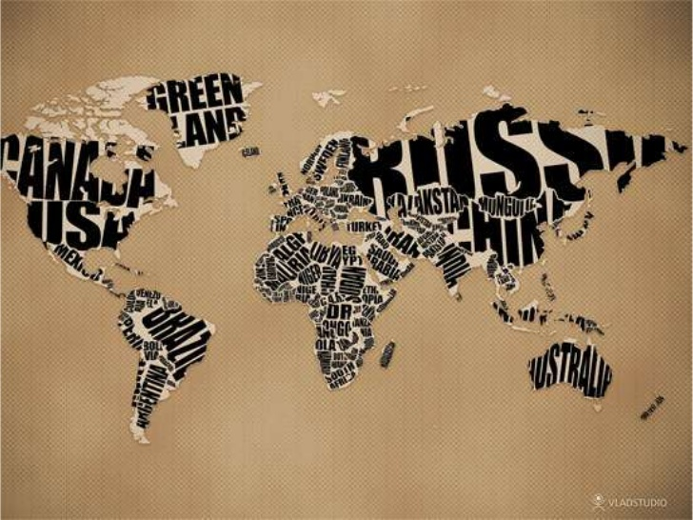

Slide 51
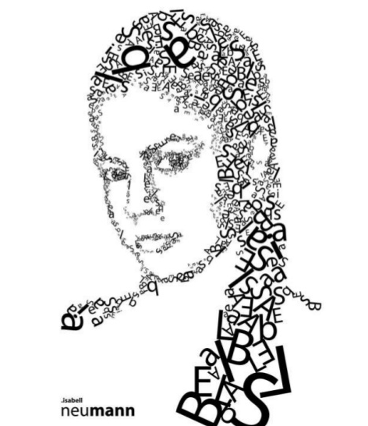

Slide 52
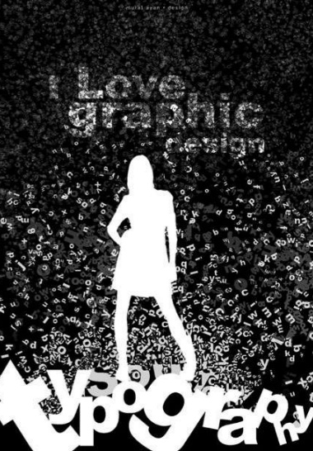

Slide 53
