Slide 1
The Study of American Government
AP US Government & Politics

Slide 2
Purposes of Government
To maintain order
To protect property
To provide public goods

Slide 3
Politics
Greek politikos
“of or relating to citizens”
Struggles over the leadership, structure, and policies of government

Slide 4
Forms of Government
Autocracy (authoritarian, dictatorship)
Oligarchy or Aristocracy
Monarchy
Democracy
Republic
Constitutional

Slide 5
What is political power?
Power: the ability of one person to cause another person to act in accordance with the first person’s intentions.
May be obvious: President sends soldiers into combat.
May be subtle: President’s junior speechwriters take a new tone when writing about a controversial issue.

Slide 6
Political Power
Authority
Legitimacy
Sovereignty
Notes:
Authority: The right to use power; not all who exercise political power have authority to do so.
Legitimacy: What makes a law or constitution a source of right (Struggles over what makes authority legitimate constitute much of U.S. history)
Sovereignty: right to govern a specific area

Slide 7
What is Democracy?
Describes at least two different political systems:
Direct or Participatory
Representative (indirect) or Elitist Theory
Notes:
Direct:
4th C BCE – Greek city-state
Pre-Revolutionary British Colonies: New England Town Meeting
impractical for reasons of time, expertise, etc.
people make unwise decisions based on fleeting emotions
Indirect: Acquisition of power via leaders in a competitive election

Slide 8
Two kinds of Constitutional Democracy Today
Parliamentary
Presidential

Slide 9
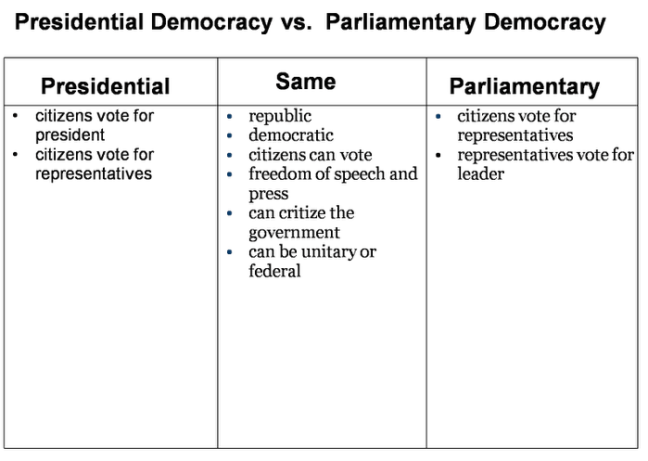

Slide 10
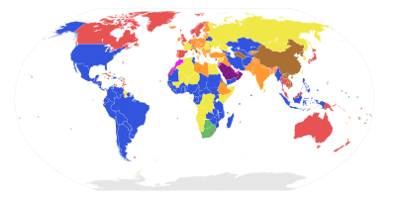
Blue: Presidential republics with a full presidential system. Yellow: Countries with a semi-presidential system. Green: Parliamentary republics with an executive presidency chosen by the parliament
Orange: Parliamentary republic with a ceremonial president, where the prime minister is the executive. Red: Constitutional monarchies where executive power is vested in a prime minister Pink: Constitutional monarchies which have a separate head of government, but where royalty hold political power Purple: Absolute monarchies Brown: Single-party state

Slide 11
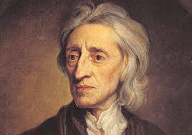
John Locke
17th century British philosopher
Greatly influenced Founders
Notes:
Believed that people can peacefully coexist if they own their own land (farms).
Argued that government should be based on the consent of the governed, managed through majority rule.
Additional protection would be based on separation of powers, with separate legislative and executive branches.

Slide 12
Is Representative Democracy Best?
Favored by Framers
Government would mediate, nor mirror, popular views.
Framers’ goal: To minimize the abuse of power by a tyrannical majority or by officeholders
Notes:
Framers viewed people as lacking knowledge and susceptible to manipulation.
The Constitution does not contain the word democracy but “republican form of government” (meaning representative democracy).

Slide 13
Conditions needed for Democracy to be successful…
1. An educated electorate
2. Economic stability (market economy)
3. Social capital
4. Ideological conditions (democratic consensus)
5. Universal suffrage
6. Political equality (all votes counted equally)
7. Govt that responds to public opinion
8. Majority rule

Slide 14
How is political power distributed?
Majoritarian politics
Elitism
Notes:
Majoritarian: Leaders constrained to follow wishes of the people very closely (Applies when issues are simple and clear)
Elitism: Rule by identifiable group of persons who possess a disproportionate share of political power; Comes into play when circumstances do not permit majoritarian decision making

Slide 15
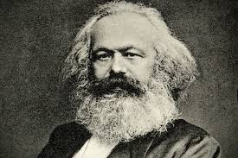
Description of four political elites
1. Class view: Marxism
Notes:
argued that governments were dominated by business owners (the bourgeoisie) until replaced by revolution of workers (the proletariat)
This view has been refined, with emphasis on the power of the rich and multinational corporations.

Slide 16
Description of four political elites
2. Power Elite theory
Notes:
States that American democracy is dominated by a combination of business leaders, top military officials, labor unit leaders, mass media executives, and heads of a few special interest groups.

Slide 17
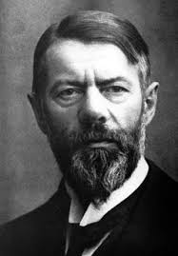
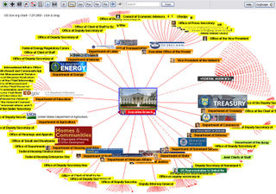
Description of four political elites
3. Bureaucratic view: Max Weber
Notes:
argues that power is mainly in the hands of appointed officials, who exercise power through their control of information, mastery of written records and detail of legislation, and the implementation of policies

Slide 18
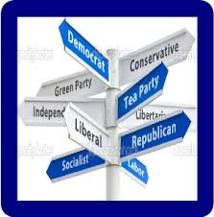
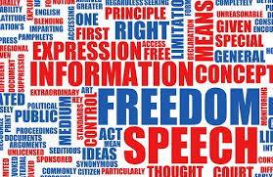
Description of four political elites
4. Pluralist view: no single intellectual parent
Notes:
argues that political resources are broadly shared
No single elite has control of enough power to dominate the political process.
Many groups (ex. economic, religious, cultural, ethnic.) compete to achieve goals
Groups that influence gov’t, work hard, and have largest membership, get what they want
Even if the average citizen does not keep up with politics, their interests will be protected by their group.
Groups must COMPROMISE to achieve goals

Slide 19
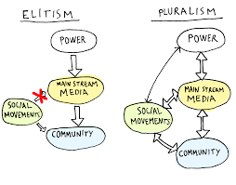

Slide 20
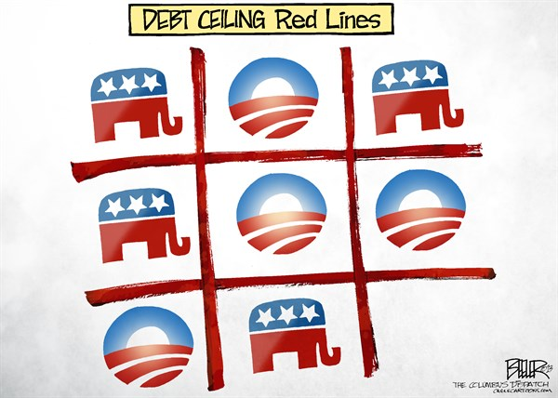
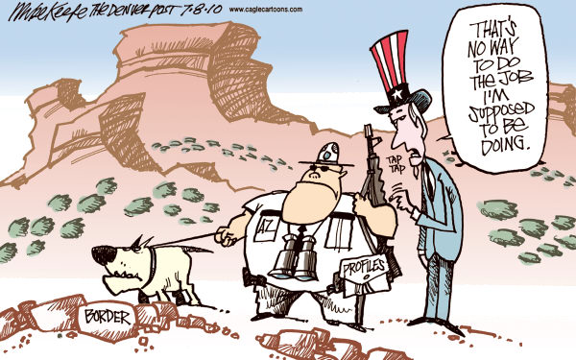
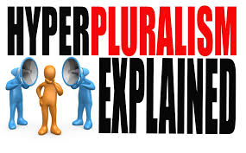
Hyperpluralism
A theory that groups are so strong that they leave government divided
Notes:
Groups push for their own policies at whichever level and branch of government may result in their favor
Create “battlegrounds” at three levels, or between three branches

Slide 21
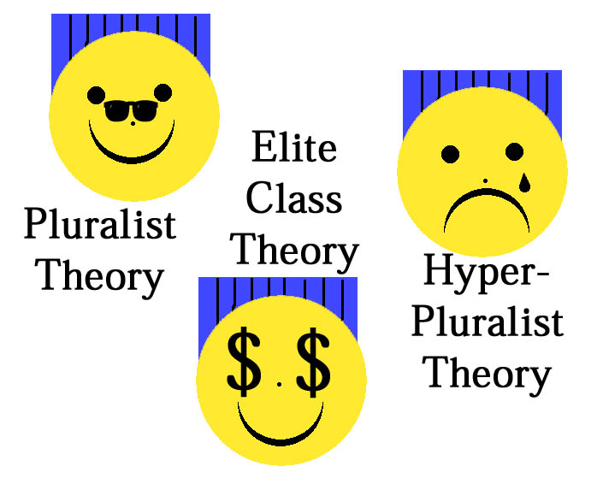

Slide 22
Arguments
For Pluralism
Against Pluralism (Hyper pluralism)
There is no unified majority in the US that always acts together.
Gov’t leaders must please groups to gain votes and money to be reelected.
Groups must compete for gov’t services and favorable laws.
Relatively low numbers of people join interest groups.
Poor citizens have less opportunity to join interest groups or contribute to them.
One can’t assume that group decisions are always in the best interest of the nation.

Slide 23
Explaining Political Change
No simple explanation
Driven by changes in elite and mass beliefs about what government is supposed to do
Major changes in US history:
Growth of federal power
Foreign policy: from isolationism to strong internationalism

Slide 24
Four Facts about US federal government
Plays a large part in our lives (but not as much as most Western democracies)
Americans rely on it to solve their problems
Perfection in government cannot be achieved (conflicting interests will always be present in democracy)
Its complicated

Slide 25
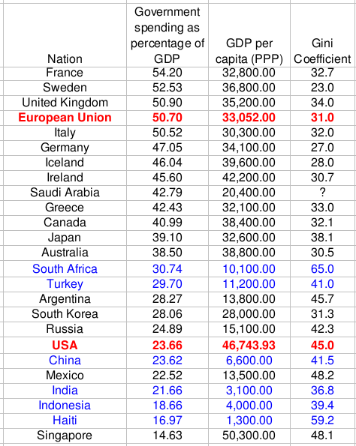

Slide 26
How Americans view the US
American history is a success story & victory for democracy
Wisdom trumped tyrannical ignorance – founding fathers are viewed as heroic and are revered
US is champion of justice – events are viewed through polarized lens (Civil War was about slavery; WWII was about defeating evil tyrants; Cold War was a triumph of democracy)
Polarizing attitude spills over to politics (black or white with no shades of gray)

