Slide 1
The Stock Market Crash & the Great Depression
US History
Mrs. Lacks

Slide 2
The Roaring 20s
A period of great economic success
People started investing the in stock market

Slide 3
What is the Stock Market?
the public invests in companies by purchasing stocks; in return for this they expect a profit

Slide 4
Stock Market Terms
Stock: shares of ownership of a company
Stockbroker: gets a commission to buy and sell stocks
Stock quotes: price of stock
Bid price: price you decide to pay
Closing price: price of stock at close
Dow Jones: the health of the market (based on stock prices of 30 representative large firms trading on NYSE)

Slide 5
Stock Market Terms
Bear Market: market decline over time
Bull Market: market increase over time

Slide 6
How does it change?
because of the booming 1920's economy, $ were plentiful, so banks were quick to make loans to investors
also investors only had to pay for 10% of the stock's actual value at time of purchase (buying on margin)

Slide 7
How does it change?
this encouraged STOCK SPECULATION - people would buy and sell stocks quickly to make a quick buck
b/c of all this buying & selling, stock value increased (Ex: G.E stock $130 → $396/share)

Slide 8
How does it change?
this quick turnover didn't aid cos. → they needed long term investments so they could pay bills (stock value was like an illusion)
unscrupulous traders would buy and sell shares intentionally to inflate a given co.'s stock value
all of this gave a false sense of security/confidence in the American market

Slide 9
How does this change?
beginning in Oct 1929, investors’ confidence dropped, leading to a market collapse
all tried to sell at once and bottom fell out of market = panic selling… (many bankruptcies as banks called in loans)
only a tiny minority of people traded on the stock exchange, but they possessed vast wealth, and the crash had a ripple effect on the economy

Slide 10
What happened?
Black Thursday - Oct. 24, 1929 - preliminary drop; didn’t scare enough people

Slide 11
What happened?
Black Tuesday - Oct. 29, 1929
bottom fell out of the stock market
people who borrowed to buy acquired huge debts
people scrambled to sell
by November investors lost $30 billion = spending in WWI

Slide 12
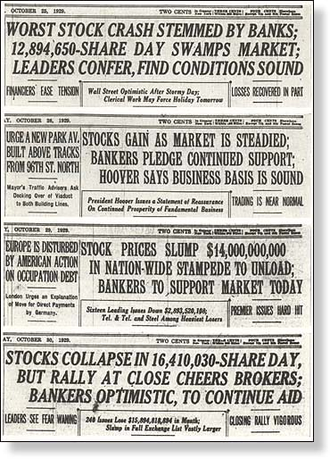

Slide 13
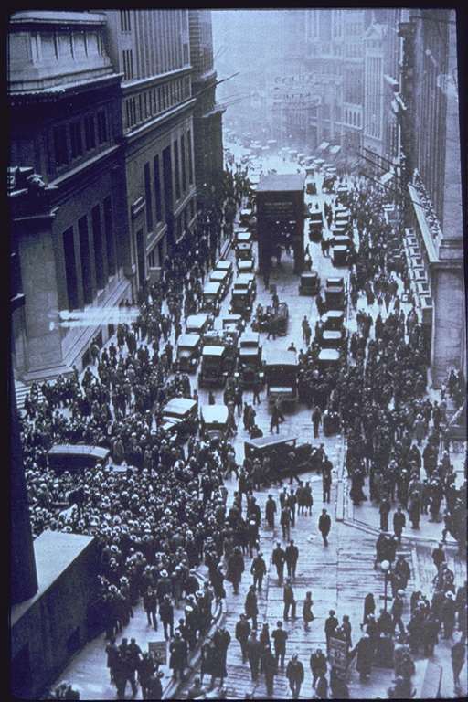
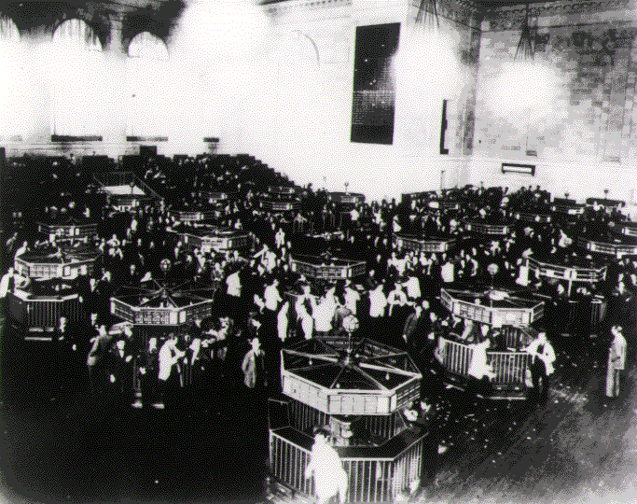
STOCK MARKET CRASH AND FINANCIAL PANIC
WALL STREET ON THE DAY OF THE CRASH, OCTOBER 1929

Slide 14
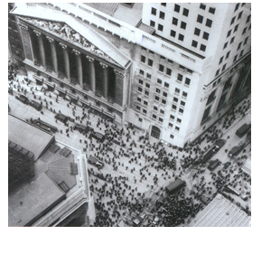
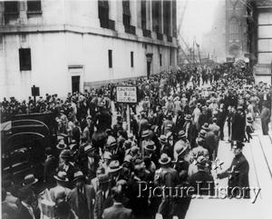
Wall Street was a scene of chaos!
Day after the crash…a rush to sell, but to who?

Slide 15
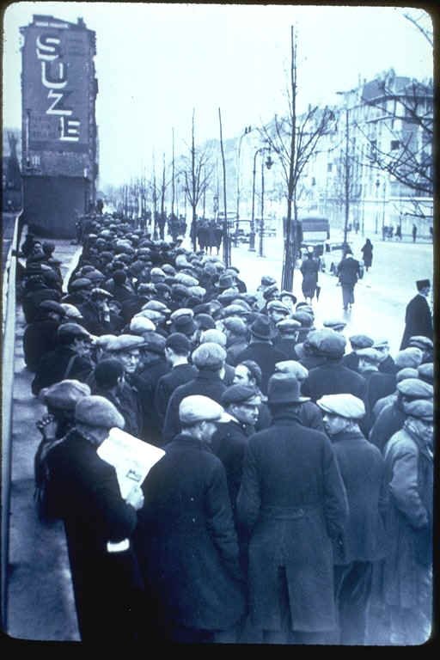
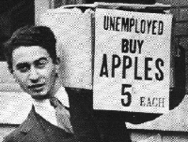
Trouble and disorder began to spread throughout the nation

Slide 16
Results of the Crash
Bank Runs - rumors that the banks were going insolvent; people rushed to get money (this actually caused them to fail)
Banks across the nation failed (no insurance on accounts)

Slide 17
Results of the Crash
Businesses were hit hard
workers lost jobs (25% unemployment in 1933)
Depression also in Europe – recovering from WWI
The Great Depression affected most Americans

Slide 18
The Great Depression Begins
US History
Mrs. Lacks

Slide 19
Impact of the Depression
some men abandon families; women do all they can; kids suffer
suicide rate up 30%; 3x more admitted to mental hospitals
quit going to doctor or dentist
no dreams of college
put off marriage
develop a habit of saving and thriftiness
Homelessness
shantytowns – small towns of shacks on the outskirts of a city
soup kitchens and breadlines where people could receive free

Slide 20
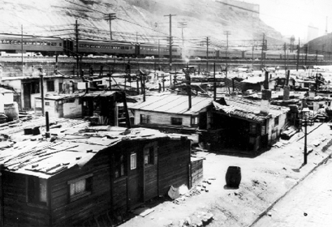
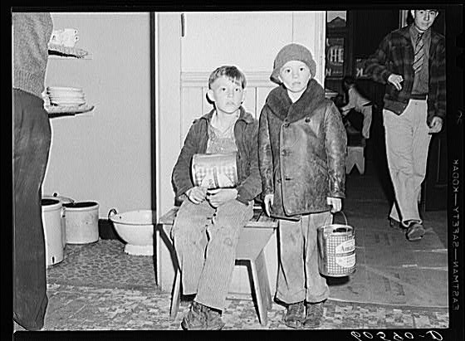
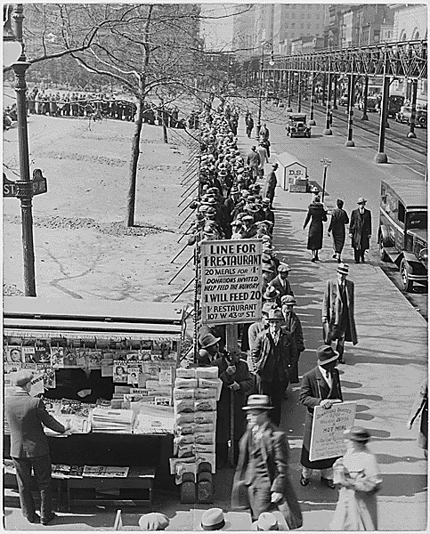
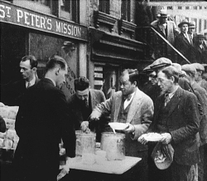
Shantytowns
Soup Kitchens
Breadlines

Slide 21
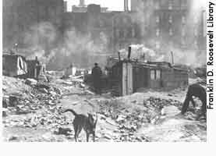
Hoovervilles sprung up all over America…”In Hoover we trusted and now we are busted.”

Slide 22
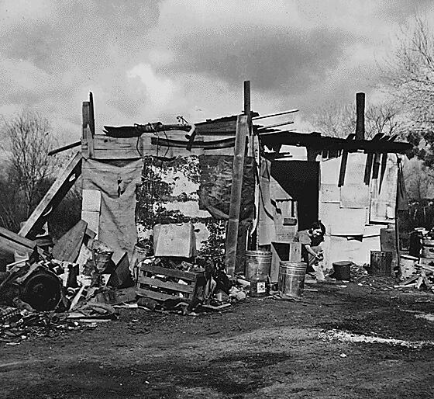
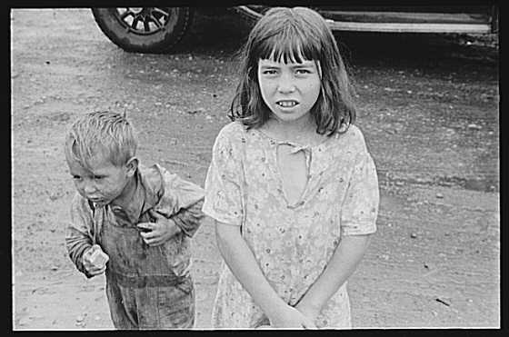
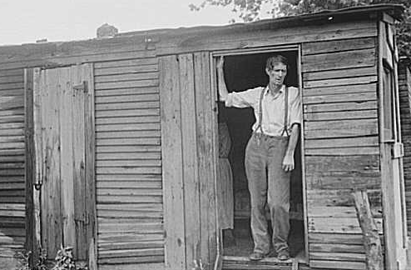
“Hoovervilles”, homeless camps

Slide 23
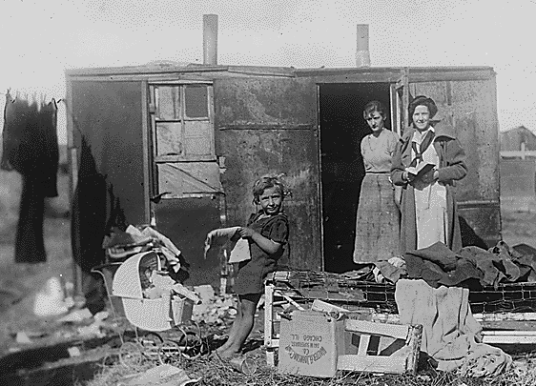

Slide 24
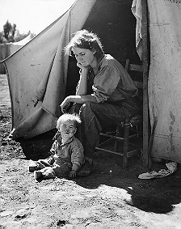
With massive unemployment, the average American’s life changed dramatically during the Depression

Slide 25
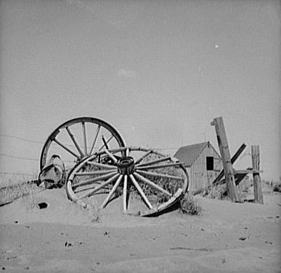
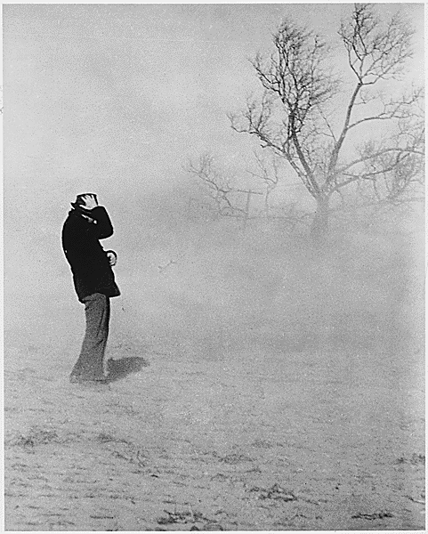
Then, as if things were not bad enough, came the Dust Bowl

Slide 26
The Dust Bowl
Great Plains
caused by drought; winds created Dust Bowl
Migration West
many ended up in California

Slide 27
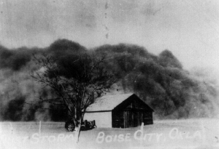
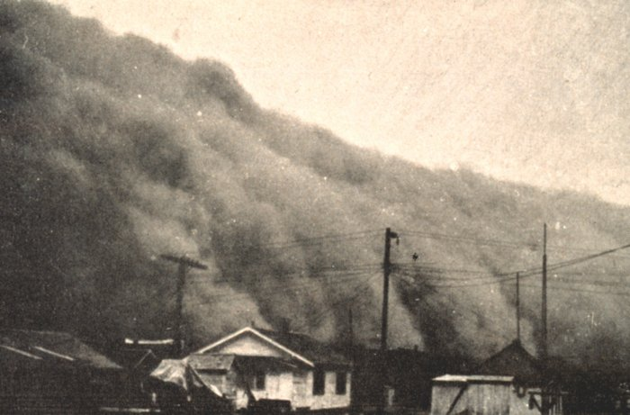

Slide 28
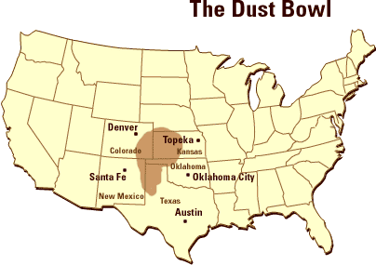

Slide 29
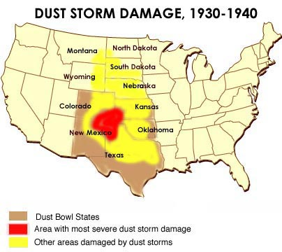

Slide 30
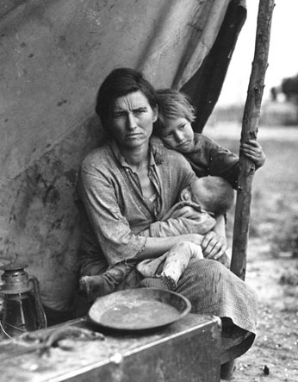
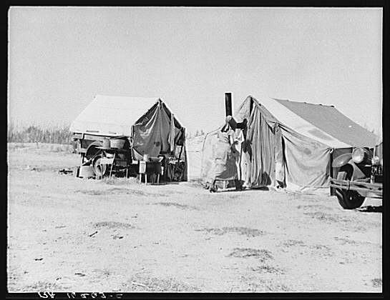
The Dust Bowl, which began in 1932, “displaced” millions of Americans

Slide 31
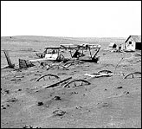
The combination of DROUGHT and DUST STORMS created a barren waste land in the American heartland

Slide 32
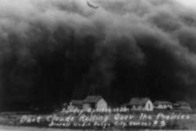
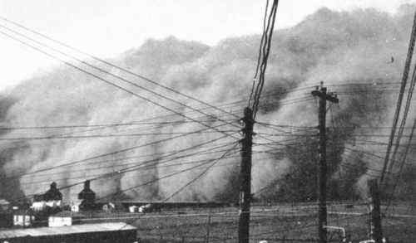
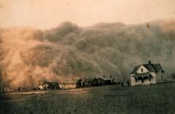
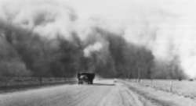
Kansas
Texas
Colorado

Slide 33
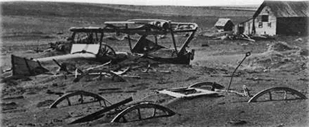
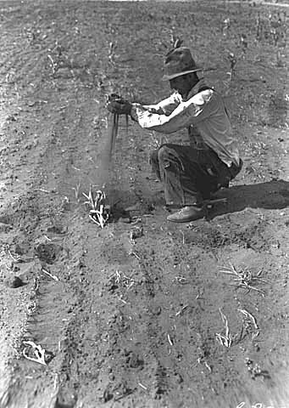
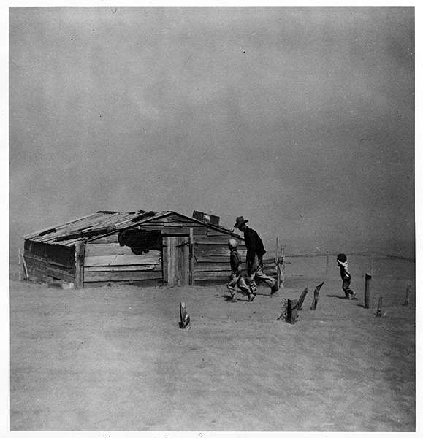
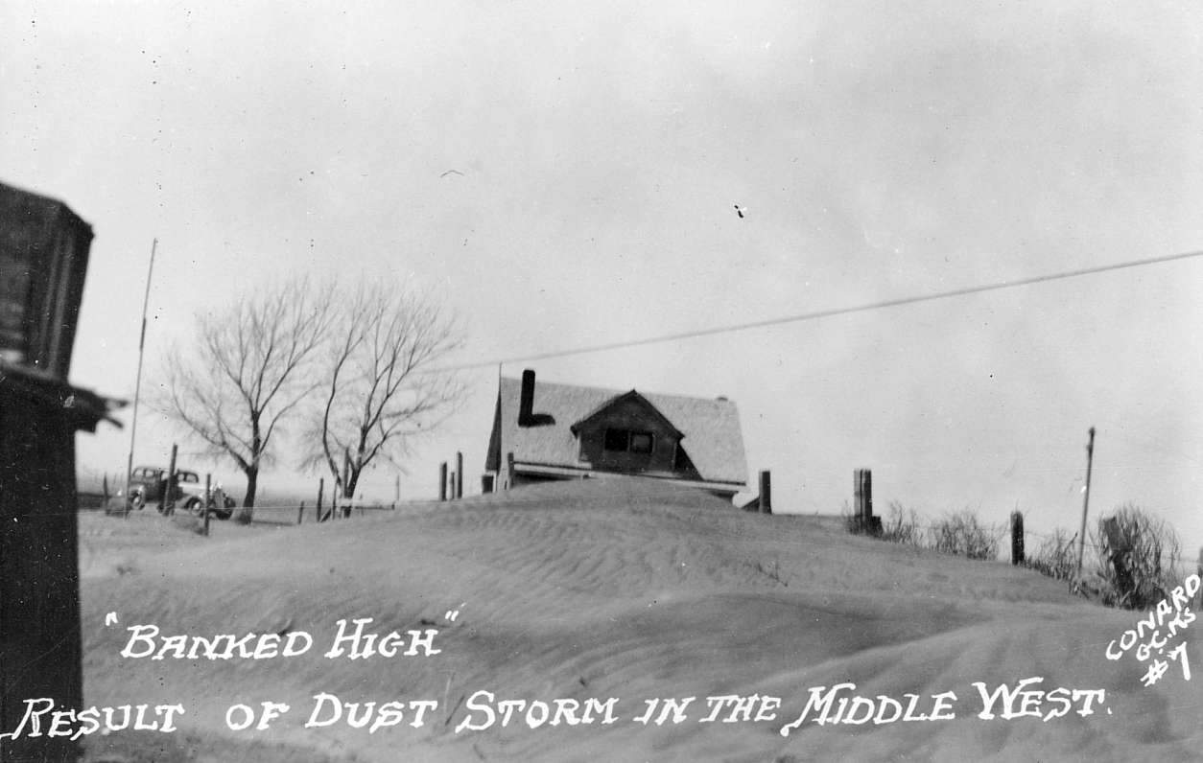
South Dakota
Minnesota
Kansas
Oklahoma

Slide 34
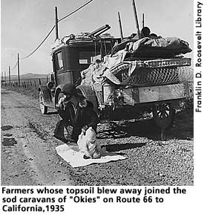
“Okies” and “Arkies” moved West hoping to find work and a way to survive

Slide 35
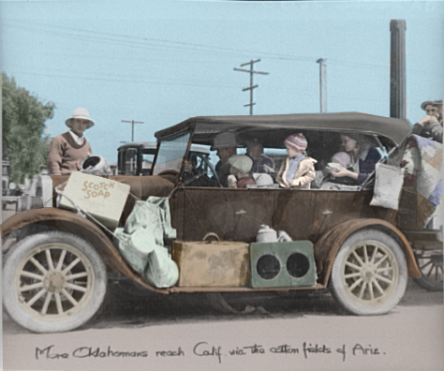

Slide 36
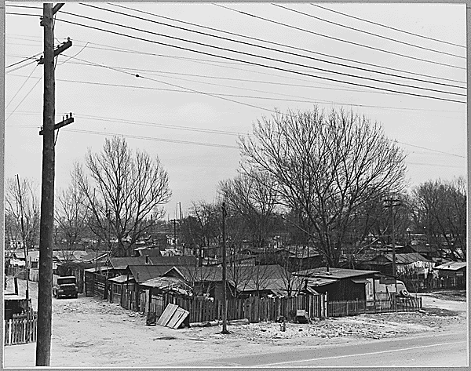
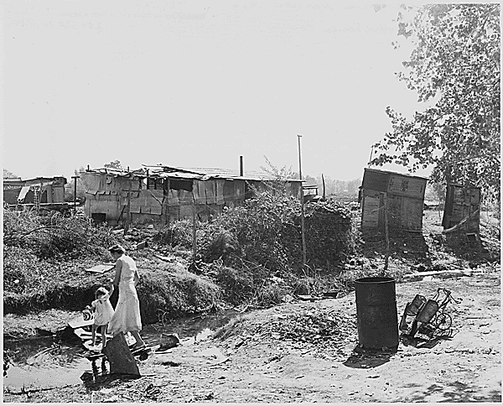
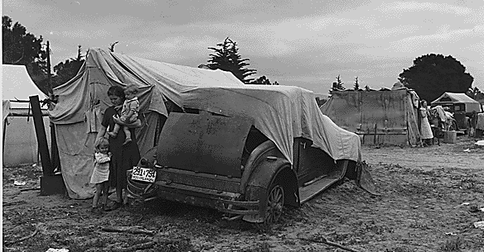
MIGRANT CAMPS IN CALIFORNIA WHERE REFUGEES CAME TO MAKE A NEW START

Slide 37
Factory Overproduction
FACTORIES WERE PRODUCING PRODUCTS BUT WAGES WERE NOT RISING FAST ENOUGH FOR PEOPLE TO BUY THEM.
THE SURPLUS PRODUCTS COULD NOT BE SOLD OVERSEAS DUE TO HIGH TARIFFS AND LACK OF MONEY IN EUROPE.

Slide 38
Farm Overproduction
DUE TO SURPLUSES AND OVERPRODUCTION FARM INCOMES DROPPED THROUGHOUT THE 1920’S.
THE PRICE OF FARM LAND FELL FROM $69 PER ACRE IN 1920 T0 $31 IN 1930.
AGRICULTURE WAS IN A DEPRESSION THAT BEGAN IN 1920 LASTING UNTIL THE OUTBREAK OF WORLD WAR II IN 1939.
IN 1929 THE AVERAGE ANNUAL INCOME FOR AN AMERICAN FAMILY WAS $750, BUT FOR FARM FAMILIES IT WAS ONLY $273.
THE PROBLEMS IN THE AGRICULTURAL SECTOR HAD A LARGE IMPACT SINCE 30% OF AMERICANS STILL LIVED ON FARMS.

Slide 39
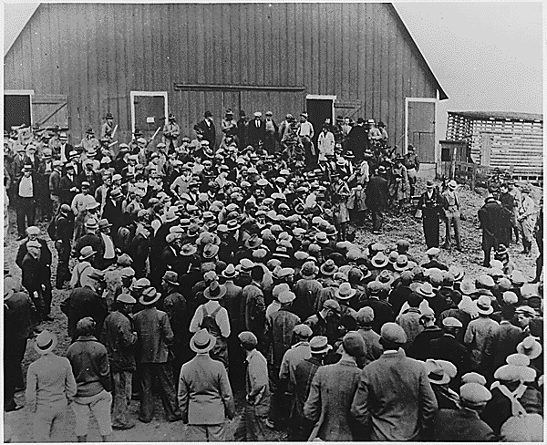
MANY FARMERS LOST THEIR FARMS. BELOW IS ONE OF THOUSANDS OF FARM FORECLOSURE SALES.

Slide 40
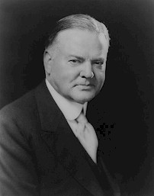
Herbert Hoover
Elected in 1928
Within eight months faced the largest economic downturn in US History
Economist, but didn’t think it was Constitutional for US government to get directly involved

Slide 41
Herbert Hoover
“rugged individualism” – success through own efforts
believed in minimal government intervention (opposed federal aid)
believed individuals, charities, and businesses should help the needy
urged employers not to cut wages or lay off workers and for workers not to strike

Slide 42
Herbert Hoover
1930 – begins taking action by putting federal money in programs to jumpstart the economy
Boulder Dam (Hoover Dam) – between Arizona and Nevada

Slide 43
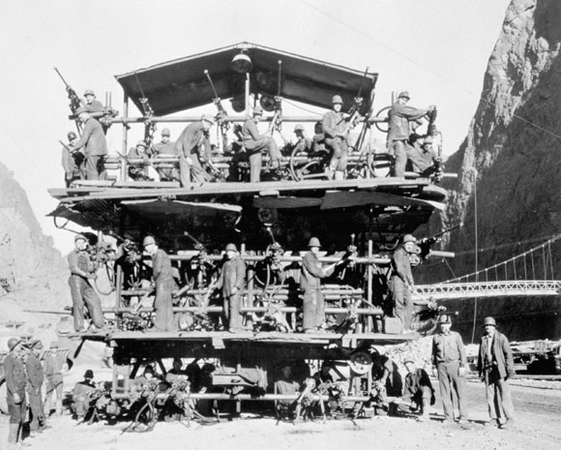
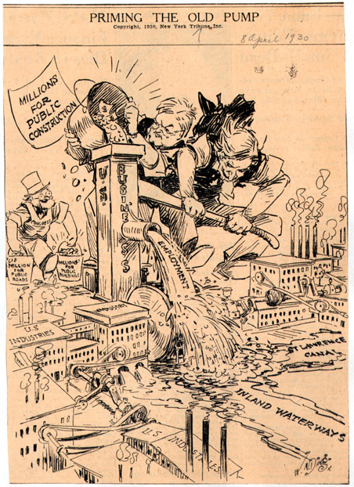
HOOVER RELIEF AND GOVERNMENT “MAKE WORK” CONSTRUCTION PROJECTS
CONSTRUCTION OF THE HOOVER DAM IN NEVADA EMPLOYED THOUSANDS WHO NEEDED JOBS

Slide 44
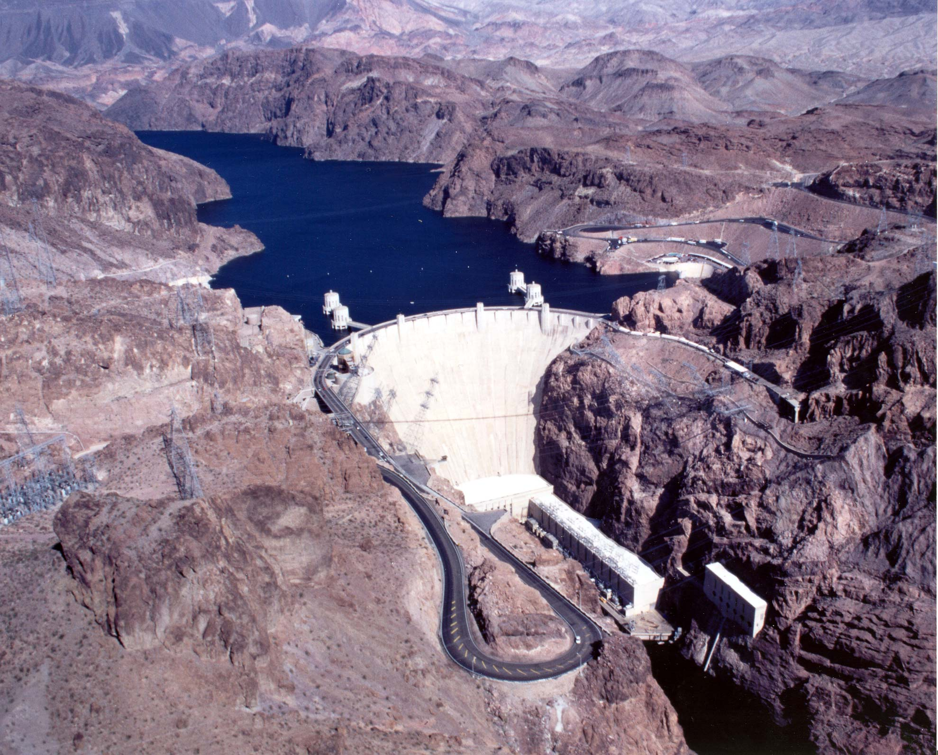
Boulder (Hoover) Dam

Slide 45
TIMELINE OF HOOVER’S ATTEMPTS AT ENDING THE GREAT DEPRESSION
1930
SMOOT –HAWLEY TARIFF PASSED TO PROTECT U.S. BUSINESS FROM FOREIGN COMPETITION. IT ONLY MADE CONDITIONS WORSE WHEN OTHER NATIONS RETALIATED WITH TARIFFS THAT KEPT OUT U.S. GOOD
THE FEDERAL RESERVE CUT INTEREST RATES AND INJECTED SOME MONEY INTO THE BANKING SYSTEM
1931
NO LEGISLATION WAS PASSED

Slide 46
1932 EVENTS
THE DEPRESSION WORSENS
INDUSTRIAL STOCK PRICES DOWN 80% SINCE 1930
10,000 BANKS FAIL WITH THEIR DEPOSITORS LOSING OVER TWO BILLION $ OF THEIR SAVINGS (today it would equal about $22 BILLION)
OVER 13 MILLION WORKERS LOST THEIR JOBS
OVERSEAS TRADE DECLINED BY 66%

Slide 47
Herbert Hoover
Hoover was blamed for the depression
Hoovervilles – shantytowns
Hoover blankets – newspapers used by homeless to keep warm
Hoover flags – empty pockets turned inside out
Right: Unemployment

Slide 48
Bonus Army
group of WWI vets and their families came to Washington to show support for a bill being debated in Congress which authorized gov. to pay a bonus to WWI vets who hadn’t received just compensation for their service
bonus had already been approved in 1924 to be paid in 1945
some felt it should be paid immediately

Slide 49
Bonus Army
Hoover supported their right to peaceful assembly
bill was defeated – most of the group went home except for @2000 which Hoover decided should be disbanded
1000 soldiers under Gen. Douglas MacArthur and Major Dwight Eisenhower went in and gassed the crowd
11 month old baby died, 8 year old boy was partially blinded, 2 people shot, and many others injured
public was stunned and outraged

Slide 50
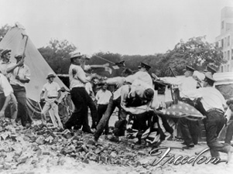
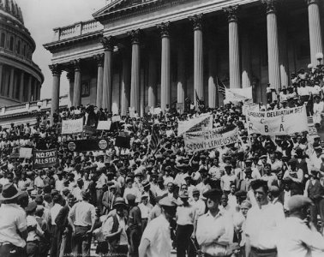
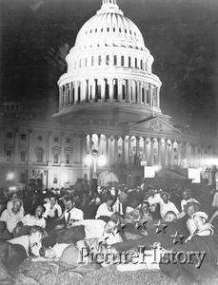
Bonus Army

Slide 51
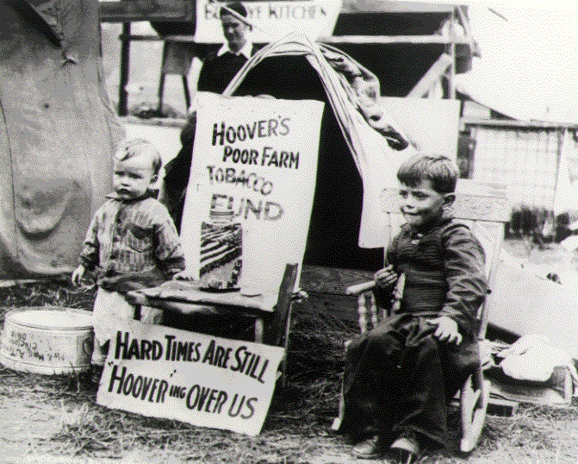
SOME BONUS MARCHERS BROUGHT THEIR FAMILIES

Slide 52
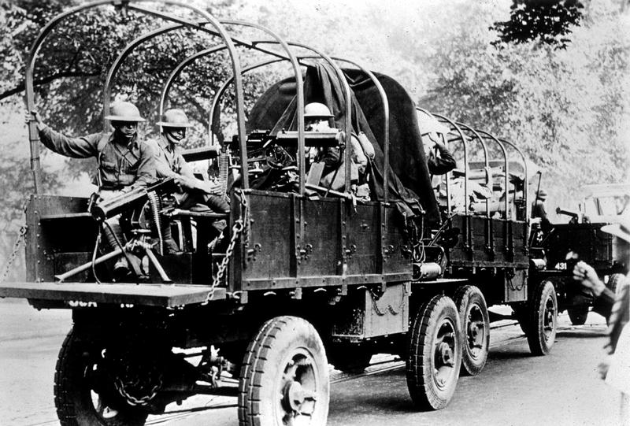
PRESIDENT HOOVER SENT THE ARMY TO DISPERSE THE BONUS MARCHERS

