Slide 1
The Middle Colonies
US History

Slide 2
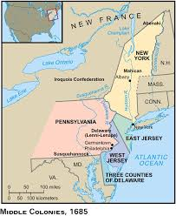
Which are considered the Middle Colonies?
New York
Pennsylvania
New Jersey
Delaware
Notes:
Today, commonly referred to as the Mid Atlantic states

Slide 3
Characteristics of the Middle Colonies?
Great farming: “bread colonies” – grain
Great ports (led to developed cities like New York & Philadelphia)
Most democratic (less aristocratic)
Diverse population (ethnically mixed, religiously tolerant)
Fewer industries than New England, but more than the South (ship building, lumbering, coal, iron)

Slide 4
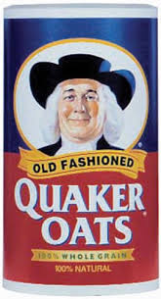
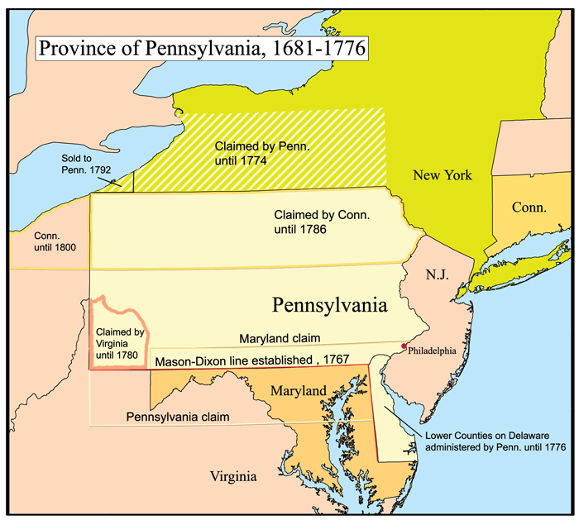
Pennsylvania
Founded by Quakers, specifically William Penn
Notes:
Primary motive for founding colony: Haven for Quakers (and those seeking religious freedom – “Holy Experiment”)
Attractive to many groups, particularly Germans

Slide 5
Pennsylvania Colony
Very tolerant of other ethnicities and religions (population grows quickly)
Climate fostered grain-growing and livestock raising
Lots of tradable goods (coal, iron, lumber, fur, etc)
Major cities: Philadelphia, later Pittsburg

Slide 6
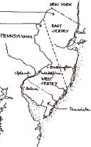
New Jersey
Land grant; named for British Island of Jersey
Characteristics: very similar to PA (also attractive to many diverse settlers)
Close to cities: Philadelphia & New York

Slide 7
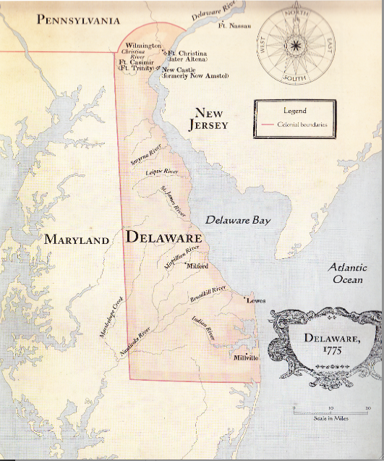
Delaware
Land grant to Lord de la War
Characteristics: very similar to PA & New Jersey
First city: Wilmington

Slide 8
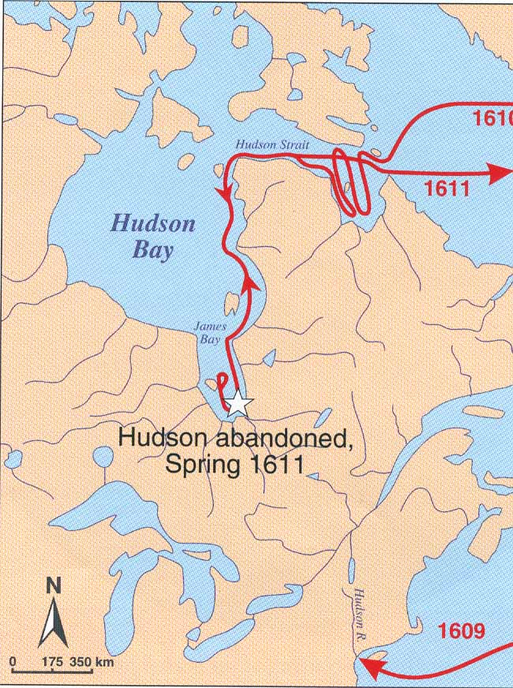
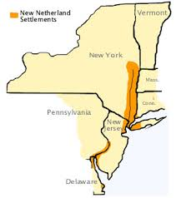
New Netherlands
Explored by Henry Hudson
New Amsterdam
Manhattan ($30)
Cosmopolitan town

Slide 9
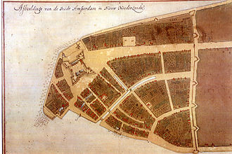
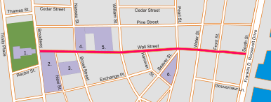
Fall of New Netherlands
Dutch built wall – Wall Street for protection from Natives
Took over New Sweden (New Jersey)
New Englanders saw growing Dutch presence as a threat
Notes:
Indians, in retaliation for Dutch violence, massacred settlers; Dutch built wall – Wall Street

Slide 10
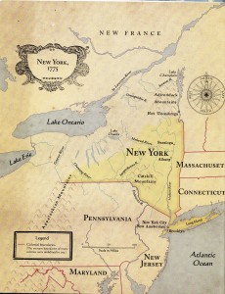
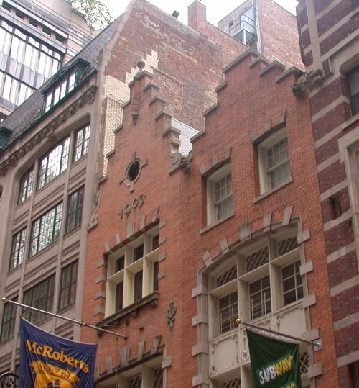
Fall of New Netherlands
1664: English King Charles II gave New Amsterdam to his brother, the Duke of York, in hopes of eliminating Dutch presence in North America
Notes:
Dutch Residue in NY: Names → Harlem, Brooklyn
Architecture → gambrel roof
Customs → Easter eggs, Santa Claus, waffles, bowling, sleighing, skating, kolf [golf].

Slide 11
Dutch Residue in NY
Names → Harlem, Brooklyn
Architecture → gambrel roof
Customs → Easter eggs, Santa Claus, waffles, bowling, sleighing, skating, kolf [golf].

Slide 12
New York Colony
Very similar to PA, NJ, DE – grain, lumber, coal, iron, fur, etc.
Major cities: New York City, then Albany (on Hudson River)
Question: Why did NYC urbanize so quickly while the Eastern Shore of Virginia did not?

