Slide 1
The Middle Colonies
AP US History

Slide 2
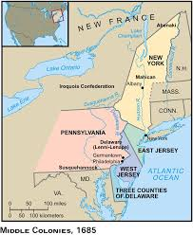
Which are considered the Middle Colonies?
New York
Pennsylvania
New Jersey
Delaware
Today, commonly referred to as the Mid Atlantic states

Slide 3
Characteristics of the Middle Colonies?
Great farming: “bread colonies” - grain
Three Rivers: Susquehanna, Delaware, Hudson
Great ports (led to developed cities like New York & Philadelphia)
Most democratic (less aristocratic)
Diverse population (ethnically mixed, religiously tolerant)
Fewer industries than New England, but more than the South (ship building, lumbering)

Slide 4
New York (aka New Netherlands)
1600s: Golden Age of Dutch history.
Major commercial and naval power.
Challenging England on the seas.
3 major Anglo-Dutch Wars
Major colonial power [mainly in the East Indies].

Slide 5
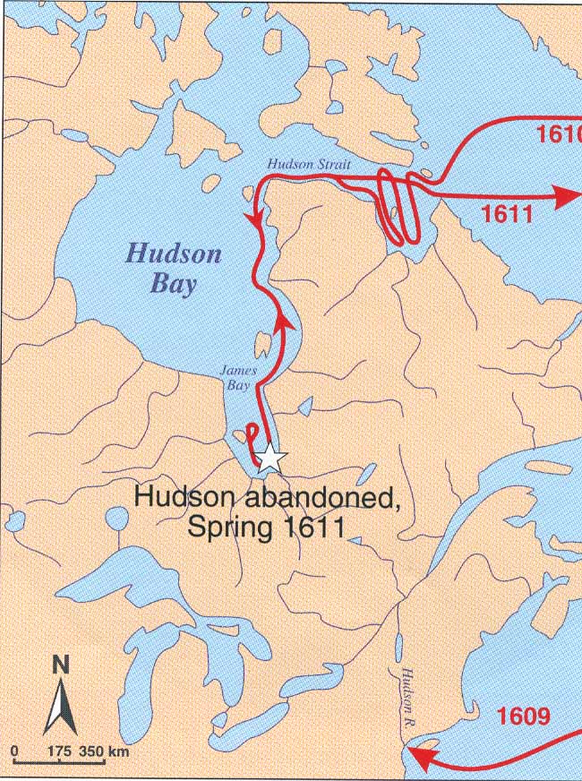
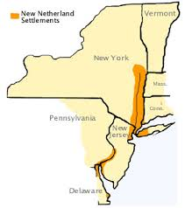
New Netherlands
Henry Hudson
New Netherlands
Patroonships
Commercial enterprise
New Amsterdam
Manhattan ($30)
Cosmopolitan town

Slide 6
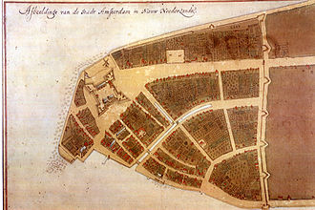
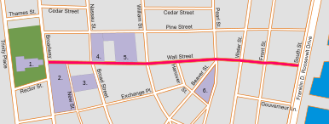
Fall of New Netherlands
Indians, in retaliation for Dutch violence, massacred settlers; Dutch built wall – Wall Street
New Englanders saw growing Dutch presence as a threat

Slide 7
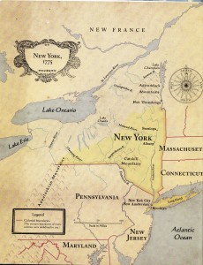
Fall of New Netherlands
1655: New Sweden (New Jersey) invaded by Dutch under Peter Stuyvesant and absorbed by New Netherlands
1664: Charles II ordered removal of Dutch from British North America
Gave New Amsterdam to his brother, the Duke of York

Slide 8
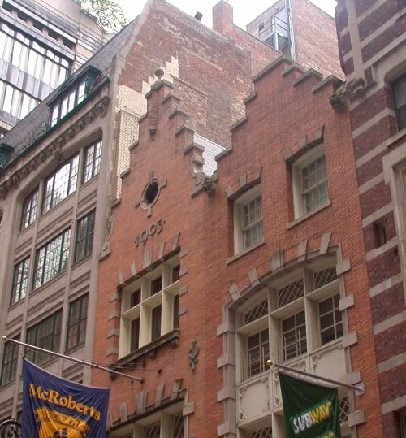
Dutch Residue in NY
Names → Harlem, Brooklyn
Architecture → gambrel roof
Customs → Easter eggs, Santa Claus, waffles, bowling, sleighing, skating, kolf [golf].

Slide 9
New York
Chapter of Liberties (1683)
Freedom of religion to all Christians
Granted suffrage to all landowners
Became a royal colony (1685) when James II became king
Limitations:
Much land, few landowners
Feudalistic (resembled plantation colonies)

Slide 10
New York
Autocratic in character
Leisler’s Rebellion (1691)
Poor whites + farmers led by Jacob Leisler rebelled due to lack of land
Inspired by Glorious Revolution & overthrow of Dominion of New England
Revolt failed, Leisler hanged, parceling of huge estates to upper class continued

Slide 11
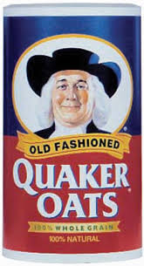
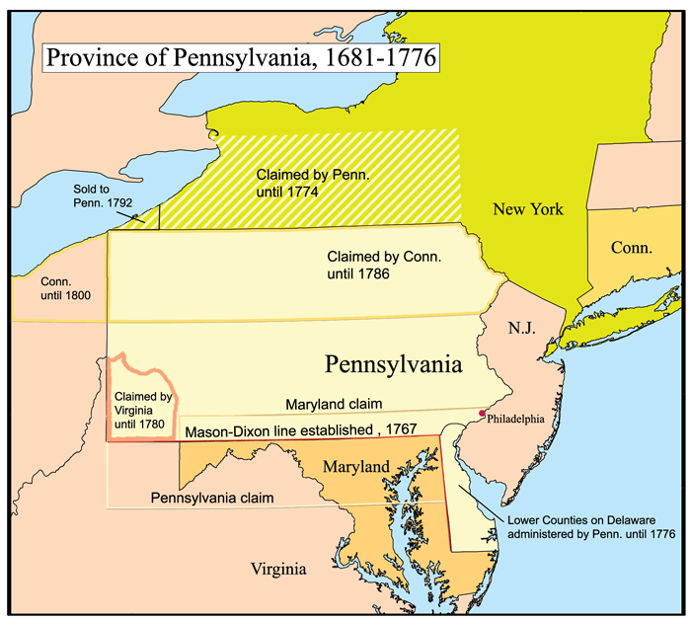
Pennsylvania
Quakers
William Penn

Slide 12
Pennsylvania
Primary motive for founding colony: Haven for Quakers (and those seeking religious freedom – “Holy Experiment”)
Secondary motive: experiment with liberal ideas while still making money
Attractive to many groups, particularly Germans

Slide 13
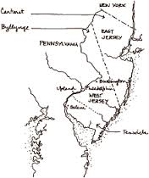
New Jersey
Started in 1664 as Quaker settlement
2 proprietors received area from Duke of York
1702: two Jerseys combined as a royal colony

Slide 14
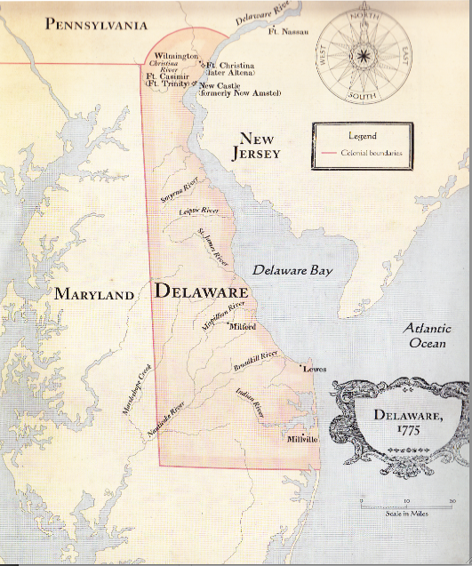
Delaware
Granted its own assembly in 1703
Contained large Quaker population
Remained under the governor of PA until the American Revolution

