Slide 1
Taxes: Understanding Your Paycheck
Economics
2015

Slide 2
Federal & State Income Taxes
“Pay-as-You-Earn” Taxation
Federal income taxes are collected throughout the course of the year as individuals earn income
Tax Withholding
The process by which employers take tax payments out of an employees pay before he or she receives it.

Slide 3
Federal Income Taxes (cont.)
Tax Returns:
At the end of the year, an employer gives employees a report showing how much they withheld in taxes.
Individuals file a tax return with information regarding exemptions and deductions that adjust the amount of tax that should have been paid.
If you paid too much, you get a refund. If you paid too little, you must pay the balance.
All tax returns must be filed by April 15^{th.}

Slide 4
Social Security Taxes
Provides funds for older Americans, their survivors, and disability insurance.
Program funded by the Federal Insurance Contributions Act (FICA).
Current FICA tax on social security: 6.2%

Slide 5
Medicare
Funds a national health insurance for people over 65 and with certain disabilities.
Paid through FICA
Current FICA tax on Medicare: 1.45%

Slide 6
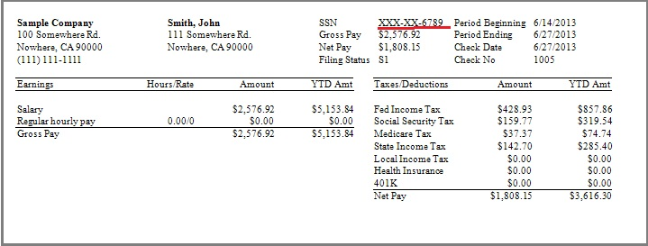
Sample Paycheck without Deductions

Slide 7
Common Additional Paycheck Deductions
Health insurance (medical, dental, and/or vision)
Disability Insurance
Life Insurance
401K (retirement)
Stock plan

Slide 8
