Slide 1
Designing On a Grid
Graphic Design
Mrs. Lacks

Slide 2
Balance
Balance in design is similar to balance in physics
A large shape close to the center can be balanced by a small shape close to the edge
A large, light-toned shape can be balanced by a small, dark-toned shape (the darker the shape, the heavier it appeals to be)

Slide 3
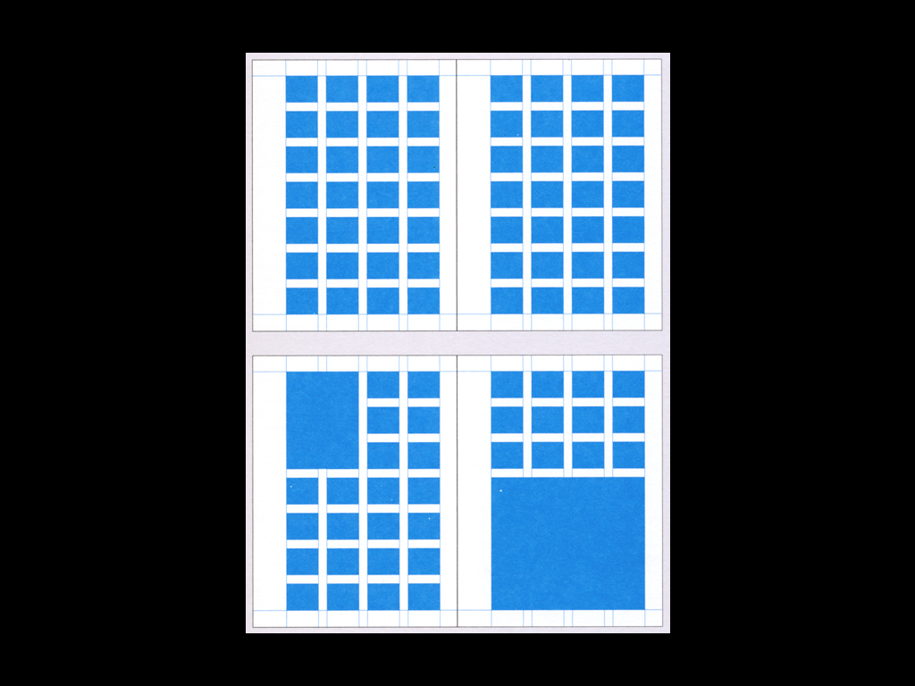

Slide 4
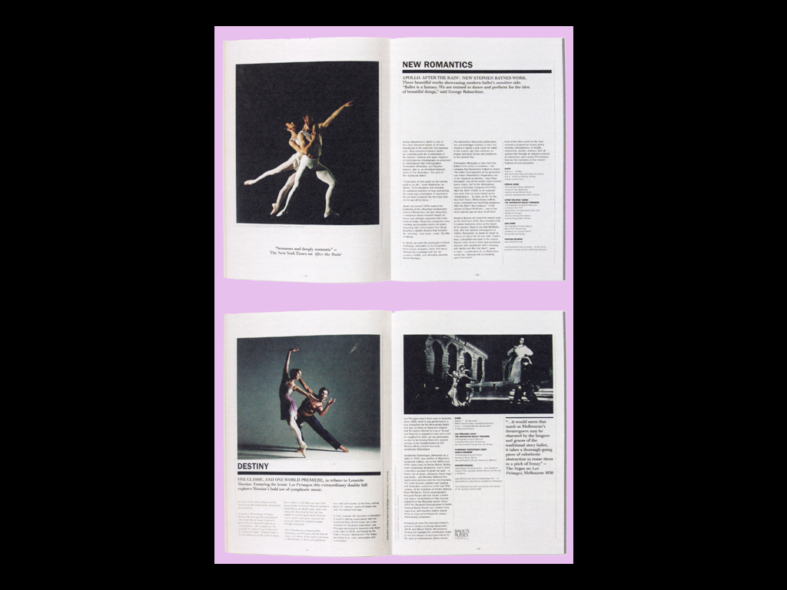

Slide 6
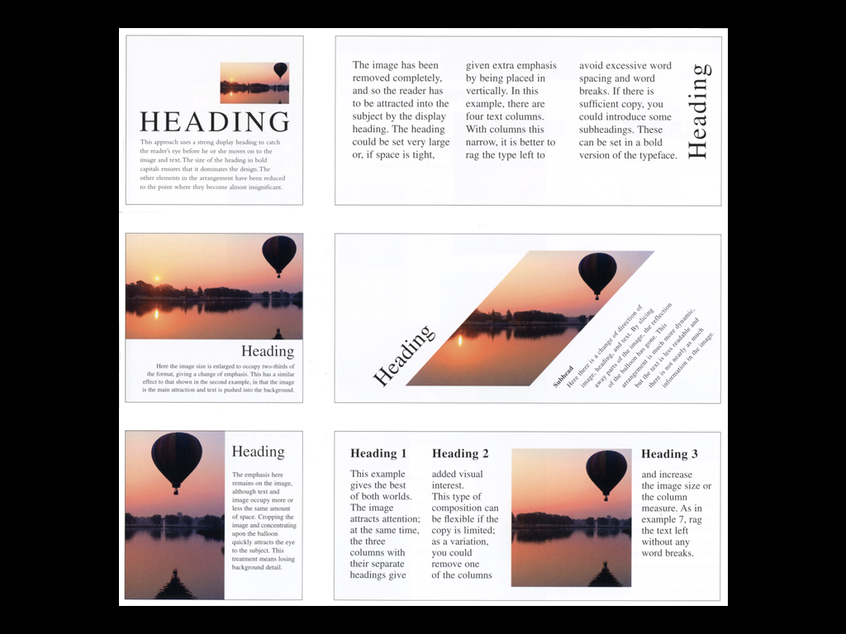

Slide 8
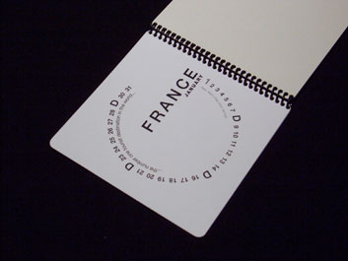

Slide 9
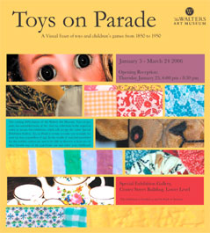
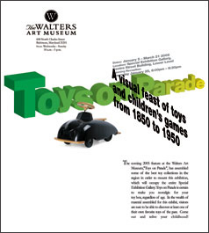
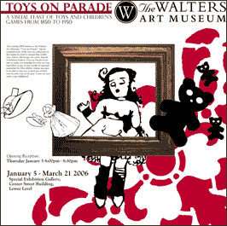

Slide 10
Repetition
Repetition with variation can be interesting, without being monotonous

Slide 13
Contrast
Contrast is the juxtaposition of opposing elements:
Colors (warm vs. cool)
Value (light vs. dark)
Direction (horizontal vs. vertical)

Slide 14
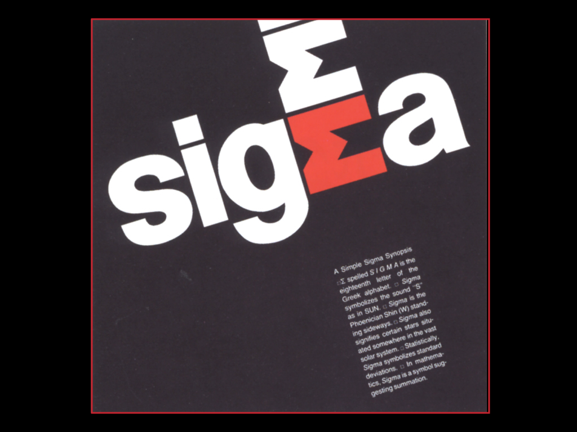

Slide 15
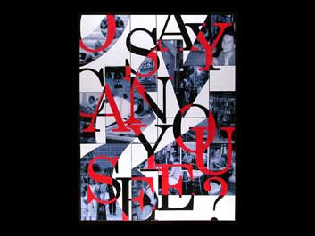

Slide 16
Harmony
The visually satisfying effect of combining similar, related elements like
Adjacent colors on a color wheel
Similar shapes

Slide 18
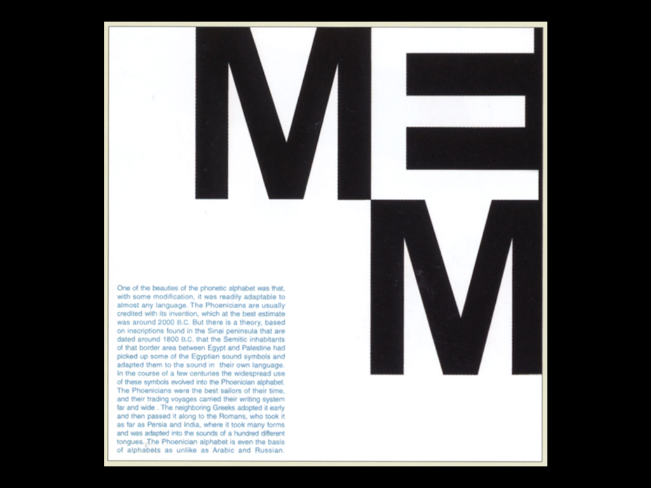

Slide 19
Dominance
Dominance gives a page layout interest counteracting confusion and monotony
Dominance can be applied to one or more of the elements to give emphasis

Slide 20
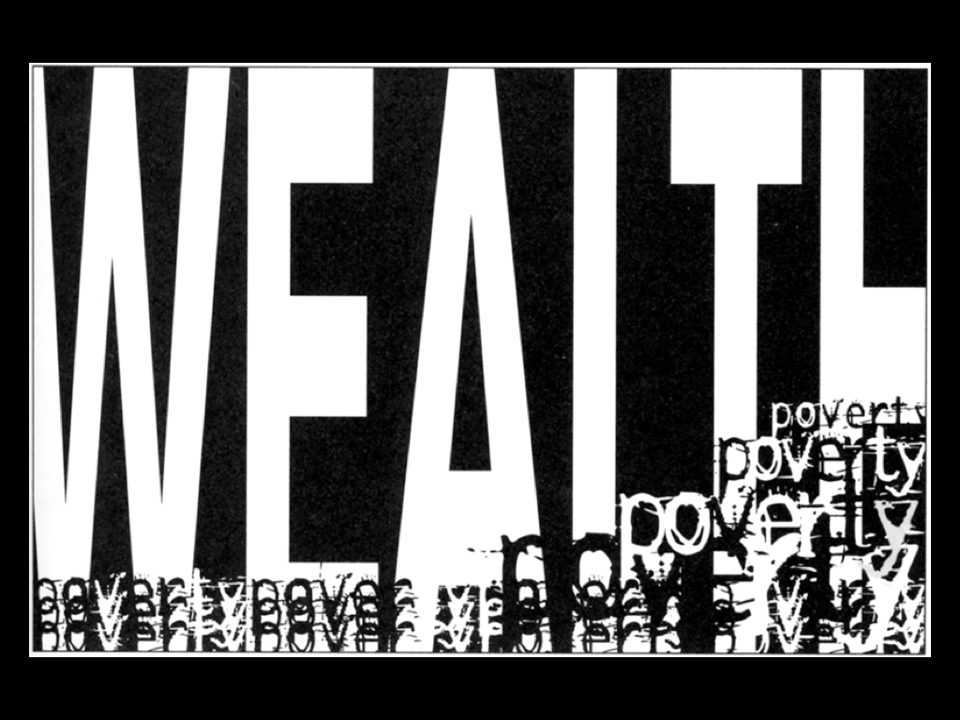

Slide 21
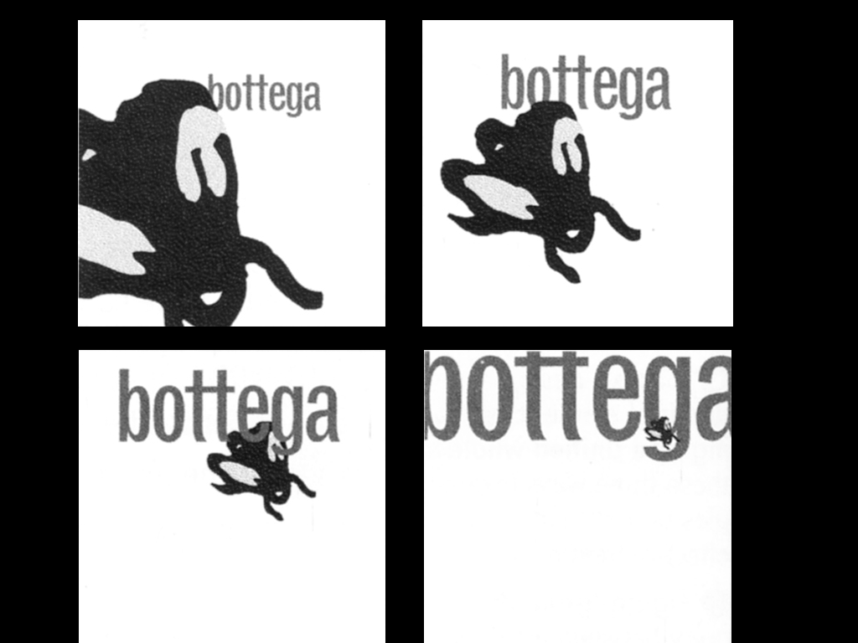

Slide 22
Unity
Relating the design elements to the idea being expressed reinforces the principle of unity
A design with an active, aggressive subject would work better with a dominant diagonal direction
A quiet, passive subject would benefit from horizontal lines, soft texture, and less tonal contrast

Slide 26
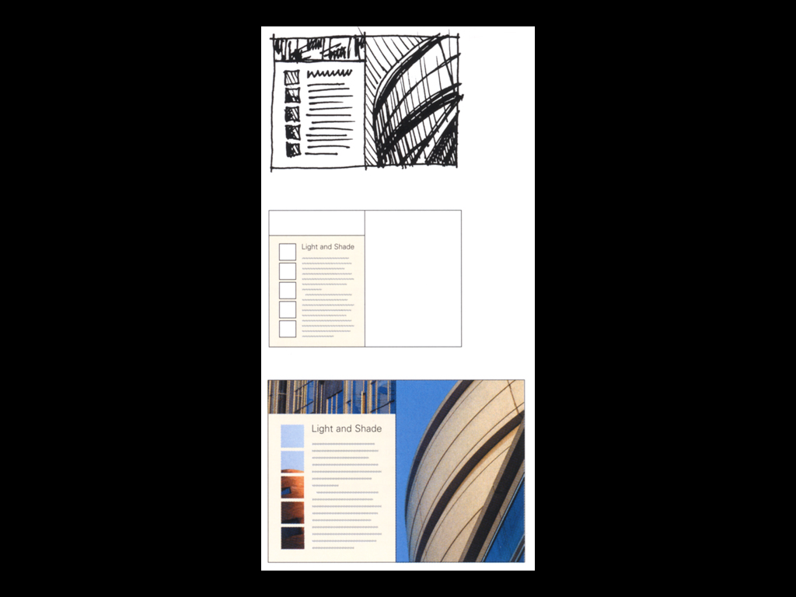

Slide 27
Negative Space
White space is good, if it has purpose (provides organization, creates movement, promotes dominance)

Slide 28
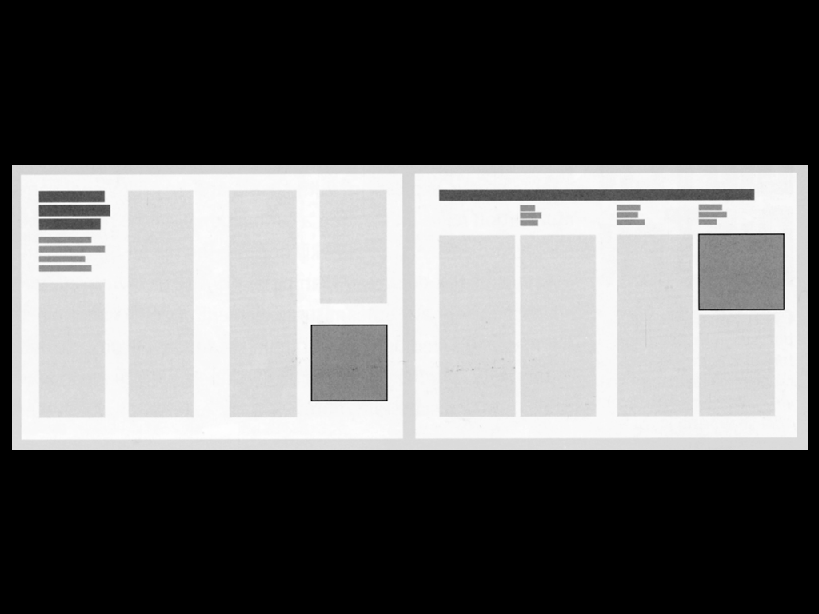

Slide 31
Designing on a Grid
Grids are everywhere

Slide 32
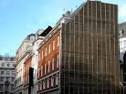
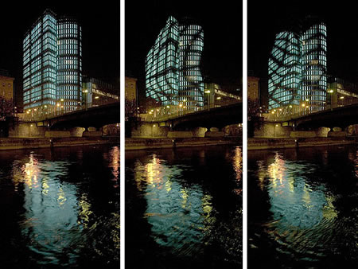
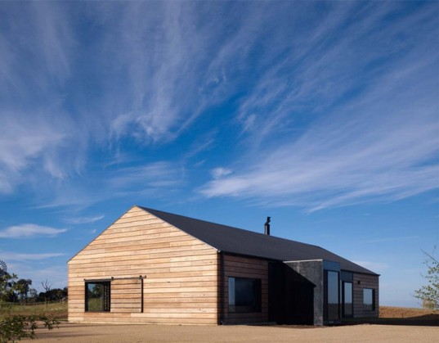
Architecture

Slide 33
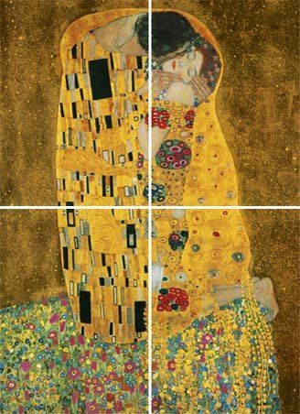
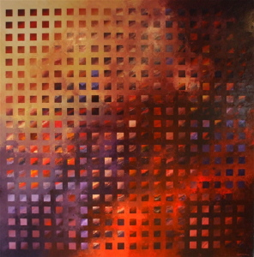
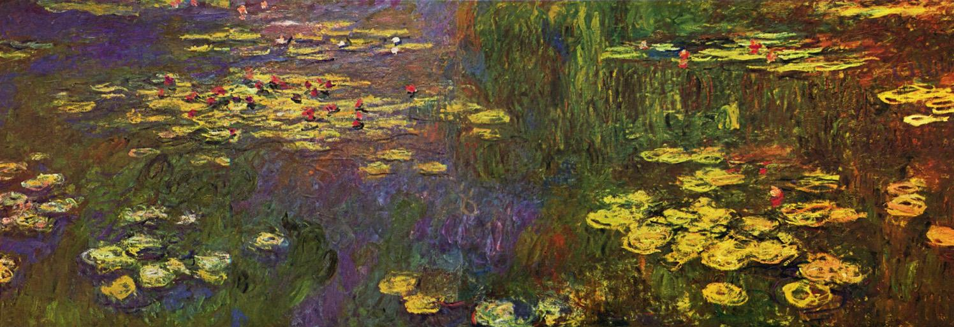
Fine Art

Slide 34
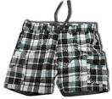
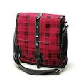
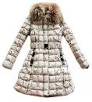
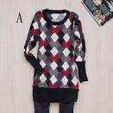
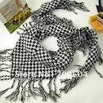
Fashion

Slide 35
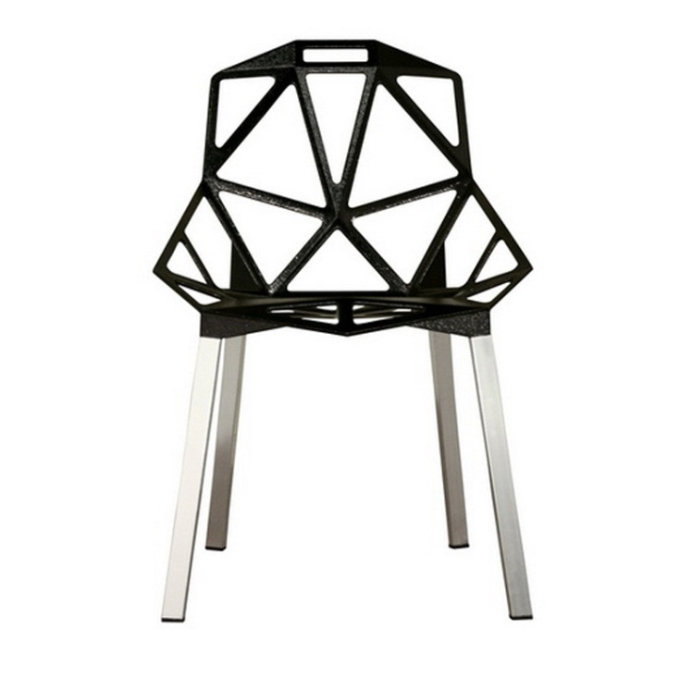
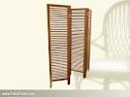
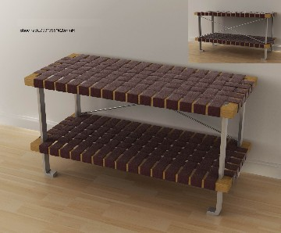
Furniture

Slide 37
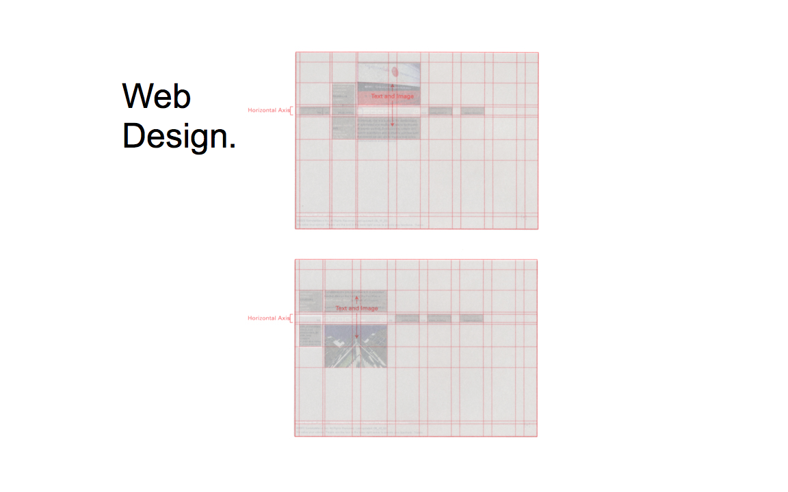

Slide 43
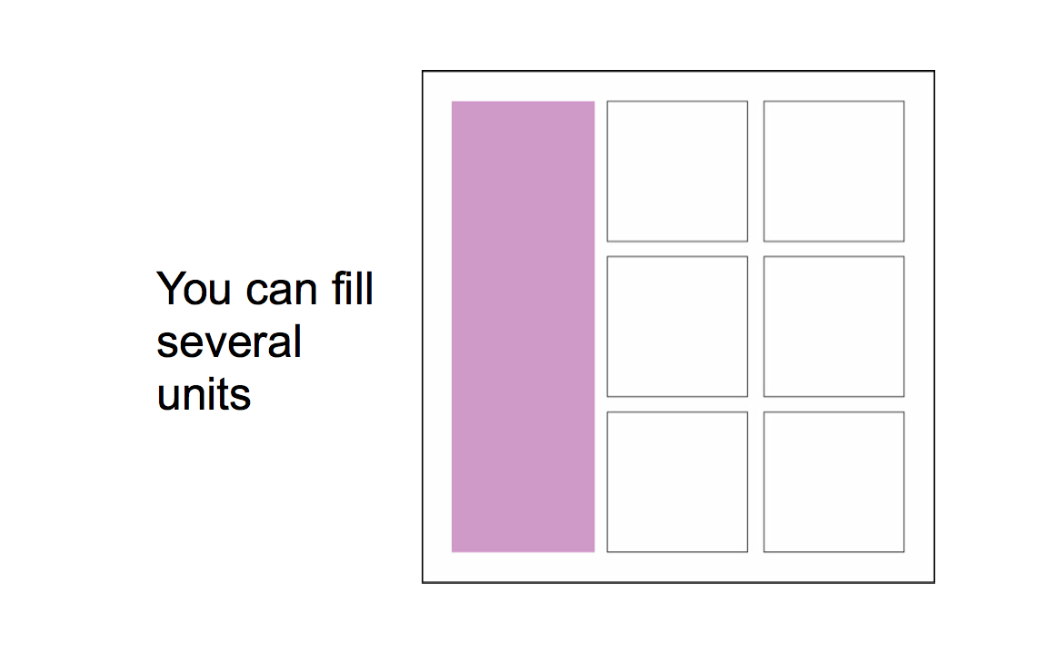

Slide 53
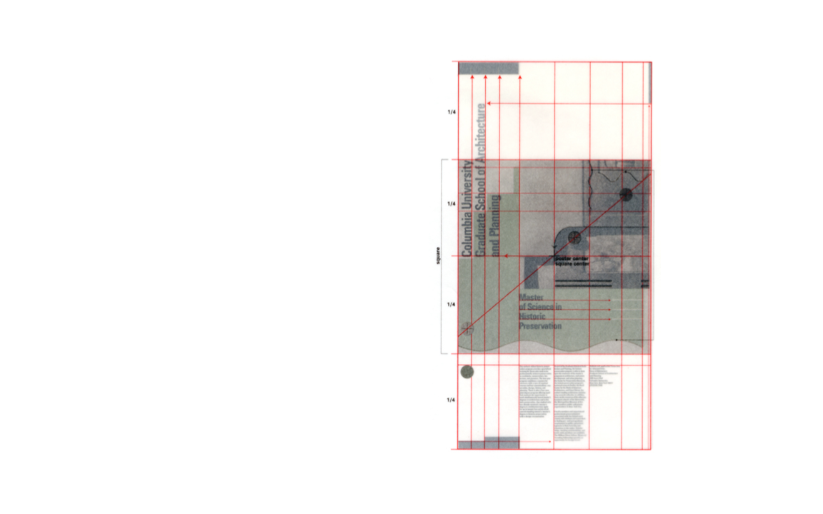

Slide 57
