Slide 1
Social Welfare Policy
AP US Government

Slide 2
Types of Benefits
Social welfare policies provide benefits to individuals, through:
Entitlement programs: government benefits that certain qualified individuals are entitled to by law, regardless of need
Means-tested programs: government programs only available to individuals below a specific line

Slide 3
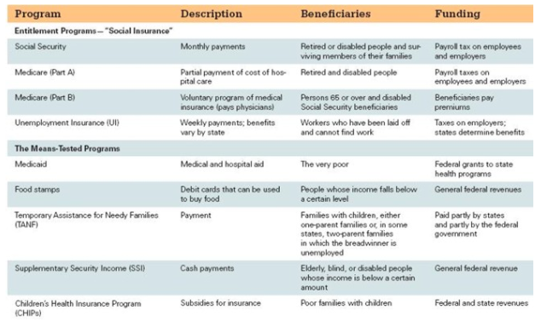
Social Welfare Programs in US

Slide 4
Entitlement Programs
Social Security Act of 1935— first government program to help people against absolute poverty
Set up Social Security Program and AFDC (Aid to Families with Dependent Children)
Expanded by President Johnson’s war on poverty & Great Society programs (started Medicare & Medicaid)

Slide 5
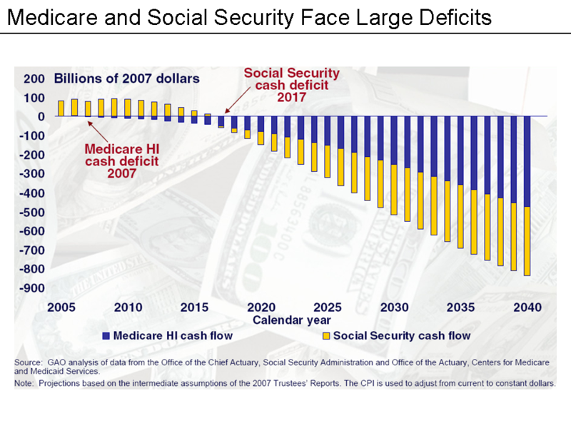

Slide 6
Who’s Poor in the US?
Poverty Line: what a family must spend for an austere standard of living
Current Poverty Line: https://aspe.hhs.gov/poverty-guidelines
Percentage of poor in US: https://www.census.gov/hhes/www/poverty/about/overview/

Slide 7
Who’s Poor in the US?
Many people move in and out of poverty in a year’s time.
Feminization of poverty: high rates of poverty among unmarried women

Slide 8
Helping the Poor?
President Reagan cut welfare benefits and removed people from benefit rolls.
Conservatives argued that welfare programs discouraged the poor from solving their problems.
Attitudes toward welfare became race coded, the belief that most people on welfare were African Americans.

Slide 9
Helping the Poor?
The Welfare Reforms of 1996
Personal Responsibility and Work Opportunity Act
Each state to receive a fixed amount of money to run its own welfare programs.
Two continuous years limit on welfare
Lifetime limit of five years placed on welfare
AFDC changed to TANF
Temporary Assistance for Needy Families
Welfare rolls declined.

Slide 10
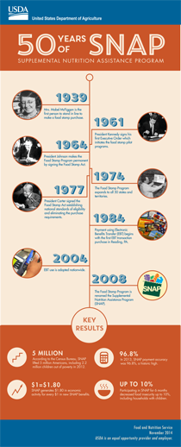
SNAP
Supplementary Nutrition Assistance Program
http://www.dss.virginia.gov/files/division/bp/fs/intro_page/income_limits/snap_hh_size102015.pdf

Slide 11
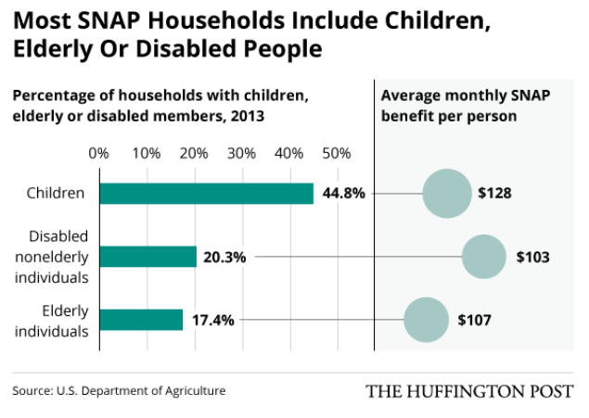
Who receives SNAP?

Slide 12
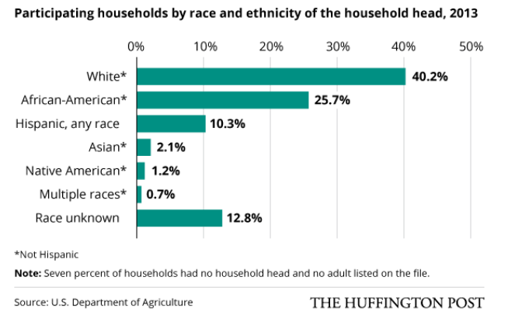
Who receives SNAP?

Slide 13
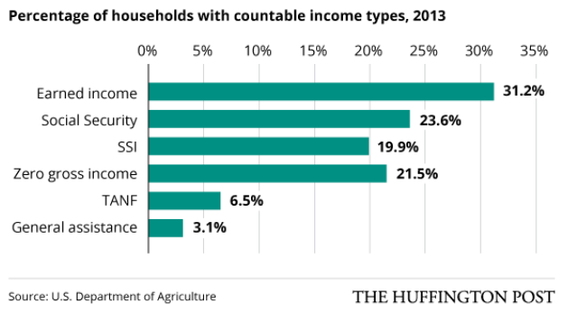
Who receives SNAP?
Notes:
SSI – Supplemental Security Income

Slide 14
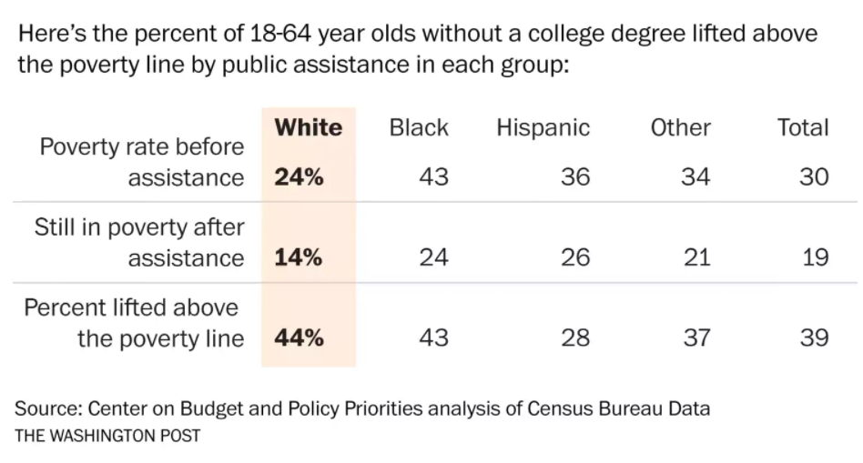
Are means tested programs working?

Slide 15
Are means tested programs working?
Yes – many have been lifted out of poverty
However, issues still exist:
Many people eligible don’t apply
Benefits aren’t enough to push people above poverty line in many areas
Notes:
Almost 40 percent of SNAP and TANF recipients have at least one adult per household working

Slide 16
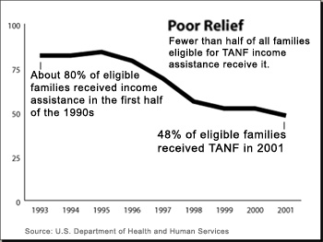

Slide 17
Total # of TANF Recipients by State (2017)
https://www.acf.hhs.gov/sites/default/files/ofa/2017_recipient_tan.pdf (US Department of Health and Human Services)

Slide 18
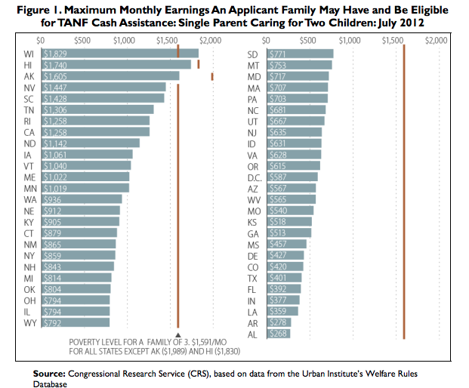

Slide 19
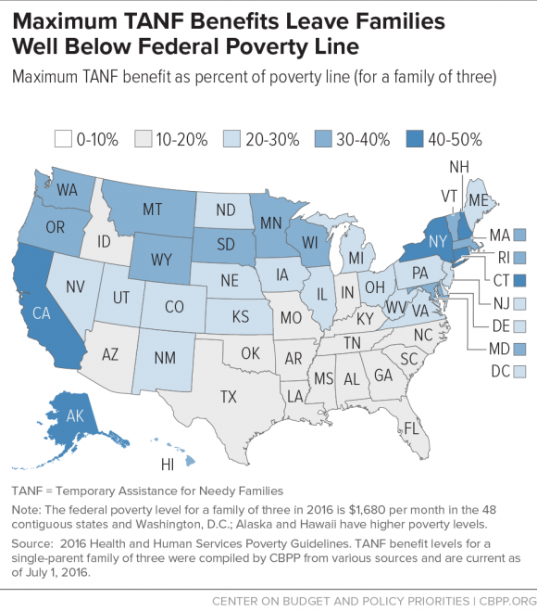
Source: http://www.cbpp.org/research/family-income-support/tanf-cash-benefits-have-fallen-by-more-than-20-percent-in-most-states
Notes:
Average in US – 20% below purchasing power

Slide 20
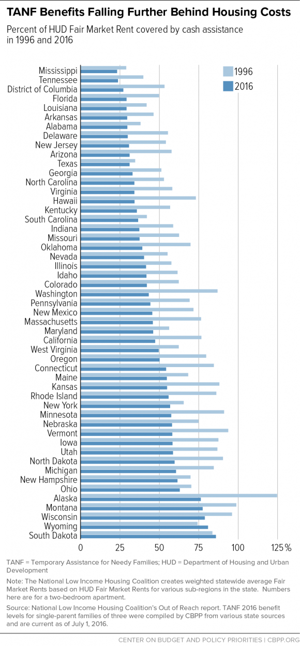
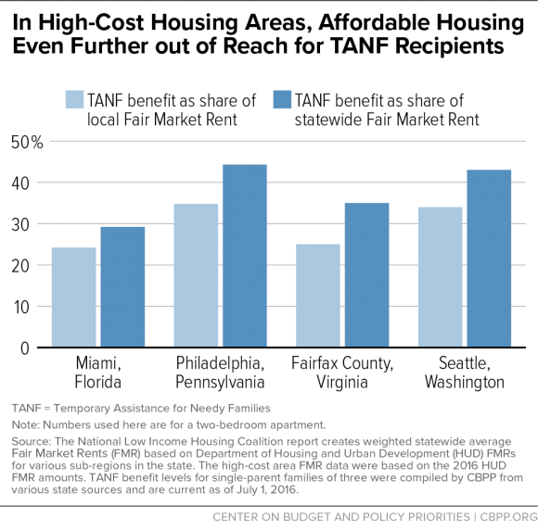

Slide 21
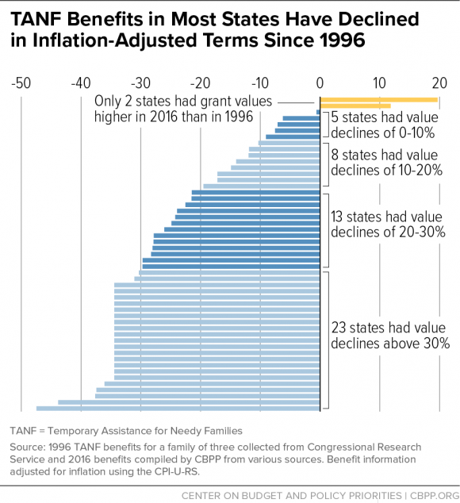
Source: http://www.cbpp.org/research/family-income-support/tanf-cash-benefits-have-fallen-by-more-than-20-percent-in-most-states

Slide 22
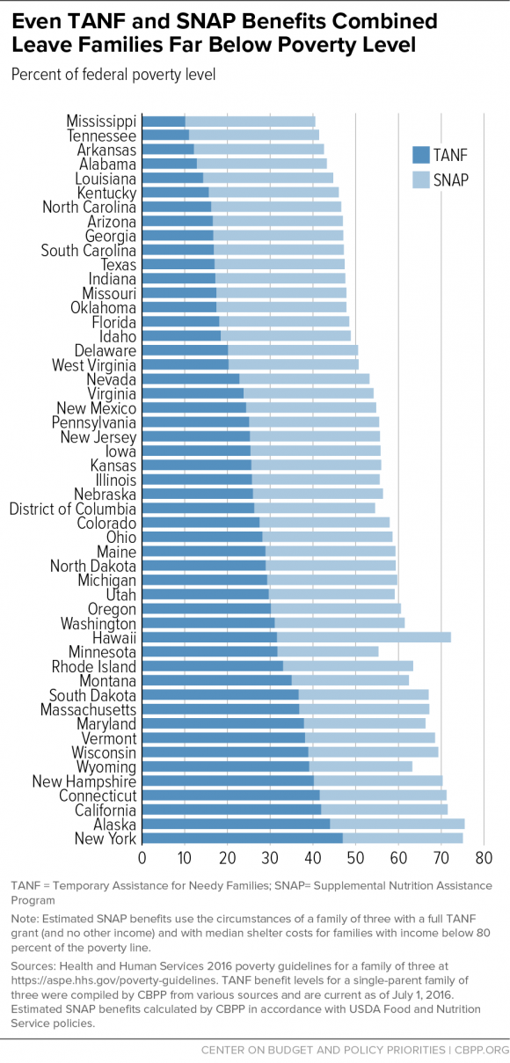

Slide 23
Conclusions
Social Welfare Policy & the Scope of Government
The growth of government has been driven by the growth of social welfare policies, which grows generation by generation.
Democracy and Social Welfare
The U.S. has a small social welfare system compared to most industrialized democracies.
There is considerable unequal political participation
by those that use the programs.
Elderly are well-organized and influential.
The poor are not organized or influential.

Slide 24
