Slide 1
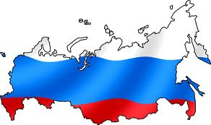
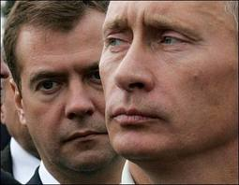
Russia
Part 1: The Making of the Modern State

Slide 2
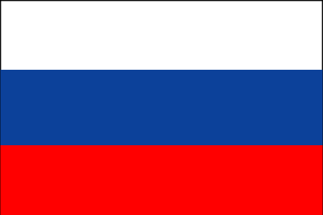
Why do we study Russia?
History of Communism (Soviet Union) & Totalitarianism
Transition to Democracy
Example of Illiberal Democracy
Current trend to authoritarianism - Putin

Slide 3
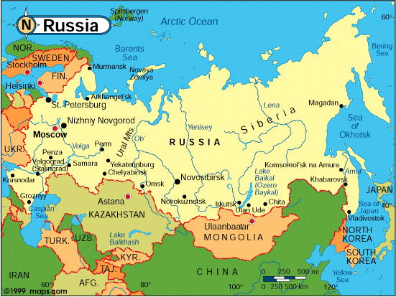
Geography
Officially, the Russian Federation
Largest successor state of the Soviet Union
Largest country in the world (area)
17,098,242 sq mi
Spans 11 time zones
Largest European country in population
140 million
73% live in urban areas
Critical location
Between Europe, Islamic World and Asia

Slide 4
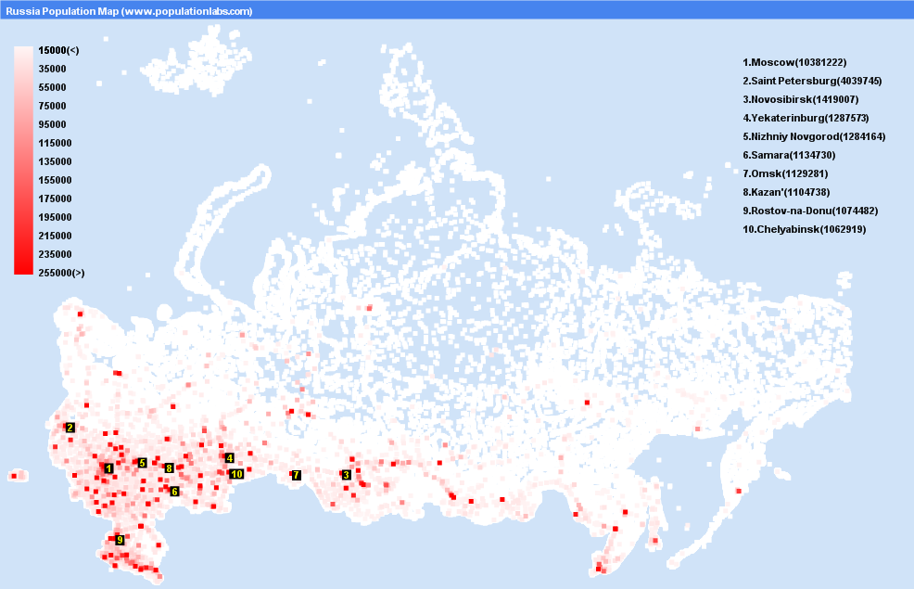
Russian Cities by Population

Slide 5
Russian (Bolshevik) Revolution 1917
Causes
political, economic & social
World War I
Key figures
Nicholas II (1894-1917)
Alexander Kerensky
V.I. Lenin & the Bolsheviks
Lenin’s interpretation of Karl Marx (Marxist-Leninism)

Slide 6
Vanguardism
Group of revolutionary leaders provoked revolution in (non-capitalist) Russia
Grows into a “vanguard party”
Political party that claims to operate in the “true” interests of the group/class that it represents, even if this understanding doesn’t correspond to the expressed interests of the group itself
Notes:
Vanguardism:
Group of revolutionary leaders provoked revolution in (non-capitalist) Russia
Grows into a “vanguard party”
Political party that claims to operate in the “true” interests of the group/class that it represents, even if this understanding doesn’t correspond to the expressed interests of the group itself
Democratic Centralism:
Mandated a hierarchical party structure in which leaders are elected from below, but strict discipline is required in implementing party decisions once they are made

Slide 7
Democratic Centralism
Mandated a hierarchical party structure in which leaders are elected from below, but strict discipline is required in implementing party decisions once they are made

Slide 8
Russia Civil War 1918 - 1921
Reds (communists) v. Whites (anti-communist coalition)
Trotsky and the Red Army
Failure of Lenin’s War Communism
Reds were victorious
Russia physically and economically destroyed by civil war

Slide 9
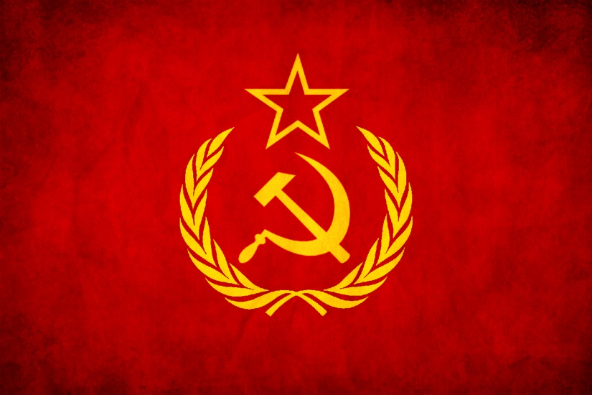
The Bolshevik Revolution
Lenin directed industrialization and agricultural development from a centralized govt
1922 Bolsheviks formed the Union of the Soviet Socialist Republics (USSR)
Cheka emphasized
international isolation
Notes:
1922 Bolsheviks formed the Union of the Soviet Socialist Republics (USSR)
Authoritarian strains eclipsed democratic elements
No competing ideologies
Cheka – security arm of the regime was strengthened and restrictions were placed on other political groups
Also a time of international isolation

Slide 10
Lenin’s NEP
Lenin’s New Economic Policy
plan to rebuild destroyed Russian economy
allowed some elements of free enterprise
capitalism (small businesses)
large industries remained nationalized
Results: successful initially, but NEP was derailed by Lenin’s death (1924)

Slide 11
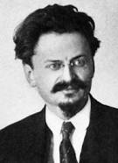
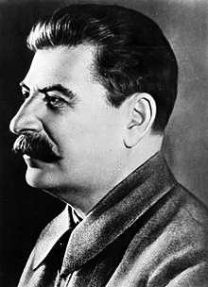
Power Struggle
Trotsky and Stalin battled for control of the Soviet Union
Stalin won; Trotsky went into exile
Economy worsened during the power struggle

Slide 12
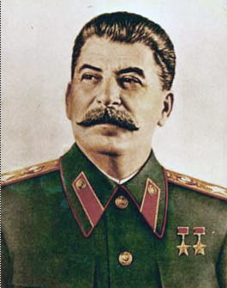
Stalinism (1929-1953)
Placed Communist Party at center of control
Allowed no other political parties to compete
Leaders identified through nomenklatura
Process of party members selecting promising recruits from lower levels
Central Committee (group of 300 party leaders that met twice per year
Politburo (above the central committee, elites of party; lead policy-making org)
General Secretary (head of the Politburo, dictator of country)
Notes:
Nomenklatura – a list of influential posts in government and industry to be filled by Communist Party appointees

Slide 13
Stalinism (1929-1953)
Collectivization
Industrialization
Totalitarianism & Purges
Notes:
Collectivization
Took land from peasants and created state run collective farms
Private land ownership abolished
By 1935, over 90% of agricultural land had been taken from the peasants and made into collective farms
It was rationalized as a means of preventing the emergence of a new capitalist class
Lead to widespread famine and deaths
Industrialization
Favored heavy industries, but neglected consumer goods
State planning committee (Gosplan)
Five Year Plan - Set goals for production of heavy industry (oil, steel, electricity)
Totalitarianism and Purges
Media censorship/state control of arts
Party authoritative source of truth
Estimated 5% of population (millions of citizens) were executed for “treason”

Slide 14
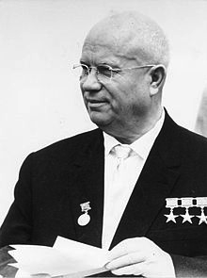
The Khrushchev Years (1958 – 1964)
Attempts at “destalinization”
Cold War - talked of “peaceful coexistance”
Poor relations with Communist China
Forced to resign by the Politburo
Notes:
Attempts at “destalinization”
Rejected terror as political control
Loosened censorship
Restructured collective farms
Reforms didn’t work - end with Brezhnev
Cold War - talked of “peaceful coexistance”
U2 Affair (1960)
Cuban Missile Crisis (1962)

Slide 15
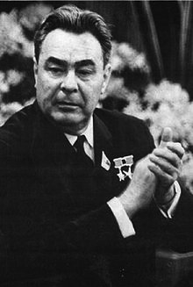
Leonid Brezhnev (1964 – 1982)
Period of stagnation
Declining economy
Brezhnev Doctrine: use force to put down revolts in Eastern Europe
Prague Spring (1968)
Poland (1970s-early 1980s)
Notes:
Brezhnev partially reversed Khrushchev’s reforms. Controls tightened in cultural sphere; Individuals who expressed dissenting views were harassed, arrested, or exiled.
Unlike in Stalinist period, political repression was predictable
Declining economy
grain production fell; it had to be imported
economy and technology fell behind that of the west
huge amount of money spent on the military

Slide 16
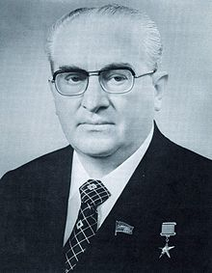
Yuri Andropov (1982 – 1984)
Attempted to revitalize Soviet economy and initiate reforms
Poor health and death slowed reform

Slide 17
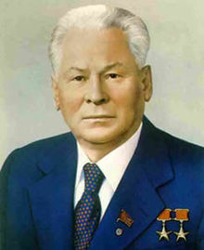
Konstantin Chernenko (1984 – 85)
Return to Brezhnev-like policies:
reformed movement squashed
Died soon after taking office
Notes:
Death – congestive heart failure and emphysema (had been smoking since age 9

Slide 18
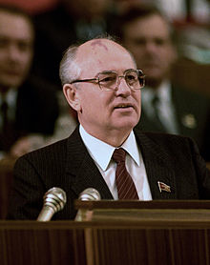
Mikhail S. Gorbachev (1985-1991)
Born and raised on a collective farm in the north Caucasus region
Worked at a machine-tractor factory
Studied law, politics and agriculture
Rose up the ranks of the Communist Party
Became general secretary of the Communist Party upon the death of Chernenko (1985)

Slide 19
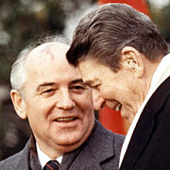
Mikhail S. Gorbachev (1985-1991)
Mikhail Gorbachev – reformer who wanted to adapt communist system to new conditions, not usher in its demise
3 Main Goals:
Glasnost
Democratization
Perestroika
Notes:
Also, “New Thinking” in foreign policy – military buildup was halted
Economic reform: perestroika
“Economic restructuring”
Characteristics and goals
encouraged free market capitalism for small businesses
allowed more local and regional decision making (less Moscow-centered command economy)
attempted to reform failing agricultural sector
hoped to raise the standard of living for Soviet citizens
make Soviet economy more competitive
Results: significant changes to Soviet economy and life
many citizens lost jobs, health insurance, and security at first
Initially weakened the Soviet Union more than it strengthened it

Slide 20
Mikhail S. Gorbachev (1985-1991)
Political reform: glasnost
“openness”
Goal: Soviet government would be more open about what was happening in the country
Characteristics for citizens
could criticize the government
given more freedom of speech and press
greater access to foreign ideas, news, culture and products
Results
increased Soviet criticism of Soviet society and even Gorbachev
hastened the process of Soviet decline

Slide 21
Mikhail S. Gorbachev (1985-1991)
Political reform: democratization (demokratizatsiia)
process of democratic reform
experimenting with some elements of democracy
Goal: make the government more responsive to popular sentiments
competitive elections (allowed non-communists to run)
ended one-party rule (1990)
Results
Growth of nationaiism
increased demands for self-determination in the Soviet Union and Eastern Europe
radicals gained influence, especially those who argued Gorbachev was not changing the Soviet Union enough in terms of capitalism and democracy

Slide 22
Mikhail S. Gorbachev (1985-1991)
Economic reform: perestroika
“Economic restructuring”
Characteristics and goals
encouraged free market capitalism for small businesses
allowed more local and regional decision making (less Moscow-centered command economy)
attempted to reform failing agricultural sector
hoped to raise the standard of living for Soviet citizens
make Soviet economy more competitive
Results: significant changes to Soviet economy and life
many citizens lost jobs, health insurance, and security at first
Initially weakened the Soviet Union more than it strengthened it

Slide 23
Mikhail S. Gorbachev (1985-1991)
Chernobyl Disaster 1986: World’s Largest Nuclear Reactor Accident
Causes
human error (emergency water cooling system turned off)
reactor (#4) had no containment structure
Effects
31 immediately killed and 500 hospitalized
radiation spread in western Soviet Union and Europe
thousands live with illnesses related to radiation
Cancer
immune deficiency (known as “Chernobyl AIDS”)
Greenpeace estimates that in the 20 years since the disaster 93 million people have died resulting from Chernobyl-related cancer
Political results: encouraged Gorbachev to expand glasnost

Slide 24
Mikhail S. Gorbachev (1985-1991)
Foreign Policy: “New Thinking”
rethinking of international relations in nonmilitary terms
emphasized cooperation, not competition with the West
Eased Cold War tensions with the United States
dialogues with US President Reagan and British Prime Minister Thatcher
nuclear disarmament treaties (ex. Moscow Treaty 1988)
Soviet Union pulled out of unpopular Afghan War (1979-89)
Allowed Eastern European states to overthrow communist governments and declare independence from Soviet sphere

Slide 25
Mikhail S. Gorbachev (1985-1991)
Collapse of the Soviet Union and Fall of Gorbachev
Failure of perestroika
Soviet Constitutional Reform (late 1980s-1991)
formation of the Congress of People’s Deputies (legislative body)
loss of one-party rule
Growth of nationalism and self-determination
Failed 1991 coup d’ état: attempt by hard-line communist to oust Gorbachev and return Soviet authority to former days
The final days of the Soviet Union
Baltic states, Russia, Belarus and Ukraine declared independence
Gorbachev resigned and Soviet Union dissolved itself (12/1991)

Slide 26
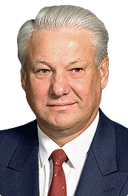
Boris Yeltsin (1991 – 1999)
Elected president of Russian Republic, 1991 (first popularly elected official in Russian history)
Yeltsin’s goals
make Russia democratic
make Russia capitalistic
Given Russia’s history, challenges were extraordinary and difficult to meet

Slide 27
Boris Yeltsin (1991 – 1999)
The 1993 Rebellion
Power struggle: Conflict between Yeltsin and the Russian parliament. Yeltsin was given extraordinary powers, which parliament wanted to reduce.
Examples: Yeltsin could issue decrees which had the power of law, could appoint heads of regional governments, and declared himself to be prime minister
Economic reform: Yeltsin wanted to initiate radical economic conversion to capitalism: “shock therapy”; opponents wanted to bring about more gradual change.

Slide 28
Boris Yeltsin (1991 – 1999)
The 1993 Rebellion: The Event
Immediate causes
Parliament attempted to impeach Yeltsin
Yeltsin dissolved parliament
The Revolt
many key Parliamentary leaders barricaded themselves into the parliament building (the “White House”), attacked a nearby radio station, and declared their own president (Alexander Rutskoi)
legislators exchanged gunfire with Moscow police
Yeltsin’s response
cut off electricity and water supply
military supported Yeltsin, stormed the parliament and forced the
legislators to surrender; 100 killed
proposed a new constitution

Slide 29
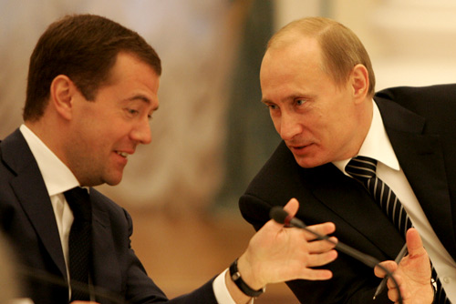
Vladimir Putin
PM: 1999 – 2000
President: 2000 – 2008
PM: 2008 – 2012
President: 2012 – Present
Putin (right) and PM Medvedev (left)

