Slide 1
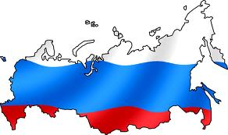
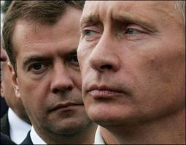
Russia
Part 2: Institutions

Slide 2
Political Structure
1993 Democratic Constitution…granted democracy but with a very strong executive
Currently considered a hybrid regime:
“Soft authoritarianism” – A combination of formal and informal mechanisms ensure the dominance of a ruling group or dominant party, despite the existence of some forms of political competition & expressions of political opposition
Semi-authoritarian - a political system in which elements of democracy are integrated into an otherwise author
Notes:
Soft authoritarianism: A system of political control in which a combination of formal and informal mechanisms ensure the dominance of a ruling group or dominant party, despite the existence of some forms of political competition & expressions of political opposition
Semi-authoritarian: a political system in which elements of democracy are integrated into an otherwise authoritarian system
Federal System:
89 regions (subnational units)
21 are ethnically non-Russian by majority (republics)
Republics differ from other federal subjects in that they have the right to establish their own official language^{[1]} and have their own constitution. Other federal subjects, such as krais (territories) and oblasts (provinces), aren't explicitly given this right. The chief executives of many republics used to have the title of president, but in 2010 an amendment to the federal law was adopted that reserves such title exclusively for the head of the Russian state
Central govt was weak under Yelstin, so many ruled themselves almost independently
Movements for independence always a threat – Chechnya

Slide 3
Political Structure
Federal System: (specifically Asymmetric Federalism)
89 regions (subnational units)
21 are ethnically non-Russian by majority (republics)
Republics differ from other federal subjects
own official language
own constitution
Other federal subjects, such as krais (territories) and oblasts (provinces), aren't explicitly given this right (ex. 2010 – illegal to call head of region a “president”)
central govt was weak under Yelstin, so many ruled themselves almost independently
Movements for independence always a threat – Chechnya

Slide 4
Conflict in Chechnya (1994 – Present)
Background on Chechnya
region in southwestern Russia
growth of Chechen nationalism: different language, religion, and culture than Russia
Chechnya demanded greater autonomy from Russian state
Yeltsin’s desire to keep Chechnya as an integral part of Russia
First Chechen War (1994-96)
bloody warfare, much of it in the Chechen capital Grozny
failure of Russia to win demonstrated the ineptness of the Russian military
Yeltsin lost popularity at home
war ended in a truce, but resumed later

Slide 5
Political Structure
Putin’s Crack-Down on Regional Autonomy
Military crushed Chechen resistance
Power Vertical (Putin used to describe unified and hierarchal structure of executive power ranging from nat’l to local level) & Creation of Super-Districts
7 new federal districts (2000; encompassed all of Russia)
Headed by presidential appointee (ensures compliance)
Notes:
Putin Reforms:
Power Vertical: Putin term to describe a unified and hierarchical structure of executive power ranging from the nat’l to local level
Super-Districts - In 2000, 7 new federal districts were created to encompass all of Russia. Each district was headed by a presidential appointee, who supervised the local authorities as Putin see fit
Purpose is to ensure compliance with federal laws & constitution
Appointment of governors – ended direct election of 89 regional governors. Now nominated by president, confirmed by regional legislatures
Removal of governors – Pres. may remove a governor who refuses to subject local law to nat’l constitution
Changes in Federation Council – governors now appoint one and regional legislature the other
Elimination of SMD in Duma – all proportional and threshold raised from 5 to 7%

Slide 6
Political Structure
Putin’s Crack-Down on Regional Autonomy
Appointment of governors of 7 super districts – ended direct election of 89 regional governors. Now nominated by president, confirmed by regional legislatures
Removal of old governors – Pres. may remove a governor who refuses to subject local law to nat’l constitution
Changes in Federation Council – governors now appoint one and regional legislature the other
Elimination of SMD in Duma – all proportional and threshold raised from 5 to 7%

Slide 7
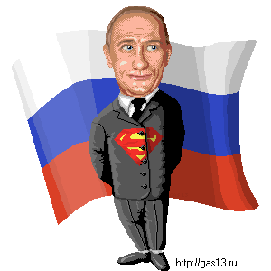
Semi-Presidential
Hybrid that borrows from pres/parliamentary systems
Strong President
Head of State – President
Vladimir Putin
Directly elected – 2 round model
Six year term*
Limit of two consecutive terms
Notes:
*Six year term started in 2012 (before that 4 year term)
2 round system, must receive 50+% of vote, if not, top two candidates face off in 2nd round
Decrees:
The President has broad authority to issue decrees and directives that have the force of law without legislative review, although the constitution notes that they must not contravene that document or other laws
Dissolving the Duma:
The President may dissolve the State Duma if it either expresses no confidence in the Government of Russia or rejects his proposed candidate for the Russian Prime Minister three times. The power to dissolve the State Duma was not exercised under the current Constitution of 1993. Before the new constitution was enacted, President Boris Yeltsin had dissolved the Congress of People’s Deputies and Supreme Soviet of Russia during the Russian constitutional crisis of 1993, although he did not have the formal constitutional powers to do so.

Slide 8
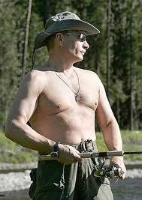
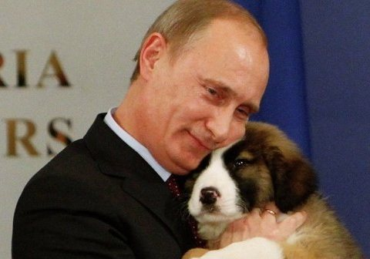
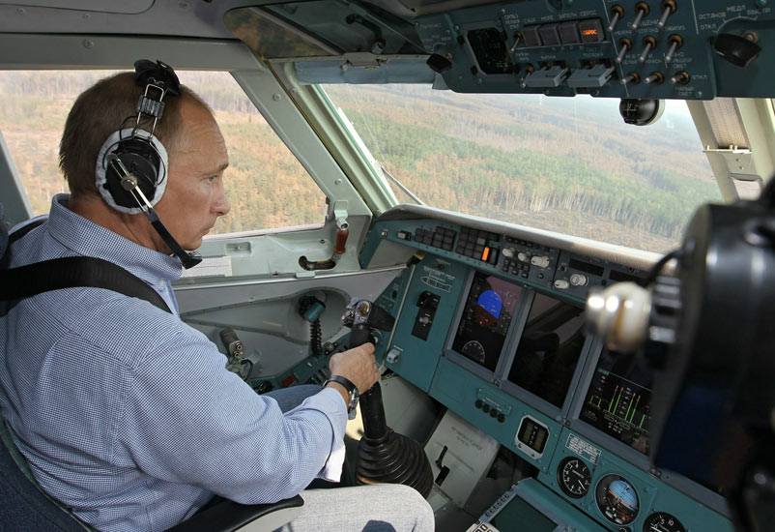
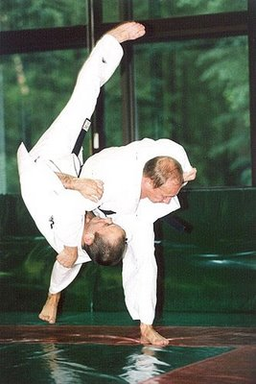
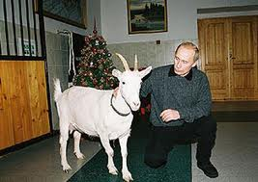
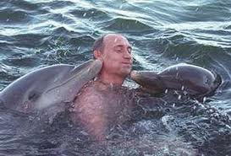
Notes:
Will be 61 years old in Sept 2013

Slide 9
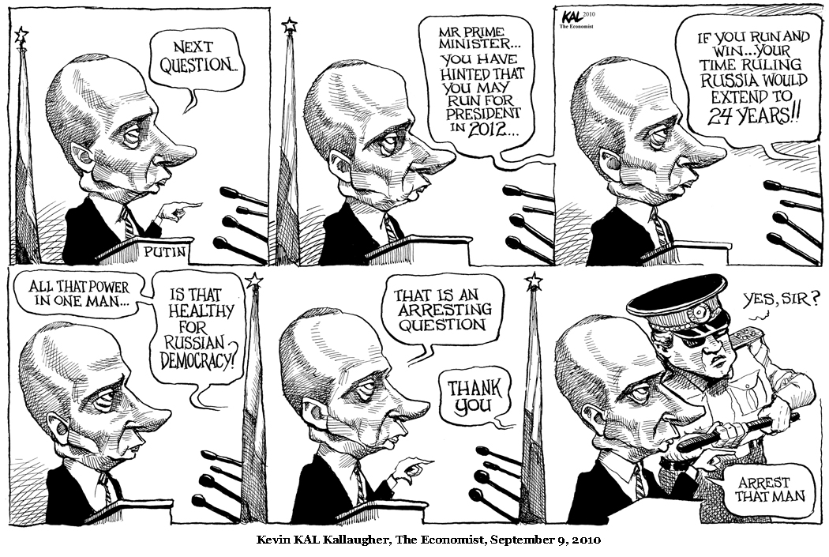

Slide 10
Semi-Presidential System
Six year term started in 2012 (before that 4 year term)
2 round system, must receive 50+% of vote, if not, top two candidates face off in 2nd round

Slide 11
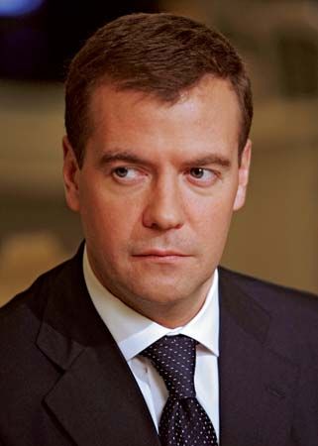
Semi-Presidential System
Powers of the President
Appoint PM, Cabinet & Governors
Issue decrees that have force of law
Dissolve the Duma
Call state of emergency/impose martial law
Call referendums
Suspend actions of other state organs
Head of Gov’t – The Prime Minister
Dmitri Medvedev
Can be removed with 2 repeat votes of no confidence within 3 mths
Notes:
*Six year term started in 2012 (before that 4 year term)
2 round system, must receive 50+% of vote, if not, top two candidates face off in 2nd round
Decrees:
The President has broad authority to issue decrees and directives that have the force of law without legislative review, although the constitution notes that they must not contravene that document or other laws
Dissolving the Duma:
The President may dissolve the State Duma if it either expresses no confidence in the Government of Russia or rejects his proposed candidate for the Russian Prime Minister three times.
The power to dissolve the State Duma has not been not exercised under the current Constitution of 1993.
Before the new constitution was enacted, President Boris Yeltsin had dissolved the Congress of People’s Deputies and Supreme Soviet of Russia during the Russian constitutional crisis of 1993, although he did not have the formal constitutional powers to do so.
Impeachment:
Involves two houses of legislative body, the Supreme Court, and the Constitutional Court
If pres dies or becomes incapacitated, PM fills the post until new pres elections can be held

Slide 12
Semi-Presidential System
Impeachment:
Involves two houses of legislative body, the Supreme Court, and the Constitutional Court
If pres dies or becomes incapacitated, PM fills the post until new pres elections can be held

Slide 13
A Bicameral Legislature
Weak check on executive power
Duma – Lower House
450 Deputies (only about 13% women)
Selected by Proportional Representation (changed in 2007 – half SMD, half PR before)
5 year terms (changed in 2011 – from 4 yr; also, now MPs are granted immunity from criminal prosecution)
Powers
Passes bills
Approves budget
Confirms president’s appointments
Powers are limited
Pres may rule by decree
Duma’s attempts to reject prime ministers have failed

Slide 14
A Bicameral Legislature
Federation Council – Upper House
Represents regions
2 members from each of 89 federal subunits
1 chosen by governor of each region, other by regional legislature (changed under Putin; originally made of elected governors)
Powers
Mostly delay bills (Duma overrides with 2/3 vote)
Approve presidential appointees and presidential decrees relating to martial law and states emergencies
May change boundaries among republics, ratify use of armed forces outside country, and appoint & remove judges

Slide 15
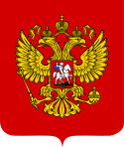
The Judiciary & Rule of Law
Constitutional Court
19 members, appointed by President, approved by Federation Council
Judicial review
Resolves conflicts regarding constitutionality of federal/regional laws & jurisdictional disputes between institutions
Pres, 1/5 of either house, citizens may request court to look at case
Court tries not to confront Presidency
Supreme Court
Final court of appeals in criminal/civil cases
Does NOT have power of judicial review

Slide 16
The Judiciary & Rule of Law
No independent judiciary existed under the old Soviet Union – courts/judges served as pawns of the Communist party
Current status of independence from executive is questionable
One problem – most prosecutors and attorneys were trained under Soviet legal system, so judiciary suffers from lack of expertise carrying out responsibilities in the Constitution

Slide 17
The Judiciary & Rule of Law
Rule of Law
Putin initiated law reform – jury trials
Procedural codes for criminal and civil rights
BUT…
Movement toward rule of law continues to be blocked by corruption
Security police continue to operate autonomously
Trials of oligarchs indicate courts still under political control of Putin
Corruption Survey Results
At least ½ of population involved in corruption daily
Bribes for auto permits, school enrollment, proper health care and favorable court rulings

