Slide 1
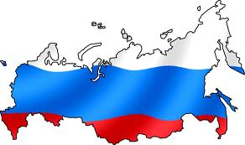
Russia
Parts 3 & 4: Citizens, Society, and the State
Public Policy

Slide 2
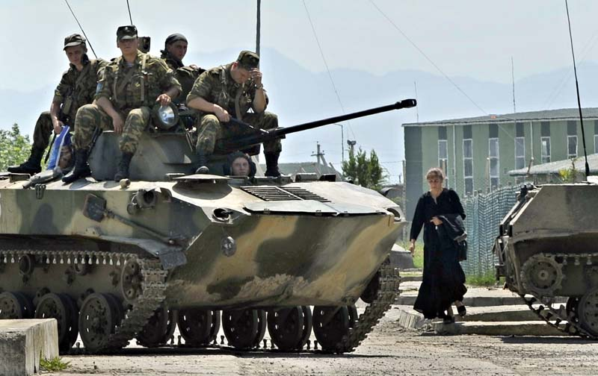
The Military
Source of Soviet strength during Cold War
Under Russian Federation weak and not a force
Showing some signs of strengthening (Georgia)
Notes:
2008: Russia’s lightning war against Georgia looks like a military triumph: An armada of Russian tanks easily crushed Georgia’s modest army in a show of muscle intended to punish its U.S.-allied neighbor, scare others and reaffirm Moscow’s influence on its former Soviet turf.
But the conflict also revealed crucial weaknesses in Moscow’s military preparedness — including faulty intelligence, a shortage of modern equipment and poor coordination

Slide 3
The Military
2008: Russia’s lightning war against Georgia
An armada of Russian tanks easily crushed Georgia’s modest army in a show of muscle
reaffirmed Moscow’s influence on its former Soviet turf
Also revealed crucial weaknesses in Moscow’s military preparedness — including faulty intelligence, a shortage of modern equipment and poor coordination

Slide 4
Linkage Institutions – Overview
Linkage Institutions – still not strong in Russia
Political Parties
Historically unstable
Put together quickly after Revolution of 1991
Most formed around particular leader(s)
1995 – 43 parties on the ballot, by 1999 only 26
Hard to develop loyalties
2007 electoral changes to all PR and threshold from 5 to 7%
Smaller parties with regional support lost representation
2007: only 4 parties gained seats
No strong opposing political parties to dominating party
State Corporatism
State determines which groups have input into policymaking
Weak civil society means interest groups have no solid footing

Slide 5
Linkage Institutions – Political Parties
Dominant Party System
A party system in which one large party directs the political system, but small parties exist and may compete in elections
What does this mean?
Multiple parties and free and (more or less) fair elections exist but one party wins every election and governs continuously
Notes:
Dominant Party System
Multiple parties and free and (more or less) fair elections exist but one party wins every election and governs continuously
Parties have to include regional representatives on list
Parties must have affiliates in more than half of regions, with a certain # of registered members in these regions
Choice of deputies on list must reflect strength of vote in region
Legally registered party
United Russia
Putin chair (not a member until recently)
Merger of several parties
Centrist, conservative, pragmatic,
Opposed to radicalism
State direction of economy
Catchall/Umbrella party
Market reforms are right-wing (pro-market and libertarian) and liberal (challenge status quo)
Conservative parties are leftist since they support strong state role in economy and society
Centrists: some reforms but preserving welfare state and gov’t intervention

Slide 6
Linkage Institutions – Political Parties
Parties have to include regional representatives on list
Parties must have affiliates in more than half of regions, with a certain # of registered members in these regions
Choice of deputies on list must reflect strength of vote in region
Legally registered party
Political Party | Seats (2011 Duma Elections)
United Russia | 238
Communist party of the RF | 92
Liberal Democratic Party | 56
A Just Russia | 64

Slide 7
Russian Ideology
Market reforms are right-wing (pro-market and libertarian) and liberal (challenge status quo)
Conservative parties are leftist since they support strong state role in economy and society
Centrists: some reforms but preserving welfare state and gov’t intervention

Slide 8
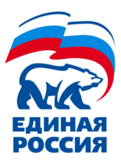
Linkage Institutions – Political Parties
United Russia
Founded in April 2001 as merger of Fatherland All-Russia Party & Unity Party of Russia
Hard to define ideology – Pro Putin
Putin chair (not a member until recently)
Centrist, conservative, pragmatic, opposed to radicalism
State direction of economy
Catchall/Umbrella party

Slide 9
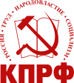
Linkage Institutions – Political Parties
The Communist Party of the Russian Federation (CPRF)
Formed from Communist party of Soviet Union
Strongest opposition party to United Russia
Less reformist than other parties
Emphasizes centralized planning and nationalism
Implies intention to regain territories lost when USSR broke apart
Supported by older Russians, economically disadvantaged and rural residents
Notes:
Dominant Party System
Multiple parties and free and (more or less) fair elections exist but one party wins every election and governs continuously
United Russia
Putin chair (not a member until recently)
Merger of several parties
Centrist, conservative, pragmatic,
Opposed to radicalism
State direction of economy
Catchall/Umbrella party
Market reforms are right-wing (pro-market and libertarian) and liberal (challenge status quo)
Conservative parties are leftist since they support strong state role in economy and society
Centrists: some reforms but preserving welfare state and gov’t intervention

Slide 10
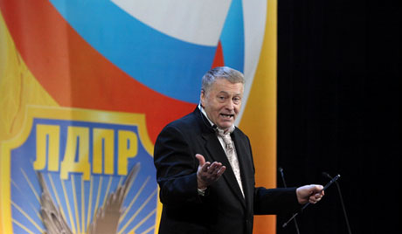
Linkage Institutions – Political Parties
Liberal Democratic Party
Misnomer!
Vladimir Zhirinovsky – extreme nationalist
Anti-Western
Nuclear threats against Japan, anti-Semitic, sexist
Strongest support from working-class men and military
Notes:
Strong support among working-class men
and military

Slide 11
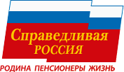
Linkage Institutions – Political Parties
A Just Russia
Formed in 2006 – merger (Motherland People’s Patriotic Union/Party of Pensioners/Party of Life)
Led by Speaker of Federation Council Sergei Mironov
Left of United Russia
Opposition in name only
Supported Presidents Putin and Medvedev
“We are the party of the working man”

Slide 12
Linkage Institutions? Oligarchs & Mafia
Oligarchs
Wealthy elite that monopolized industries after privatization
At one point controlled over ½ of Russian GNP
Oil industry, media
Backed Yeltsin, but Putin now resisting their control
Mafia
Controls underworld crime
Gained power after Revolution of 1991
Notes:
Oligarchs
Loose version

Slide 13
Linkage Institutions - Media
Some state-owned (Russia TV and Channel One)
Some privately owned, but controlled by state (NTV is owned by state-controlled Gazprom)
Govt intervenes in some manner if government is criticized
52 journalists have been murdered since 1992, making Russia the 3rd most dangerous country for journalists in the world
Ranks 140th out of 178 in terms of press freedom

Slide 14
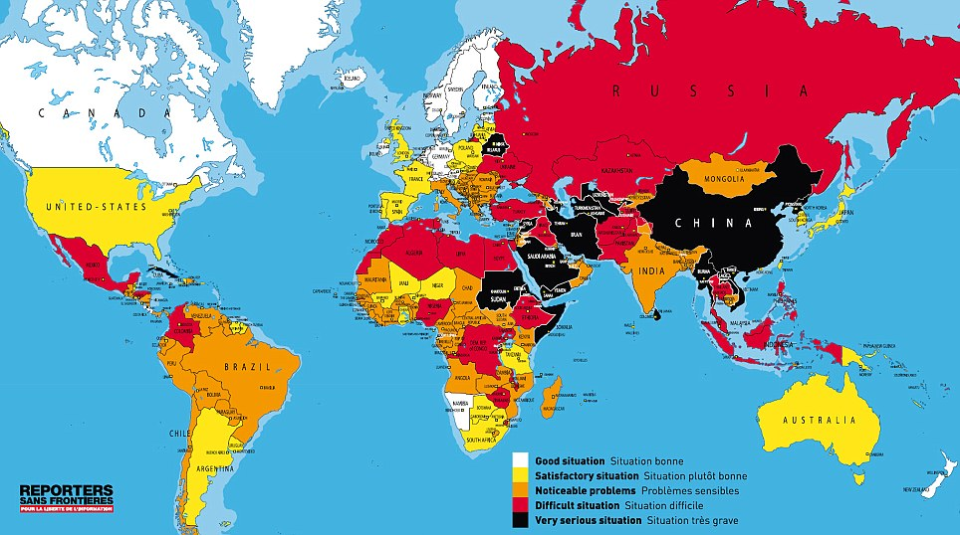

Slide 15
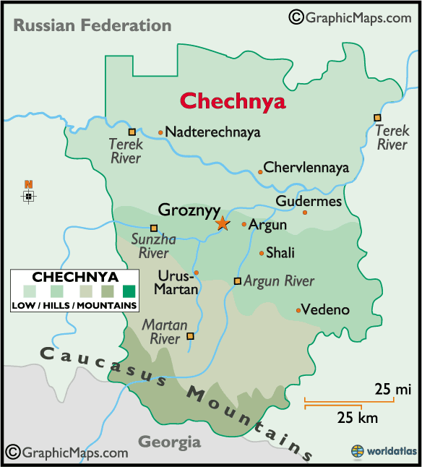
Social Cleavages -Nationality
Biggest Cleavage is Nationality
80% are Russian
Tatar = 3.8% (Muslim)
Ukrainian = 2%
Bashkir = 1.2%
Chuvash = 1.1%
Other = 12.1%
Because of structure of federation, ethnicity tends to be coinciding with region and often religion too
Russkii vs Rossiiskii
Chechnya - primary Muslim region has fought for independence (unique; most ethnicities have economic incentive to stay)
Notes:
In the USSR, just over 50% of pop was ethnically Russian
Now most of the major ethnic minorities reside in other Soviet successor states
Russkii – Russian word for Russian ethnicity
Rossiiskii – refers to people of various ethnic backgrounds that make up Russian citizenry
Chechnya
Most ethnic minorities would like to have independence, but most have trade benefits that induce them to stay
Chechnya is a notable exception
Chechens have been involved in terrorist acts
The govt knows that if Chechnya is successful, other independence movements will break out in the country
In effort to gain legitimacy for Russian govt in Chechnya, a referendum was held to vote on a new constitution for the region
Was approved by Chechen voters, even though it declared their region was an “inseparable part” of Russia

Slide 16
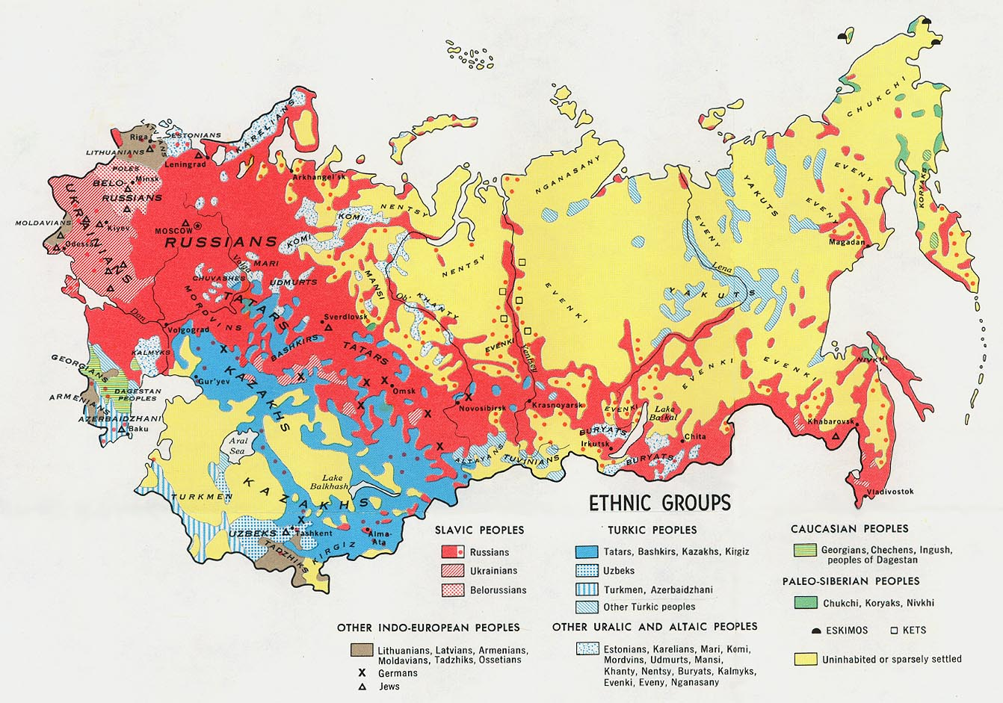
Social Cleavages -Nationality
Notes:
In the USSR, just over 50% of pop was ethnically Russian
Now most of the major ethnic minorities reside in other Soviet successor states
Russkii – Russian word for Russian ethnicity
Rossiiskii – refers to people of various ethnic backgrounds that make up Russian citizenry
Chechnya
Most ethnic minorities would like to have independence, but most have trade benefits that induce them to stay
Chechnya is a notable exception
Chechens have been involved in terrorist acts
The govt knows that if Chechnya is successful, other independence movements will break out in the country
In effort to gain legitimacy for Russian govt in Chechnya, a referendum was held to vote on a new constitution for the region
Was approved by Chechen voters, even though it declared their region was an “inseparable part” of Russia

Slide 17
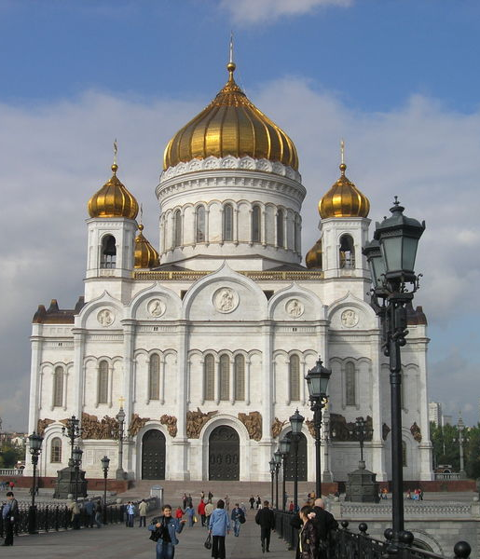
Social Cleavages - Religion
Most ethnic Russians identify themselves as Russian Orthodox, but are largely nonreligious
Other religions are represented in small percentages
Muslims, Roman Catholic, Protestant, Jewish
Recent rapid rise in Muslim share of population (10-15%)
Moscow (laborers)
The Caucasus (area between Black & Caspian Seas)
Includes Chechens
Very unstable region
Bashkortostan and Tatarstan
Notes:
Religion History:
Tsarist Russia was overwhelmingly Russian Orthodox, tsar was spiritual head of church
Soviet Union – prohibited religious practices of all kinds – most people lost religious affiliations during 20th century
2007 – Russian Church Abroad (split after Bolshevik revolution b/c a “godless regime” was in power) reunited with Russian Orthodox Church after Putin met with church officials – reassured them he was a “believing” president
Moscow retained ultimate authority in appointments – critics say church is too much under gov’t control
Growing Muslim Population
Russia has more Muslims than any other European state besides Turkey
The Muslim share of the country’s population is expected to increase from 11.7% in 2010 to 14.4% in 2030
Russia’s non-Muslim population is expected to shrink by an average of 0.6% annually over the same 20-year period
Muslim women generally have more children than other women in Russia (marry more, divorce less, have fewer abortions)
Muslim population has greater percentage in younger ages
Some anti-Semitic and anti-Muslim feelings with rise of an exclusionary form of nationalism

Slide 18
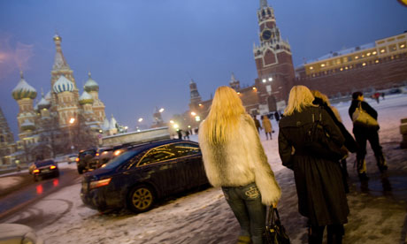
Social Cleavages – Other
Social Class
Tzarist Russia – nobility vs. peasantry
In USSR – Communist party members (elite) vs. non-members
Modern times – small class of really rich (started with Oligarchs) vs working class (middle class small by Western standards)
Rural/Urban
73% now live in cities, mostly in west
More likely to be well educated and more in touch with western values
Notes:
Social Class History:
Tsarist Russia nobility vs peasantry
Soviet Union abolished social class BUT created new division between communist party members/non-members
Only 7% were party members, but all political leaders were recruited from this group (nomenklatura)
However egalitarian views were promoted and economic/social background not important
Soviet times created large lower class, not much better off than Americans living in poverty
Late Soviet/Early Post-Soviet: severe inflation erased workers’ and pensioners’ life savings
New Russians: new upper class: previously held important state or party positions or ties to organized crime, and a few were entrepreneurs
Late 1990s and early 2000s: small middle class emerged in larger cities; older and rural remained poor, but general prosperity trickled down (partly through government programs)

Slide 19
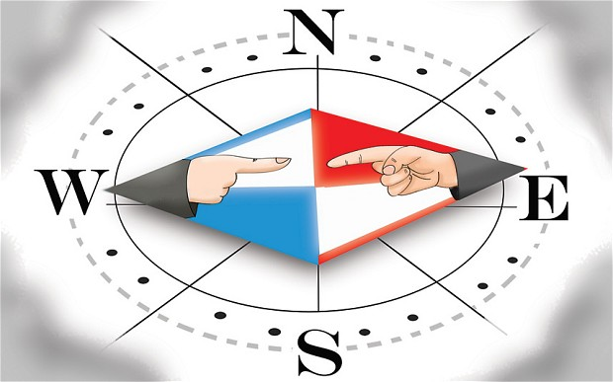
Political Culture
Deference to authority
Tradition of personalistic authority
Highly centralized leadership
Mistrust of Government
Most of population historically alienated from political system
Subjects rather than participants
Statism and Collectivist tendencies
Expect the state to take an active role in their lives
Collectivism/egalitarianism – distrust those who get ahead
Desire for order/stability
Even at expense of personal freedom
Notes:
Collectivist Distrust those who get ahead…Who Wants to Be a Millionaire – audiences give the wrong answer so contestants won’t win

Slide 20
Political Culture
Discussion Question: In Russia, when a contestant on the show “Who Wants to be a Millionaire” asks the audience for help, the audience usually gives the incorrect answer. Based on your understanding of Russian political culture/cultural values, WHY do you think they give the wrong answer?

Slide 21
Political Culture
Discussion Question: In Russia, when a contestant on the show “Who Wants to be a Millionaire” asks the audience for help, the audience usually gives the incorrect answer. Based on your understanding of Russian political culture/cultural values, WHY do you think they give the wrong answer?
Because of Collectivist value, they distrust anyone who gets ahead, especially those who try to “get rich on the backs of the audience members”
Notes:
http://www.go2cio.com/articles/index.php?id=3603
Now in Russia, the oligarchs"-a select group of entrepreneurs who found a way to make quick money after the Soviet collapse-"all achieved their wealth by means which were of dubious regard at best. That's the first thing that Russians resent. And secondly I think they resent the very fact that these people have become so much richer than everyone else."
From this perspective, it is clear that the Who wants to Be a Millionaire audiences in Russia see contestants as trying to get rich on the backs of the audience members-and why should they contribute to such unfair behavior?

Slide 22
Political Culture
Slavophile vs. Westerner
Slavophile:
Nationalism
Defense of Russian interests/Slavic culture
Strong military
Reject western values
Against integration
Westerner:
Reformers
Want integration
Open to western values
Putin’s supporters tend to be ________________.
Notes:
Slavophile vs. Westerner
Slavophile: nationalism, defense of Russian interests/Slavic culture, strong military, reject western values and integration
Westerner: reformers, want integration

Slide 23
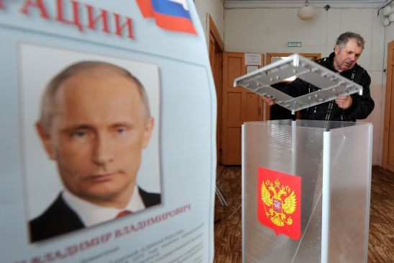
Political Participation
Voting:
Voting 100% under USSR (compulsory)
Presidential Elections: 2008 around 70%, 2012 65%*
*2012 Presidential Election – plagued by reports of fraud/corruption
Putin won 99.82 percent of the vote in Chechnya
Precinct 451 in the capital Grozny, where Putin got 1,482 votes and (former Communist leader Gennady) Zyuganov got one. Only 1,389 people were registered to vote in the precinct. (equivalent to107% turnout)
Notes:
2012 Presidential Election – plagued by reports of fraud/corruption
Putin won 99.82 percent of the vote in Chechnya
Precinct 451 in the capital Grozny, where Putin got 1,482 votes and (former Communist leader Gennady) Zyuganov got one. Only 1,389 people were registered to vote in the precinct. That means the turnout was 107 percent
New Protest Law:
The law allows individuals to picket, only if there is at least a 50-meter distance between each person picketing. All mass actions are forbidden where they would interfere with residents' access to transport, social infrastructure, everyday goods, pedestrian or motor traffic.
The list of specific places where mass action is forbidden is so exhaustive that it is hard to imagine an area that such a rally could occur. Any action with more than 100 participants has to be authorized, and is not allowed to have more than one person per every two square meters. The law says that any protest planned to take place near a government building would have to abide by separate rules
The Other Russia
Unites a wide range of opposition figures from both the left and right
July 31, 2009 leaders initiated series of monthly protests, each held on 31st of months with 31 days, to affirm right to free assembly provided for in Article 31 of constitution
Dec 31, 2010, dozens of protesters arrested

Slide 24
Political Participation
Civil Society
Slowly started to emerge since 1991
Under Putin many obstacles: Registration, reporting requirements, gov’t supervision
2007 restricting of use of public demonstrations and protests:
The law allows individuals to picket, only if there is at least a 50-meter distance between each person picketing.
All mass actions are forbidden where they would interfere with residents' access to transport, social infrastructure, everyday goods, pedestrian or motor traffic.
The list of specific places where mass action is forbidden is so exhaustive that it is hard to imagine an area that such a rally could occur.
Any action with more than 100 participants has to be authorized, and is not allowed to have more than one person per every two square meters.
The law says that any protest planned to take place near a government building would have to abide by separate rules

Slide 25
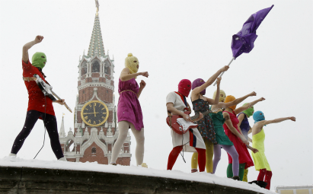
The Other Russia
Opposition movement
Unites a wide range of opposition figures from both the left and right
July 31, 2009 leaders initiated series of monthly protests, each held on 31st of months with 31 days, to affirm right to free assembly provided for in Article 31 of constitution
Dec 31, 2010, dozens of protesters arrested
Consider Putin a dictator
http://www.theotherrussia.org

Slide 26
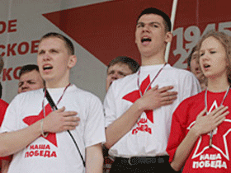
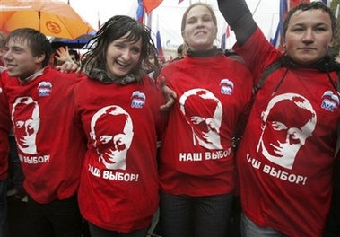
Political Participation
Russian Youth Groups
Created by Putin
Nashi (largest), Youth Guard and Locals
Part of an effort to build a following of loyal, patriotic, young people (diffuse youthful resistance)
Organize mass marches and demonstrations
Notes:
Nashi
Marches/demonstrations (ex: against corruption of gov’t opponents, not gov’t officials)
Critics say Nashi is a modern version of Komsomol, youth wing of the Communist Party of Soviet Union
Nashi receives grants from the gov’t and large state-run businesses, so critics of the group see it as an arm of an increasingly authoritarian state

Slide 27
Nashi
“Youth Democratic Anti-Fascist Movement "Ours!"'
Marches/demonstrations (ex: against corruption of gov’t opponents, not gov’t officials)
Critics say Nashi is a modern version of Komsomol, youth wing of the Communist Party of Soviet Union
Nashi receives grants from the gov’t and large state-run businesses, so critics of the group see it as an arm of an increasingly authoritarian state

Slide 28
Russia: Public Policy

Slide 29
The Economy
Consistent issue: how much of the centralized planning economy should be eliminated and how should the market economy be handled?
Yeltsin’s “shock therapy” created chaos – resulted in small group of entrepreneurs running economy
1997: economic devastation
gov’t defaulted on billions in debt
Stock market lost half its value
2002: 30,000 rubles = 1 dollar
Mafia and oligarchs still prospered

Slide 30
The Economy
1997 – 2007: period of growth
New privatized industries
Standard of living rose
Govt still struggled to run industry effectively
Ex. Summer 2007 – no hot water for weeks (rich & poor); govt shut down for maintenance to pipes
2008: suffered from global economic crisis
Stock market dropped 70%
$20 billion govt stimulus to financial sector & citizens didn’t work

Slide 31
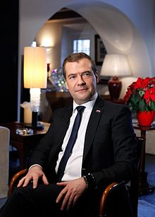
The Economy
Today
Fueled by huge oil and gas reserves (private and state run)
Govt owns Gazprom (gas industry giant)
Recentralization vs decentralization?
Medvedev pushes to
decentralized more industry
seek new industry not in energy (volatile)
Reform tax system to ease tax burden

Slide 32
Foreign Policy
Consistent focus:
What is relationship with the West? (US & EU)
What is role among Confederation of Independent States (CIS) – former Soviet States?

Slide 33
Foreign Policy - CIS
Russia is clear leader, but always under strict scrutiny by others
Trade agreements bind them
Nationalities divide them
Experts believe the “confederation” will not survive

Slide 34
Foreign Policy - CIS
Examples of Russian authoritarianism:
2004 interference with Ukrainian election (Putin campaigned for Yanukovich; when he lost, Putin said election was fraudulent and elections were held again, Yanukovich won)
2007: Estonia removed Soviet era statue from its capital
computers went down all over country next day in protest
Youth protesters in Moscow egged Estonian embassy
2008: Georgia region of South Ossetia wanted independence
Russia rolled in tanks
Georgian president Saakashvili allied with US (named main rd George W. Bush St)
Russia attacked
French President Nicolas Sarkozy initiated ceasefire agreement

Slide 35
Russia & the West
Relationship is rocky (esp since Ukrainian conflict, 2014)
Has not recovered well from loss of superpower status
Strongly defined by clout of its oil & gas industries
Half of all trade with EU (keeps resentment low)
Maintains relationship with BRIC
International Organizations:
UN – Permanent Security Council Member
G8 (kicked out bc of Ukraine in Mar 2014; now G7)
WTO (since Aug 2012)
Many more…

Slide 36
Population Issues
Significant population decline
141 million now
Projected 116 million by 2050 (18% decline)
Why?
Low birth rate
Poor health choices (high death rate)
Life expectancy: 59 (men); 72 (women)
Russian govt encouraging Russians living abroad to come home (repatriation)

Slide 37
