Slide 1
Landmark Supreme Court Cases
Robert Fritz

Slide 2
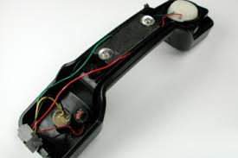
Katz v. United States
Federal agents suspected Katz of transmitting gambling information over the phone
FBI Wiretapped his phones
Found him guilty and convicted him

Slide 3
Constitutional Question
Does the Fourth Amendment protection against unreasonable searches and seizures require the police to obtain a search warrant in order to wiretap a public pay phone?

Slide 4
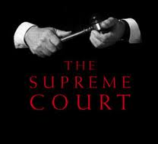
Conclusion of The Case
The court ruled that this violated his fourth amendment rights
7 votes for Katz, 1 vote against

Slide 5
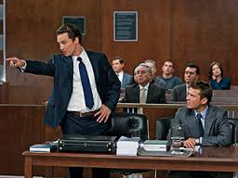
Gideon v. Wainwright
Clarence Earl Gideon was charged with Breaking and Entering
Appeared in court without a lawyer
Sentenced to 5 years in prison

Slide 6
Constitutional Question
Does the Sixth Amendment's right to counsel in criminal cases extend to felony defendants in state courts?

Slide 7
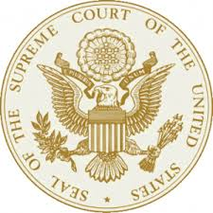
Conclusion of The Case
9 votes for Gideon, o votes against
Constitution guarantees the right to counsel as a protection of due process

