Slide 1
Reconstruction
AP US History
Mrs. Lacks

Slide 2
Reconstruction Era
1865 – 1877
period after the Civil War when the U.S. focused on abolishing slavery, destroying all traces of the Confederacy, and "reconstructing" both the South and the Constitution

Slide 3
Key Questions
How do we bring the South back into the Union?
How do we rebuild the South after its destruction during the war?
How do we integrate the newly emancipated blacks?
What branch of government should control the process of Reconstruction?

Slide 4
State of the Union
North vs. South economy
war-related industries grew (firearms, woolens, wagon building); iron and coal
northern economy boomed (by end of war was producing more coal, iron, merchant ships, etc than entire country had in 1860)
southern economy devastated
end of slavery as a labor system
wrecked most of region’s industry
wiped out 40% of livestock
destroyed much of farm machinery and railroads
left 1000s of acres of uncultivated farmland in weeds
Cost of the war = $20 billion

Slide 5
Three Proposed Plans for Reconstruction
1. Lincoln’s Plan: 10% Plan
Proclamation of Amnesty and Reconstruction (December 8, 1863)
Replace majority rule with “loyal rule” in the South.
Pardon to all but the highest ranking military and civilian Confederate officers.
When 10% of the voting population in the 1860 election had taken an oath of loyalty and established a government, it would be recognized

Slide 6
Three Proposed Plans for Reconstruction
Lincoln’s Plan: 10% Plan
1864, “Lincoln Governments” formed in LA, TN, AR
“loyal assemblies”
Weak, dependent on North for survival

Slide 7
Three Proposed Plans for Reconstruction
2. Wade-Davis Bill (July 1864)
Proposed that Congress, not the President should be in charge of Reconstruction
Majority (not just 10%) of eligible population must take an oath
Passed by Congress, but killed by Lincoln’s pocket veto

Slide 8
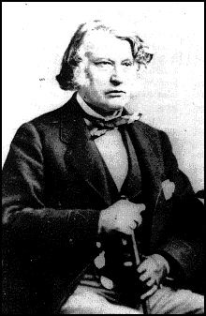
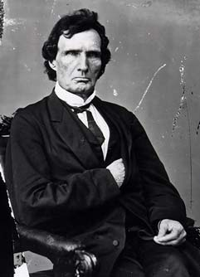
Radical Republicans

Slide 9
Three Proposed Plans for Reconstruction
3. Johnson’s Plan
declare secession illegal
future loyalty oath
ratify the 13th Amendment

Slide 10
What are the plans failing to address?

Slide 11
The needs of former slaves
land, voting rights, protection under the law

Slide 12
Answer 1
Former Confederate leaders?

Slide 13
Black Codes
Discriminatory laws that restricted the lives of freed blacks
Restored many of the restrictions of slavery
Examples: prohibited blacks from carrying weapons, serving on juries, testifying against whites, marrying whites, starting their own businesses, etc.

Slide 14
Ku Klux Klan
Began as a social club in Tennessee after war
From the Greek kuklos, meaning Circle of Brothers

Slide 15
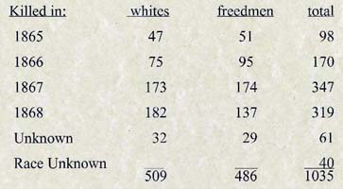
Ku Klux Klan
Major Goal: destroy the Republican Party
throw out Reconstruction gov.s
aid planter class in controlling black laborers
prevent blacks from exercising political rights
opposition to the violence will bring gradual decrease in the Klan’s activities

Slide 16
Nathan Bedford Forrest
From TN
Slave trader
Confederate LT. General
“The Wizard of the Saddle”
1st Grand Wizard of the KKK

Slide 17
Ku Klux Klan
1st Klan: 1865 – 1870s (500,000 members)
Veterans of the Confederate Army
Resisted Reconstruction by intimidating freedmen and white Republicans
Southern elites didn’t like it because it served as an excuse for federal troops to continue occupation
Organization declined from 1868 to 1870 and was destroyed by President Grant's passage and enforcement of the Force Acts of 1870 and 1871

Slide 18
Ku Klux Klan
Mississippi
1871

Slide 19
Ku Klux Klan
2nd Klan: 1915 – 1944 (4 million members)
Formed due to the Great Migration in the early 1900s and the lack of jobs of long-term Americans
racism, anti-Catholicism, anti-Communism, nativism, and anti-Semitism
At its peak in the mid-1920s, the organization included about 15% of the nation's eligible population, approximately 4–5 million men
Died out during the Great Depression and World War II

Slide 20
Ku Klux Klan
Cross burning in the 1920s

Slide 21
The Birth of a Nation
1st Hollywood Blockbuster (for innovative technical achievement)
Based off of the Clansmen by Thomas Dixon
Provoked controversy for its sympathetic account of the rise of the KKK

Slide 22
Ku Klux Klan
3rd Klan: since 1946
researchers estimate there may be more than 150 Klan chapters with 5,000-8,000 members nationwide
The U.S. government classifies them as hate groups, with operations in separated small local units.

Slide 23
13th Amendment
Ratified in December, 1865.
Neither slavery nor involuntary servitude, except as punishment for crime whereof the party shall have been duly convicted, shall exist within the United States or any place subject to their jurisdiction.

Slide 24
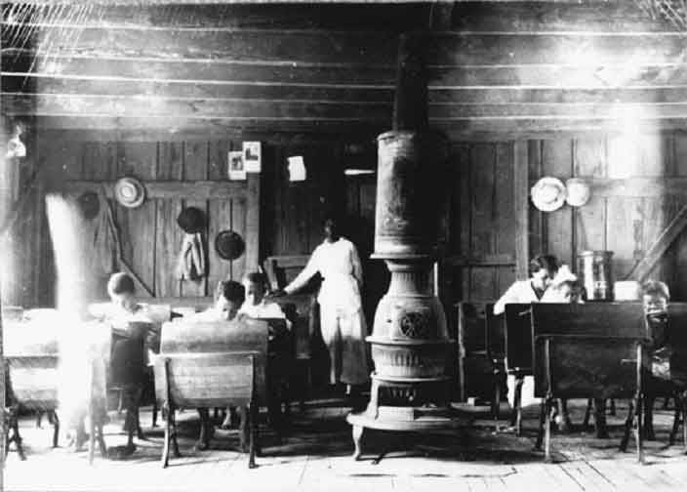
Freedman’s Bureau

Slide 25
Freedman’s Bureau
As seen through the eyes of the South… plenty to eat and nothing to do

Slide 26
Civil Rights of 1866
gave blacks citizenship and forbade state from passing discriminatory laws that restricted their lives (black codes)

Slide 27
Johnson’s Response
Johnson vetoed both renewal of the Freedman’s Bureau and Civil Rights Act
both overridden by congress (1st time!)
Johnson said it was beyond the scope of Congress’s powers
began a battle between congress and the president
presidential reconstruction will come to a halt

Slide 28
14th Amendment
Ratified in July, 1868.
Provide a constitutional guarantee of the rights and security of freed people.
Insure against neo-Confederate political power.
Enshrine the national debt while repudiating that of the Confederacy.
Southern states would be punished for denying the right to vote to black citizens!

Slide 29
Reconstruction Acts of 1867
Military Reconstruction Act
Command of the Army Act
Tenure of Office Act

Slide 30
Johnson’s Impeachment
Johnson removed Stanton, Feb 1868
Replaced radical generals in field
House impeached him on Feb 24, 1868 even before charges were brought forth, 126 - 47

Slide 31
Johnson’s Impeachment
Senate, 11 week trial
Acquitted, 35 – 19 (one vote short of required 2/3 vote)

Slide 32
The Grant Administration
1868 – 1876
Election of 1868
Ulysses S. Grant & Schuyler Colfax (Republican)
Horatio Seymour & Frank Blair (Democrat)

Slide 33
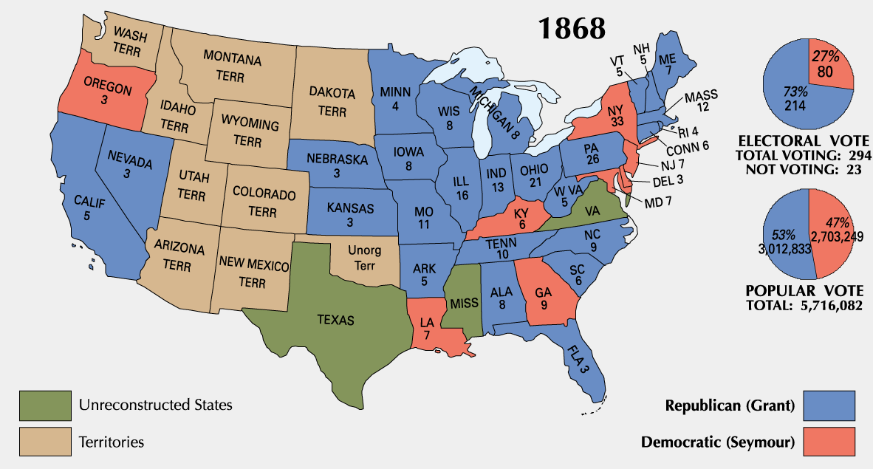

Slide 34
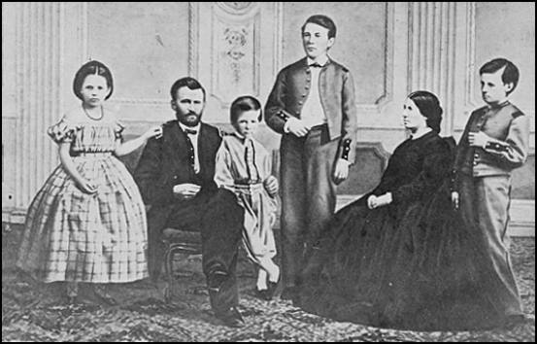
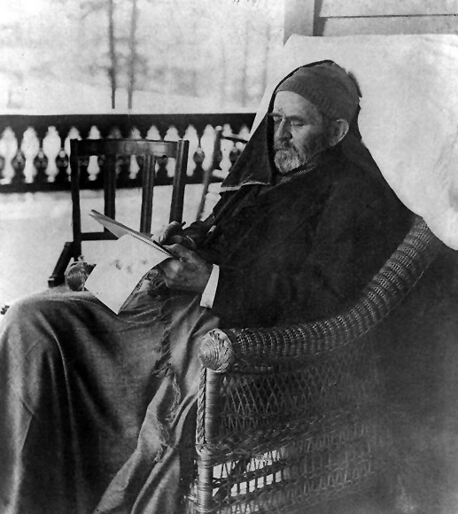
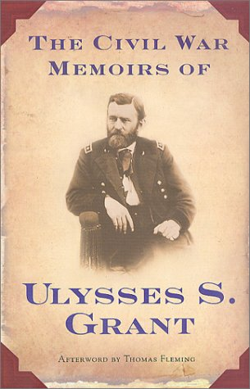
President Grant

Slide 35
Grant Administration Scandals
Grant presided over an era of unprecedented growth and corruption
Credit Mobilier Scandal
Whiskey Ring
Indian Ring

Slide 36
Tweed Ring
New York City
William Marcy Tweed
Notorious head of Tammany Hall’s political machine
Democratic Party
Thomas Nast
Crusading cartoonist, reporter

Slide 37
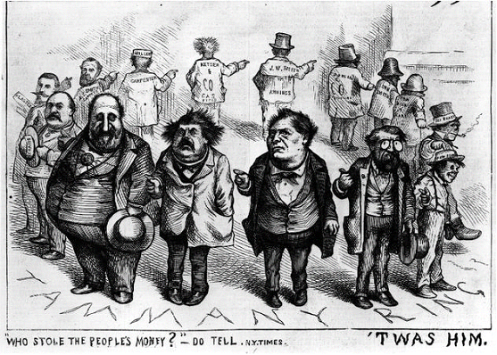
Who stole the people’s money?

Slide 38
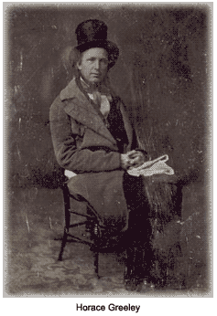
Election of 1872
Rumors of corruption during Grant’s first term discredit Republicans
Horace Greeley runs as a Democrat/ Liberal Republic candidate
Reformer (women’s rights, utopianism)
Disagreed with slavery but hated abolitionists
Signed Jefferson Davis’ bail bond
Employed Karl Marx as a foreign correspondent for three months
Greeley attacked as a fool and a crank
Greeley died on November 29, 1872

Slide 39
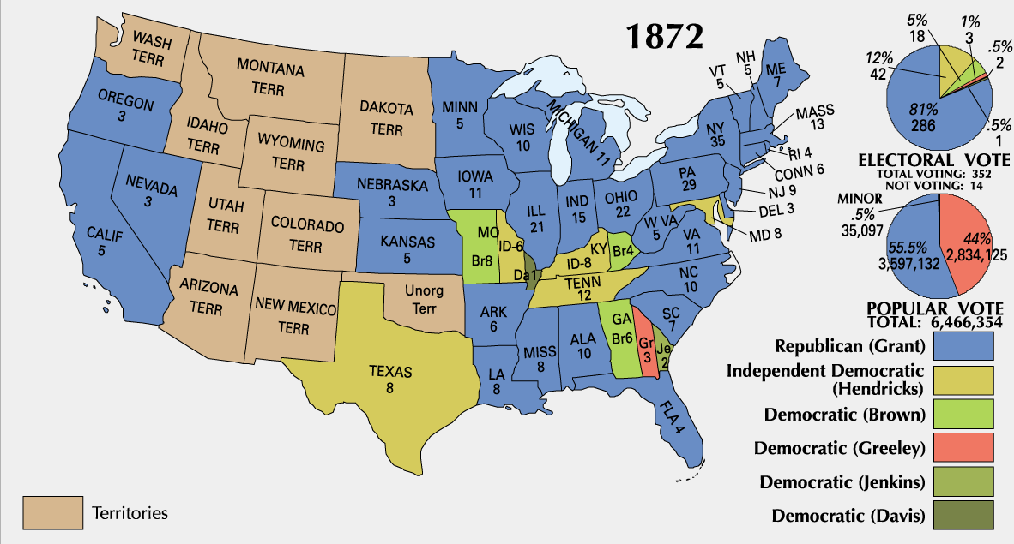

Slide 40
Panic of 1873
Over speculation
Inflation
Specie Redemption Act (1875)
Greenback Party formed (1876)

Slide 41
Legal Challenges
The Slaughterhouse Cases (1873)
Bradwell v. Illinois (1873)
US v. Cruickshank (1876)
US v. Reese (1876)

Slide 42
How did blacks adjust to society?

Slide 43
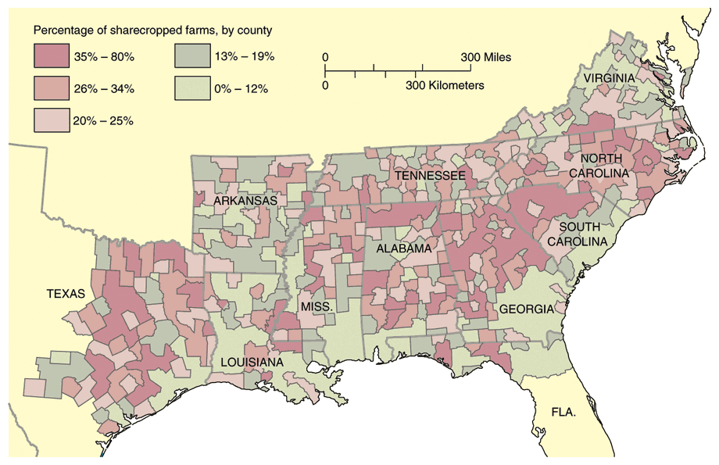
Sharecropping

Slide 44
Tenant Farming & Crop Lien System
Furnishing Merchant | Tenant Farmer | Landowner
Loan tools and seed up to 60% interest to tenant farmer to plant spring crop. Farmer also secures food, clothing, and other necessities on credit from merchant until the harvest. Merchant holds “lien” {mortgage} on part of tenant’s future crops as repayment of debt. | Plants crop, harvests in autumn. Turns over up to ½ of crop to land owner as payment of rent. Tenant gives remainder of crop to merchant in payment of debt. | Rents land to tenant in exchange for ¼ to ½ of tenant farmer’s future crop.

Slide 45
Southern Politics
Republicans made of 3 groups
Scalawags - white southerner who joined Republican party
some wanted south to industrialize
majority are small farmers wanting to improve economic position and didn’t want former wealthy farmers to regain power
Carpetbaggers - northerners who move to south after war
various motives for moving
African Americans - largest group of southern republicans
90% of qualified voters actually voted
lack of unity between groups due to different goals

Slide 46
Carpetbaggers
Southerners considered them ready to loot and plunder the defeated South
Called this because they came South with travel bags

Slide 47
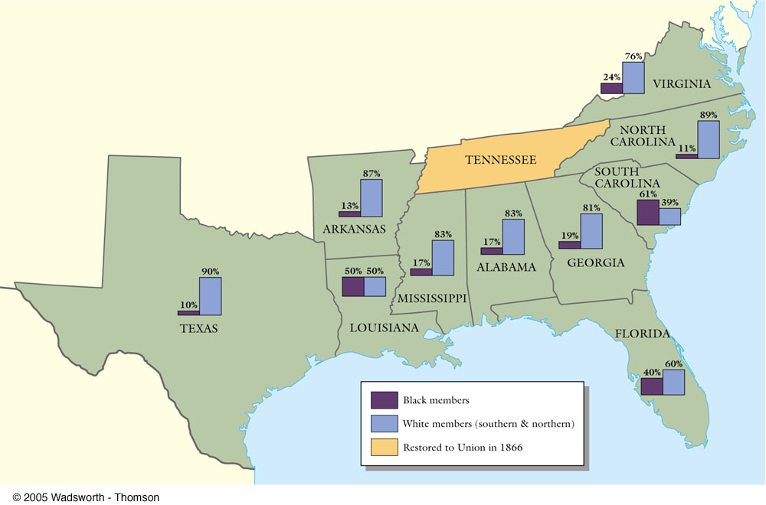
Black & White Political Participation

Slide 48
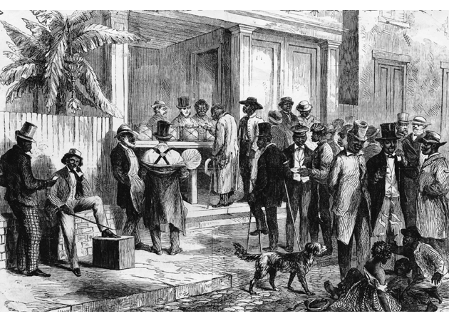
Blacks in Southern Politics
Core voters were black veterans.
Blacks were politically unprepared.
Blacks could register and vote in states since 1867.

Slide 49
Historically Black Colleges

Slide 50
15th Amendment
Ratified in 1870.
The right of citizens of the United States to vote shall not be denied or abridged by the United States or by any state on account of race, color, or previous condition of servitude.
The Congress shall have power to enforce this article by appropriate legislation.
Women’s rights groups were furious that they were not granted the vote!

Slide 51
Hiram Rhodes Revels
Born in NC a freeman to a mixed father and white mother
Barber, then preacher
Elected to the Miss State Senate
1st African American in the Senate (Republican)
Served from 1870 – 71 (short term because he finished Jefferson Davis’ term)
First of five African Americans to serve in the Senate

Slide 52
Blanche Kelso Bruce
First African American to serve a full term in Senate (1885 – 1881)
Republican
Born in VA as a house slave
Was legally freed and was arranged to become an apprentice to a printer
Moved to Mississippi and became a wealthy landowner
Elected to US Senate
Only former slave to serve in the Senate
First African American to receive any votes at a major party’s nominating convention (1880 Republican National Convention in Chicago)

Slide 53
Failure of Reconstruction
Enforcement Acts 1870-1871
federal supervision of elections in the south
gave president power to use federal troops in areas of Klan activity
Amnesty Act - 1872
returned the right to vote and hold federal or state office to @160,000 former confederates (left out high-ranking officials)
weakened power of republicans in the south

Slide 54
Civil Rights Acts of 1875
Crime for any individual to deny full & equal use of public conveyances and public places.
Prohibited discrimination in jury selection.
Shortcoming → lacked a strong enforcement mechanism.
No new civil rights act was attempted for 90 years!

Slide 55
Northern Support Wanes
“Grantism” & corruption.
Panic of 1873 [6-year depression].
Concern over westward expansion and Indian wars.
Key monetary issues:
should the government retire $432m worth of “greenbacks” issued during the Civil War.
should war bonds be paid back in specie or greenbacks.

Slide 56
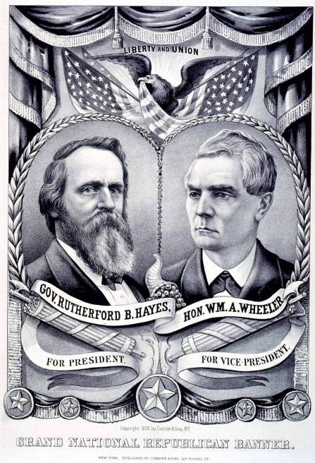
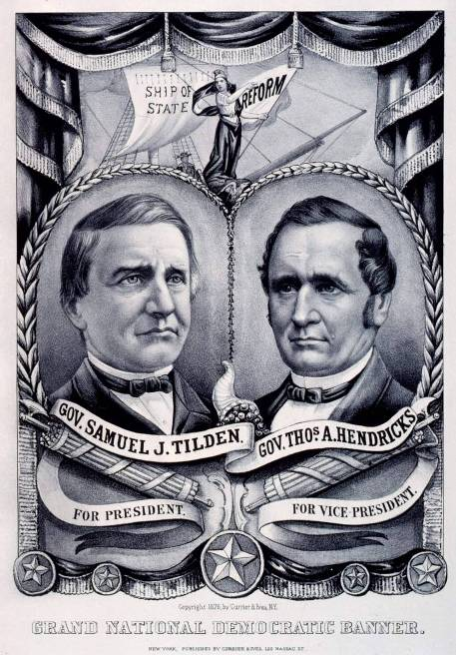

Slide 57
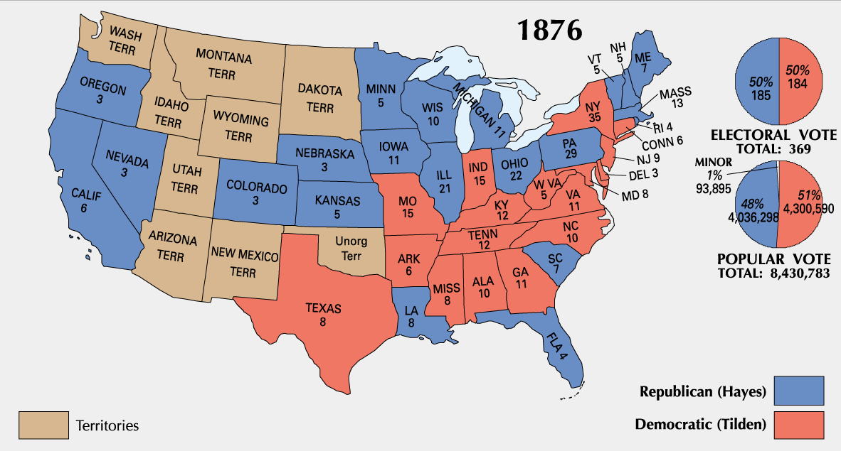

Slide 58
Political Crisis of 1877
Corrupt Bargain Part II?

Slide 59
Hayes Prevails

Slide 60
Alas, the woes of childhood…
Sammy Tilden, “Boo hoo! Ruthy Hayes got my presidency, and he won’t give it to me!”

Slide 61
End of Reconstruction
Home Rule: Southern Democrats regain control
Restricted the rights of freed slaves
Wiped out social programs
Slashed taxes
Dismantled the public school system
The country turns its attention back to Westward expansion

