Slide 1
New Jersey V. T.L.O.
By: Rachel Spencer

Slide 2
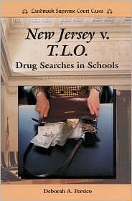
Who is involved?
A teacher found a girl and her friend smoking cigarettes in one of the bathrooms in a New Jersey High school.
Sent to the principals office
Purse was searched

Slide 3
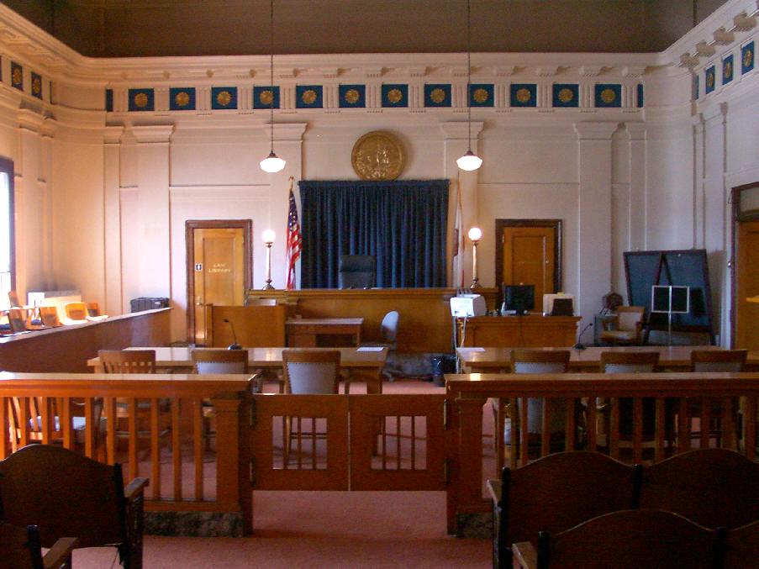
How it got to the Supreme Court
Juvenile Court
The Appellate Division of the New Jersey Superior Court
The New Jersey Supreme Court

Slide 4
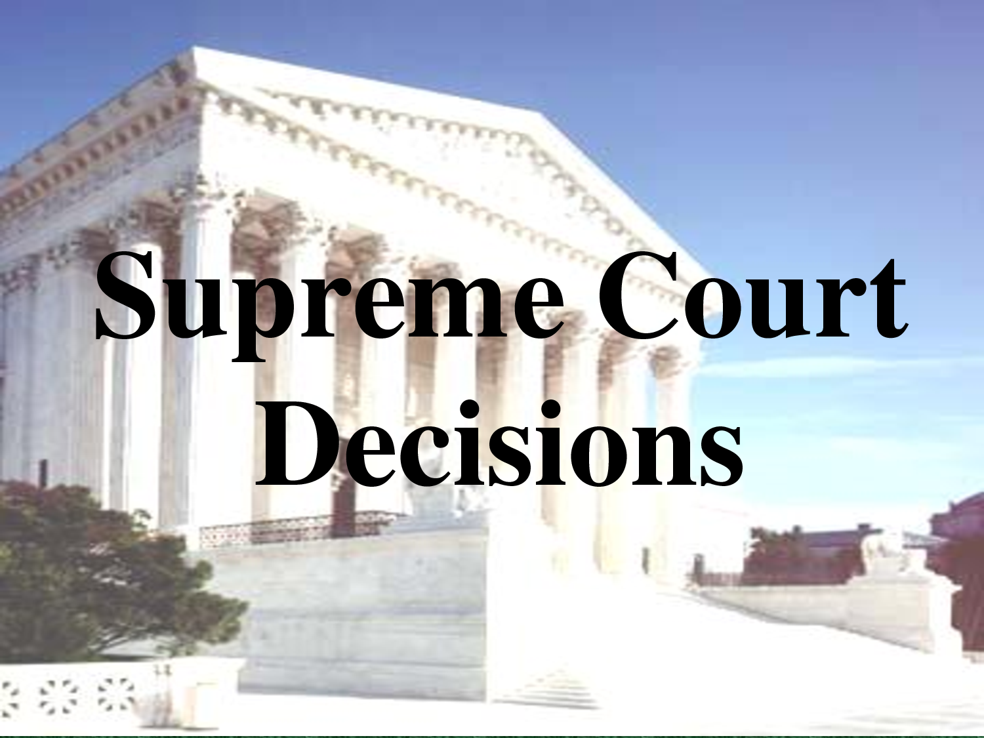
Supreme Court Decision
Evidence in the purse cannot be used.
Violates 4th amendment

Slide 5
Why is it important
More rights to people in school
People now need warrants to search other peoples stuff

Slide 6
University of California Regents V. Blakke

Slide 7
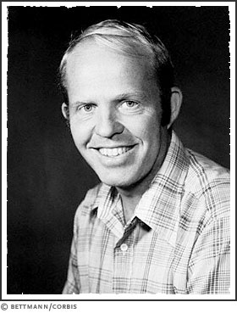
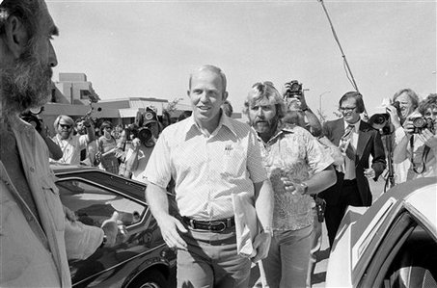
Who is Involved
Allan Burke
University of California

Slide 8
How it got to the Supreme Court
University kept appealing

Slide 9
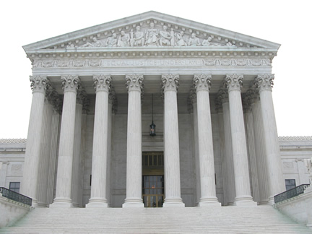
Supreme Court Decision

Slide 10
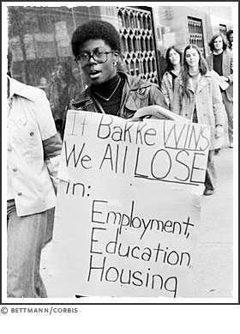
Why is it important

