Slide 1
NIGERIA
“Nigeria is not a nation. It is a mere geographical expression.”
--Chief Obafemi Awolow
Part 1: The Making of the Modern State

Slide 2
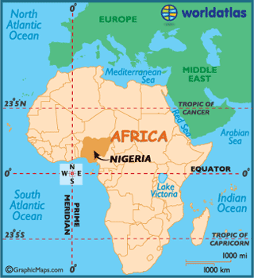
Why Study Nigeria?
LDC trying to democratize
History of colonialism, military rule, parliamentary democracy & presidential democracy
Ethnic/Religious/Regional Cleavages
Largest population in Africa
Federalism
Resource curse (oil)
Patron-Client Relations (Prebendalism)

Slide 3
Pre-Colonial Influences (800 – 1860)
Regional trade connections
North: Early influence of Islam and centralized government
SW: Kinship-based politics with less centralized governments
Complex political identities
Democratic impulses

Slide 4
Colonial Period (1860 – 1960)
Objective: Gain natural resources - access to Niger River trade route.
Authoritarian rule
No checks on power
Individualism – capitalism
Christianity
Intensification of ethnic politics
Active civil society

Slide 5
Influence of British Rule
Authoritarian rule – British established chiefs to rule on their behalf
Interventionist state – no “free market”… chiefs expected to rule to meet economic goals set by the British
Individualism – self-interest of capitalism was mixed with state-domination of the economy
Intensification of ethnic politics – Hausa-Fulani, Igbo, Yoruba competed for “rewards” from British

Slide 6
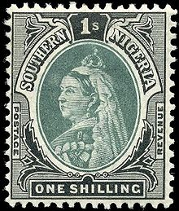
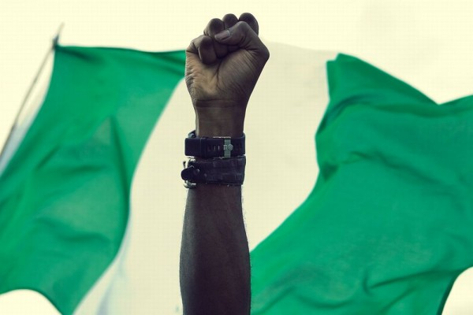
Influence of British Rule
Deepened ethnic and regional divisions
Indirect rule in the north (Muslim leaders)
Direct rule in south
Christianity
(Islam already in North from Arab traders)
Western-style education
Mostly in south (Christian missionaries)
Independence – 1960
Since then…the ”National Question”
Should we even be a country?
Notes:
Authoritarian rule – British established chiefs to rule on their behalf
Interventionist state – no “free market”… chiefs expected to rule to meet economic goals set by the British
Individualism – self-interest of capitalism was mixed with state-domination of the economy
Intensification of ethnic politics – Hausa-Fulani, Igbo, Yoruba competed for “rewards” from British

Slide 7
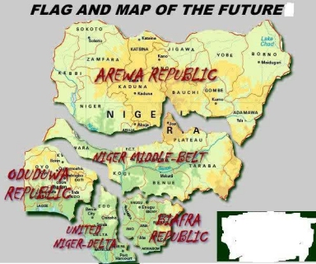

Slide 8
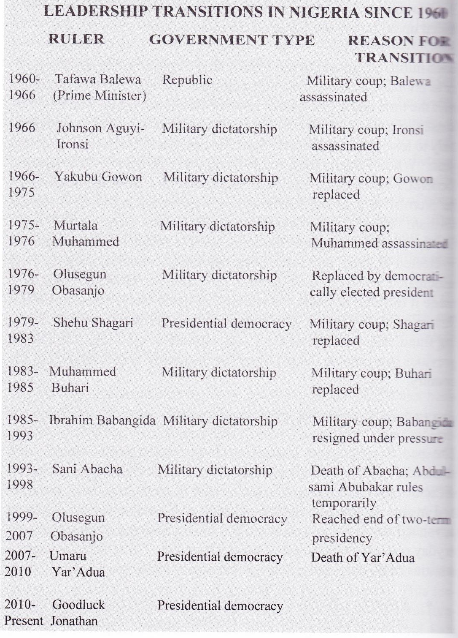
Since Independence
1960-1979 – British parliamentary style democracy
Why didn’t it work?
Ethnic divisions made it difficult to identify a majority party or allow a PM to have necessary authority
1979 – Presidential System
Both systems experienced frequent interruptions/periods of Military Rule –frequent coups
Notes:
1967-70 Biafran Civil War
First military ruler, Ironsi, justified his authority by announcing his intention to end violence and stop political corruption
Killed in a coup by a 2nd general
Coup sparked the Igbo to fight for independence for their land – called Biafra
Country did remain together, but only under military rule

Slide 9
Since Independence
1967-70 Biafran Civil War
First military ruler, Ironsi, justified his authority by announcing his intention to end violence and stop political corruption
Killed in a coup by a 2nd general
Coup sparked the Igbo to fight for independence for their land – called Biafra
Country did remain together, but only under military rule

Slide 10
Since Independence
Other Trends
Intensification of ethnic conflict – Hausa-Fulani formed a majority coalition with Igbo, angering the Yoruba
Personalized rule and corruption
Govt revenue goes to Nigerian elite through patron-client system/prebendalism
Two military presidents: Babangida and Abacha maintained large foreign bank accounts with regular deposits diverted from Nigerian state (oil $)
Federalism – attempt to pacify ethnic tension, though military leaders did not allow much local power
Economic dependence on oil – enriches those in power, who ignore other sectors of the economy
Notes:
Corruption:
Two military presidents: Babangida and Abacha maintained large foreign bank accounts with regular deposits diverted from Nigerian state (oil $)
Loyalty Pyramids
Senior govt officials are supported by a broader base of loyal junior officials
State control of resources means that those in the pyramid get the spoils, and they alone have access to wealth and influence

Slide 11
Since Independence
Loyalty Pyramids
Senior govt officials are supported by a broader base of loyal junior officials
State control of resources means that those in the pyramid get the spoils, and they alone have access to wealth and influence

Slide 12
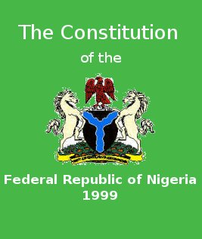
Sovereignty, Authority, and Power
Constitutionalism – eluding Nigeria so far
First constitution in 1914
8 more since (latest in 1999)
Military and civilian leaders alike have never felt the need to obey constitutions, and often write new ones upon taking power

Slide 13
Sovereignty, Authority, and Power
Legitimacy
Newly independent (1960)
Highly fragmented along ethnic, regional, religious lines
The sole stable national institution is the military
Leads to legitimacy of military’s right to rule
Most leaders have been generals
Extremely low legitimacy of government, overall
Massive corruption, distrust of government

Slide 14
Economic Development
Rentier State based on oil revenue
Debt because of over-reliance on oil and corruption
1980s Nigeria was forced to turn to international organizations for help in managing its huge national debt
World Bank/International Monetary Fund helped develop economic structural adjustment program
Restructure and diversify Nigerian economy to decrease dependence on oil
Notes:
Rentier state, like Iran

Slide 15
NIGERIA
“The trouble with Nigeria is simply and squarely a failure of leadership. There is nothing basically wrong with the Nigerian character. There is nothing wrong with the Nigerian land or climate or water or air or anything else.”
--Chinua Achebe
Part 2: Institutions

Slide 16
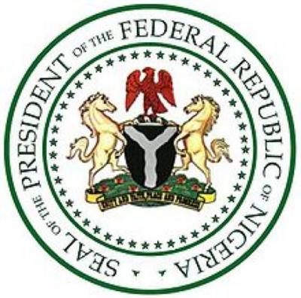
The Basics
Democracy (fragile)
Federal
Territory divided into 36 federal states + federal capital territory, Abuja
Presidential
Bicameral Legislature
*Currently neither checks or balances operate, and state and local governments are totally dependent on the central government

Slide 17
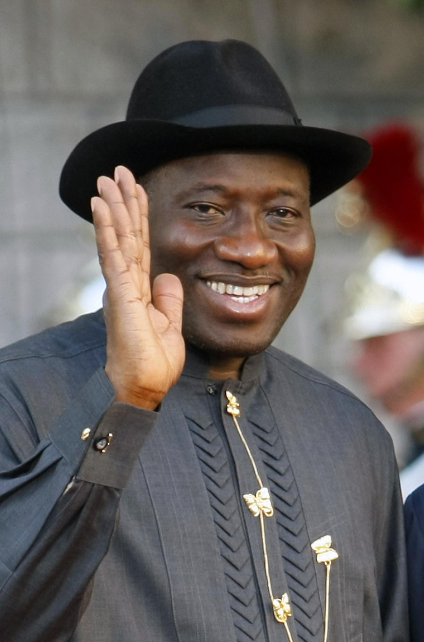
The Executive
Executive – President and Cabinet
Directly elected, 4 yr term, 2 term limit
May appoint officials to all parts of national government without approval of legislature (leads to patrimonialism)
Current President: Goodluck Jonathan

Slide 18
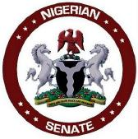
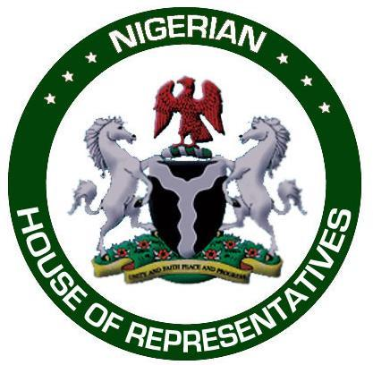
The Legislative
Legislature – parliamentary until 1979, now bicameral National Assembly
Senators and Representatives serve 4 year terms, elected the week before the president
Senate
109 Senators, 3 per state, 1 from Abuja
Very diverse given the different regions that are equally represented
House of Representatives
360 members
Very little power, but occasionally acts as a check on president (like when Obasanjo wanted a 3rd term)

Slide 19
The Bureaucracy
Bureaucracy – assumed to be bloated, corrupt, and inefficient
Parastatals – privately owned, but headed by government appointees (part of the patron-client network)
Provide public utilities or major industries
Nigerian Electric Power Administration (NEPA) – called “Never Expect Power Again” by Nigerians
Changed name to Power Holding Company (PHC) – called “Please Hold Candle” by Nigerians
State corporatism – parastatals serve to give the appearance of public/private cooperation, while really giving the state control
Notes:
Parastatals:
Nigerian Electric Power Administration (NEPA) – called “Never Expect Power Again” by Nigerians
Changed name to Power Holding Company (PHC) – called “Please Hold Candle” by Nigerians

Slide 20
The Judiciary
Federal and state courts with an appeals process up to the Supreme Court
Strong and autonomous after independence, but since ravaged by military rule
Most judges today are not well versed in law, easily manipulated by the government
Theoretically in charge of judicial review, not practically
Law is complicated by the sharia which operates in 12 northern states, controversially

Slide 21
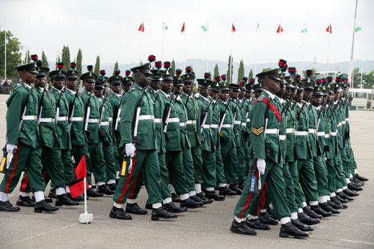
The Military
Guess what? It’s strong!
Military made distinctions between “military in government” and “military in barracks” after early coups
“Military in government” presidents (like Babangida) had to restrain influence of traditional military
Appointed senior military to cabinet positions to make them part of his patronage network
The best place for young Nigerians to improve their lives, demonstrate their talents
Controversial, but it is the one national institution with the capability to restore order

Slide 22
NIGERIA
Part 3: Citizens, Society & the State

Slide 23
Citizens, Society, and the State
Necessary condition for democratization: citizens need to have time to pay attention and participate in the political process
Problem for Nigeria:
60% live in poverty
Large gap between rich and poor (Gini = 50.6)
Health issues – AIDS epidemic (1 in 11 AIDS carriers are Nigerian)
Literacy – 75.7% for men, 60.6% for women

Slide 24
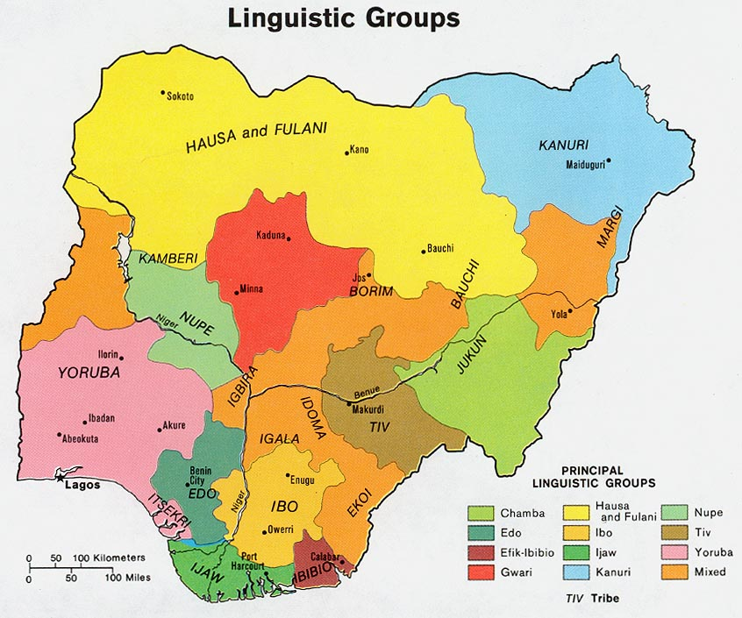
Cleavages
One of the most fragmented societies in the world
Ethnicity – 250 to 400 distinct ethnic groups (different languages, religion)
Hausa-Fulani – 29%
Yoruba – 21%
Igbo (Ibo) – 18%
Religion – 50% Muslim, 40% Christian, 10% various native religions
Disputes rooted in preferential treatment British gave to Christians, role of sharia in Nigerian law
Notes:
Hausa-Fulani, Igbo, and Yoruba tribes are largest, but can’t speak each other’s languages and have no contact generally

Slide 25
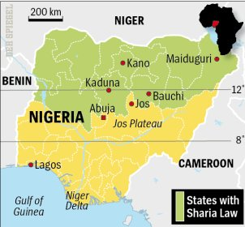
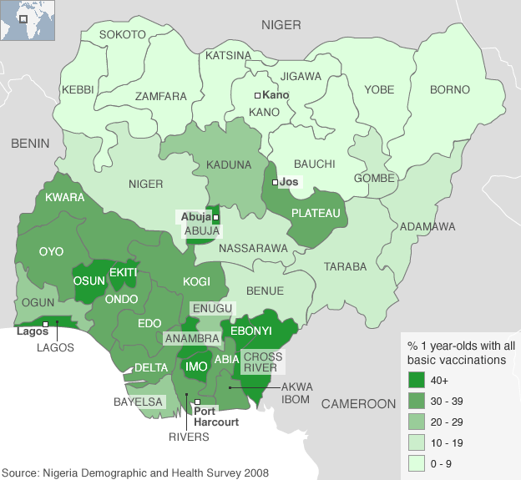
Cleavages
Region – North (predominantly Muslim) vs. South (predominantly Christian)
Urban/rural differences – political organizations, interest groups, media only operate in cities
Social class – elite are those with ties to the state, who often use the treasury to benefit themselves

Slide 26
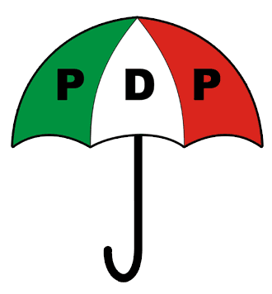
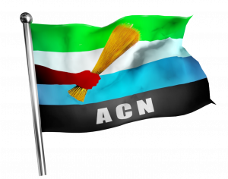
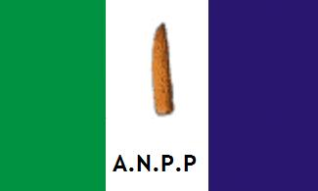
Political Parties
Regionally based
Extreme factionalization resulted in development of so many parties, there is no coherent party system
Parties appear and disappear based on leaders
Currently:
People’s Democratic Party (PDP)
All Nigeria People’s Party (ANPP)
Action Congress (AC) – merger of many parties
Notes:
People’s Democratic Party (PDP) – Obasanjo and Yar’Adua’s party of power, “won” in most parts of the country with Southern and Northern candidates
All Nigeria People’s Party (ANPP) – General Muhammad Buhari’s party
Action Congress (AC) – merger of many parties, led by Atiku Abubakar (who was disqualified from running in 2007, then reinstated by the Supreme Court days before the election)

Slide 27
Political Parties
People’s Democratic Party (PDP) – Obasanjo and Yar’Adua’s party of power, “won” in most parts of the country with Southern and Northern candidates
All Nigeria People’s Party (ANPP) – General Muhammad Buhari’s party
Action Congress (AC) – merger of many parties, led by Atiku Abubakar (who was disqualified from running in 2007, then reinstated by the Supreme Court days before the election)

Slide 28
Political Parties
These parties are becoming less regional, and increasingly run a “ticket” with candidates of different regions, campaigning across all of Nigeria
Why?
1999 Constitutional requirement
Winning presidential candidate must receive 25% of votes cast in at least 2/3 of all states
Attempt to prevent regional candidates from winning the presidency and unite Nigeria

Slide 29
Elections
Independent National Election Commission (INEC) requires parties to qualify for national elections with at least 5% of votes in 2/3 of states
Legislative
109 Senators elected by popular vote (3 per state, 1 from Abuja)
360 House of Representatives elected in SMD plurality elections
Presidential
2 ballot majority system (with the regional requirement)
All elections usually involve fraud and irregularities

