Slide 1
Landmark Court Cases
By: Michael Riopel

Slide 2
Court Case #1- Yates V. United States
Communism
Violate 1st Amendment?
Conclusion

Slide 3
Court Case #2 Bethel School District V Fraser
“Graphic Sexual Metaphors”
Violates 1st Amendment?
Conclusion

Slide 4
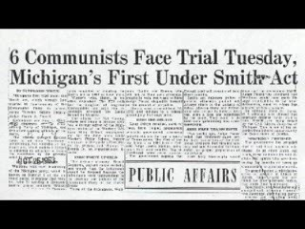
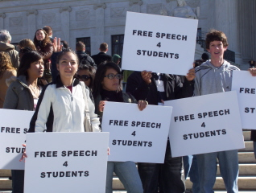
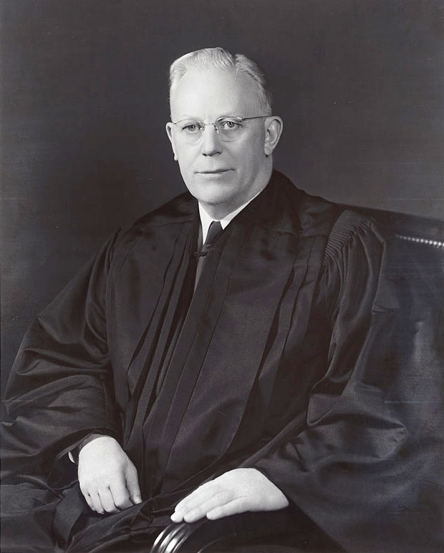
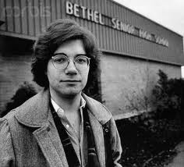
Pictures

