Slide 1
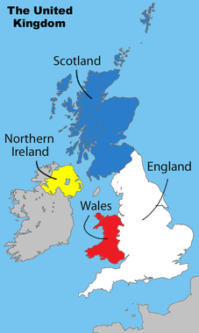
Part 1: Making of the Modern British State
Spring 2014

Slide 2
The United Kingdom
Discussion Question: Why do we study the UK?

Slide 3
Why do we study the UK?
Evolutionary Democracy
Now an Advanced Democracy
Parliamentary Democracy
Westminister model
Great Power in the Past
Past hegemonic power
High Standard of Living
Unitary Form of Government
Example of Devolution
Notes:
Great power in the past:
By 1870, British trade represented nearly ¼ of the world total
By 1900, Queen Victoria ruled an empire that included 25% of the world’s population
Britain exercised direct colonial rule over 50 countries (including one of the AP6 – Nigeria)
Britain also dominated worldwide network of independent states
Britain rule as a hegemonic power, controlling alliances and international economic order and shaping domestic political developments in countries throughout the world
Example of Devolution
1997 devolved power to Assemblies in Scotland & Wales
1998 devolved power to Assembly in N. Ireland

Slide 4
Geography
Officially: The United Kingdom of Great Britain and Northern Ireland; or UK, or Britain
One State, 4 Nations
GB = ________________________
UK = ________________________
Less subject to invasion than rest of Europe
Britons feel both apart from and part of Europe

Slide 5
Geography
Officially: The United Kingdom of Great Britain and Northern Ireland; or UK, or Britain
One State, 4 Nations
GB = England, Scotland & Wales
UK = GB + Northern Ireland
Quick Explanation
Less subject to invasion than rest of Europe
Britons feel both apart from and part of Europe

Slide 6
Magna Carta: protection against absolute power and arbitrary acts; trial by jury, due process, protection of private property (often ignored)
Bill of Rights and Glorious Revolution: Consent of Parliament for most acts of monarch; free elections, right to petition king
Parliament Act of 1911
Supremacy of House of Commons; HOL can only delay bills for 1 year; 5 year terms for HOC
1215
1628
1688-9
1830-84
1911
1941
Great Reform Acts
Increased size of electorate and reformed election procedures
Beveridge Plan - Five Giant Evils:
Want
Squalor
Ignorance
Disease
Idleness
Petition of Right
Trial by jury, rule of law, tax only w/Parliament’s consent, no martial law during peace
Britain’s Evolutionary Democracy
Notes:
Bill of Rights: Without parliament consent: no standing army in peace, execution of laws, taxes; right to petition king, free elections
Great Reform Act (1832): only about 300,000 more men could vote
Second Reform Act (1867): male urban workers could vote electorate size increased to 3 million
Third: rural vote
Representation Acts of 1884 and 1885 increased suffrage so much that working class men were majority of electorate
By early 20th century, all men could vote
1918: most women could vote
1928: all women could vote

Slide 7
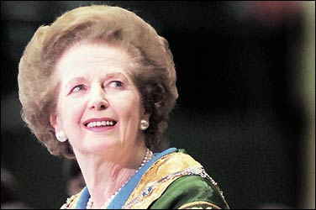
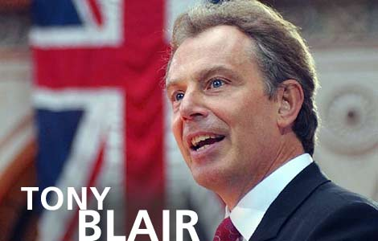
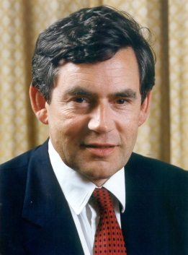
Collective Consensus: Establishment of welfare state (NHS) and commitment to Keynesian economics and state intervention;
Dismantling of British Empire
David Cameron (PM): Hung Parliament, Coalition government with Nicholas Clegg, Deputy PM (Liberal Democrat)
Margaret Thatcher: Conservative Party ; Iron Lady; Neoliberalism
Tony Blair
“New Labour”/Third Way
1945-1979
1979
1979-90
1990-1997
1997-2007
2007-10
Economic Crisis
Decline in industrial production, Loss of colonies, Oil Prices, Labor Union Demands (1970s)
Winter of Discontent: Widespread strikes lead to Thatcher’s victory
John Major:
Lost majority through defections and by-elections; He who hesitates….
Gordon Brown
Britain’s Evolutionary Democracy
Notes:
Strikes: Coal, gravediggers, garbage among others

Slide 8
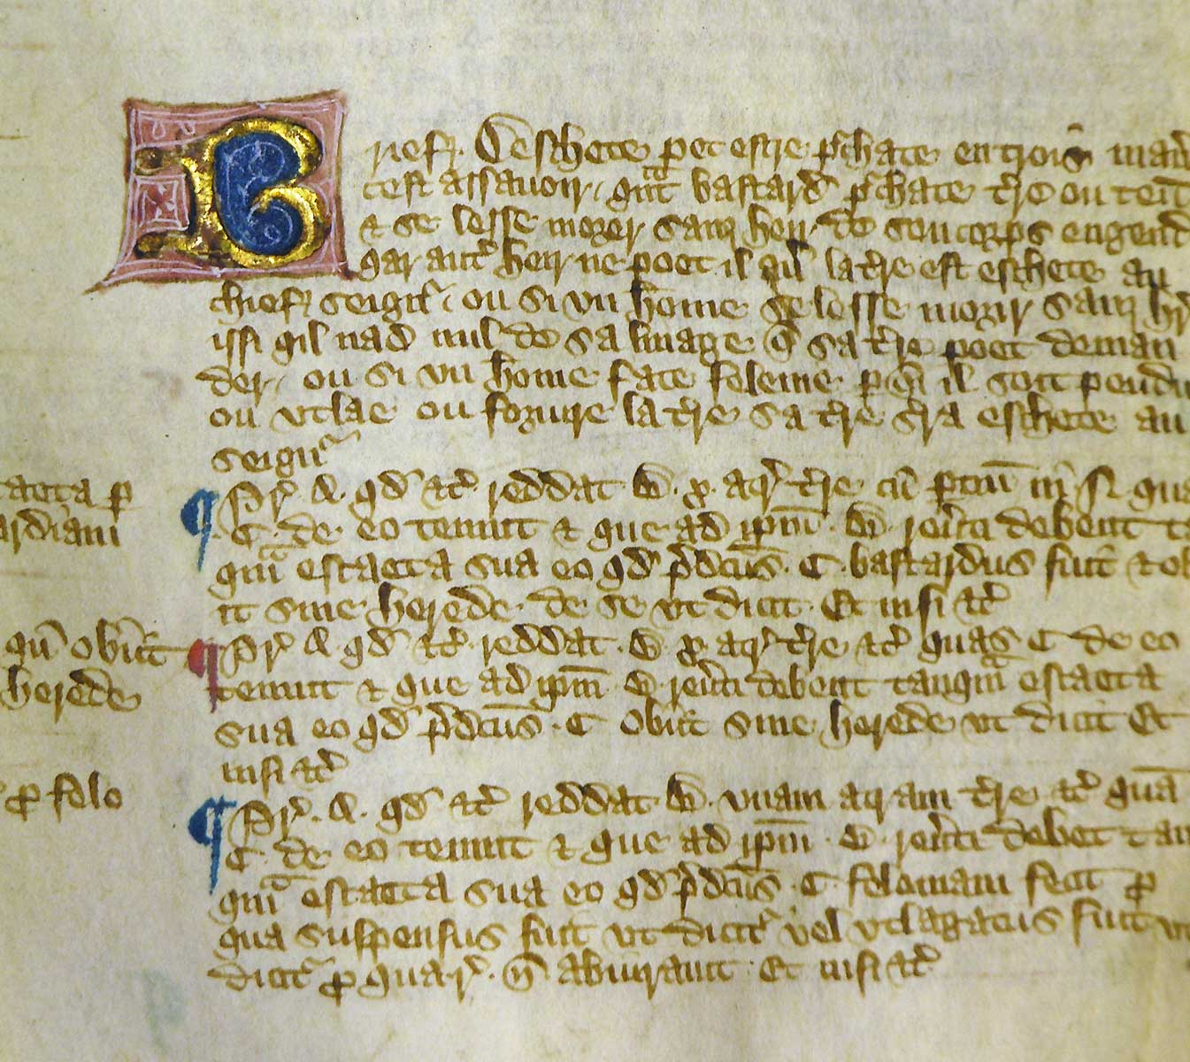
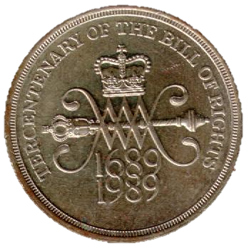
Evolutionary Democracy
Legitimacy based on tradition (crown) and Rational-Legal Authority
No single codified constitution
“Constitution of the Crown”
Important legal documents and Common Law
Notes:
Common Law allows the decisions that public officials and courts make to set precedents for later actions and decisions, eventually forming a comprehensive set of principles for governance

Slide 9
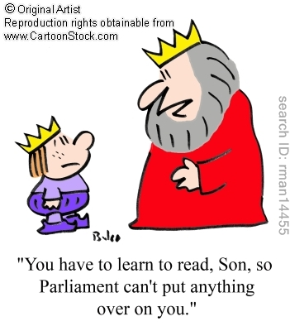
Evolutionary Democracy
Shaping of Monarch
From absolute power to symbolic role y
Parliament’s Rise in Power
Gradualism
Gradual Extension of Voting Rights
Spurred by Industrial Revolution
Great Reform Act of 1832 – 300,000+ men gained right to vote
1867 – working class people
1918 – Women age 28+, men 21+
1928 – Women 21+
Notes:
Industrial Revolution’s Influence:
Also spurred development of labor unions to protect workers’ rights
1870 – mandatory elementary education put into law
Early 1900’s laws for old age pensions
The struggle to extend the vote took place mostly without violence, but it lasted for centuries
Voting age for both women/men was lowered to 18 in 1969

Slide 10
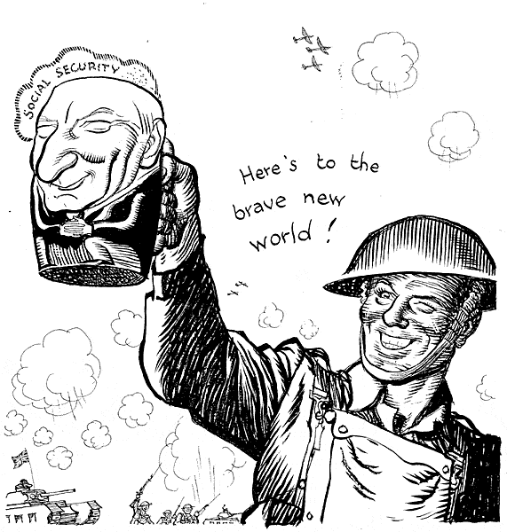
Political & Economic Change
Collective Consensus (after WWII)
Consensus in politics – most Britons and all major political parties agreed that governments should work to:
Narrow gap between rich/poor
Led to creation of a Welfare State
Set of public policies designed to provide for citizens’ needs through provision of pensions, health care, unemployment insurance, & assistance to the poor
Included creation of National Health Service (1948)
State responsibility for economic growth and full employment
Notes:
Collective Consensus
Grows out of British tradition of noblesse oblige
Duty of the upper classes to take responsibility for the welfare of lower classes
Welfare State
Cradle to grave benefits
Full employment = less than 4% unemployment

Slide 11
Political & Economic Change
Discussion Question: Why do you think there was collective consensus on the need for a welfare state after WWII?

Slide 12
Political & Economic Change
Discussion Question: Why do you think there was collective consensus on the need for a welfare state after WWII?
During WWI & WWII, state involvement in the economy increased to direct the war effort, and to help with the Depression between the wars
After WWII: Beveridge Report, need to rebuild, diminishing population, fear of depression, yearnings for a better life
Notes:
Beveridge Report at end of WWII:
Beveridge argued for social progression which required a coherent government policy:
'Social insurance fully developed may provide income security; It is an attack upon Want. But Want is one only of five giants on the road of reconstruction and in some ways the easiest to attack. The others are Disease, Ignorance, Squalor and Idleness (unemployment).‘
The problem of a diminishing population, Beveridge argued, made it 'imperative to give first place in social expenditure to the care of childhood and to the safeguarding of maternity'. Other areas covered were unemployment, disability and retirement

Slide 13
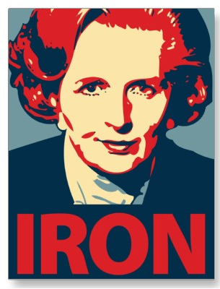
Margaret Thatcher & Neoliberalism
Margaret Thatcher (Conservative Party, PM 1979-90)
Blamed weakened economy on socialist (collectivist) policies
Privatized business and industry
Cut back on social welfare programs
Tough on labor unions
Returned to market force controls on economy
Policies reflect influence of neoliberalism:
Revival of classic liberal values that promote free competition among businesses within the market, including reduced gov’t regulation & social spending
Notes:
Margaret Thatcher
1970’s – beginning of economic stagnation and declining competitiveness of key British industries; strife and class tensions
Thatcher believed collectivism had weakened British industry and permitted powerful, self-serving unions to hold country for ransom
Sought to jump-start economy by cutting taxes, reducing social services where possible, and using government policy to stimulate competitiveness and efficiency in private sector
As Secretary of Education , she eliminated free milk from school lunches (called Milk Snatcher)
TINA: “There is no alternative”
Privatization: British Petroleum; Sugar Refining; British Airways; British Aerospace; Ports; British Telecom; Cable and Wireless Telecommunications; British Leyland; Jet-engine division of Rolls Royce; Long-distance trucking; British Gas; Jaguar and Rover
Never lost a general election (resigned within party when she lost support)
Poll tax: each household charged by the # of residents. The same amount each regardless of rental amount (led to downfall)

Slide 14
Margaret Thatcher
Discussion Question: Is it a contradiction that a member of the Conservative Party followed a policy of neo-liberalism? Explain!

Slide 15
Margaret Thatcher
Discussion Question: Is it a contradiction that a member of the Conservative Party followed a policy of neo-liberalism? Explain!
No because liberalism has a different meaning in the UK (and the rest of the world) than it does in the U.S. Liberalism supports minimal government interference. Our Republican party would be more likely to follow liberal/neo-liberal policies than our Democratic Party!

Slide 16
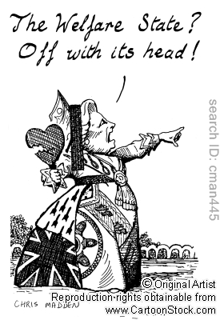
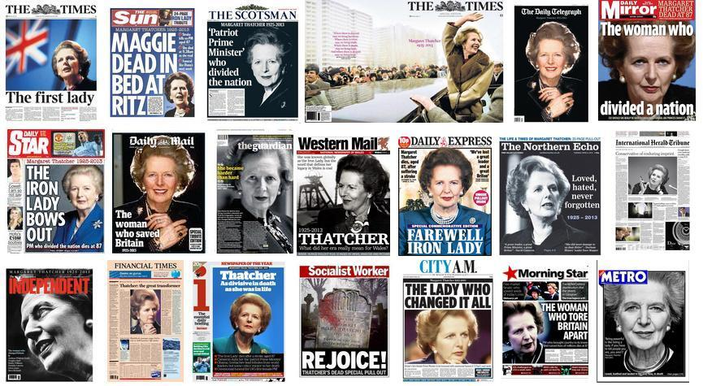
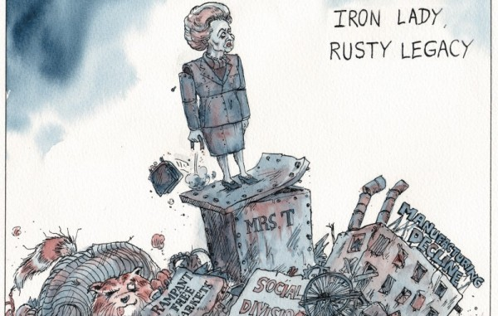
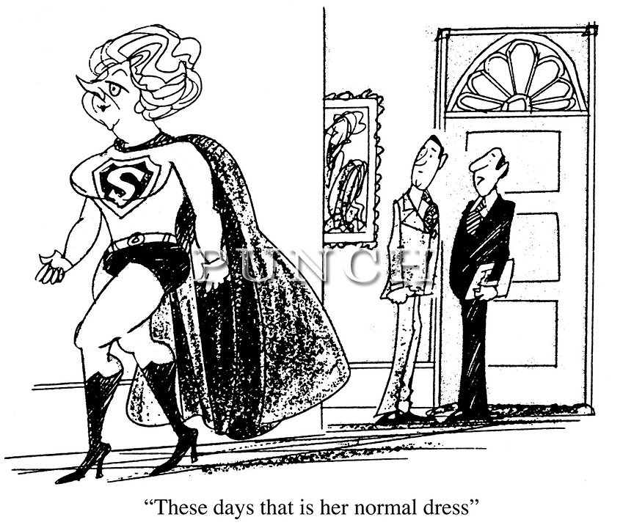
Notes:
What is Margaret Thatcher’s Legacy?

Slide 17
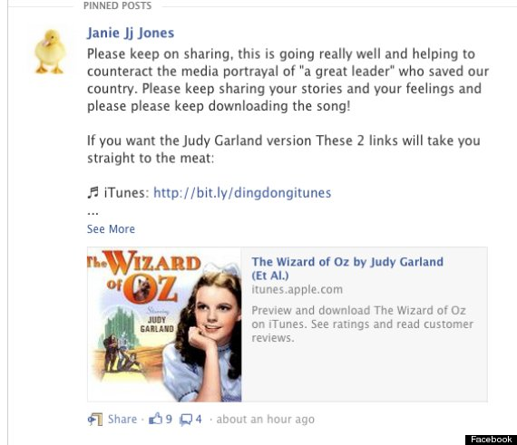
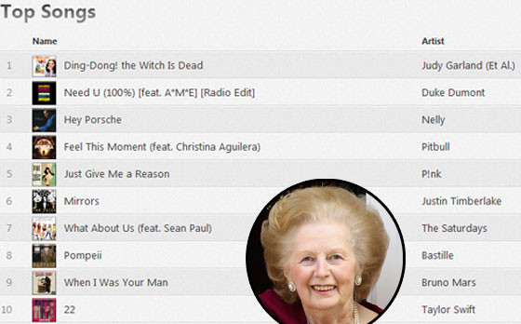

Slide 19
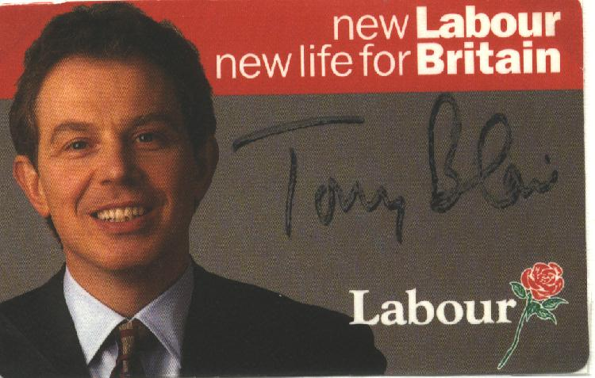
Tony Blair & New Labour
Tony Blair (Labour Party, PM 1997-2007)
“New Labour” and Third Way
Party didn’t change names, just “reinvented”
Rejected historic ties between Labour govt’s and trade unions and emphasized partnerships with business

Slide 20
Tony Blair & New Labour
Reforms:
Devolution to Scotland and Wales
Elected Mayor and council for London
Removal of voting rights of hereditary peers in House of Lords
Incorporates Convention on Human Rights into British law
Eliminates part of Clause IV of party’s constitution which committed party to seek “the common ownership of the means of production, distribution, and exchange”
Freedom of Information Act (passed in 2000)
Electoral Reform – Referendum on AV (failed 2011)
Downfall: Iraq War & seen as George W. Bush’s “puppy”

Slide 21
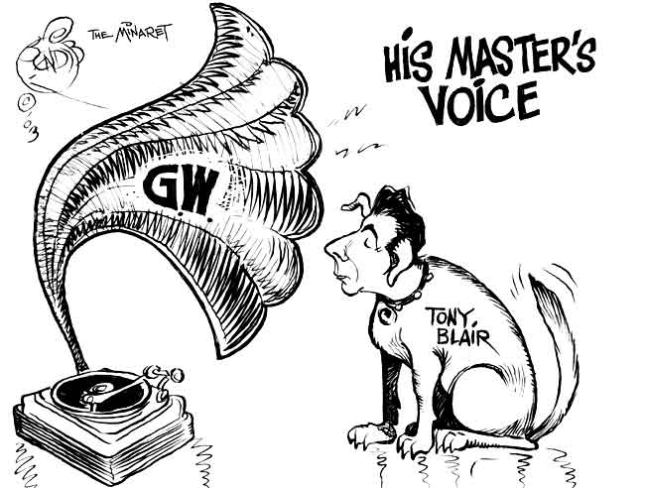
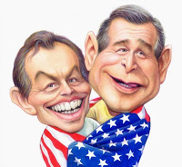

Slide 22
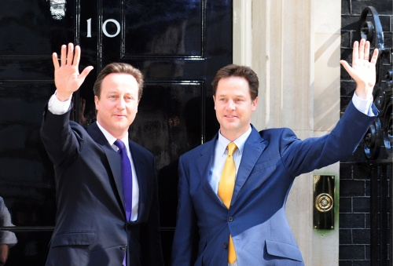
Conservative-Liberal Coalition
David Cameron (Conservative Party, PM 2010- present)
Took party in more mainstream direction
Reached out to youth
2010 Election – Hung Parliament
When no party has a majority of seats in Parliament
Led to Conservative- Liberal Democrat coalition
Nick Clegg (Lib Dem) – Deputy PM
“Big Society”
Wide-ranging initiatives to empower ordinary citizens to take control over their lives
Shift power downward from state to communities/citizens
British History
Condensed
Notes:
David Cameron
promoted agendas including climate change, citizen activism, reduction of gap between rich and poor and reduction of global development gap

