Slide 1
Supreme court case project
Laura Merritt

Slide 2
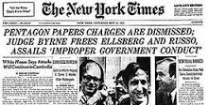
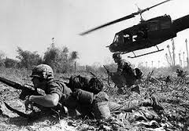
NY times Co v. United States 1971

Slide 3
Who is involved
The New York Times
The United States Court System

Slide 4
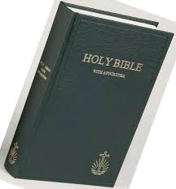
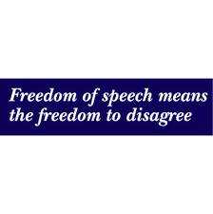
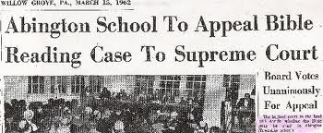
Abington V. Schempp 1963

Slide 5
WHO IS INVOLVED?
School District of Abington
Edward Schempp
Ellory Schempp

Slide 6
What’s the story?

Slide 7
What was the court determining?

Slide 8
Why is the case so important?

Slide 9
What are the potential effectS?

