Slide 1
Supreme Court Case Project
Laura Dodson

Slide 2
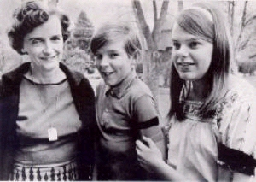
Tinker v. Des Moines
1965
Mary Beth Tinker, John Tinker, Christopher Eckert
Korean War Protest

Slide 3
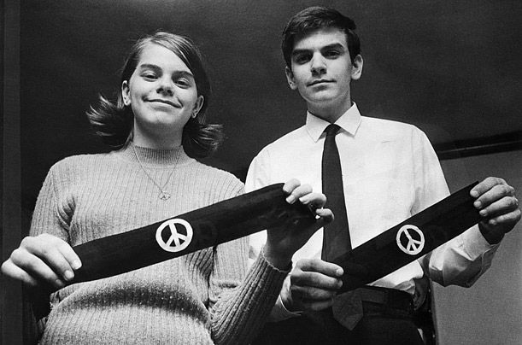
Tinker v. Des Moines
Parents sued school district
U.S. Court of Appeals sided with school

Slide 4
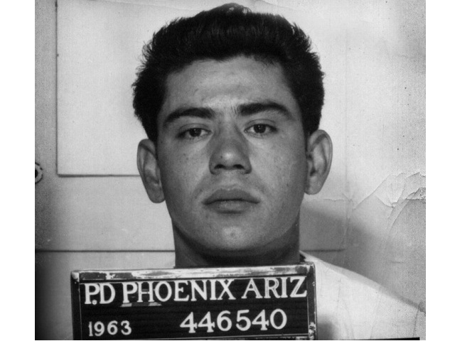
Miranda v. Arizona
1966
Miranda was arrested but not told his rights
Confessed to his crime

Slide 5
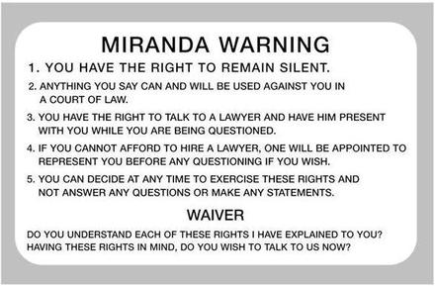
Miranda v. Arizona
U.S. Court of Appeals ruled this as not violating his rights
Miranda Rights are now used every time someone is taken into custody

