Slide 1
Engel v Vitale
Cantwell v Connecticut

Slide 2
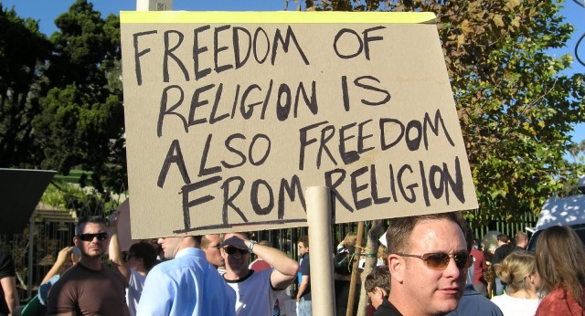
Cantwell v Connecticut

Slide 3
Who is invoved?
Jesse Cantwell and his son
Jehovah's Witnesses

Slide 4
What's the story?
The Cantwells distributed religious materials by traveling door-to-door and approaching people on the street
Arrested for violating a local ordinance requiring a permit for solicitation and for inciting a breach of the peace

Slide 5
How'd they get to the USSC?
Appeal from and Certiorari to the Supreme Court of Errors of Connecticut
Was ruled upon in Connecticut before getting the writ

Slide 6
What was the court determining?
Did the solicitation statute or the "breach of peace" ordinance violate the Cantwell's First Amendment free speech or free exercise rights?

Slide 7
Why is this case important?
Before this case, it was not legally clear that the First Amendment protected religious practitioners against restrictions at the state and local levels, as well as federal
Began an era of greatly strengthened religious freedom

Slide 8
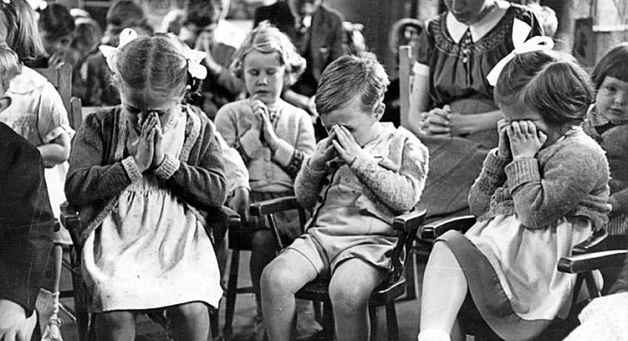
Engel v Vitale

Slide 9
Who is invoked?
A school in New York

Slide 10
What's the story?
The Board of Regents for New York authorized a short, voluntary prayer for recitation at the start of each school day
The prayer read: "Almighty God, we acknowledge our dependence upon Thee, and beg Thy blessings upon us, our teachers, and our country."

Slide 11
What's the court determining?
Does the reading of a nondenominational prayer at the start of the school day violate the "establishment of religion" clause of the First Amendment?

Slide 12
How'd the get to the USSC?
Certiorari to the Court of Appeals of New York

Slide 13
Why is this case so important?
This was the first case which effectively prohibited the government from sponsoring or endorsing officials prayers in school.

