Slide 1
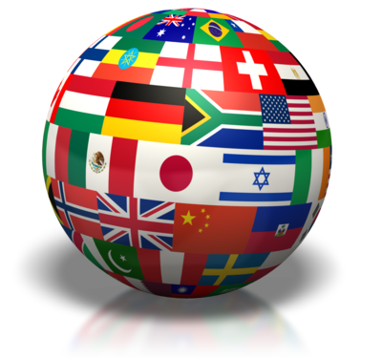
Part One: Intro to Comparative Politics
“Without comparisons to make, the mind does not know how to proceed.” – Alex de Tocqueville
“A man who has tasted only his mother’s soup has no basis to claim that hers is the best.” – African Proverb

Slide 2

What is Comparative Government & Politics?
Government = leadership & institutions that make policy
Politics = power to make decisions
  Formal & informal
  How is power gained & maintained?
Comparative Politics Definition:
Field within political science that focuses on domestic politics (internal) and analyzes patterns of similarity and difference

Slide 3
Conflict
Foreign Policy
International Organizations
Elections
Party Systems
Executive-Legislative Relations
Interest Groups
Legislatures
International Relations vs Comparative Politics
Revolution
Political
Economy
Environmental
Politics
International Relations
(Between Countries)
Comparative Politics
(Within Countries)
Notes:
Note the overlap. These two fields of study are increasingly overlapping because of globalization. Courses on international relations now often integrate a concern with how internal political processes affect states’ behavior toward other states, while course in comparative politics highlight the importance of transnational forces for understanding what goes on within a country’s border.

Slide 4
Comparative
Politics
Study of political systems around the world
Investigates governmental institutions
Investigates formal and informal political arrangements and attitudes that support governmental institutions
Why are some countries prosperous and others are not?
Why do different types of governments predominate in certain regions and not others?
Why and how are certain individuals or groups able to exercise influence over public policy?
What explains political behavior?
Who rules?
Where and why do particular types of political behavior occur?
Notes:
Zagorski

Slide 5
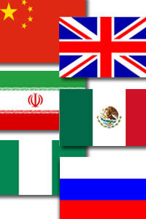
What Are We Comparing?
Concepts
Countries and their institutions, policies, and events
The AP 6:
  UK (or Britain)
    Not “England”
  Russia
  China
  Mexico
  Iran
  Nigeria
Notes:
What are institutions? Examples?

Slide 6
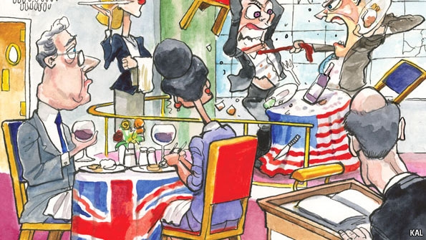
Why Compare?
Understand why nations react the same/differently to the same/similar events
Put concepts, situations in context
Evaluate
Develop generalizations
Test theories

Slide 7
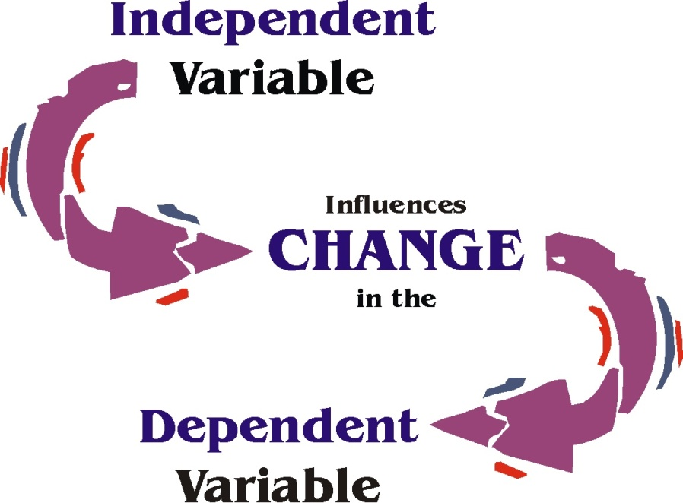
The Comparative Method
Ways to Compare
  Empirical Data – facts, numbers, statistics
  Normative Issues – based on value judgments
Use of the Scientific Method
  Hypothesis
  Independent variable vs. Dependent Variable
  Correlation vs. Causation
Notes:
Hypothesis: speculative statement about relationship between two or more variables
Independent variable: influences the dependent variable
Dependent variable: variable that is measured; depends on action of independent variable
Correlation: exists when a change in one variable accompanies a change in another
Causation – the idea that one variable (the independent variable) causes another (the dependent variable)

Slide 8
The Comparative Method
Example: Why are poverty rates higher in one country than in others?
Hypothesis: Poverty level might be caused by low levels of formal education.
  Independent variable?
  Dependent variable?
  Positive or inverse correlation?
Notes:
Independent variable = level of education
Dependent variable = poverty level
Inverse – as levels of education increase, poverty level declines

Slide 9
Sample Multiple Choice Question
Which of the following is an example of an inverse (negative) correlation?
  A. The amount of violence present in world politics is greatest when there are four states of relatively equal power.
  B. The frequency with which people vote is unrelated to religion.
  C. The higher the level of education in a state, the greater the likelihood of people voting.
  D. The lower a state’s gross domestic product, the less it spends on education.
  E. The greater a state’s socioeconomic development, the less likely it is that there will be internal political violence.
Notes:
Independent variable = level of education
Dependent variable = poverty level
Inverse – as levels of education increase, poverty level declines

Slide 10
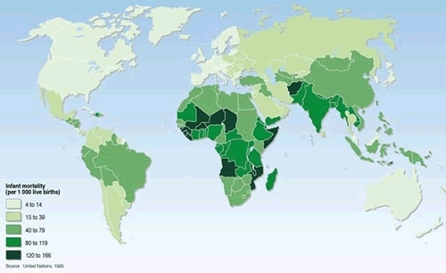
Notes:
Infant Mortality Rate per country

Slide 11
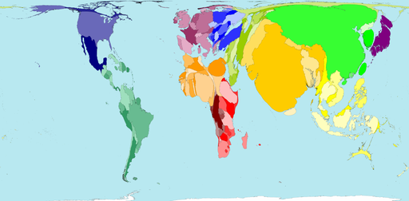
Notes:
World population by proportion to world (Worldmapper)

Slide 12
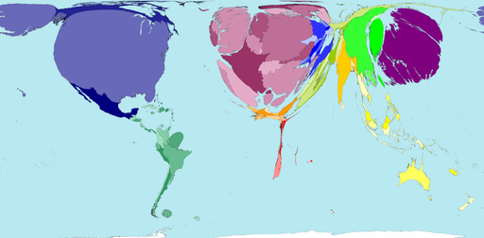
Notes:
Number of Freight Trucks

Slide 13
Comparative Approaches
Various terms are used to compare countries
Old Approach: Three Worlds
  1 – United States and its allies
  2 - Soviet Union and its allies
    Soviet Union collapsed in 1991, Russia maintains many relationships
  3 - Third world nations
    Economically deprived and underdeveloped
Newer Approaches
  Democracy vs. authoritarianism (political)
  Communism vs. capitalism (economic)
Notes:
Three World Approach – used until early 1990’s – based on Cold War politics

Slide 14
Comparative Approaches
New approaches must also take into account:
  Role of informal politics
  Importance of political change
  Integration of political and economic systems
Our Approach: Countries fall into one of 3 groups:
  “Advanced” democracies
    UK and U.S.
  Communist and post-communist countries
    China and Russia
  Less developed and newly industrializing
    Newly industrializing – Mexico and Iran(?)
    Less developed - Nigeria
Notes:
Role of informal politics – gain a deeper understanding of political systems if you connect civil society (way that citizens organize/define themselves and their interests) to the ways that formal government operates.
Informal politics takes into consideration not only the ways that politicians operate outside their formal powers, but also the impact that beliefs, values and actions of ordinary citizens have on policy-making.
Political Change – world no longer dominated by two superpowers
Integration of political and economic systems – cannot be truly separated. Attitudes/behaviors of citizens are affected in many ways by ec inefficiency, ec inequality, & ec decision-making. They may turn to gov’t for solutions and gov’t must respond
Advanced Democracies – have well established democratic govts and a high level of economic development
Communist/Post-Communist – These countries have sought to create a system that limits individual freedoms in order to divide wealth more equally. Communism flourished during 20th century, but lost ground to dem. Regimes by beginning of 21st century.
Newly Industrializing – experiencing rapid economic growth and have shown a tendency toward democratization and political and social stability. Note: Iran has many characteristics that make it difficult to categorize in this scheme
Less Developed – lack significant ec development, then to have authoritarian governments, although Nigeria has shown some signs of democratization in recent yrs.

Slide 15
Possible FRQ’s
Explain the importance of studying comparative politics.
Describe some ways political scientists typically classify countries.
Describe why institutions are important when studying comparative politics.

Slide 16
Part Two: Sovereignty, Authority & Power
“Sovereignty is not given, it is taken.” -- Kemal Ataturk (Turkish soldier)
“I have as much authority as the Pope, I just don't have as many people who believe it.” -- George Carlin (comedian)

Slide 17
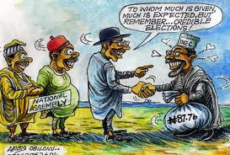
Sovereignty, Authority & Power
Power
  Party A’s ability to get Party B to do something it may not do otherwise
Authority
  Legal right to use power
Sovereignty
  Legal right and ability (power) of a state to carry out actions & policies within its territory
Notes:
Power:
Coercion/force, persuasion, incentives
Sovereignty:
Can be challenged internally or externally
External: not overly dependent on resources or decisions of another power
Internal: sole authority within a territory capable of making and enforcing laws and policies

Slide 18
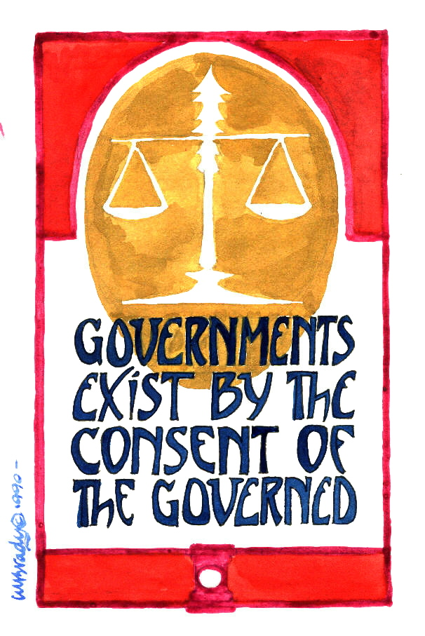
Concept of Legitimacy
Right to rule, as determined by citizens
Traditional
  Tradition determines who should rule and how
Charismatic
  Dynamic personality of a leader
Rational-legal
  Based on well-established laws and procedures
    Common law
    Code law
Notes:
Legitimate Governments
People accept the authority of leaders
Other countries recognize the regime’s right to rule
Authoritarian Governments generally ARE legitimate
Essentially, it confers authority and power based not on coercion, but on consent.
Traditional Legitimacy
Rests on the idea that someone or something is valid because “it has always been that way.”
The longer a traditional legitimacy has been in place, the more institutionalized it becomes and, thus, carries the weight of history on its side
A specific family for example
Most monarchies based on this concept
Charismatic Legitimacy
Is based on the power of ideas and is typically embodied by one individual
Rational-Legal Legitimacy
Is based on a system of laws and procedures that are highly institutionalized
People abide by the decisions in this system because they believe rulers serve the public’s best interest
Modern western nations are built on the rational legal foundation
Common Law: based on tradition, past practices, and legal precedents (Britain)
Code Law: based on written rules/codes of law (China, Mexico, Russia)

Slide 19
Legitimacy: Other Sources
Other factors that encourage legitimacy:
  Economic Well-Being
  Nationalism
  Shared Political Culture/Ideology
  Shared Religion
  Satisfaction with government’s performance/responsiveness

Slide 20
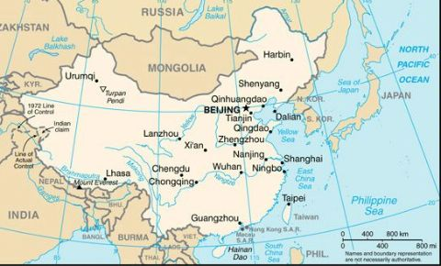
States, Nations, and Regimes
State – political system that has sovereignty (political power) exercised over a population in a defined geographic territory through a set of public institutions
  Institutions such as executives, legislatures, judiciaries, bureaucracies
  Establish and maintain armed forces
Notes:
State
= population + defined territory + governing institutions + sovereignty + international recognition
Can maintain armed forces – use violence if necessary
Political institution:
set of rules, norms, or standard operating procedures that is widely recognized and accepted by the society and that structures and constrains political actions
In order to carry out public policies, government structures such as parliaments, bureaucracies, and administrative agencies perform functions, which in turn enable the government to formulate, implement, and enforce policies
formal and informal rules that structure the relationship among individuals
Institutions are stable and long-lasting (even when leaders change)

Slide 21
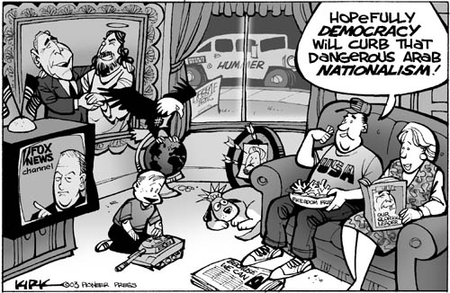
States, Nations, and Regimes
Nations
  Human community with shared history, culture and/or political identity
  Nationalism = common political identity
  Often share common ethnic identity
  Multinational states: consist of a multitude of different nations.
  Example: The Soviet Union, Yugoslavia, and Czechoslovakia were multinational states that have now broken apart.
Notes:
Nations:
Nations larger than states: Germans found in Austria, Switzerland, Netherlands
Nations divided in two: Korea
Nations without states: Basques, Jews in past, Palestinians
Nationalism
pursuit of a set of rights for a nation, including the right of political control over a certain territory
Nation-state:
state boundaries AND nation identity coincide

Slide 22
States, Nations, and Regimes
Regimes
  Political system of a state
  Rules that states set and follows in exerting power over time
  Endure beyond individual governments or leaders
Government
  The group of people and organizations that hold political authority in a state at any one time
Metaphor
  “The state is the machinery of politics and the regime is its programming, the government is the operator."
Notes:
Government is the leadership or elite in charge of running the state

Slide 23
The Diversity of States
Since WWII 125 new countries have join the 68 states that existed in 1945.
  Largest group of new states is in Sub-Saharan Africa
  More than 20 new countries formed in the 1990s
    Mostly the successor states of the Soviet Union, Yugoslavia, and Czechoslovakia
These states share many characteristics, but they also vary in many ways that shape their politics.

Slide 24
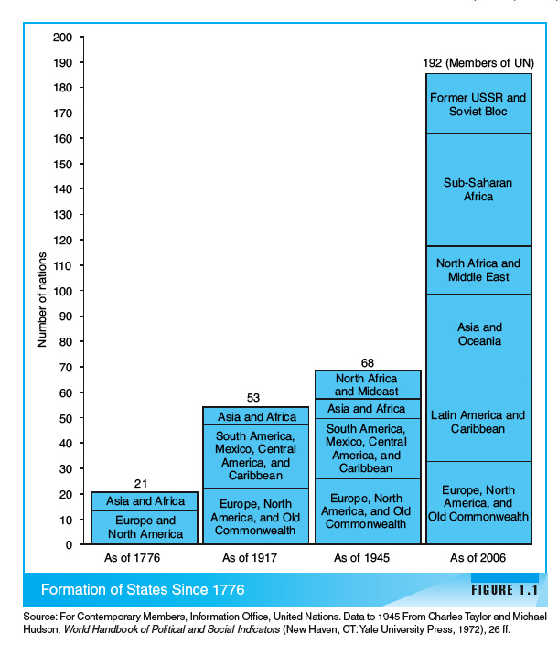

Slide 25
The Diversity of States
Big and small states
  Vatican City - smallest legally independent entity in geographic size and population
  Russia - largest landmass
  China and India - largest populations
Political implications of geographic and population size?
  Big countries not always most important
  Small ones can be: Cuba, Israel, Vatican City, Iraq
Area and population do not determine a country’s political system.
Geographic location can have strategic implications.

Slide 26
The Diversity of States
All states face common challenges:
  Building community
  Fostering economic and social development
  Advancing democracy and civil liberties

Slide 27
Building Community
Absence of common identity can have severe political consequences.
  Conflict over national, ethnic, or religious identities can cause political turmoil.
Easier for some nations; not for others
  Japan: ethnically homogenous, common language and a long national political history
  Nigeria: accidental and artificial creation of British colonial rule and has no common pre-colonial history; sharply divided on religion; 250 different ethnic groups

Slide 28
Nationality and Ethnicity
There is a fine line between nations and ethnic groups.
Ethnicity need not have any objective basis in genetics, culture, or history.
Ethnic differences can be a source of political conflict.
  Former Soviet bloc
  Former Yugoslavia
In many developing countries, boundaries cut across ethnic lines.
  Former colonies: Britain withdrew from India and divided the subcontinent into a northern Muslim area - Pakistan - and a southern Hindu area - India.
    Consequence: terrible civil conflict and “ethno-religious” cleansing
  Nigeria
  Rwanda
Traits related to political significant “ethnicity”
  Physical differences, language, norms against intermarriage, religion, and negative historical memories.
Multiethnic countries

Slide 29
Language
Language and social division
  5,000 different languages in use in the world today
  Only 200 languages have a million or more speakers
  Only 8 classified as world languages
  English is the most truly international language.
    380 million people speak English at home
    1.8 billion live in countries where English is one of the official languages
  Other international languages: Spanish; Arabic; Russian; Portuguese; French; and German
Political systems cannot avoid committing themselves to one or several languages.
  Conflicts over educational policies or language use in government
    Quebec

Slide 30
Religious Differences and Fundamentalism
States vary in their religious characteristics.
  Religion may be a basis of national identity for a majority of the population: Israel, the Irish Republic, and Pakistan
  Iran is a theocratic regime.
    Religious authorities govern
    Religious law is part of the country’s legal code
  Religion can be a rallying point for political movements.
    Poland
Christianity is the largest and most widely spread religion.
  Roman Catholics, Protestants, and Orthodox
Muslims are the second largest religion group and the most rapidly growing.
Can be a source of intense antagonism
  Religious “fundamentalism”

Slide 31
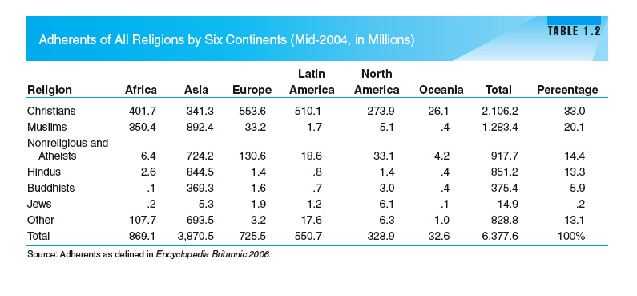

Slide 32
Fostering Economic Development
Two major forces transforming political systems and nations
  Process of economic development
  Political democratization
A political system cannot satisfy its citizens if it does not foster these social and economic development.
Living standards
  Globalization, democratization, and marketization
  HDI- Human Development Index
Structure of the labor force
  Agriculture
  Urbanization
Wide gap in living standards still exists across nations of the world.
Productivity requires resources to develop a skilled and healthy labor force and an infrastructure that supports material welfare.

Slide 33
Problems of Economic Development
The unequal distribution of resources and opportunities are among the most serious causes of political conflict.
  Large GNP may conceal significant differences in distribution of these resources.
  Country’s politics affected by internal divisions of income, wealth, etc.
    Some countries work to limit these divisions: India
    Economic inequality in America is as great as several poor nations, such as China and Egypt.
  First stages of industrialization may actually increase income inequality even though economic development may narrow the differences eventually, but that is not guaranteed.

Slide 34
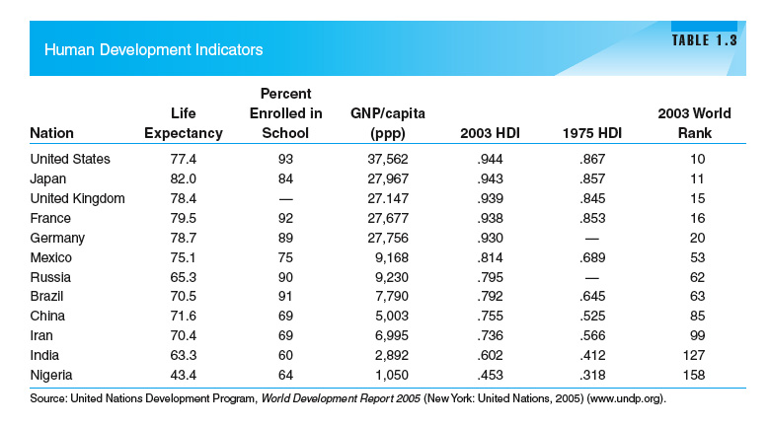

Slide 35
Problems of Economic Development
Another correlate of development is population growth.
  Generally population growth occurs when positive things, like health care improvement, increased living standards, occur.
  Rapid population growth, however, can pose policy challenges for many developing nations.
  Fertility rates
  Coercive policies: China
Economic growth can also create environmental costs.
  Despoiled forests, depleted soils and fisheries, polluted air and water, nuclear waste, endangered species, and ozone questions.
  Shortages of clean water, air, and adequate sanitation.

Slide 36
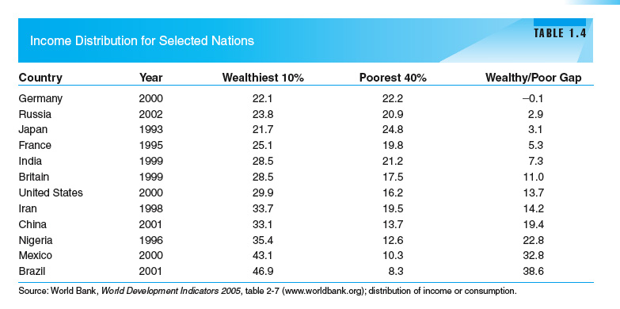

Slide 37
Fostering Democracy, Human Rights, and Civil Liberties
Democratization is the second major force transforming contemporary political systems.
  Includes the enhancement of human rights and the expansion of freedom.

Slide 38
Fostering Democracy, Human Rights, and Civil Liberties
The most important general distinction in classifying political systems:
  Democratic systems versus authoritarian systems
  Authoritarian: lack one or several of the defining features of democracy
    Oligarchy
    Totalitarian
  Waves of Democratization
    First: during the first half of the 20th century: Western states
    Second: 1943 to 1960s: newly independent states and defeated authoritarian powers
    Third: 1974 involving Southern Europe, East Asia, Latin America, and a number of African states.
    Result: democracy more of a common goal of the global community

Slide 39
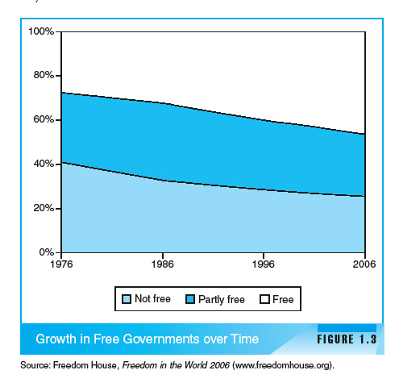

Slide 40
Types of Regimes - Democracy
What is Democracy?
The word democracy means many different things to many different people. For many, “democratic” means good things and “nondemocratic” means bad.
Basic Definition: political power exercised either directly or indirectly through participation, competition, and liberty.
BUT even political theorists can’t agree on exact definition…more of a spectrum.

Slide 41
Types of Regimes - Democracy
Various Textbook Definitions:
(Almond) - a political system in which citizens enjoy a number of basic civil and political rights, and in which their most important political leaders are elected in free and fair elections and accountable under a rule of law.
(Barrington) A regime type that involves the selection of government officials through free and fair elections, a balance between the principle of majority rule and the protection of minority interests, and constitutional limitations on government actions.
Notes:
There is no guarantee that democracies will grant human rights and civil liberties to all people. Democracies are supposed to find a balance between respecting the will of the majority and protecting the rights of the minority.

Slide 42
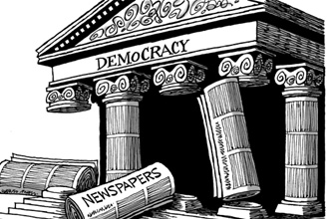
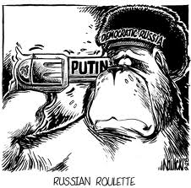
Types of Regimes – Democracy (Liberal vs Illiberal)
    Liberal (substantive) Democracies typically include:
      Competitive Elections
      Civil liberties
      Rule of law
      Neutrality of the judiciary
      Open civil society
      Civilian control of the military
    Illiberal or Procedural Democracies
      Appear like other established democracies (elections) but do not have many of the features listed above
Notes:
A liberal democracy is the term used by many political scientists to imply a system that promotes participation, competition, and liberty.
Competitive elections: regular, free, and fair
These types of democracies are rooted in the idea of liberalism, with an emphasis in individual rights and freedom.
Participation is central to a liberal democracy. The most basic way to participate is through voting and elections. Through these, the public is given the opportunity to have control over public officials and their policies.
In a liberal democracy, suffrage (the right to vote) must be available to all adult citizens with few restrictions.
Rule of Law
"For the United Nations, the rule of law refers to a principle of governance in which all persons, institutions and entities, public and private, including the State itself, are accountable to laws that are publicly promulgated, equally enforced and independently adjudicated, and which are consistent with international human rights norms and standards. It requires, as well, measures to ensure adherence to the principles of supremacy of law, equality before the law, accountability to the law, fairness in the application of the law, separation of powers, participation in decision-making, legal certainty, avoidance of arbitrariness and procedural and legal transparency."
Illiberal Democracy: a governing system in which, although elections take place, citizens are cut off from knowledge about the activities of those who exercise real power because of the lack of civil liberties. It is not an 'open society'.

Slide 43
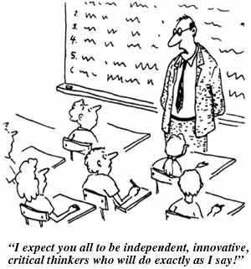
Types of Regimes - Authoritarian
Authoritarianism is a political regime where a small group of individuals exercises power over the state without being constitutionally responsible to the public.
Examples?
Notes:
Examples?
Single dictator, hereditary monarch, small group of aristocrats, or single political party

Slide 44
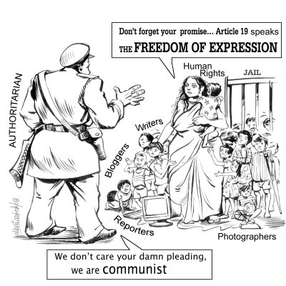
Types of Regimes:
Authoritarian
Authoritarian Characteristics:
Elites who hold political power make decisions
Some based on Communism
Some based on Corporatism
  Gov’t officials interact with people/groups outside gov’t before they set policy
  Patron-Client Systems – Favors and services to their supporters
Economy is tightly controlled by the political elite
Citizens have little to no input on selection of leaders
Restriction of civil liberties very common
Notes:
Communist party controls gov’t, economy, social life

Slide 45
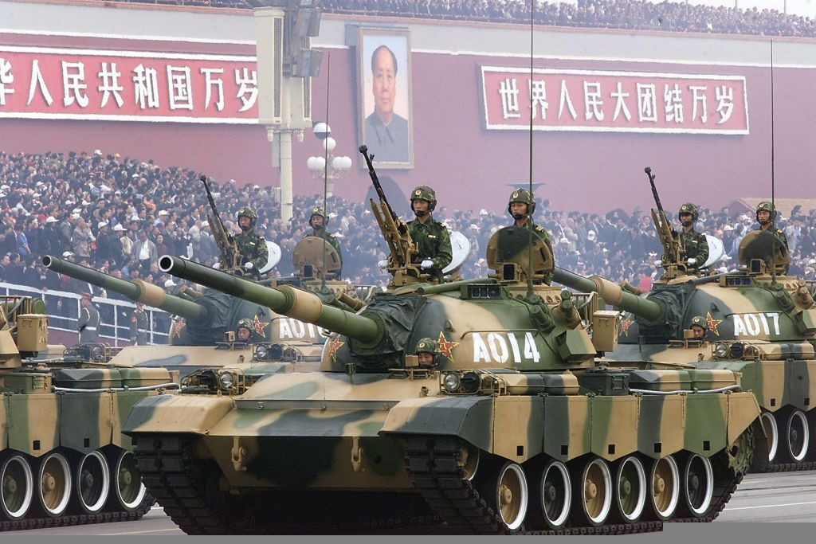
Totalitarian Regimes
Totalitarianism is a highly centralized regime that possesses some form of strong ideology that seeks to transform and absorb aspects of the state, society, and the economy.
Much more negative connotation than authoritarian
Very repressive
Use violence/terror
Examples?
Notes:
Examples: Hitler's Nazi's rule Germany, Stalin's Soviet Russia, and Mussolini's Italy, are all cases of totalitarian governments. Modern day example - North Korea

Slide 46
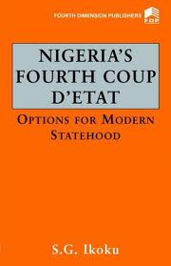
Military Regimes
Military rule
  Nondemocratic
  Prevalent in Latin America, Africa and parts of Asia
  Usually begins with a coup d’etat
  Examples?
Notes:
Military Rule
Increasingly, more common in states that are struggling with legitimacy and stability and in those where there is a high level of public unrest or violence
The military sees itself as the only organized force able to ensure stability
Coup D’etat
Coup may or may not have widespread support among the people
Once they take control, leaders often restrict civil rights and keep political parties from forming
Usually lack a specific ideology or source of authority

Slide 47
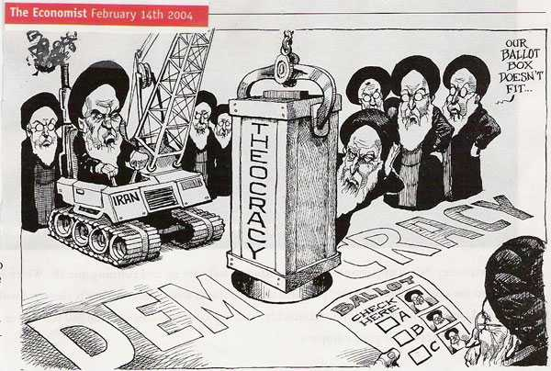
Theocracy
Theocracy: a political system in which religious leaders control political decisions and religious law provides the basis for policy decisions.
Examples?

Slide 48
Review
Which of the following is NOT an essential ingredient for a liberal democracy?
A. Open civil society
B. Proportional Representation
C. Neutrality of the judiciary
D. Rule of Law
E. Civil Liberties
Notes:
Answer: B

Slide 49
Review
Frequent coups d’etat are most often associated with regimes that are
A. Totalitarian
B. Parliamentarian
C. Presidential
D. Corporatist
E. Under military rule
Notes:
Answer: E

Slide 50
Review
Countries that have democratic procedures in place but have significant restrictions on them are referred to as
A. Totalitarian regimes
B. Authoritarian regimes
C. Substantive democracies
D. Illiberal democracies
E. Liberal democracies
Notes:
Answer: D

Slide 51
Discussion Questions
1. Can you think of any historical examples where the government of the United States has had high legitimacy? Low legitimacy?
2. List two examples of traditional legitimacy and explain why you chose this example.
3. List two examples of charismatic legitimacy and explain why you chose this example.
4. List two examples of rational-legal legitimacy and explain why you chose this example.
5. What is one recent example in our nation where rational-legal legitimacy prevailed despite the protests of many?

