Slide 1
Health Insurance
Economics
2015

Slide 2
What is Insurance?
Insurance is defined as a means of protecting against risk.
Risk is a state in which multiple outcomes are possible and the likelihood of each possible outcome is known or can be estimated.

Slide 3
What is health care?
Definition: The prevention, treatment, and management of illness and the preservation of mental and physical well-being through the services offered by the medical and allied health professions.

Slide 4
What is Health Economics?
Health economics is the study of how (scarce) resources are allocated to and within the health economy.
Production of health care (doctors, specialists, or nurses).
How do we distribute health care across the population?
How much money should the government spend on health care?

Slide 5
US Health Care System
Traditionally
Based on free-market system
Run by private insurance companies

Slide 6
US Health Care System
Health insurance is provided by many separate entities
Most are run by private sector
Anthem
Optima
Cigna
Some programs provided by government
Medicare (federal)
Medicaid (state)
Children’s Health Insurance Program (federal)
Veteran’s Health Administration (federal)

Slide 7
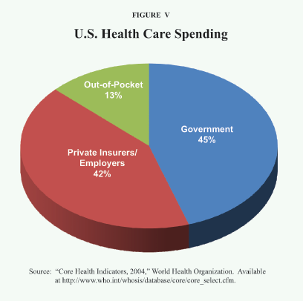

Slide 8
Basic Health Care Info
Medicare
covers citizens and long-term residents 65 years and older and the disabled
administered by federal govt
Medicaid
covers low income people in certain categories, including children, pregnant women, and the disabled
administered by the states

Slide 9
Basic Health Care Jargon
Health Maintenance Organization (HMO) – means you pick your doctor and go to him/her for everything
Preferred Provider Organization (PPO) – means you can go to any doctor, any time
Health Savings Account (HSA) – in addition to your health insurance you can also deposit money into a non-taxable account to use specifically for medical expenses

Slide 10
Basic Health Care Jargon
Premium: how much you pay each month
Co-pay: what you pay when you get to the doctor’s office (insurance takes care of rest depending on visit and health care plan)

Slide 11
Basic Health Care Jargon
Deductible: The amount you owe for health care services your health insurance or plan covers before your health insurance or plan begins to pay.
For example, if your deductible is $1,000, your plan won’t pay anything until you’ve met your $1,000 deductible for covered health care services subject to the deductible. The deductible may not apply to all services.

Slide 12
US Health Care System
You pay insurance company (monthly, bi-weekly)
Insurance company pays doctor

Slide 13
Sample Health Care Premiums

Slide 14
US Health Care System
About 85 percent of Americans have health insurance either through…
Their employer or spouses (59.3%) – usually the company pays for it, or employee pays a percentage
Individual plans (8.9%) – pay per month, 6 month, or yearly period (price depends on age and pre-existing conditions)
Federal government (27.8%) – covered if you fit into a specific category (elderly, veteran, etc.)

Slide 15
US Health Care System
15 percent of Americans have no health insurance at all
Why?
Work for small businesses who can’t afford to provide benefits (or can provide benefits but would have to pay employees less)
Do not apply for short term or basic coverage
Choose not to pay for it
Can’t afford it

Slide 16
US Health Care System
About 60 percent of American debt comes from health bills
Why is it so expensive?

Slide 17
US Health Care System
Why is it so expensive?
Medical advances (equipment, medicine) are expensive
People don’t pay, so rates for everyone else go up
End of life costs
US is VERY unhealthy comparatively (obesity, diabetes, chronic illnesses)
Lifestyle choices - addiction

Slide 18
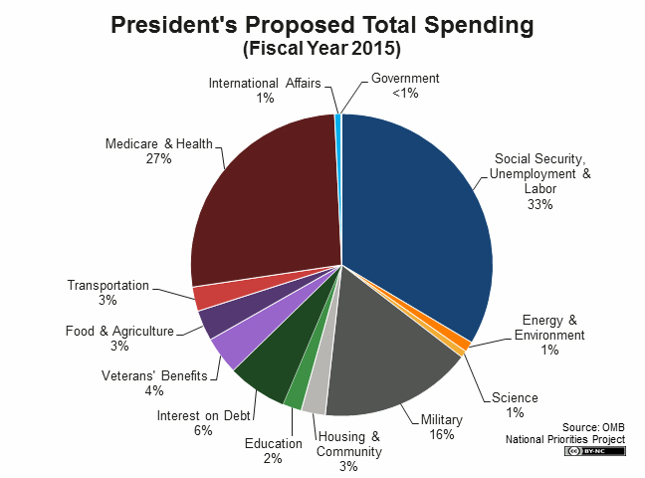

Slide 19
Comparatively
The US far outspends the rest of the world in health care
That said…
US ranks 57th for infant mortality rate
US ranks 43rd for life expectancy at birth

