Slide 1
Festival Poster Project
Graphic Design
Mrs. Lacks

Slide 2
Task
Create a poster for a music festival. You may use any genre and any collection of bands/musicians within that genre – dead or alive.
Use elements and principles of design to create mood/emotion and to inform and attract an audience

Slide 3
Requirements
1 8.5 X 11 Poster
Design on a grid
At least three colors (consider meaning)
At least two typefaces
Information: time, place, ticket information, performances (at least 3 bands/musicians)
You may work individually, or with one other person.

Slide 4
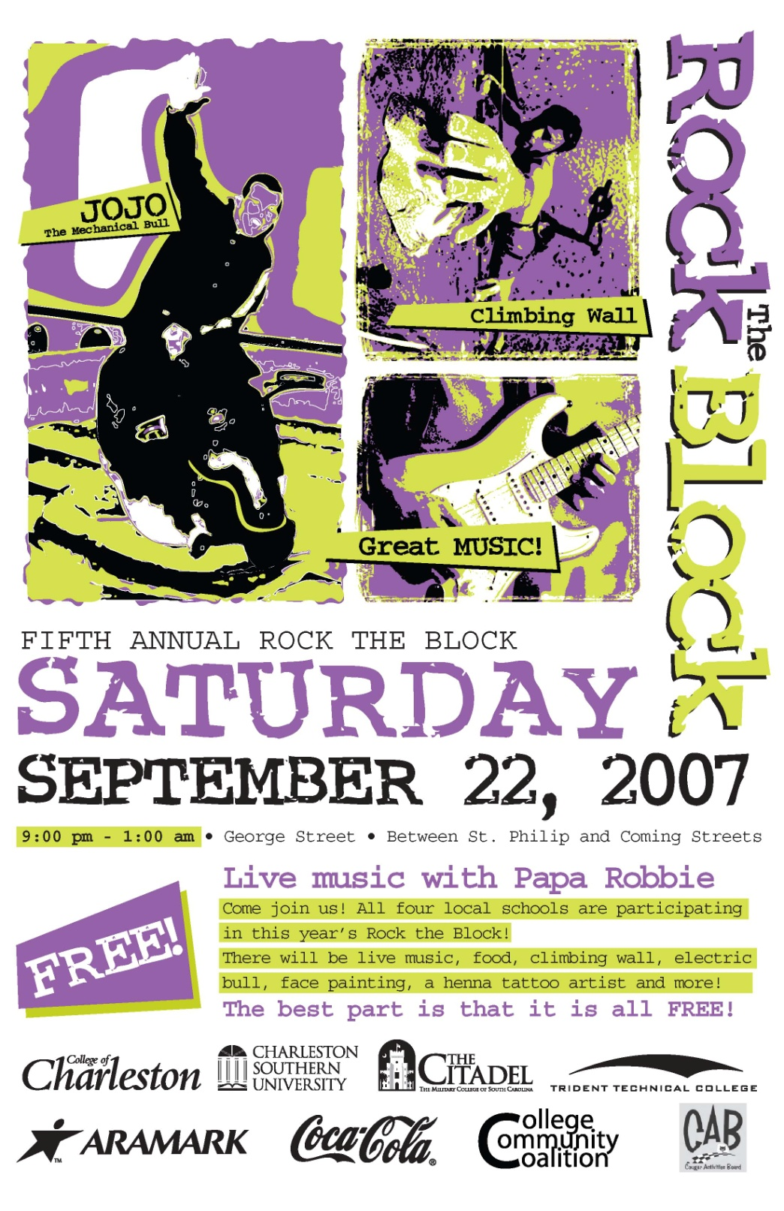
Unity or Chaos?

Slide 5
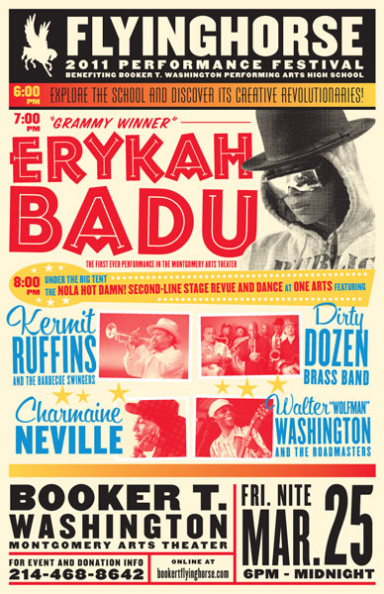
Unity or Chaos?

Slide 6
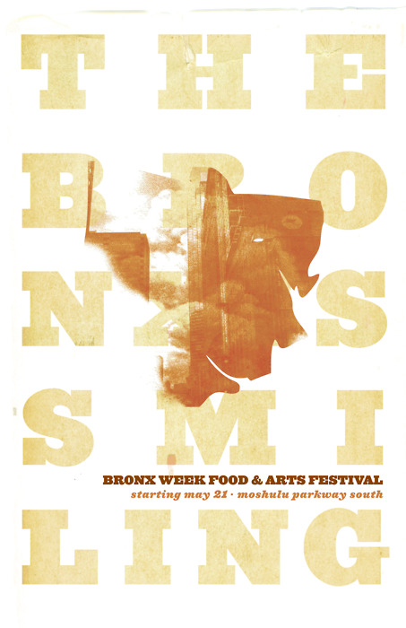
Simple or adequate?

Slide 7
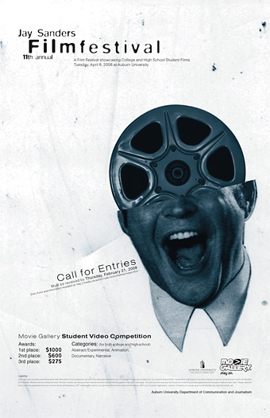
Emotion?

Slide 8
Emotion?

Slide 9
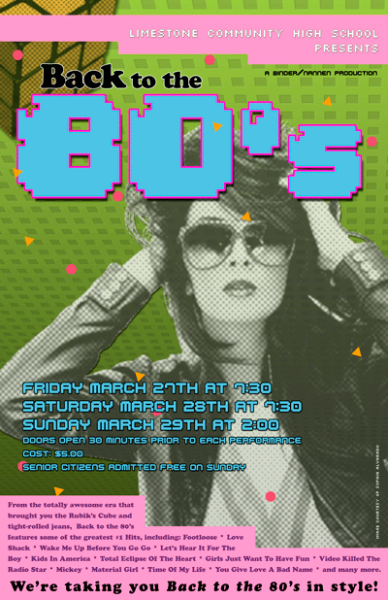
Genre?
Does the poster tell you without the text?

Slide 10
Examples/Inspiration

Slide 11
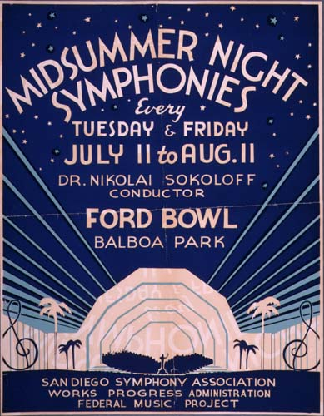

Slide 12
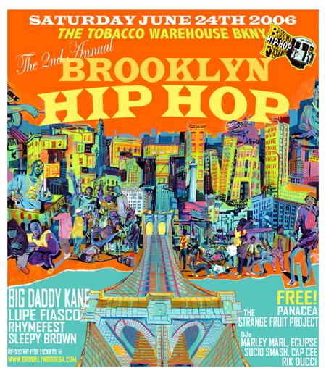

Slide 14
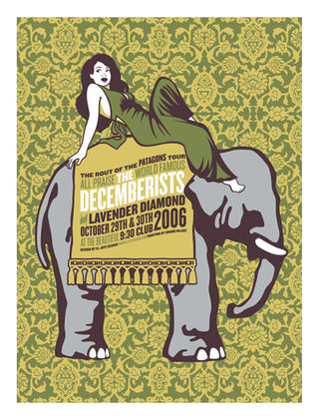

Slide 16
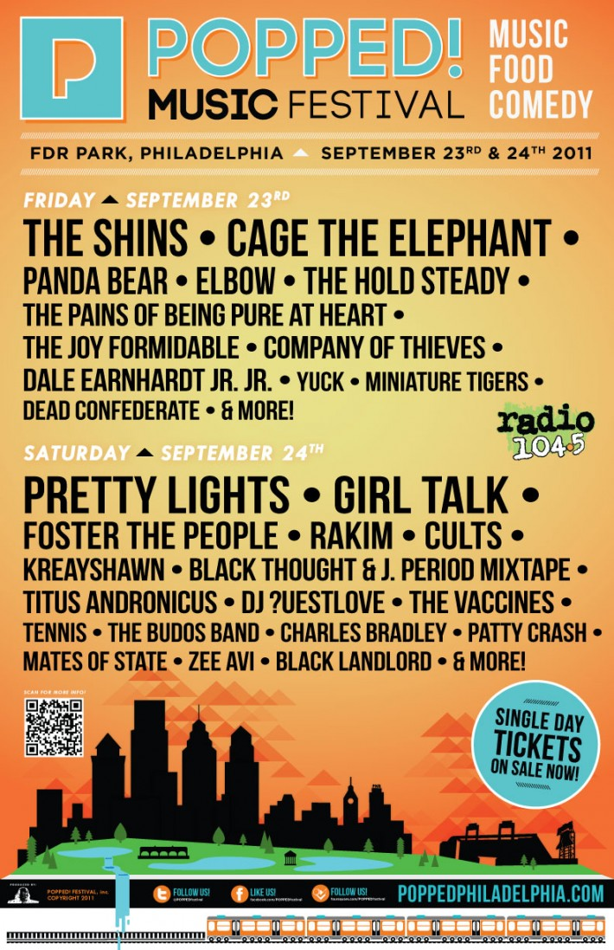

Slide 17
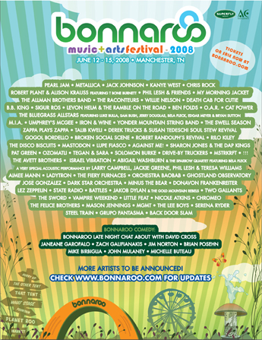

Slide 18
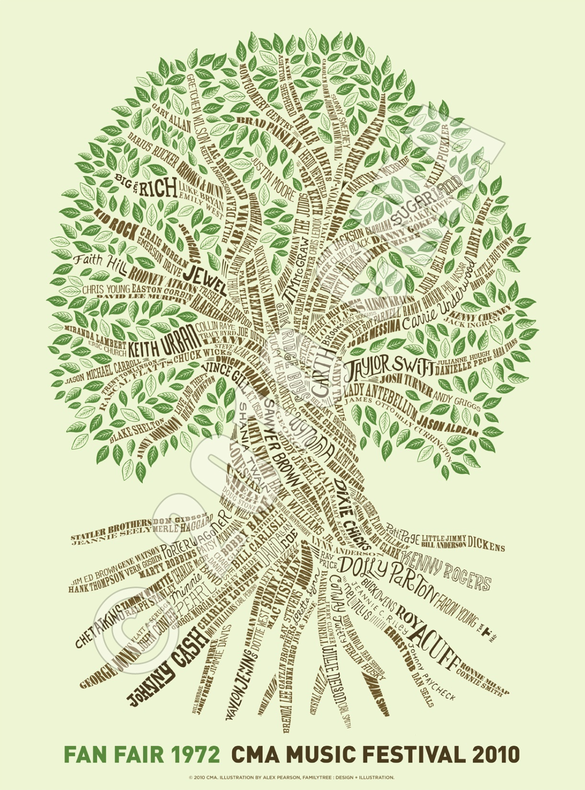

Slide 19
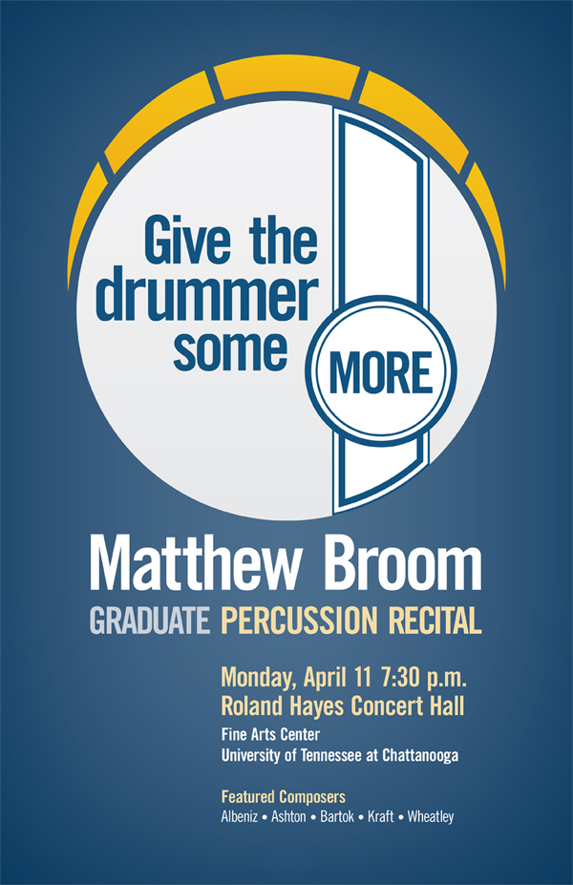

Slide 20
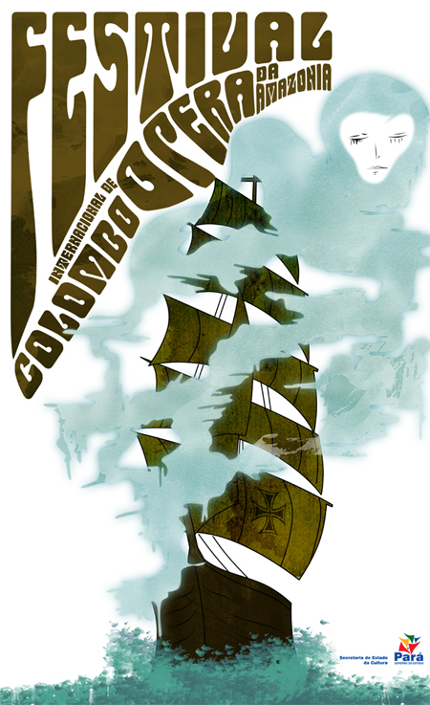

Slide 21
