Slide 1
European Exploration of the Americas
US History

Slide 2
1492
Columbus’ first of four voyages
Seeking economic gain (gold and other riches)
Killed, enslaved Natives in Caribbean
Initiated exchange of goods between Europe, North America, and later Africa
Later called the Columbian Exchange
Included slave trade (started with Natives sent to Spain)
Included food, animals
Exaggerated stories of riches inspired further exploration
Led to the deaths of 90% of Native Americans within 100 years (killed or died of disease)

Slide 3
Spanish Discoverers
Vasco Nunez Balboa
Ferdinand Magellan
Ponce de Leon
Francisco Coronado
Juan Cabrillo
By 1519, Spain had gained little economically from Exploration (gold & silver mines not developed until 1540s)

Slide 4
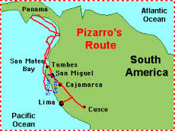
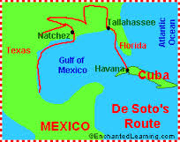
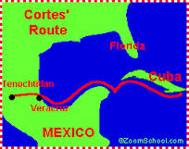
Spanish Conquerors
Hernando de Soto
Hernando Cortez
Francisco Pizarro

Slide 5
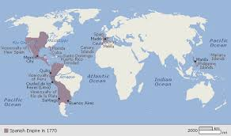

Slide 6
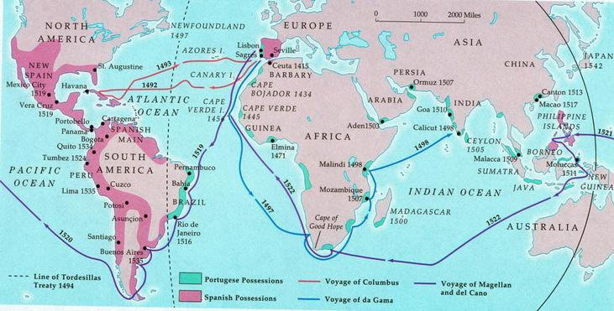

Slide 7
Long-term Impact of Spanish Conquest in the New World
Intermarriage created distinctive Latin American culture of mestizos: Amerindian & Spanish
Empire stretched from California and Florida to the tip of South America.
St. Augustine fortress erected (1565): oldest European settlement in U.S.
New Mexico (1609)
Texas (1716)
California (1763)

Slide 8
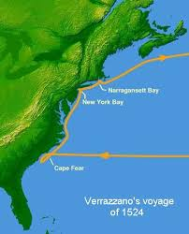
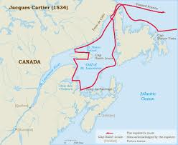
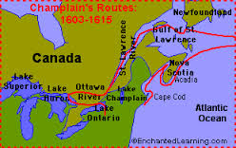
French Explorers
Giovanni da Verrazano
Jacques Cartier
Samuel de Champlain

Slide 9
Of the European powers, the French were the most successful in creating an effective trading relationship with the Indians
English settlers sought to remove or exterminate Amerindians
Spanish sought to Christianize Indians and use them for forced labor.
Utilized the encomienda system (forced labor in towns), hacienda system (forced labor for farming), and later, the mission system (forced conversion).
The French became great gift givers (the key to getting on with Amerindians who based inter-tribal relationships on gift giving)

Slide 10
The French & Trade
The beaver trade led to exploration of much of North America; (heavy demand for fur in European fashion)
Coureurs de bois (“runners of the woods”) – Rough frontiersmen who sought to tap the lucrative fur trade.
French seamen - voyageurs -- recruited Indians into the fur trade

Slide 11
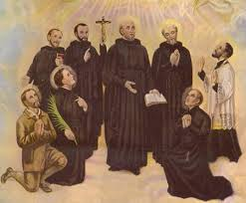
Jesuits
Catholic Missionaries who sought to convert Indians and save them from the fur trappers.

Slide 12
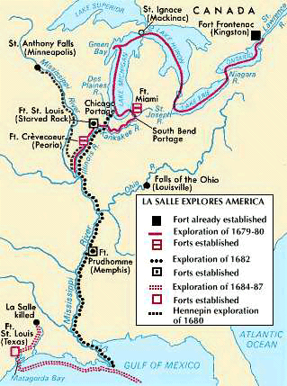
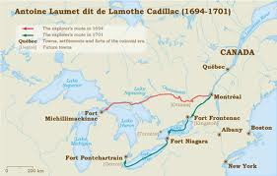
Other French Explorers
Antoine Cadillac
Robert de la Salle

Slide 13
Impact of French Exploration
Diseases
Gun warfare
alcoholism

Slide 14
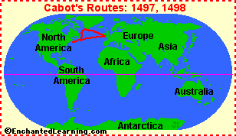
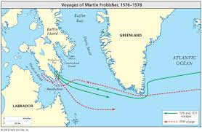
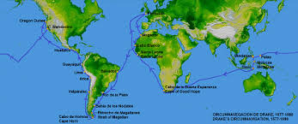
Original English Exploration
John Cabot (Giovanni Caboto), 1497-98
Martin Frobisher, 1576
Sir Francis Drake, 1577 - 1590

Slide 15
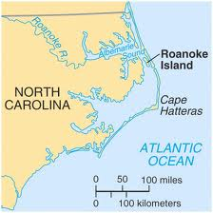
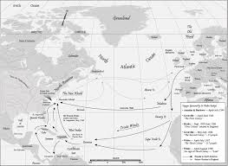
English attempts to colonize in the late-16th century
Sir Humphrey Gilbert, 1583
Sir Walter Raleigh, 1585

Slide 16
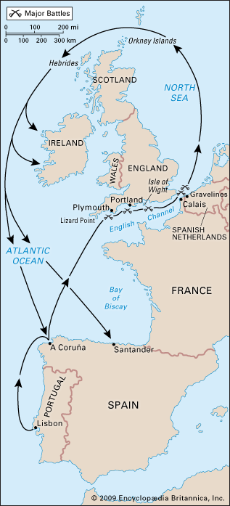
Spanish Armada (1588)
Protestant England vs. Catholic Spain
Queen Elizabeth vs. King Phillip II
Spanish invaded England
England wins
Ensured English naval dominance

Slide 17
England’s Search for Empire
Eventual peace with Spain provided opportunities overseas without harassment
Population growth provided workers/ potential colonists
Unemployment (economic opportunity), farm land, adventure, markets, political freedom, religious freedom, social change.
Joint-stock companies provided financial means: investors pooled resources for sea expeditions.

Slide 18
Results of contact between Native-Americans and Europeans
For Native Americans
Mass death and genocide: By 1600, nearly 90% of Native American population perished
European impact on culture: cattle, swine and horses, firearms.

Slide 19
Results of contact between Native-Americans and Europeans
For Europeans
Global empires for 1st time in human history.
Explosion of capitalism (Commercial Revolution)
Revolution in diet

Slide 20
Contributions of Mother Countries to North America
England: Democratic forms of local gov’t; tradition of hard-working, zealous individuals, English language
France: Language, culture, and religion introduced to Canada and Louisiana and to many Amerindians west of Appalachians; large-scale trade with Amerindians
Spain: Schools, hospitals, and printing presses established by missionaries; Spanish language in the Southwest; teaching of Christianity and handicrafts to Amerindians

Slide 21
Bibliography
Bailey, Thomas A., Kennedy, David M.: The American Pageant, 10th edition, Lexington,
Massachusetts: D.C. Heath, 1994
College Board, Advanced Placement Course Description: History -- United States, College
Entrance Examination Board, 2004
Foner, Eric & Garraty, John A., editors: The Reader’s Companion to American History, Boston:
Houghton MifflinCompany, 1991
Josephy, Jr., Alvin M., 500 Nations: An Illustrated History of North American Indians, Alfred A
Knopf, New York, 1994.
Loewen, James W., Lies My Teacher Told Me: Everything Your American History Textbook Got
Wrong, New York: The New Press, 1995
Murrin, John et al, Liberty, Equality, and Power: A History of the American People, 2nd ed., Fort Worth: Harcourt Brace 1999
Nash, Gary: American Odyssey, Lake Forest, Illinois: Glencoe, 1992
Waldman, Carl, Atlas of the North American Indian, New York: Facts on File, 1985
Zinn, Howard, A People’s History of the United States,

