Slide 1
Part Three (continued): Electoral Systems & Linkage Institutions
“Our political institutions work remarkably well. They are designed to clang against each other. The noise is democracy at work.” -- Michael Novak (American philosopher)

Slide 2
Electoral Systems
Rules that decide how votes are
Cast
Counted
Translated into seats in a legislature

Slide 3
Electoral Systems (FPTP)
First Past the Post (FPTP), Plurality, Winner Take All
Winner must get more votes than anyone else
Does NOT require a majority to win*
Single member districts (SMD)
Encourages large, broad-based parties**
Why?
Notes:
Single member districts (SMD) - candidates compete for a single representative’s seat
FPTP/plurality: Used by U.S., GB, India , Nigeria
Some countries amend plurality rule through use of a runoff. In a runoff, the two candidates who receive the most votes in the first round compete again. Candidate who gets most (a majority) is winner.
This only applies to true plurality voting, not 2nd round/majoritarian

Slide 4
Electoral Systems (PR)
Plurality systems encourage large, broad-based parties because…
no matter how many people run in a district, the person with the largest # of votes wins
this encourages parties to become larger, spreading their “umbrellas” to embrace more voters
Parties without big groups of voters supporting them have little hope of winning
The Problems with First Past the Post Voting Explained - YouTube

Slide 5
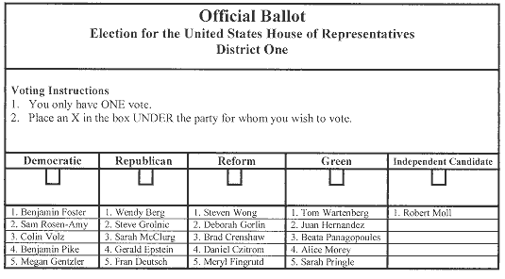
Electoral Systems
Proportional Representation (PR)
Creates multi-member districts
More than one legislative seat in each district
Ballots are cast for a party, not an individual
Open vs closed list
Percentage of votes a party gets determines # of seats
Encourages multiple parties
Notes:
Can have open or closed list (open – ppl pick, closed – party picks)
Example, if there are 10 seats and party gets 40% of vote, they get 4 seats
Used by Russia (since 2005), before that mixed.
Pure form encourages a large # of small parties because they have a good chance of getting some of their candidates elected.
This could lead to high # of parties with 1 seat (1%), so most set a threshold
Threshold – minimum % of vote that a party must receive in order to secure even one seat in the legislature
Usual threshold is 5% (Israel has lowest – only 2%)

Slide 6
Electoral Systems (PR)
Discussion Question: Why do PR Electoral Systems encourage a multi-party system?
Pure form encourages a large # of small parties because they have a good chance of getting some of their candidates elected
This could lead to high # of parties with 1 seat (1%), so most set a threshold
Threshold – minimum % of vote that a party must receive in order to secure even one seat in the legislature
Usual threshold is 5% (Israel has lowest – only 2%)

Slide 7
Electoral Systems
Discussion Question: What are the advantages of PR Electoral Systems?
Minority interests are represented
Women are more likely to be elected to office
Emphasis on ideas over personalities
Discussion Question: What are the disadvantages of PR Electoral Systems?
Too many small parties with disproportionate importance
PR facilitates extremist parties
Notes:
Advantages:
Gives small parties platforms to voice their concerns; small parties may receive important cabinet positions in coalition governments
In every country in which women hold at least 25% of legislative seats, PR is used in the selection of the legislature; In countries with mixed systems, more women have held PR-linked seats than FPTP district seats
PR systems lead voters to select among political parties rather than individual candidates, making the policy positions of parties more important
Disadvantages:
While FPTP systems can shut small parties out of the legislature, PR systems can give them a disproportionate amount of power
Especially if threshold is low

Slide 8
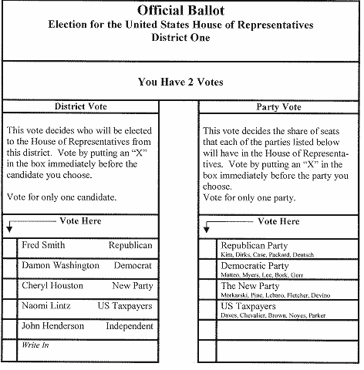
Electoral Systems
Mixed system
Combines first past the post & proportional
Some # of seats are single-member & some are proportional
Mixed-Member Proportional Representation Explained - YouTube
Notes:
Example: Mexico (and Russia until 2007, now PR)
300 of the 500 members of the Chamber of Deputies (the lower house) are elected through FPTP in SMD and 200 members are selected by proportional representation

Slide 9
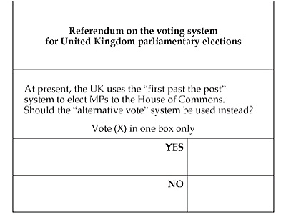
Types of Elections
Election of public officials
Referendum
Votes on policy issues
Examples?
Plebiscite
A non-binding vote to gauge public opinion on an issue
Initiative
Vote on a policy initiated by the people
Notes:
Referendum – national ballot called by the govt on a policy issue
Allows the public to make direct decisions about policy itself. (US only at state/local level, but used nationally elsewhere)
Britain put devolution of powers to Scottish and Welsh parliaments before voters in those regions using a referendum
Britain also used national referendum for vote on Alternative Voting System
Plebiscite – type of referendum that is non-binding. Recent example is Puerto Rico/statehood
Initiative - This is done by getting a certain number of signatures from the public, which obligates the government to hold a national referendum.

Slide 10
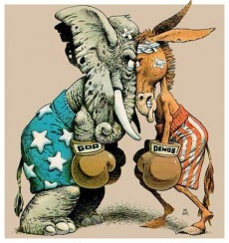
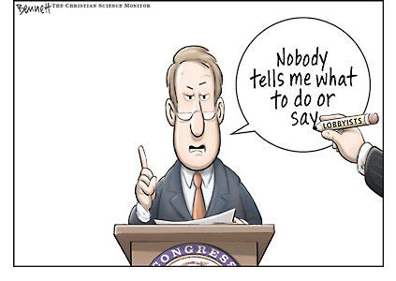
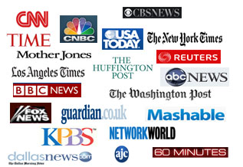
Linkage Institutions
Connect (“link”) the government to its citizens
Political parties
Interest groups
Media
Notes:
The larger the population, the more complex the govt’s policy-making activities, the more likely the country is to have well-developed linkages institutions.

Slide 11
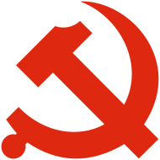
Linkage Institutions – Political Parties
Political Parties
Functions?
One-Party System
Communist States
One-Party Dominant System
Mexico during most of 20th cent (PRI domination)
Russia (United Russia)
Notes:
Functions of a political party:
Help bring different people and ideas together to establish the means by which the majority can rule.
Provide labels for candidates that help citizens decide how to vote.
Hold politicians accountable to the electorate and other political elites.
One Party System
Definition: a party system in which one political party controls the govt and voters have no option to choose an opposition party
Communist states have one-party systems that dominate the govts
One-Party Dominant System
Def: a party system in which one large party directs the political system, but small parties exist and may compete in elections
In a nondemocratic regimes, may allow small, nonthreatening parties to exist to give legitimacy to regime

Slide 12
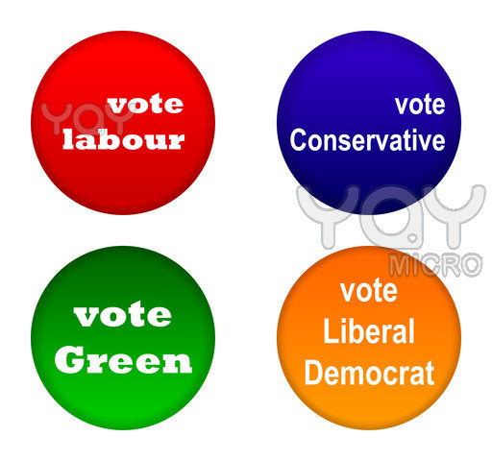
Linkage Institutions – Political Parties
Two-party system
The most rare system
Two-and-a-Half Party System?
Third party that influences which of two major parties get in power
Multi-party systems
Most common
Found in parliamentary systems commonly
Notes:
Two Party system (US)
Def: a party system in which two main parties compete for majority control of the govt; small parties may exist but play no role in national electoral outcomes
Rare- Only 15 countries in world today (including U.S., UK, India & Nigeria)
Most important single reason for existence of a two-party system is plurality electoral system (FPTP).
Two-and-a-Half Party system (UK?)
Def: party system in which two large parties exist alongside a third party that receives a smaller but notable share of the national vote
The votes that one of the large parties loses to the 3rd party determine which of the two large parties control the govt
Presence of a third party can prevent a majority govt…would eventually lead to a multiparty system
Multi-Party System
Def: a party system with several important political parties, none of which generally gains a majority of the seats in the national legislature
Most European countries today have multi-party systems.
Most democracies use this
Usually arise in countries with strong parl. Systems, particularly those that use PR

Slide 13
Interest Groups
Organizations of like-minded people
Want to influence & shape public policy
Often have a great deal in common with political parties
Discuss: How are interest groups different from political parties?

Slide 14
Interest Groups
Differences:
Parties influence govt primarily through the electoral process (run candidates). Interest groups often support candidates, but do not run their own candidates.
Parties generate and support a broad spectrum of policies; interest groups support one or a few related policies.

Slide 15
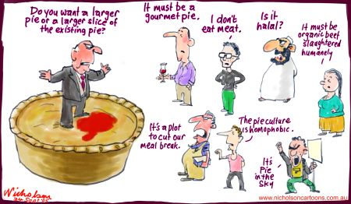
Interest Groups
Evaluate in terms of how much autonomy they have
Authoritarian (“transmission belts”)
Democracies
Pluralism
Corporatism
Pluralism
Power is split among many groups
Notes:
Authoritarian
Groups have almost no independence
In China, only govt-endorsed groups may exist
Used as agents to extend party’s influence beyond its membership to shape views of
citizens.
Also used as transmission belt to convey to their members the views of the party elite.
Democracy
Interest Group Pluralism
Compete with each other and with govt for influence over state policy.
Multiple groups may represent a single societal interest.
Group membership is voluntary and limited.
Select their own leaders/raise their own funds
Groups often have a loose or decentralized organizational structure.
There is clear separation between interest groups and the government.

Slide 16
Interest Groups
Corporatism
Fewer groups compete, usually one for each interest sector (labor, ag)
Two Types:
State Corporatism
State determines which groups are brought in
Neocorporatism
Interest groups take the lead and dominate the state
Notes:
Corporatism
The group’s monopoly over its sector is officially approved by the state and sometimes protected by the state

Slide 17
Interest Group Strength: Autonomy From the State
Less Autonomy
More Autonomy
Interest
Groups as
“Transmission
Belts”
Interest
Group
Pluralism
Corporatism
No autonomy
From the state
State and interest group autonomy mixed
Autonomy
from
the state

