Slide 1
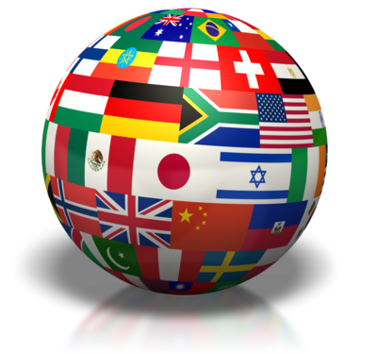
Part Two: Sovereignty, Authority & Power (continued) - Democratization
“Sovereignty is not given, it is taken.” -- Kemal Ataturk (Turkish soldier)
“I have as much authority as the Pope, I just don't have as many people who believe it.” -- George Carlin (comedian)

Slide 2
Fostering Democracy, Human Rights, and Civil Liberties
Democratization is the second major force transforming contemporary political systems.
Includes the enhancement of human rights and the expansion of freedom.

Slide 3
Fostering Democracy, Human Rights, and Civil Liberties
The most important general distinction in classifying political systems:
Democratic systems versus authoritarian systems
Authoritarian: lack one or several of the defining features of democracy
Oligarchy
Totalitarian
Waves of Democratization
First: during the first half of the 20th century: Western states
Second: 1943 to 1960s: newly independent states and defeated authoritarian powers
Third: 1974 involving Southern Europe, East Asia, Latin America, and a number of African states.
Result: democracy more of a common goal of the global community

Slide 4
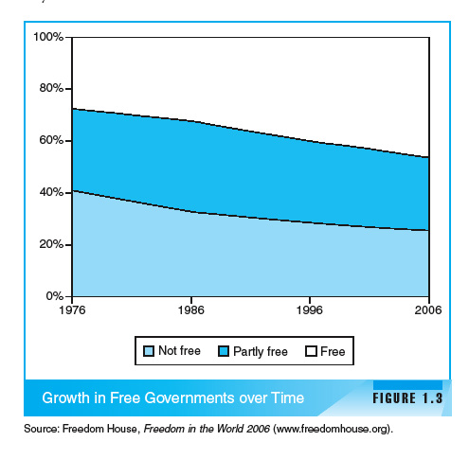

Slide 5
Types of Regimes - Democracy
What is Democracy?
The word democracy means many different things to many different people. For many, “democratic” means good things and “nondemocratic” means bad.
Basic Definition: political power exercised either directly or indirectly through participation, competition, and liberty.
BUT even political theorists can’t agree on exact definition…more of a spectrum.

Slide 6
Types of Regimes - Democracy
Various Textbook Definitions:
(Almond) - a political system in which citizens enjoy a number of basic civil and political rights, and in which their most important political leaders are elected in free and fair elections and accountable under a rule of law.
(Barrington) A regime type that involves the selection of government officials through free and fair elections, a balance between the principle of majority rule and the protection of minority interests, and constitutional limitations on government actions.
Notes:
There is no guarantee that democracies will grant human rights and civil liberties to all people. Democracies are supposed to find a balance between respecting the will of the majority and protecting the rights of the minority.

Slide 7
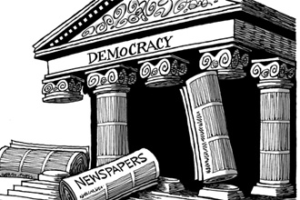
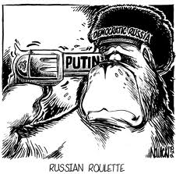
Types of Regimes – Democracy (Liberal vs Illiberal)
Liberal (substantive) Democracies typically include:
Competitive Elections
Civil liberties
Rule of law
Neutrality of the judiciary
Open civil society
Civilian control of the military
Illiberal or Procedural Democracies
Appear like other established democracies (elections) but do not have many of the features listed above
Notes:
A liberal democracy is the term used by many political scientists to imply a system that promotes participation, competition, and liberty.
Competitive elections: regular, free, and fair
These types of democracies are rooted in the idea of liberalism, with an emphasis in individual rights and freedom.
Participation is central to a liberal democracy. The most basic way to participate is through voting and elections. Through these, the public is given the opportunity to have control over public officials and their policies.
In a liberal democracy, suffrage (the right to vote) must be available to all adult citizens with few restrictions.
Rule of Law
"For the United Nations, the rule of law refers to a principle of governance in which all persons, institutions and entities, public and private, including the State itself, are accountable to laws that are publicly promulgated, equally enforced and independently adjudicated, and which are consistent with international human rights norms and standards. It requires, as well, measures to ensure adherence to the principles of supremacy of law, equality before the law, accountability to the law, fairness in the application of the law, separation of powers, participation in decision-making, legal certainty, avoidance of arbitrariness and procedural and legal transparency."
Illiberal Democracy: a governing system in which, although elections take place, citizens are cut off from knowledge about the activities of those who exercise real power because of the lack of civil liberties. It is not an 'open society'.

Slide 8
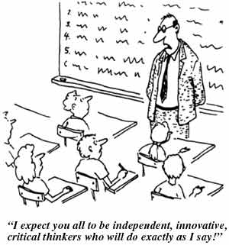
Types of Regimes - Authoritarian
Authoritarianism is a political regime where a small group of individuals exercises power over the state without being constitutionally responsible to the public.
Examples?
Notes:
Examples?
Single dictator, hereditary monarch, small group of aristocrats, or single political party

Slide 9
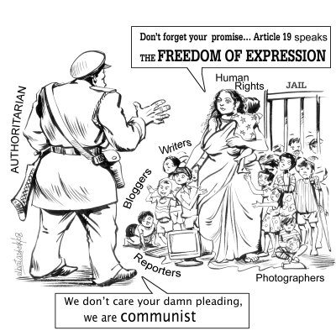
Types of Regimes: Authoritarian
Authoritarian Characteristics:
Elites who hold political power make decisions
Some based on Communism
Some based on Corporatism
Gov’t officials interact with people/groups outside gov’t before they set policy
Patron-Client Systems – Favors and services to their supporters
Economy is tightly controlled by the political elite
Citizens have little to no input on selection of leaders
Restriction of civil liberties very common
Notes:
Communist party controls gov’t, economy, social life

Slide 10
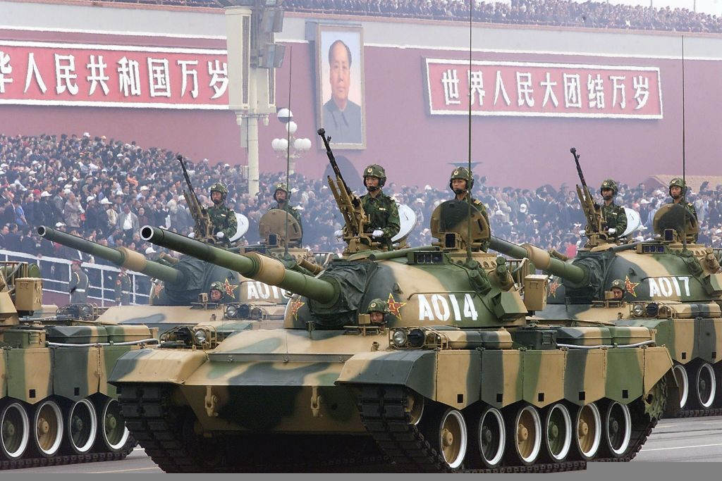
Totalitarian Regimes
Totalitarianism is a highly centralized regime that possesses some form of strong ideology that seeks to transform and absorb aspects of the state, society, and the economy.
Much more negative connotation than authoritarian
Very repressive
Use violence/terror
Examples?
Notes:
Examples: Hitler's Nazi's rule Germany, Stalin's Soviet Russia, and Mussolini's Italy, are all cases of totalitarian governments. Modern day example - North Korea

Slide 11
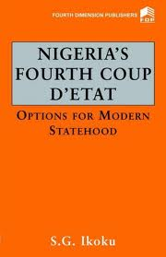
Military Regimes
Military rule
Nondemocratic
Formerly prevalent in Latin America, Africa and parts of Asia
Usually begins with a coup d’etat
Examples?
Notes:
Military Rule
Increasingly, more common in states that are struggling with legitimacy and stability and in those where there is a high level of public unrest or violence
The military sees itself as the only organized force able to ensure stability
Coup D’etat
Coup may or may not have widespread support among the people
Once they take control, leaders often restrict civil rights and keep political parties from forming
Usually lack a specific ideology or source of authority

Slide 12
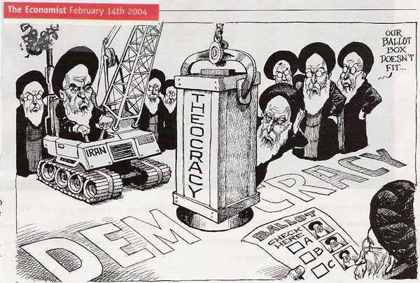
Theocracy
Theocracy: a political system in which religious leaders control political decisions and religious law provides the basis for policy decisions.
Examples?

Slide 13
Part Three: Political Structures/Institutions
“Our political institutions work remarkably well. They are designed to clang against each other. The noise is democracy at work.” -- Michael Novak (American philosopher)

Slide 14
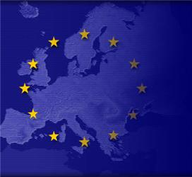
Levels of Government
Supranational Organizations – organizations in which nations are not totally sovereign actors
International or regional
Trend towards states pooling their sovereignty to gain political, economic or social clout
Examples?
Growing because of globalization
Notes:
Examples?
NATO (North Atlantic Treaty Organization)
European Union
NAFTA (North American Free Trade Agreement)
OPEC (Organization of the Petroleum Exporting Countries)
United Nations
Globalization:
Integration of social environmental, economic, cultural activities of nations resulting from increased international contacts

Slide 15
Levels of Government
Unitary System
Concentrates all policymaking powers in one geographic place
Central government is responsible for most policies
Most countries have unitary
Federal System
Power divided between the central government & sub-units
Regional bodies have significant powers (taxation, lawmaking, keeping order)
Confederal
Power spread among many sub-units (states for example)
Weak central government
EU
Notes:
Unitary Countries – 172
Federal Countries:
21 countries
11% of countries, 38% of people, 49% of land
AP 6:
Unitary: GB (although devolving power to regional), China, Iran
Federal: Russia, Mexico, Nigeria
Confederal: European Union

Slide 16
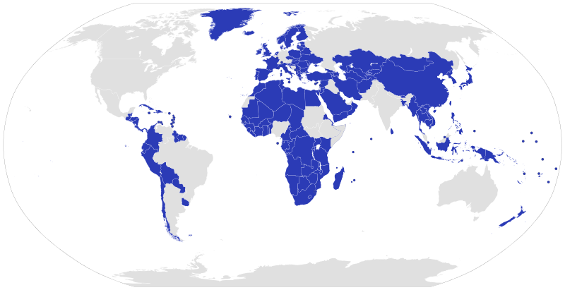
Unitary States

Slide 17
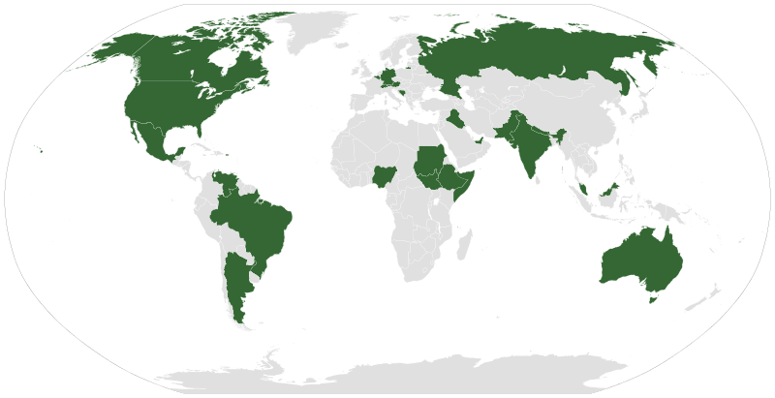
Federal States

Slide 18
Confederate States
Historical examples:
US before Constitution was ratified (originally governed by the Articles of Confederation)
Confederate States of America (American South during Civil War)
Serbia & Montenegro (2003 – 2006)
Modern examples (arguable):
Iroquois Confederacy (consists of six Native American groups)
Canada
Belgium
EU

Slide 19
Levels of Government
Advantages of Federal System:
Makes it easier to govern a very large country (physically largest countries tend to have fed arrangements – not China though)
Better accommodates regional differences
Helps guard against concentration of political power
Disadvantages:
Lack of uniformity in policy (ex: voting registration requirements, education requirements)
If territorial lines of subunits correspond to deep social divisions, federalism reinforces those divisions
Notes:
Advantage of Unitary: Are in a better position to redistribute resources from richer regions to poorer regions (thus creating more equality)

Slide 20
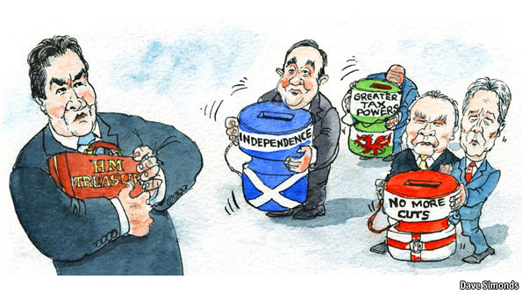
Devolution
Sometimes, leaders of unitary systems voluntarily choose to decentralize power
Called devolution – transfer of power from a central govt to lower/regional govt
Why would they do this?
Notes:
Devolution is a reaction to centrifugal forces – those that divide and destabilize the country.
Leaders attempt to keep the country unified by devolving power to certain regions.

Slide 21
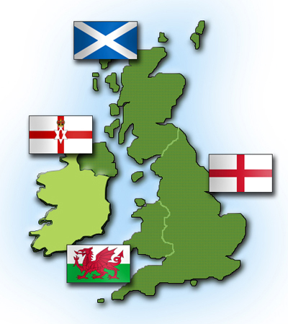
Three Causes of Devolution
Ethnic Forces
Identity based on language, religion, customs
Ethnonationalism
See themselves as a distinct nation with a right to autonomy
Example?
Economic Forces
Regional inequalities in income or standard of living
Spatial Forces
Usually occur on the margins/borders of the state
Esp if water/mountains separate from central power and neighbor nations support separation
Notes:
Ethnic: Britain has devolved power to Scottish and Welsh parliaments
Spatial: Puerto Rico is island close to other independent islands

Slide 22
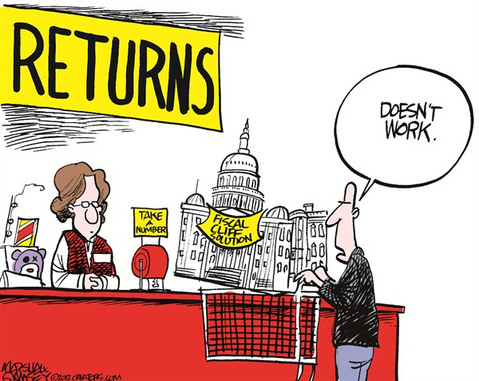
Political Institutions
Structures of the political system
Carry out the work of governing
Vary by country
Common structures that exist in most countries are legislatures, executives, judicial systems, bureaucracies, and armies
Notes:
Just because you see the same type of institution in two different countries, don’t assume they serve the same functions

Slide 23
Example - Legislatures Vary in Importance
U.S. Congress Extremely active role in forming public policy. | House of Commons in Britain Public policy is usually initiated by the cabinet members and this house is usually a deliberating body that formally enacts and amends legislation. | National People’s Congress (China) Essentially, a tool of party leaders. They meet and listen to statements by party leaders and “rubberstamp” decisions made by someone else.

Slide 24
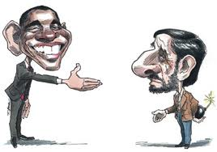
Executive Office
Carries out the laws & policies of the state
Head of State
Symbolizes and represents the people
May or may not have policymaking power
Head of Government
In charge of actually running the government
The Chief Executive
Most important person in policymaking
Varies by government
The Cabinet
Most important decision making body in parliamentary systems

Slide 25
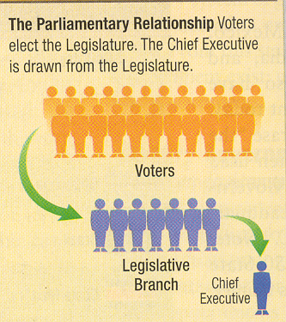
Parliamentary vs. Presidential Systems
Parliamentary Systems
Citizens vote for legislative reps, which pick leader of executive branch from majority party
Head of State = mostly symbolic figurehead
Head of Gov’t = day to day
Fusion of powers between executive & legislative branches
Cabinet members = leaders of majority party in Parliament
Chief executive usually does not have veto power
Irregular intervals between elections and votes of confidence
Notes:
Parliamentary:
AP 6: GB
Head of Gov’t usually called prime minister (GB), also called premier (China) or chancellor (Germany)
MP’s have stipulated term in office, but it is maximum amt of time before new elections must be held. Prior to that, PM could be removed or could call early parliamentary elections.
Votes of Confidence/No Confidence: If sitting gov’t fails to get support for a bill, govt is forced to resign and new elections may be held

Slide 26
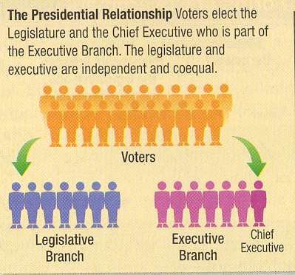
Parliamentary vs. Presidential Systems
Presidential Systems
Citizens vote for legislative reps and executive branch leaders
President – both Head of State & Head of Gov’t
Separation of powers/System of checks and balances
President picks cabinet members
President can veto
Fixed Terms
Semi-Presidential Systems
Prime Minister and President Coexist
Notes:
Presidential:
Mexico, Nigeria, Iran (+Supreme Leader)
Semi Pres:
Russia, China (non-democratic)

Slide 27
Parliamentary vs. Presidential Systems
Parliamentary:
Advantages: efficiency in passing legislation, clearer accountability to voters
Disadvantages: instability, hasty decision-making
Presidential:
Adv: checks power of legislature; since directly elected, more of a national mandate
Disadv: difficulty removing unpopular president until next election, gridlock!, creeping authoritarianism
Semi Pres:
Adv: shields pres from criticism (can blame on PM), can remove unpopular PM and maintain stability from pres. fixed term, additional checks and balances
Disadv: confusion about accountability, confusing and inefficient legislation

Slide 28
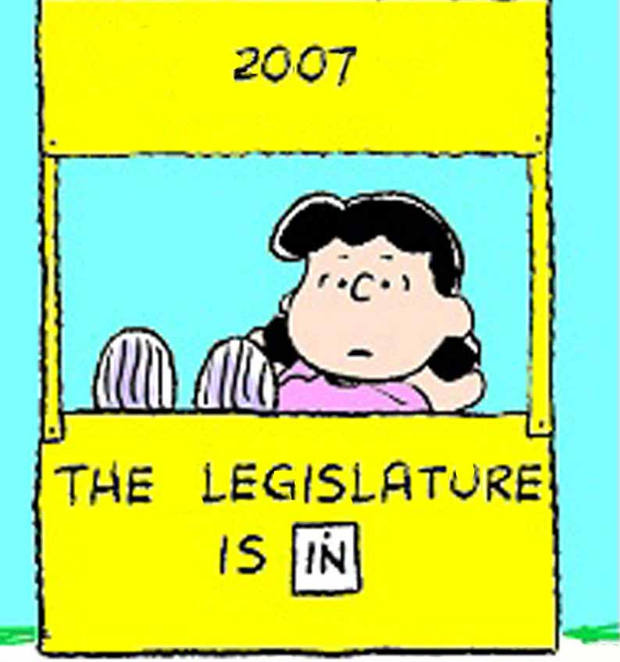
Legislatures
Branch that makes laws
Bicameral
Two houses
Advantages/Disadvantages?
Unicameral
One house
Advantages/Disadvantages?
Notes:
Today, more than 80% of the countries belonging to UN have legislatures, suggesting that a govt that includes a representative popular component increases its legitimacy
Bicameral: more practical with federalism, check and balance, BUT gridlock
Unicameral: no gridlock, BUT no check on power

Slide 29
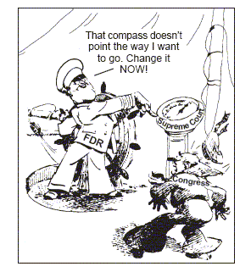
Judiciaries
Vary significantly from country to country
Courts in authoritarian systems generally have little/no independence; decisions controlled by chief exec.
Constitutional Courts
Highest judicial body, rules on constitutionality of laws
Judicial review
Power of the judiciary to review laws and executive actions for their constitutionality
Notes:
The judiciary is still a relatively weak branch in most of the AP6, but takes different forms in each.

Slide 30
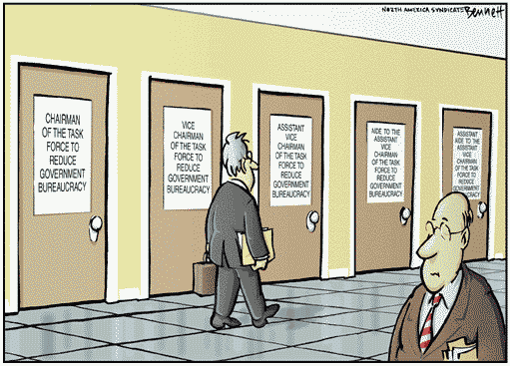
Bureaucracies
Agencies that implement government policy
In democracies
Discretionary power
Continuity over time
In authoritarian regimes
Head of government exercises control
Patronage system
Notes:
Weber: a well-organized complex machine that is a “rational” way for a modern society to organize its business.
Discretionary power: power given to bureaucrats to make small decisions in implementing leg/ex decisions.
Patronage system: political supporters receive jobs in return for getting leader elected.

Slide 31
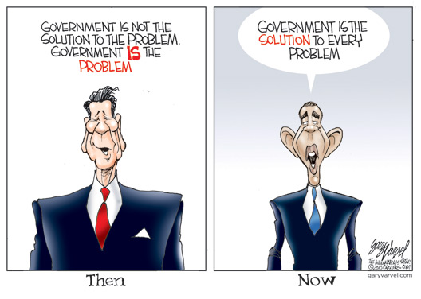
Common Characteristics of Bureaucracies
Non-elected positions
Impersonal, efficient structures
Formal qualifications for jobs
Hierarchical organization
Red tape/inefficiency
Notes:
Bureaucrats are appointed, usually salaried and are not elected by public.
Impersonal bc they are goal oriented, have little concern for personal feelings.
Formal qual. – Authoritarian (must at least have education/experience; Dem – have institutionalized as prerequisites form appt.
Everyone has a boss, except for the guy at the top.
As grow in size and complexity efficiency breaks down.

