Slide 1
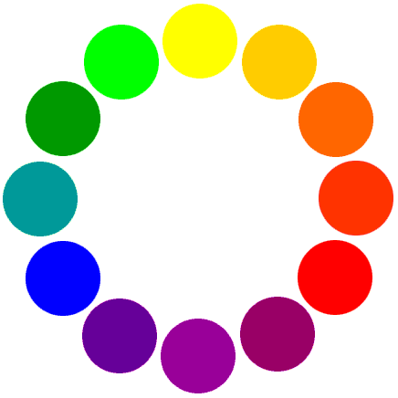
Color Psychology

Slide 2
RED
Excitement
Strength
Passion
Speed
Danger

Slide 3
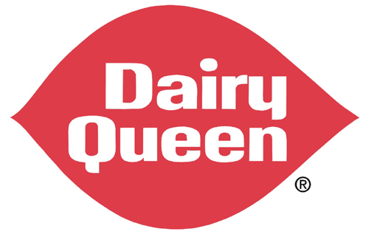
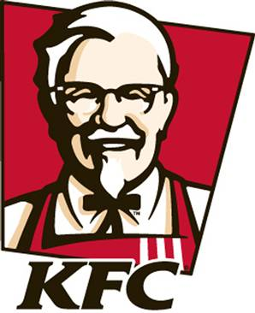
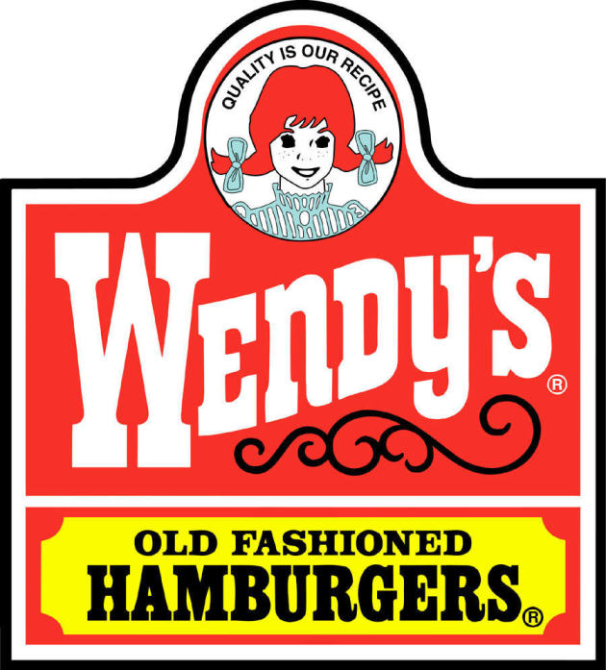
RED
Red also makes you hungry…

Slide 4
ORANGE
Playfulness
Warmth
Vibrant

Slide 5
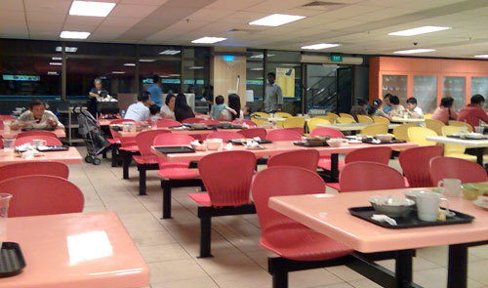
ORANGE
Orange also makes people want to hurry…

Slide 6
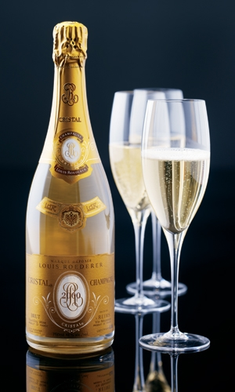
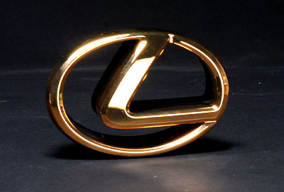
GOLD
Prestige
Expensive

Slide 7
YELLOW
Warmth
Sunshine
Cheer
Happiness

Slide 8
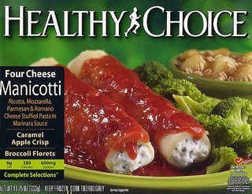
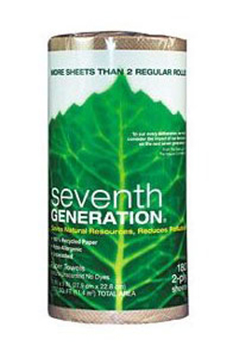
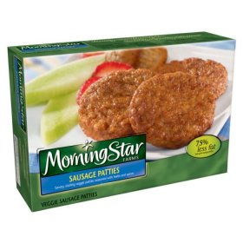
GREEN
Nature
Fresh
Cool
Growth
Abundance
Health

Slide 9
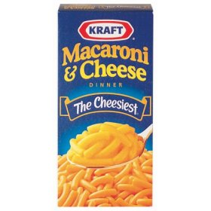
BLUE
Trust
Reliability
Belonging

Slide 10
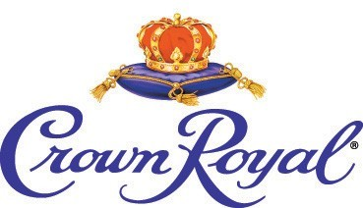
PURPLE
Royal
Spirituality
Dignity

Slide 11
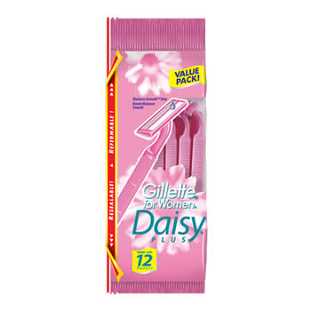
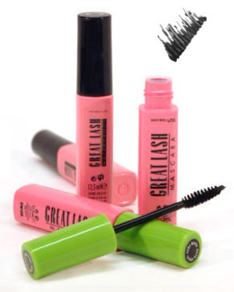
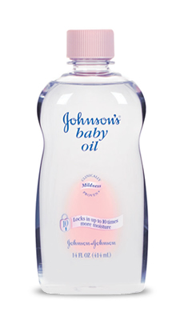
PINK
Soft
Sweet
Nurture
Security

Slide 12
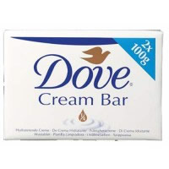
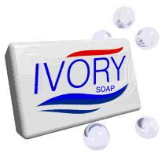
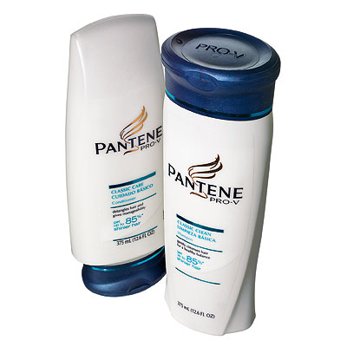
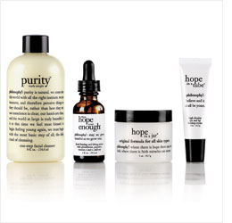
WHITE
Pure
Clean
Youthful
Mild

Slide 13
BLACK
Sophisticated
Elegant
Seductive
Mystery

Slide 14
SILVER
Prestige
Cold
Scientific

Slide 15
Color & Marketing
85% of shoppers place color as a primary reason for why they buy a particular product
Color increases brand recognition by 80%
Men and women have different favorites in terms of color (ex. 57% of men say blue; 35% of women say blue)
Most people associate color with price (orange and yellow are cheap; black and navy are expensive)
SOURCE: http://www.quicksprout.com/the-complete-guide-to-understand-customer-psychology-chapter-4/#.

Slide 16
Cross-cultural Colors
http://www.quicksprout.com/the-complete-guide-to-understand-customer-psychology-chapter-4/

