Slide 1
Colonial Culture
Mrs. Lacks: US History

Slide 2
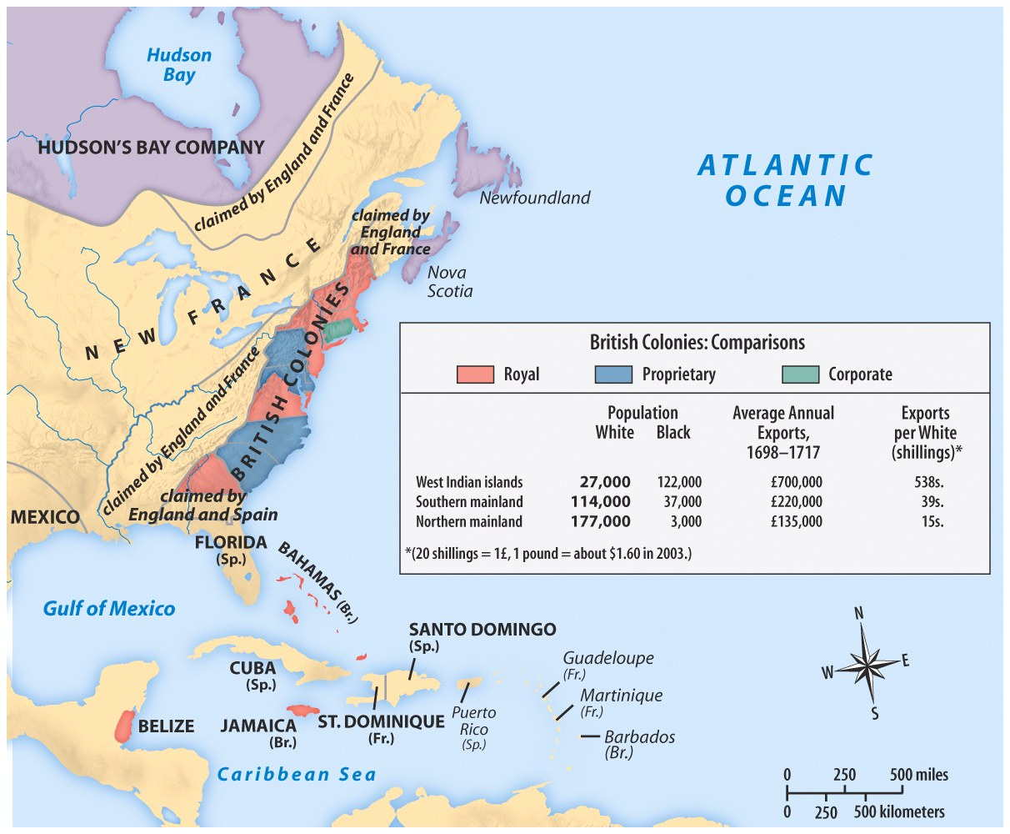

Slide 3
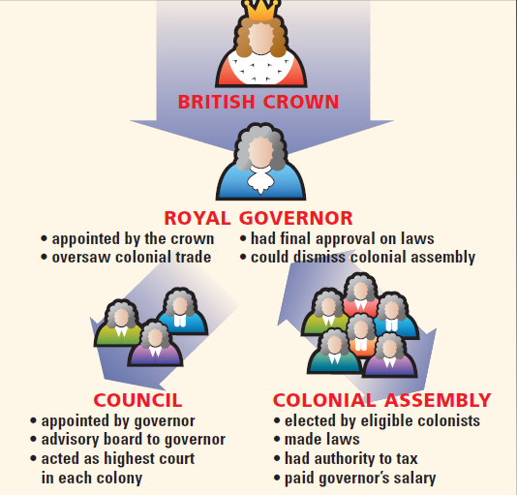
Politics in the Colonies (1775)
Colonial governments:
Bicameral legislatures
One governor
Court system
Notes:
8 colonies had royal governors, 3 under proprietors (MD, PA, DE), and 2 under self-governing charters (CT, RI)
Used bicameral legislatures – upper house (council) chosen by king, lower house by elections
Self-taxation through elected legislatures was highly valued

Slide 4
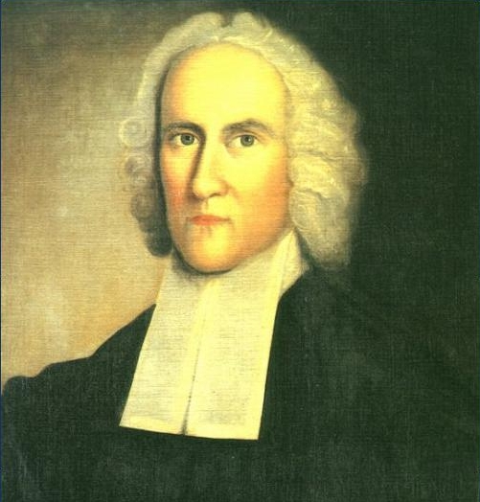
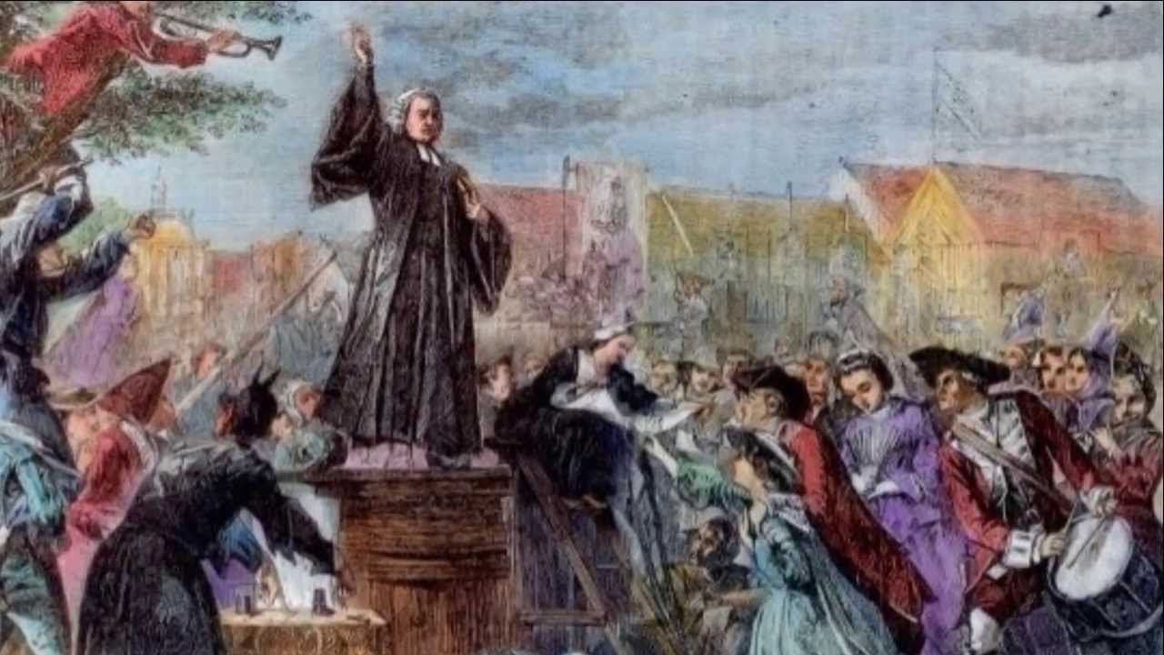
Great Awakening
Notes:
1740s & 1750s
religious revival that started in New England and spread south
Led by preacher Jonathan Edwards
Targeted non church goers, as well as Native Americans and Africans
New protestant denominations formed

Slide 5
Higher Education
Harvard, 1636—First colonial college; trained candidates for ministry
College of William and Mary, 1694 (Anglican)
Yale, 1701 (Congregational)
Great Awakening influences creation of 5 new colleges in mid-1700s
College of New Jersey (Princeton), 1746 (Presbyterian)
King’s College (Columbia), 1754 (Anglican)
Rhode Island College (Brown), 1764 (Baptist)
Queens College (Rutgers), 1766 (Dutch Reformed)
Dartmouth College, 1769, (Congregational)

Slide 6
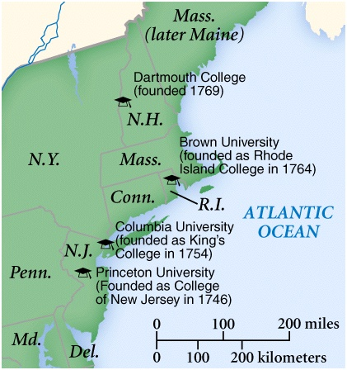
New colleges founded after the Great Awakening

Slide 7
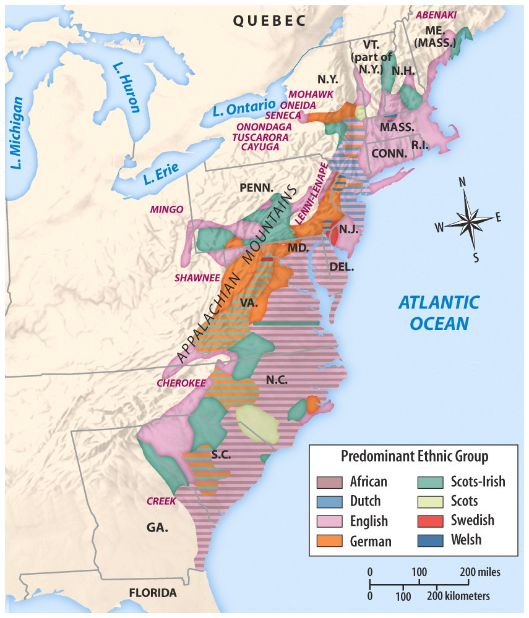
British North America, a melting pot

Slide 8
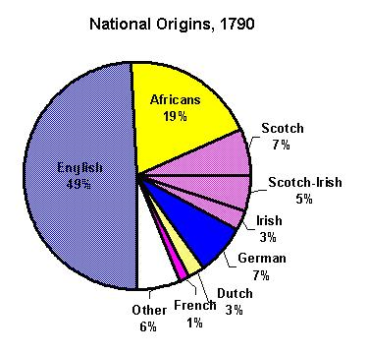

Slide 9
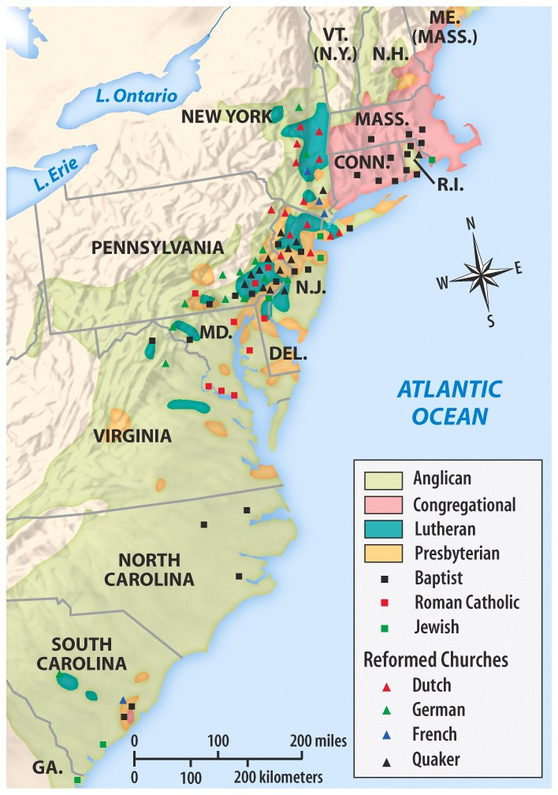
British North America, a melting pot

Slide 10
Colonial Culture Trends
Social Events:
Attending church (most important ritual; showed status)
Tea drinking
punishment of criminals in public (reminded people of what not to do)
Attending elections (south)

Slide 11
City vs. Country Life
Urban life:
went to marketplaces
more contact w/the outside world [newspapers, ports]
Rural life:
Stayed on or close to farm
Probably never traveled far
Little access to school, church, and the outside world

Slide 12
Strict social hierarchy

Slide 13
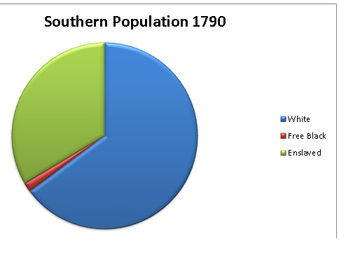
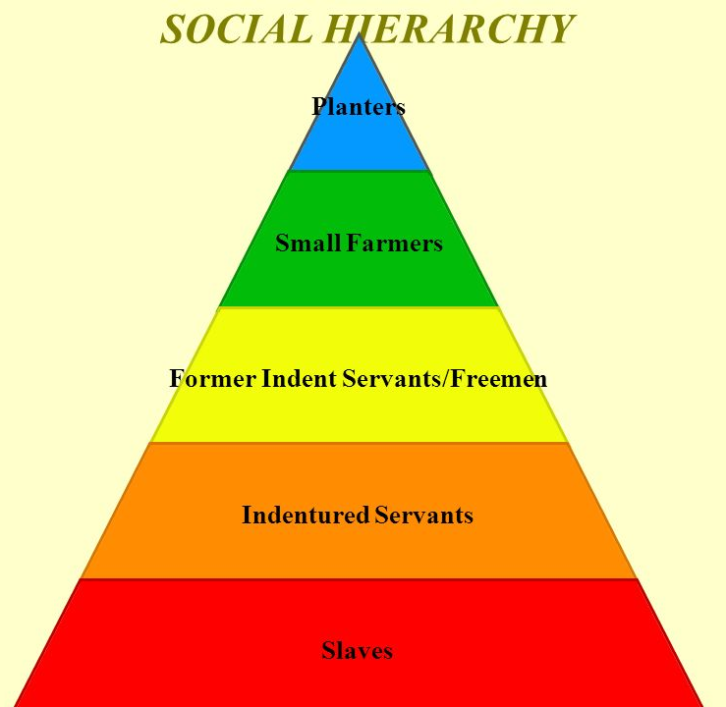
Southern Colonies
Largest group: poor whites
Smallest group: planters/rich whites

Slide 14
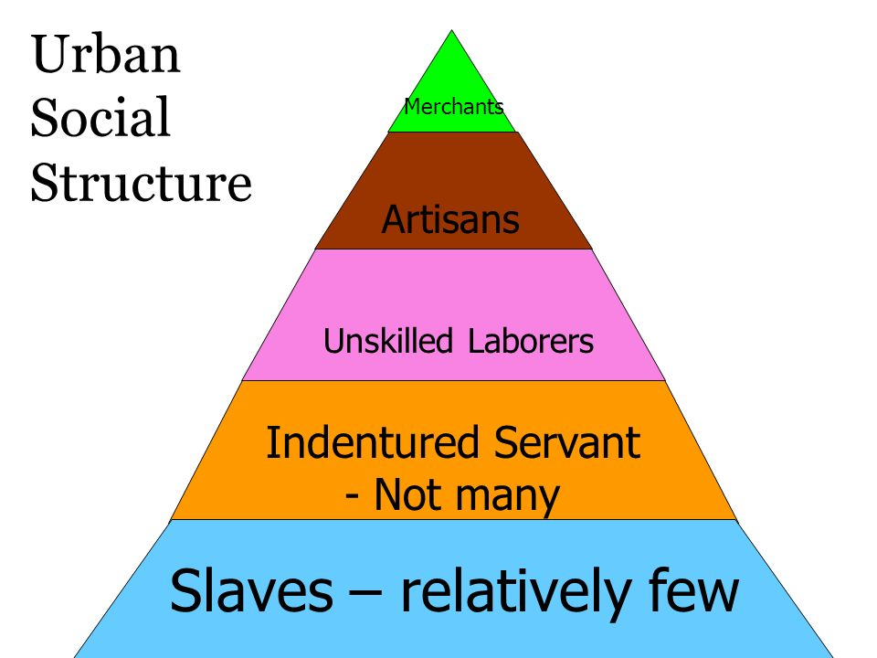
New England & Middle Colonies

Slide 15
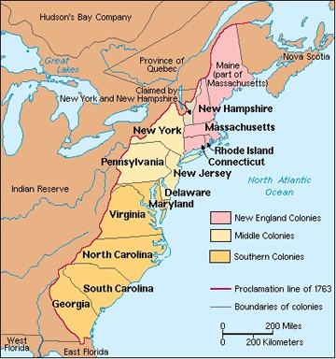
England & Colonies Prosper
Notes:
British colonies grew quickly and were soon very successful traders
New England: ships, fish, lumber, furs
Middle: lumber, wheat, iron
South: tobacco and rice

Slide 16
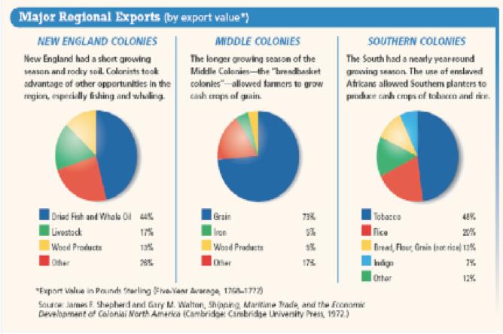

Slide 17
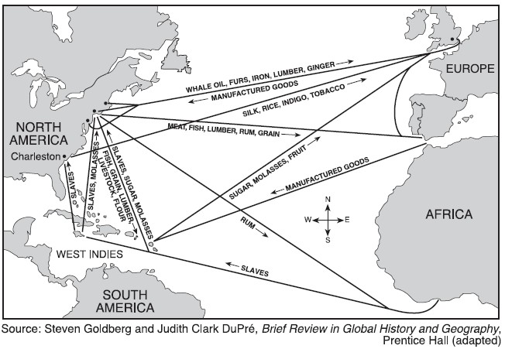
Triangular Trade
Notes:
Trade between Europe, Africa, and North America
Europe sent manufactured goods to Africa
Africa sent slaves to North America
North America sent raw materials like sugar, cotton, and tobacco to Europe

Slide 18
Britain wanted more profit from lucrative colonial trade!

Slide 19
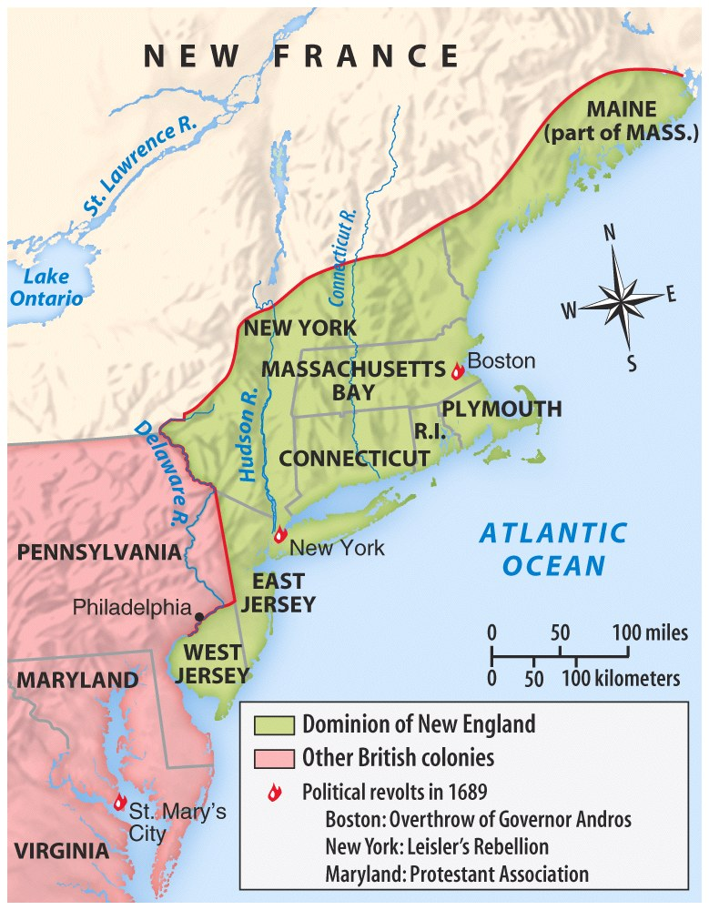
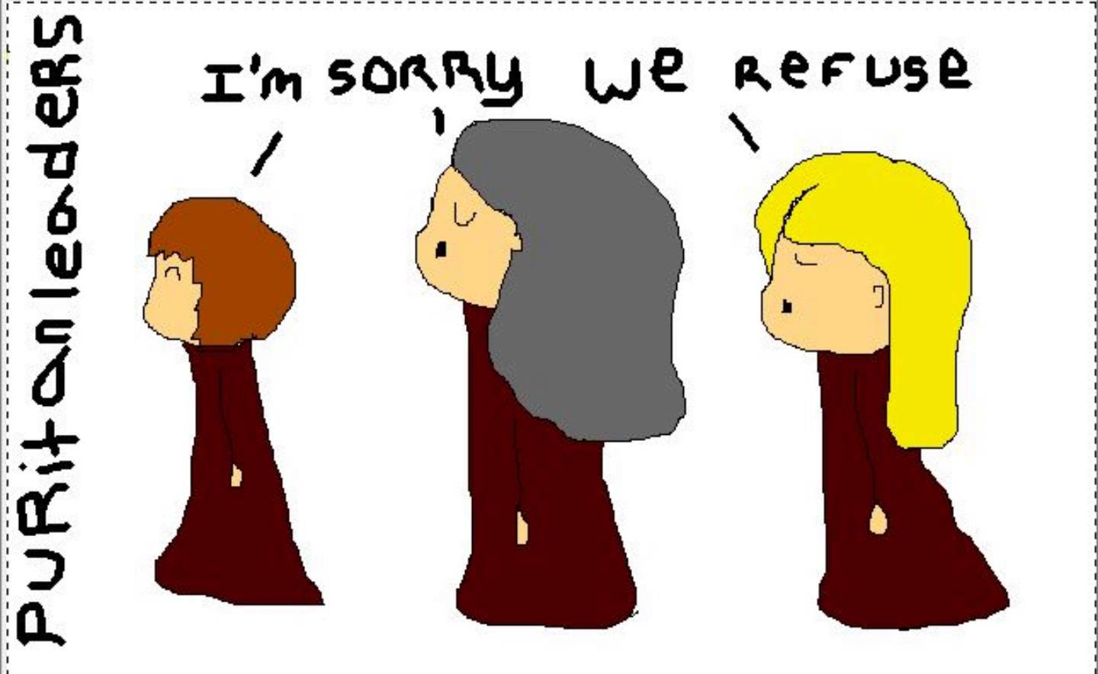
Dominion of New England
Combined New England & Middle Colonies (except PA & DE) under one administrative unit controlled by King
Results?
Notes:
Results:
Implemented taxes without consent
Eliminated town meetings, schools, etc
Colonists mad
Only lasted three years; dissolved due to attacks by Indians – crown didn’t want to deal with it

Slide 20
Navigation Acts
Purpose: To enforce mercantilism
Rules?
Results?
Notes:
NO country could trade with the colonies unless the goods were shipped in either colonial or English ships
All vessels had to be manned by crews that were at least ¾ English or colonial
The colonies could export certain products, including tobacco and sugar, and later rice, molasses, and furs, only to England
Almost all goods traded between the colonies and Europe first had to be unloaded at an English port

Slide 21
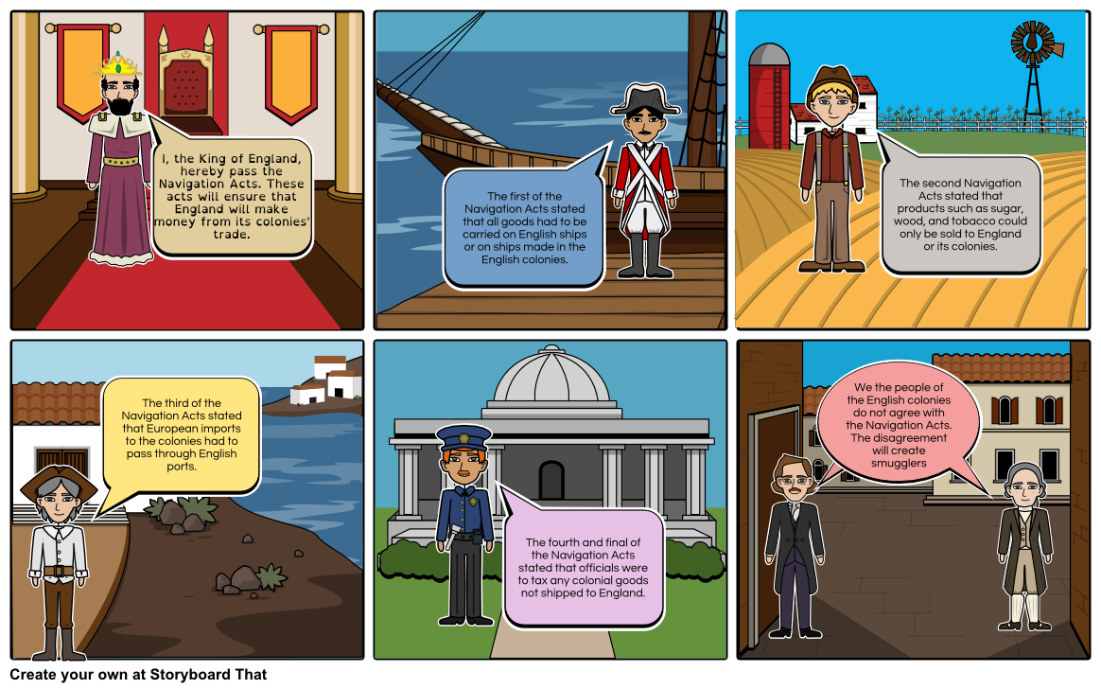

Slide 22
Conclusion
British at home vs. British in colonies
Growing differences…
Political
Social
Economic

