Slide 1
Checking & Savings Accounts
Economics
2015

Slide 2
What is a Checking Account?
Common financial service used by many consumers (a place to keep money)
Funds are easily accessed (Check, ATM, debit card, phone, Internet)
Services and fees vary depending upon the financial institution

Slide 3
Why necessary?
Money is insured (FDIC)
Convenience – useful for paying bills; easier & safer than carrying a large amount of cash
Spending Plan Tool (Keeps a record of where money is spent)
Allows for direct deposit (electronic transfers of payments directly from the payer’s account to the account of the person being paid)

Slide 4
How do you get one?
Shop around/compare banks based on your needs
Personally go to bank with money to deposit
Set up account with teller and deposit cash
Receive debit card and checks via mail

Slide 5
Types of Accounts
regular checking account - designed for customers who write a few checks each month and do not keep a minimum amount of money in the account

Slide 6
Types of Accounts
Joint account
Used by two or more people who have equal access to the account
usually used by married couples or businesses with more than one owner.

Slide 7
Types of Accounts
Savings Account
an account that earns interest on the balance for the depositor
Used to store money, not for every day purposes

Slide 8
ATM
Automated teller machine
Used for withdrawing or depositing cash
May charge fees if if the ATM used is not provided by the financial institution sponsoring the card

Slide 9
Debit Cards
Electronically connected to a bank account
Money is automatically taken from the bank account when purchases are made
Requires a PIN (personal identification number) to confirm the user is authorized to access the account

Slide 10
Pros Cons
Convenient
Small
Allows a person to carry less cash
Does not allow overspending
Can lose track of balance if transactions are not written down
Opens checking account up to credit fraud
Others can gain access to the account if the card is lost and PIN is known

Slide 11
Debit Cards
Account Number—Links all purchases made with the card to a designated bank account
Expiration Date— The debit card is valid and may be used until this date
Cardholder’s Name— The cardholder’s full name is written out and displayed.
Magnetic Strip— When the debit card is swiped, the magnetic strip automatically withdraws funds from the cardholder’s account.

Slide 12
Debit Cards
Authorized Signature— Sign in the signature box on the back of the debit card to authorize payments
Should also write, “See ID” in the signature box
Ensures the person using the card is authorized to do so
Verification Number—This three digit code is located on the back of the card in the signature area
Help ensure the card is in the cardholder’s possession when making purchases
Prevents unauthorized use

Slide 13
What is a check?
Used at the time of purchase as the form of payment
Piece of paper pre-printed with the account holder’s:
Name
Address
Financial institution
Identification numbers

Slide 14
Other checking components
Checking Account Register
Place to immediately record all monetary transactions for a checking account
Transactions include: Written checks, ATM withdrawals, debit card purchases, deposits and additional bank fees
Checkbook contains
Checks
the register to track monetary transactions
Deposit and withdrawal slips

Slide 15
Checking Account Register
Place to record all monetary transactions for a checking account
Deposits, checks, ATM use, debit card purchases, additional bank fees
Used to keep a running balance of the account
Remember… record every transaction!

Slide 16
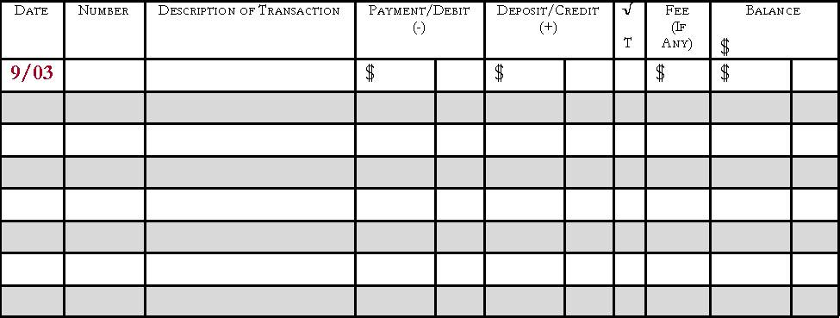
Check Register
Date
The date the check was written or transaction was made

Slide 17
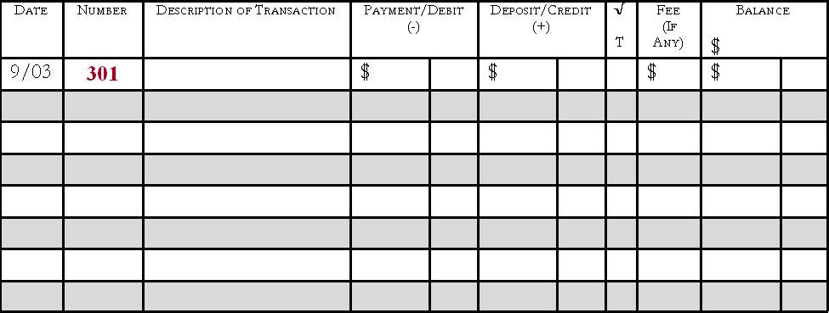
Check Register
Number
The number of the written check; if a debit card or ATM was used, write DC or ATM

Slide 18
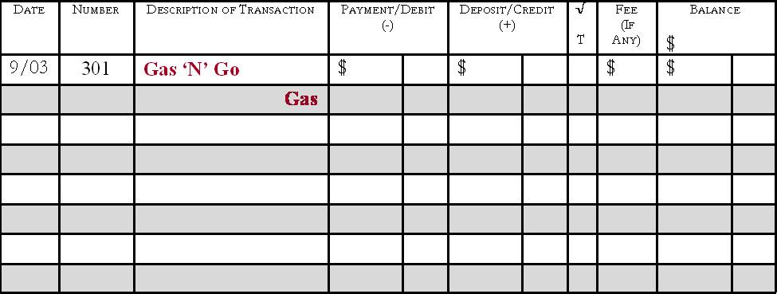
Check Register
Description of Transaction
The person/business the check was written to or where the debit card was used
Gray line can be used to write the memo

Slide 19
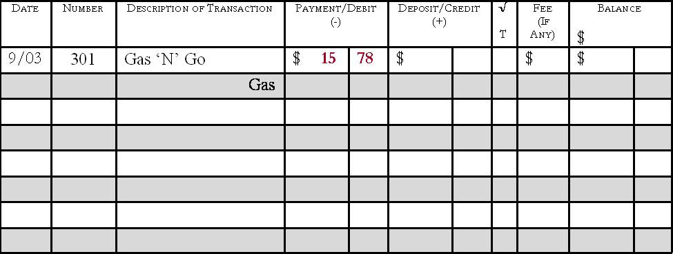
Check Register
Payment/Debit(-)
Amount of the transaction
Deducted from the balance

Slide 20
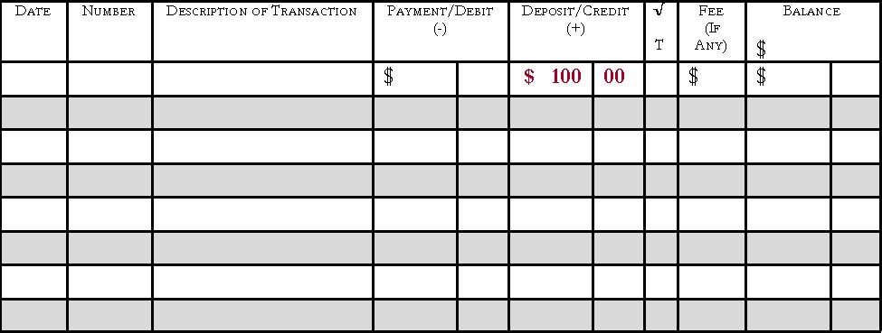
Check Register
Deposit/Credit(+)
Amount of the transaction
Added to the balance

Slide 21
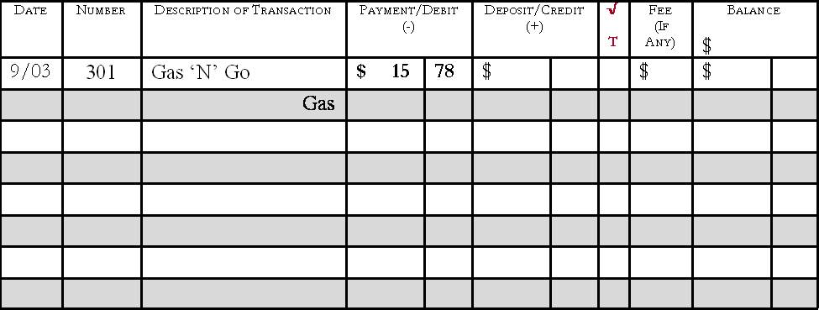
Check Register
√ T
A box used to track whether the check has cleared on the monthly bank statement when reconciling at the end of each month

Slide 22
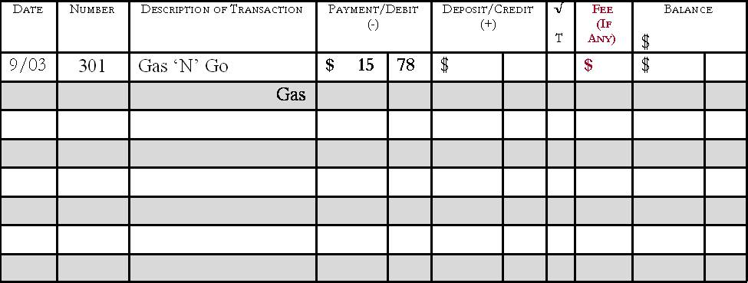
Check Register
Fee (if any)
Any extra fees charged to the account
Listed on the bank statement

Slide 23
Check Register
Balance
The running total of the checking account
Calculated by adding or subtracting each transaction
Keep this updated

Slide 24
Bouncing a Check
Check written for an amount over the remaining balance in the account
“Bounces” due to insufficient funds
Fee charged
Harms personal credit

Slide 25
Endorsing a check
Endorsement: signature (approves that it can be cashed or deposited)
Must be endorsed

Slide 26
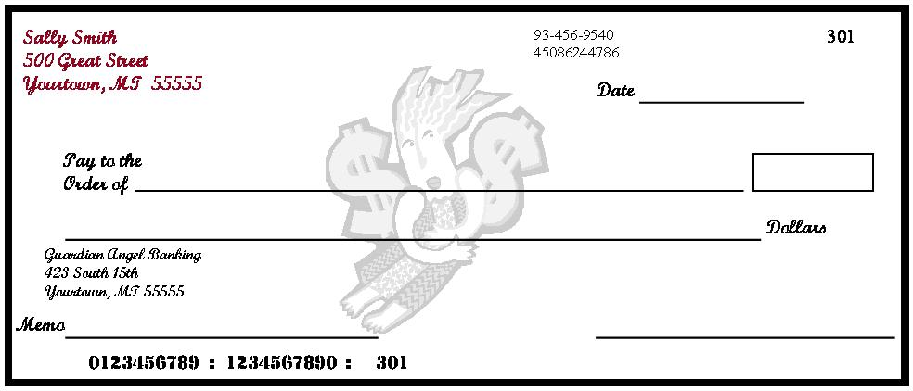
Writing a Check
Personal Information
Account holder’s name and address
May include a phone number, not required
DO NOT list a social security number for safety reasons

Slide 27
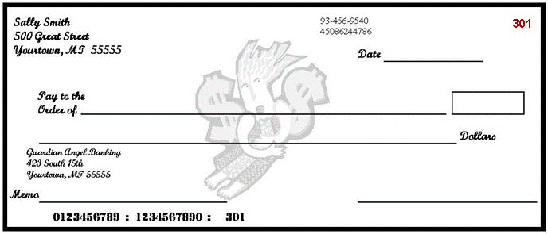
Writing a Check
Check Number
Numbers used to identify checks
Printed chronologically

Slide 28
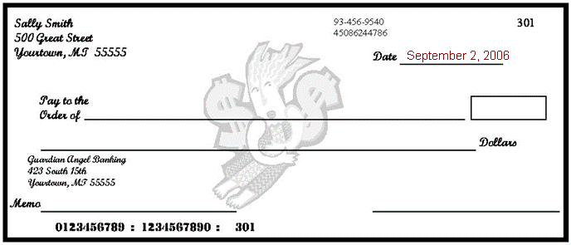
Writing a Check
Date
The date the check is written

Slide 29
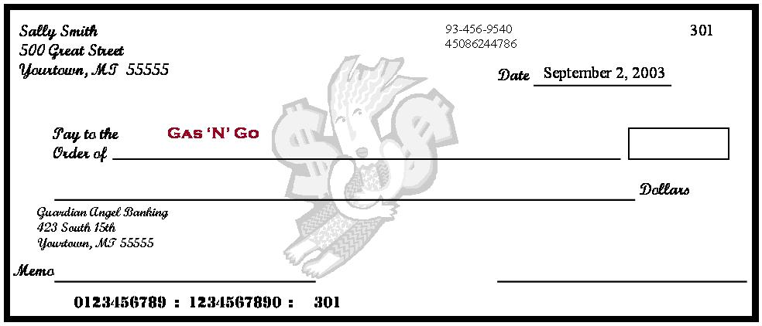
Writing a Check
Pay to the Order of
The name of the person or business to whom the check is being written

Slide 30
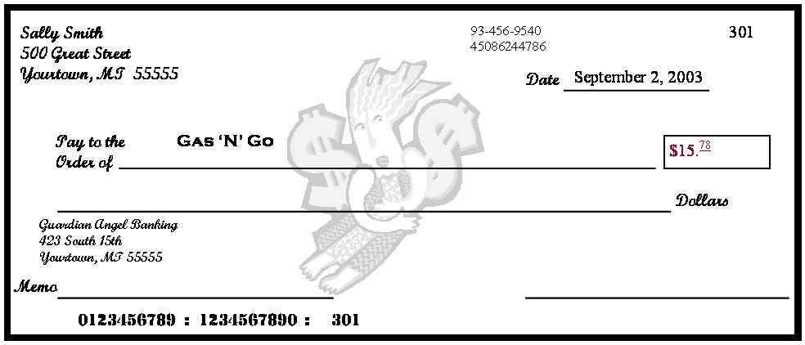
Writing a Check
Amount of the Check in Numerals
The amount of the check written numerically in the box
Write the cents smaller and underline
Write the numbers directly next the dollar sign to prevent someone else from adding numbers to change the amount

Slide 31
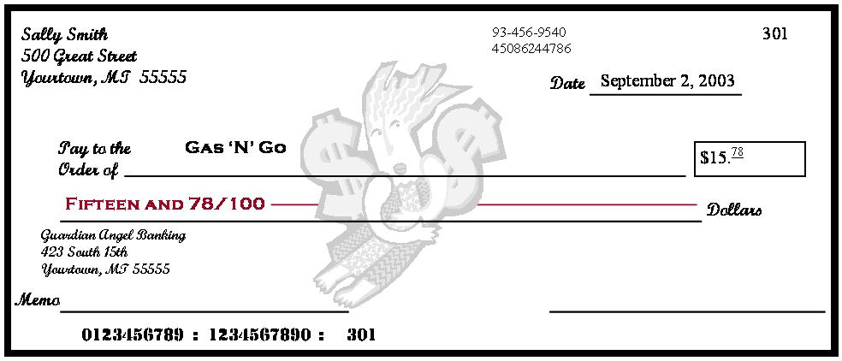
Writing a Check
Amount of the Check in Words
The amount of the check written in words on the second line
Start at the far left of the line, write the amount in words, followed by ‘and’, and the amount of cents over 100; draw a line from the end of the words to the word ‘dollars’

Slide 32
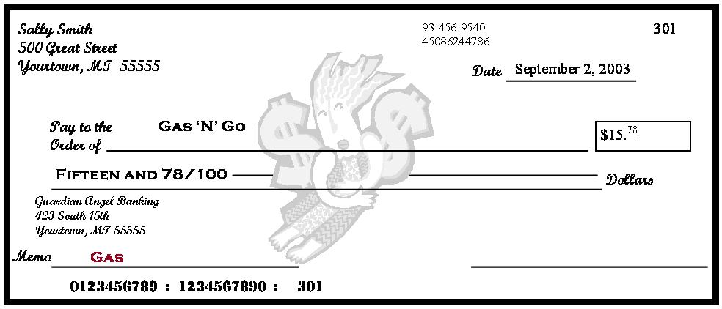
Writing a Check
Memo
Space used to identify the reason for writing a check; optional
Good place to write information requested by a company when paying a bill, generally the account number

Slide 33
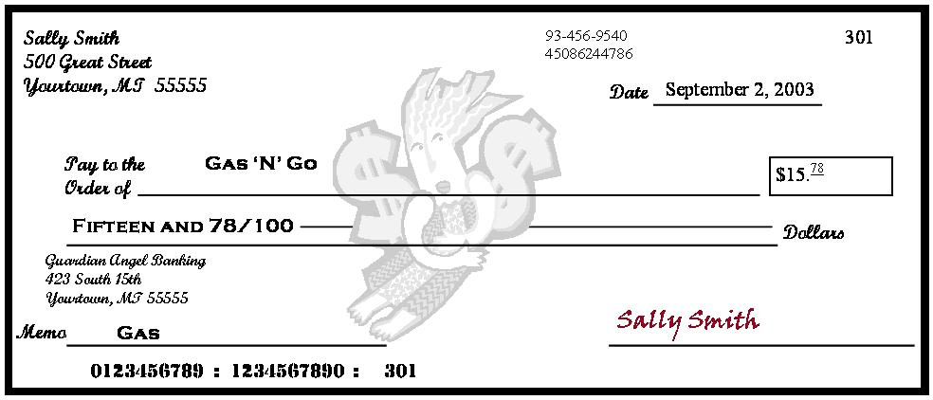
Writing a Check
Signature
The account holder’s signature agreeing to the transaction

Slide 34
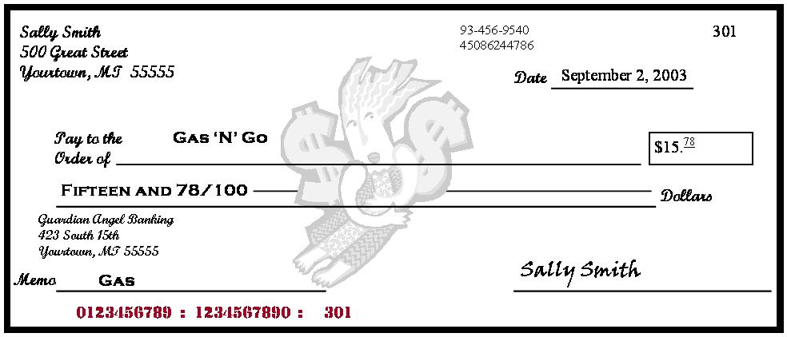
Writing a Check
Identification Numbers
First - routing numbers to identify the account’s financial institution
Second - account number
Third - check number

Slide 35
Writing a Check Exercise

Slide 36
Making a Deposit
Deposit slip
Contains the account holder’s account number and allows money (cash or check) to be deposited into the correct account
Located in the back of the checkbook

Slide 37
Making a Deposit
Complete a deposit slip to make a deposit
Deposited amount must be recorded in the checking account register to keep the balance current
Deposits can be made at an ATM or with a bank teller

Slide 38
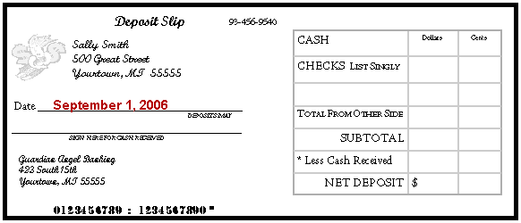
Completing a Deposit Slip
Date
The date the deposit is being made

Slide 39
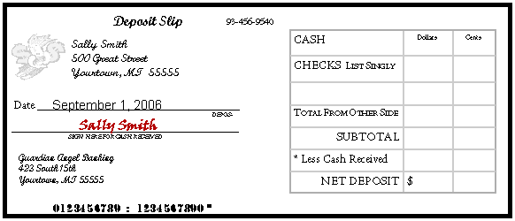
Completing a Deposit Slip
Signature Line
Sign this line to receive cash back

Slide 40
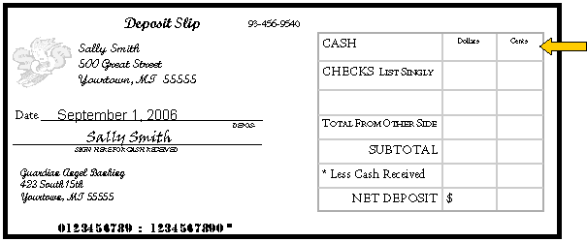
Completing a Deposit Slip
Cash
The total amount of cash being deposited

Slide 41
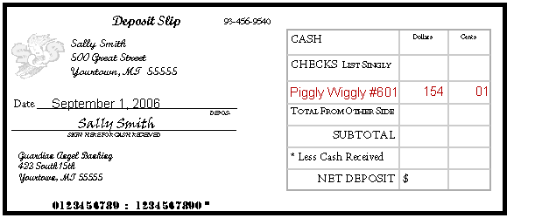
Completing a Deposit Slip
Checks
List each check individually
Identify each check on the deposit slip by abbreviating the name of the check writer

Slide 42
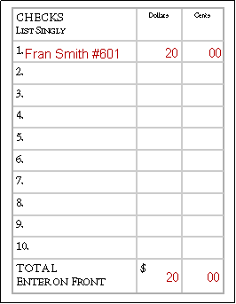
Completing a Deposit Slip
Checks
If more checks are being deposited than number of spaces on the front, use the back
List each check
Add the total, enter it on the front

Slide 43
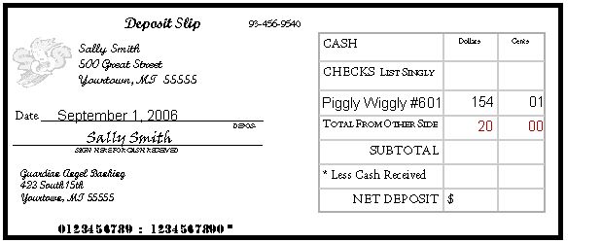
Completing a Deposit Slip
Total from Other Side
The total amount from all checks listed on the back

Slide 44
Completing a Deposit Slip
Subtotal
The total amount of cash and checks

Slide 45
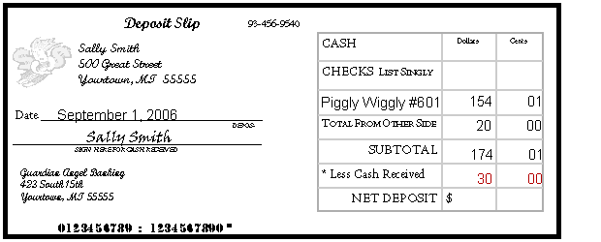
Completing a Deposit Slip
Less Cash Received
The amount of cash back being received
This amount is not deposited into account

Slide 46
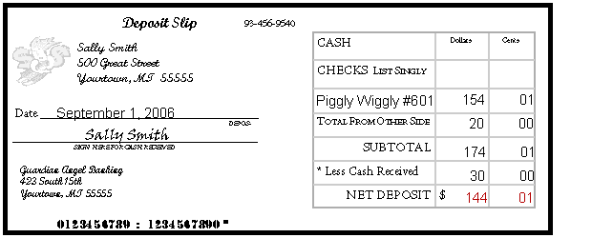
Completing a Deposit Slip
Net Deposit
The amount being deposited into the account
To calculate the amount, subtract the cash received from the subtotal

Slide 47
Withdrawals
Withdrawal slips may also be filled out to take money out of your account
Most people use the ATM instead

Slide 48
Monthly Bank Statement
Lists each transaction and current account balance (available via mail or online)
Deposits
Checks
Debit Card transactions
ATM transactions
Additional fees

Slide 49
Safety
If a checkbook, ATM, and/or debit card becomes lost or stolen
Immediately report it to the financial institution
File a report with the police
Reported lost/stolen checkbook:
Financial institutions generally do not hold the account holder liable for any fraudulent charges
Fees may be involved

