Slide 1
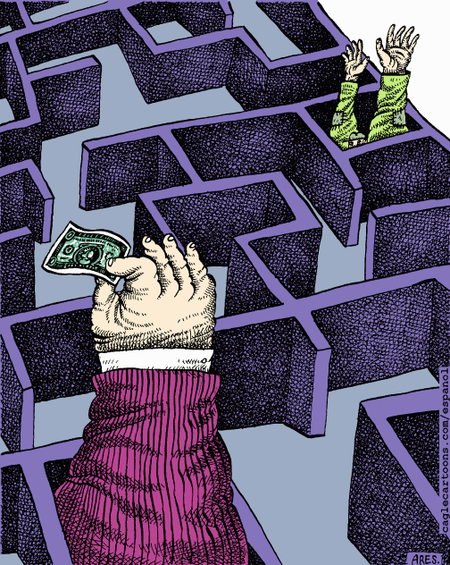
Campaign Finance
AP & US Government
“There are two things that are important in politics.
The first is money and I can’t remember what the second one is.”
—Ohio political boss and U.S. Senator Mark Hanna, 1895

Slide 2
How much does it cost to run for president?
George W. Bush (R) | $345,259,155
John Kerry (D) | $310,013,730
Ralph Nader | $4,563,877
$74.6 million in public financing during the general election
$74.6 million in public financing during the general election
$0
Total spending by all presidential candidates = $717.9 million
Source: http://www.opensecrets.org/presidential/index.asp?sort=E

Slide 3
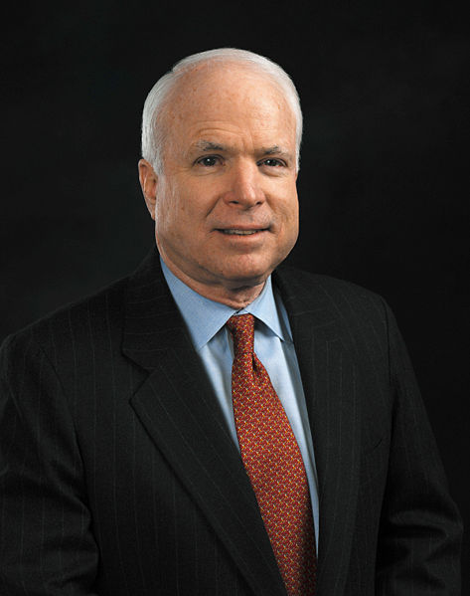
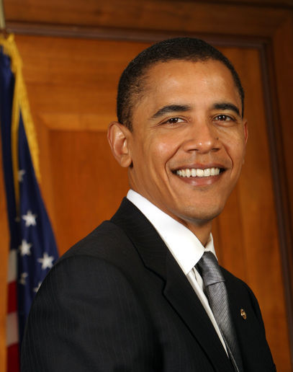
How much does it cost to run for president?
Barack Obama (D) | $730 million
John McCain (R) | $333 million
$84 million in public financing during the general election
Rejected public financing
Total spending by all presidential candidates = $1.76 billion
Source: http://www.opensecrets.org/presidential/index.asp?sort=E

Slide 4
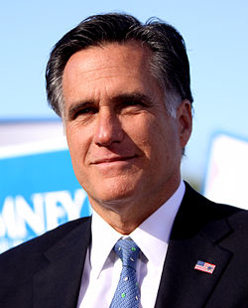
How much does it cost to run for president?
Barack Obama (D) | $541 million
Mitt Romney (R) | $336 million
First incumbent president to rejected public financing
Rejected public financing
Total spending by all presidential candidates = $1.96 billion
Source: http://www.opensecrets.org/presidential/index.asp?sort=E

Slide 5
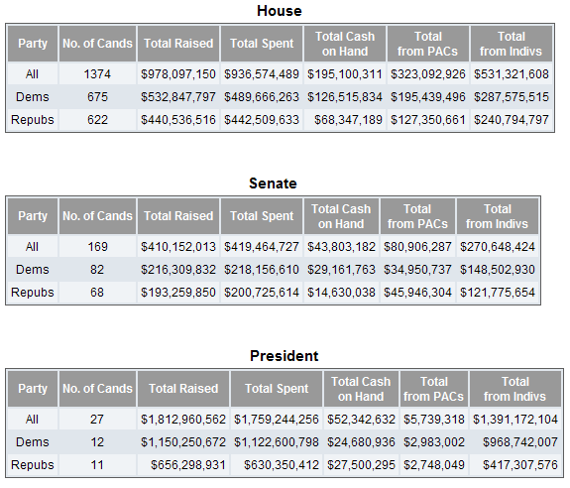
Notes:
2008

Slide 6
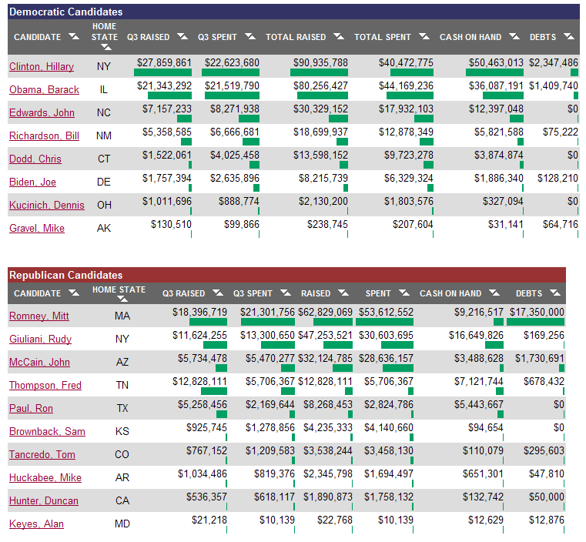
Notes:
2008

Slide 7
Washington on the “customary means of winning votes”
28 gallons of rum
50 gallons of rum punch
34 gallons of wine
46 gallons of beer
2 gallons of cider royal
There were only 391 eligible voters in his district!

Slide 8
Lincoln’s Campaign Expenses in 1846
75¢ for a barrel of cider
“I did not need the money. I made the canvass on my own horse; my entertainment, being at the houses of friends, cost me nothing; and my only outlay was seventy-five cents for a barrel of cider, which some farm-hands insisted I should treat them to.”

Slide 9
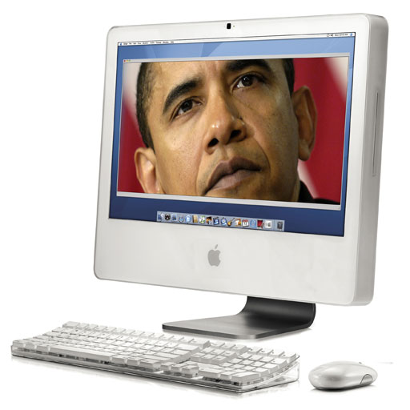
Why do we spend so much more today?
Expansion of the electorate:
Increasing government involvement in the economy:
Cost of mass media
Notes:
Expansion of the electorate:
The 17th Amendment was passed in 1913. It instituted the direct popular election of U.S. Senators.
About the same time, most states turned from party nominating conventions to direct primaries.
With the ratification of the 19th Amendment in 1920, women won the right to vote.
Increasing government involvement in the economy:
Corporate tax policy
Anti-trust law
Cost of mass media
Television markets
Internet

Slide 10
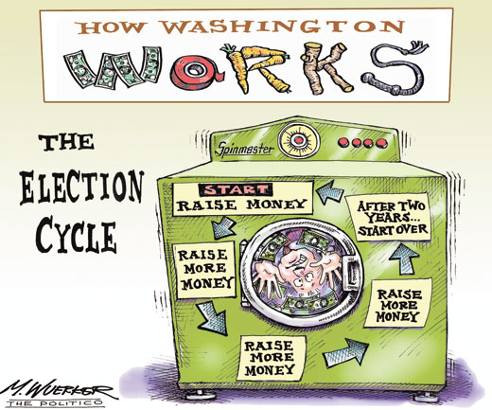
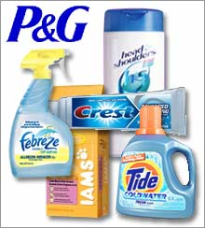
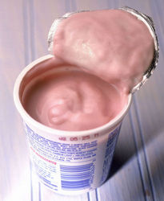
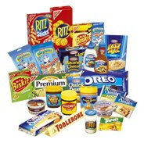
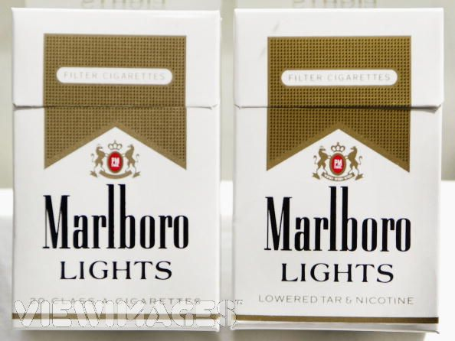
Do we spend too much on political campaigns?
231 million voting age citizens = $7.62 per person
213 million voting eligible citizens = $8.67 per person
172 million registered voters = $10.23 per person
131 million votes cast = $13.43 per person

Slide 11
Where does all this money come from?
Answer #1: Public financing
Do you want $3 of your federal tax to go to the Presidential Election Campaign Fund?
□ Yes
□ No

Today, just 11% of taxpayers check off the box that allocates $3 to the federal election campaign fund—down from 28% two decades ago.

Slide 12
Who Receives the Checkoff Dollars?
Presidential Nominees in the General Election.
Presidential Primary Candidates.
Party Nominating Conventions.
Source: http://www.fec.gov/info/checkoff.htm
Notes:
Presidential Nominees in the General Election. The Republican and Democratic nominees in the general election receive a fixed amount of checkoff dollars. Nominees from other political parties may qualify for a smaller, proportionate amount of checkoff funds if they receive over five percent of the vote.
Checkoff dollars are given only to presidential candidates who demonstrate broad-based public support—defined as those who in the primary elections raise over $5,000 in each of 20 states (i.e., over $100,000), consisting of small contributions ($250 or less) from individuals.
General election nominees must agree not to accept any private contributions (from individuals or PACs, for example).
Candidates must promise not to spend more than $50,000 of their own money on their campaign.
Recipients of public funds must adhere to a limit on total spending.
Presidential Primary Candidates. Candidates in the Presidential primaries may receive checkoff dollars, in the form of matching funds. Contributions of up to $250 from individuals are matched dollar for dollar. PAC and party contributions are not matchable.
Party Nominating Conventions. The national parties receive checkoff funds to cover the costs of their national conventions held every four years to select their Presidential nominees.

Slide 13
Opting Out
Increasingly, major party candidates for president—including Bush, Kerry, and Dean in 2004—are opting out of the public finance system during the primary season.
Although matching funds could potentially bring in $18.7 million in taxpayer dollars to a campaign (by matching the first $250 on individual contributions), accepting public funds is conditioned by a $45 million spending limit. Bypassing the system allows candidates to raise unlimited cash, which creates an uneven playing field.
"Mr. ‘Change-Your-Opinion-for-Expediency’ is saying, ‘Oh, I’m now able to raise money. Maybe we should get out of the system.’”
—John Kerry on Dean’s decision to opt out of public financing
Shortly after, Kerry did the same…
Dean announcing to supporters that he will forego public financing for his primary campaign (CBS)

Slide 14
Opting Out
"Mr. ‘Change-Your-Opinion-for-Expediency’ is saying, ‘Oh, I’m now able to raise money. Maybe we should get out of the system.’”
—John Kerry on Dean’s decision to opt out of public financing
Candidates are increasingly opting out of public financing during the primary season.
Shortly after, Kerry did the same…
Dean announcing to supporters that he will forego public financing for his primary campaign.

Slide 15
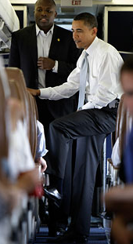
…the first major party candidate to drop out of the system…

Slide 16
Where does all this money come from?
Answer #2: Private donations
Individuals
PACs

Slide 17
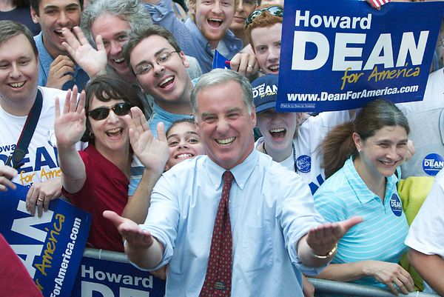
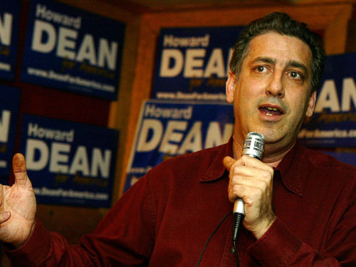
Where does all that money go?
In 2004, the Dean campaign raised $41.7 million
$7 million on advertising
$7 million on staff and consultants
$5 million on direct mailings
$2 million on travel
$2 million on technology
$2,772 at the Louisville Slugger Museum for personalized “Dean for America bats
$3,000 for cowbells given out at a single event
$6,000 on a single visit to Lake Champlain Chocolates
$300,000 for fleece jackets, hats, T-shirts with the “Dean for America” logo

Slide 18
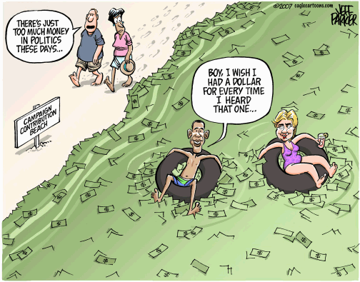
Does money buy elections?

Slide 19
Does money, at least, buy influence?
The real loser last week on Election Day appears to be Karl Rove, who now has to explain to his shadowy billionaire donors how he spent hundreds of millions of dollars in “independent” expenditures on Mitt Romney's behalf and came up a cropper… Of the nearly $103.6 million spent in the general election by [Rove’s super PAC] American Crossroads, only 1.29 percent ended in the “desired result.”

Slide 20
How can we possibly control this system?
Disclosure laws
Public financing laws
Contribution limits
Spending limits

Slide 21
Disclosure Laws
Major committee contributions to the Leahy for U.S. Senator Committee, 2004:
ACCENTURE PAC
AMERICAN ASSOCIATION OF ORAL AND MAXILLOFACIAL SURGEONS POLITICAL ACTION COMMITTEE
AMERICAN POSTAL WORKERS UNION COMMITTEE ON POLITICAL ACTION
INTERNATIONAL BROTHERHOOD OF ELECTRICAL WORKERS COMMITTEE ON POLITICAL EDUCATION
MACHINISTS NON PARTISAN POLITICAL LEAGUE
SERVICE EMPLOYEES INTERNATIONAL UNION COMMITTEE ON POLITICAL EDUCATION
The Leahy campaign also received contributions from 4,781 individuals.

Slide 22
Should contributions to political campaigns be disclosed like NASCAR sponsorships? Is that enough?

Slide 23
1974 FECA Amendments
Imposed contribution limits, including an individual $1,000 limit
Imposed expenditure limits, including an individual $1,000 limit
Required disclosure reports to be filed by those collecting contributions or making expenditures
Created voluntary public financing system for presidential candidates
Created the Federal Election Commission

Slide 24
Federal Election Commission
Purpose
to administer and enforce the Federal Election Campaign Act (FECA), the statute that governs the financing of federal elections.
The duties of the FEC, which is an independent regulatory agency, are to
disclose campaign finance information
enforce the provisions of the law such as the limits and prohibitions on contributions,
oversee the public funding of Presidential elections.

Slide 25
Hard $ vs Soft $
“Hard money” refers to donations made directly to political candidates. These must be declared with the name of the donor, which becomes public knowledge, and are limited by legislation.

Slide 26
Hard $ vs Soft $
“Soft money” is money that is not made directly to a candidate's campaign, but is spent on an activity, especially issue advertising, which promotes a candidate’s positions or funds thinly veiled attacks on the opponent’s positions, that obviously benefit the candidate.
Since it is not actually received or spent by the candidate’s campaign, there are no legal limits.

Slide 27
Buckley v. Valeo (1976)
The Court upheld the constitutionality of certain provisions of the election law, including:
By upholding contribution limits, money became harder to raise.
Limitations on contributions to candidates for federal office
Optional public funding of presidential elections
Reporting and disclosure requirements
Creation of the Federal Elections Commission (FEC)
The Court declared other provisions of the FECA to be unconstitutional, in particular:
The limitations on expenditures by candidates and their committees, except for presidential candidates who accept public funding.
By striking down spending limits, the demand for money increased.
“A restriction on the amount of money a person or group can spend on political communication during a campaign necessarily reduces the quantity of expression by restricting the number of issues discussed, the depth of the exploration, and the size of the audience reached. This is because virtually every means of communicating ideas in today's mass society requires the expenditure of money.”

Slide 28
Bipartisan Campaign Reform Act (2002)
Increased contributions for individuals giving to federal candidates
Updated every 2 yrs by FEC
2015 – 2016:
$2700 (per candidate)
$5000 (per PAC)
More info: https://www.opensecrets.org/overview/limits.php

Slide 29
Is Money the Equivalent of “Speech”?
The Buckley case would seem to allow spending limits that are "narrowly tailored” toward “compelling governmental interests." Should the appearance of corruption be one of those conditions?

Slide 30
Is Money the Equivalent of “Speech”?
The First Amendment provides that “Congress shall make no law...abridging the freedom of speech...or the right of the people peaceably to assemble.” The right to assemble has been interpreted to include the freedom of association.
Using standard First Amendment tests, the Supreme Court has held campaign laws are constitutional if they are “narrowly tailored” to advance a “compelling public interest.”
In key cases such as Buckley v. Valeo, the Court has found that combating “corruption or the appearance of corruption” is such a compelling public interest, and upheld contribution limits.
Source: http://www.cfinst.org/eguide/legal.html#

Slide 31
Bipartisan Campaign Reform Act (2002)
“Hard money” refers to donations made directly to political candidates. These must be declared with the name of the donor, which becomes public knowledge, and are limited by legislation.
“Soft money” is money that is not made directly to a candidate's campaign, but is spent on an activity, especially issue advertising, which promotes a candidate’s positions or funds thinly veiled attacks on the opponent’s positions, that obviously benefit the candidate. Since it is not actually received or spent by the candidate’s campaign, there are no legal limits.
PACs and Super PACs
527s and 501(c)4s

Slide 32
“Electioneering Communications”
A central provision of the Bipartisan Campaign Reform Act (BCRA) was a ban on unlimited “soft” money contributions for “electioneering communications” by corporations, labor unions and wealthy individuals to the national political parties.
The communication refers to a clearly identified federal candidate;
The communication is publicly distributed by a television station, radio station, cable television system or satellite system for a fee (newspapers, magazines, and the internet are excempt);
The communication is distributed within 60 days prior to a general election or 30 days prior to a primary election to federal office.

Slide 33
Issue Ads and Eight Magic Words
Vote for
Elect
Support
Cast your ballot for
Smith for Congress
Vote against
Defeat
Reject

Slide 34
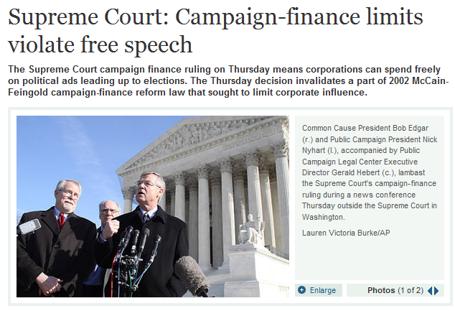
Citizens United

Slide 35
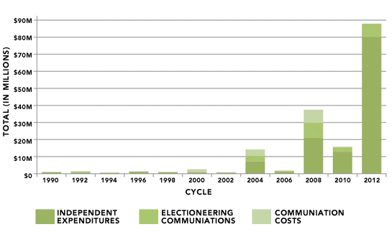
Citizens United Has Already Doubled The Amount Of Outside Spending In Presidential Election Years

Slide 36
Types of Advocacy Groups
Political action committees (PACs) – An organization formed for the purpose of influencing elections on a local, state or federal level. PACs may donate directly to a candidate’s campaign with limits on annual contributions to the PAC.
Super PACs – The FEC also allows for 527 Independent Expenditure PACs (or “Super PACs”). These are groups who make no contributions directly to the campaigns of any candidates, but instead make “independent expenditures” of their money to support their causes. They may engage in unlimited political spending as long as they do not coordinate directly with candidates or political parties. Also unlike traditional PACs, they can raise funds from corporations, unions and other groups, and from individuals, without legal limits. Donors must be disclosed.
Notes:
Political action committees (PACs) – An organization formed for the purpose of influencing elections on a local, state or federal level. PACs may donate directly to a candidate’s campaign with limits on annual contributions to the PAC.
Super PACs – The FEC also allows for 527 Independent Expenditure PACs (or “Super PACs”). These are groups who make no contributions directly to the campaigns of any candidates, but instead make “independent expenditures” of their money to support their causes. They may engage in unlimited political spending as long as they do not coordinate directly with candidates or political parties. Also unlike traditional PACs, they can raise funds from corporations, unions and other groups, and from individuals, without legal limits. Donors must be disclosed.

Slide 37
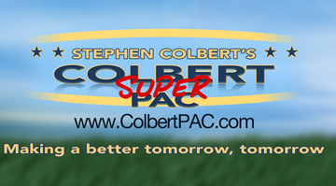
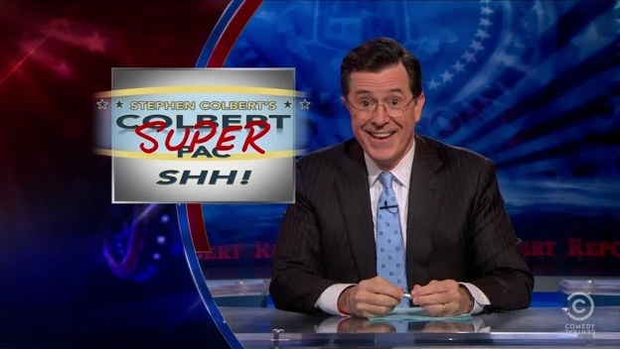

Slide 38
Types of Advocacy Groups
527 Groups
501(c)4 Groups
Citizens United "allowed non-profit corporations under the Tax Code 501(c) to spend unlimited amounts of money running... political advertisements while not revealing their donors."
Notes:
527 Groups - A tax-exempt group organized under section 527 of the Internal Revenue Code. These groups raise unlimited "soft money," which they use for voter mobilization and certain types of issue advocacy, but not for efforts that expressly advocate the election or defeat of a federal candidate. They must disclose their donors.
501(c)4 Groups — Nonprofit, tax-exempt groups organized under section 501(c) of the Internal Revenue Code. 501(c)(4) groups are commonly called “social welfare” organizations that may engage in political activities, as long as these activities do not become their primary purpose. These groups are not required to disclose their donors publically.

Slide 39
Contribution Limits, 2011-2012
 | To any candidate or candidate committee | To any national party committee | To any PAC or other political committee | Total
Time Period | per election | per calendar year | per calendar year | per calendar year
Individual can give | $2,500 (indexed for inflation) | $30,800 per party committee (indexed for inflation) | $10,000 to each state or local party committee $5,000 to each PAC or other political committee | $117,000 per two year election cycle as follows: $46,200 per cycle to candidates; and $70,800 per cycle to all national party committees and PACs (with a maximum $40,000 per cycle to PACs)
PACs (also known as Multi-Candidate Committees) can give | $5,000 | $15,000 | $5,000 | No limit
Other Political Committee can give | $1,000 | $20,000 | $5,000 | No limit
Federal law forces candidates to raise small amounts of money from many different contributors. While still difficult, the internet can make this possible (e.g., Howard Dean, Barack Obama).

Slide 40
Independent expenditures
Electioneering communications
Issue ads
Notes:
Independent expenditures, also known as express advocacy, are likely to be limited to ads, flyers, or the like that expressly advocate the election or defeat of a clearly identified candidate by using such words as "vote for," "defeat," or "support" a named candidate for office.
Electioneering communications also refer to a clearly identified candidate, but its message is subject to an interpretation other than it is expressly advocating for or against a particular candidate. Unlike independent expenditures, an electioneering communication does not use words such as "vote for" or "vote against" that expressly call for the election or defeat of the candidate. Only broadcast, cable, or satellite communications that are made within 60 days before the general election or 30 days before a primary, and are targeted to the relevant electorate in certain ways, qualify as electioneering communications.
Issue ads include any ads that address public policy issues and perhaps the position of particular public officials on those issues, but due to their wording or timing do not qualify as either independent expenditures or electioneering communications.

Slide 41
Type of entity engaging in outside spending | 501(c)(4)s (social welfare organizations) 501(c)(6)s (business leagues) | 501(c)(5)s (e.g., labor unions) | 527s not subject to FEC reporting requirements for political committees | Super PACs | All others required to register with FEC as a political committee maintaining federal account
Are there limits on the size of contributions that can be made to entity? | NO | NO | NO | NO | YES
Is entity making Independent Expenditures required to disclose most of its contributors? | NO | YES | YES | YES | YES
Is entity making Electioneering Communications required to disclose most of its contributors? | NO (corporations) YES (others) | YES | YES | YES | YES
Is entity engaging in Issue Ads required to disclose most of its contributors? | NO | YES | YES | YES | YES

Slide 42
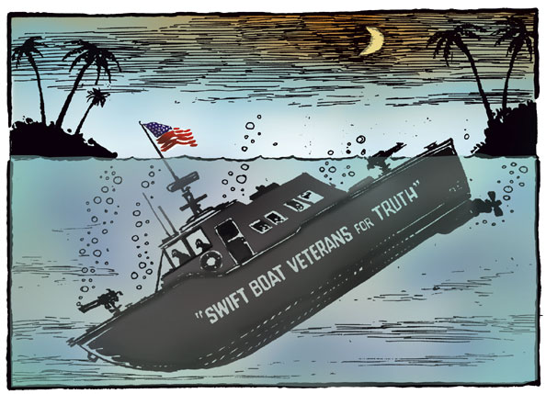
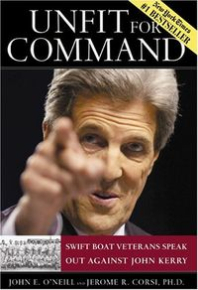
527s
Is there a difference between issue advocacy and candidate advocacy?

Slide 43
Under federal election law, coordination between an election campaign and a 527 group is not allowed.

Slide 44
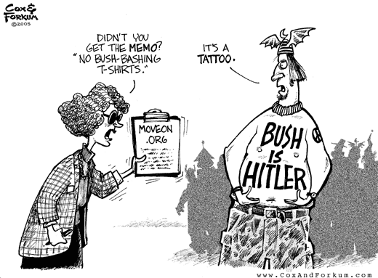
Following the 2004 presidential campaign, the FEC fined a number of organizations, including MoveOn.org and Swift Boat Veterans for Truth.
The FEC argued that these groups had specifically advocated for the election or defeat of candidates, making them subject to federal regulation and its limits on campaign contributions.

Slide 45
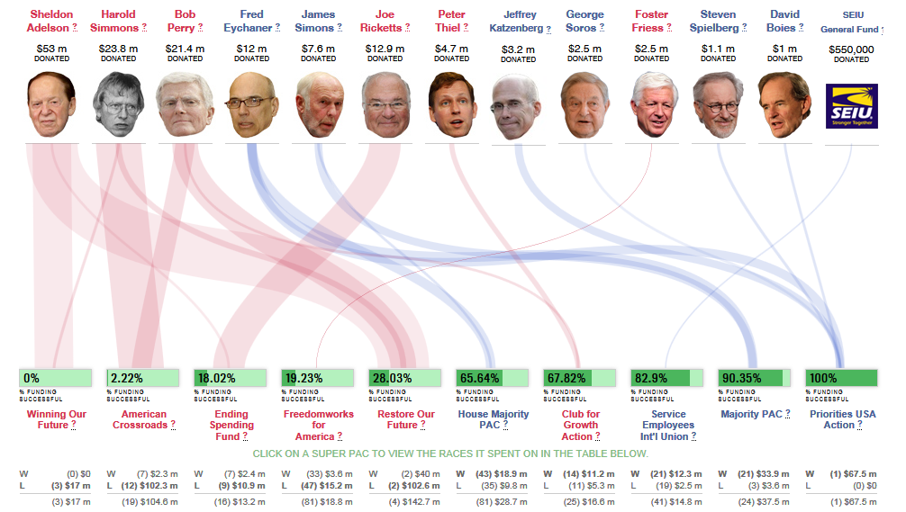
2012’s Winners and Losers

Slide 46
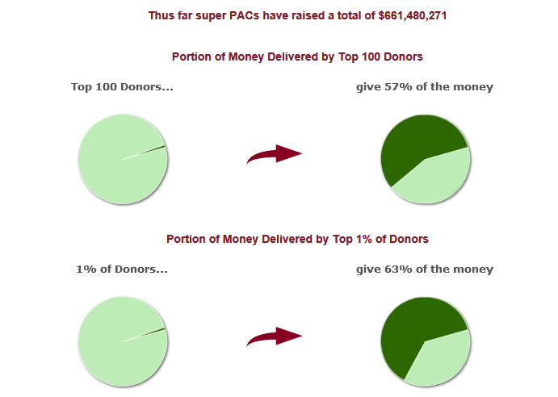
1,117 | Number of super PACs
$661,480,179 | Total raised by super PACs
$710,011,924 | Total spent by super PACs

Slide 47
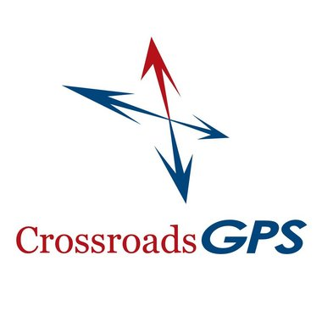
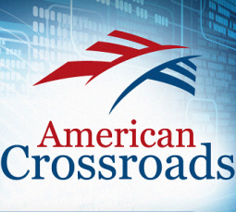
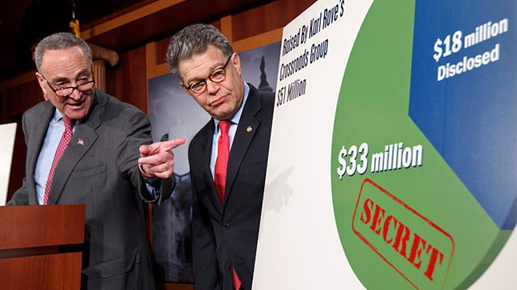
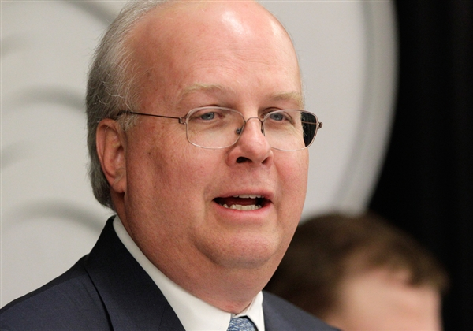
Karl Rove’s American Crossroads is a Super PAC, but Crossroads GPS (Grassroots Policy Strategies) is a non-profit 501(c)4 organization that is not required to report contributions or contributors to the FEC.

Slide 48
American Crossroads spent about $105 million in independent expenditures
Crossroads GPS spent $70.8 million.
The Center for Responsive Politics found that American Crossroads spent money for or against 20 congressional candidates in 14 election contests, with 3 of its preferred candidates winning, while Crossroads GPS spent money for or against 27 federal candidates in 24 elections, with 7 of its preferred candidates winning.

Slide 49
Banning “Soft Money”
The central provision of the Bipartisan Campaign Reform Act (BCRA), otherwise known as the McCain-Feingold law, is a ban on unlimited “soft” money contributions by corporations, labor unions and wealthy individuals to the national political parties. In an effort to further curb the influence of corporate and labor money on federal elections, the bill's sponsors included restrictions on certain types of advertising just before an election.
The law applies to “electioneering communications,” which are defined as broadcast ads (television or radio) airing within 30 days of a primary election or 60 days of a general election that mention or refer to a federal candidate and are aimed at 50,000 or more members of the electorate of the office the candidate is seeking.
Still, individuals can spend as much of their own money as they want, whenever they want, on ads that mention a federal candidate, as long as the individual does not "coordinate" with the candidate's campaign.

Slide 50
Political Action Committees
A Political Action Committee (PAC) is a common term for a political committee set up for the purpose of raising and spending money to elect and defeat candidates. Most PACs represent ideological, business or labor interests.
The following are federal campaign spending limits for PACs, which are in accordance with the Bipartisan Campaign Reform Act of 2002.
A PAC can give $5,000 to any candidate committee per election, primary, general or special.
They can also give up to $15,000 annually to any national party committee, and $5,000 annually to any other PAC.
PACs may be given up to $5,000 from any one individual, PAC or party committee per calendar year.
A PAC must register with the Federal Election Committee, in 10 days of its formation, providing name and address for the PAC, its treasurer and any connected organizations.

Slide 51
The Rise of 527s
 | Committee | Expenditures
1 | America Coming Together | $78,040,480
2 | Joint Victory Campaign 2004 | $72,588,053
3 | Media Fund | $57,694,580
4 | Service Employees Int’l Union | $47,730,761
5 | Progress for America | $35,631,378
6 | American Federation of State, County, and Municipal Employees | $26,170,411
7 | Swift Vets & POWs for Truth | $22,565,360
8 | MoveOn.org | $21,565,803
9 | College Republican National Committee | $17,260,655
10 | Club for Growth | $13,074,256
Often called “soft money” PACs, a §527 organization can accept contributions in any amount from any source.
Because 527 organizations do not make expenditures that directly advocate for the election or defeat of candidates they are largely unregulated by the FEC and not subject to the same limits.
One of the leading Democratic interest groups, ACT was dedicated to defeating President Bush in November 2004. Run by longtime Democratic operatives and financed in part by wealthy Democratic donors, the group financed a massive voter mobilization effort in 17 battleground states.
Source: http://www.opensecrets.org/527s/527cmtes.asp?level=X&format=&cycle=2004

Slide 52
Has Money Corrupted Our Electoral Process?
What does money have to do with democracy? A great deal!
It gives wealthy people and groups and unfair advantage in influencing the election outcome;
It affects who votes and how they vote;
It becomes a condition for who runs for office and who does not;
It affects information that the electorate receives about the candidates and their issue positions;
It affects public perceptions of how the system is working and whether it is fair;
Source: Stephen J. Wayne, Is This Any Way to Run a Democratic Election? (2001): 85.

Slide 54
 | Primary Candidates | GENERAL ELECTION
 |  | Major Party Nominees | Minor/New Party Nominees
National Spending Limit | $10 mil. + COLA | $20 mil. + COLA | $20 mil. + COLA
State Spending Limit | The greater of $200,000 + COLA or $0.16 x state VAP | None | None
Exempt Fundraising Limit | 20% of national limit | Not applicable | 20% of national limit
Maximum Public Funds Candidate May Receive | 50% of national limit | Same as national limit | Percentage of national limit based on candidate's popular vote.
National Party Spending Limit for Candidate | Not applicable | $0.02 x VAP of U.S. + COLA | $0.02 x VAP of U.S. + COLA
Limit on Spending from Candidate's Personal Funds | $50,000 | $50,000 | $50,000

