Slide 1
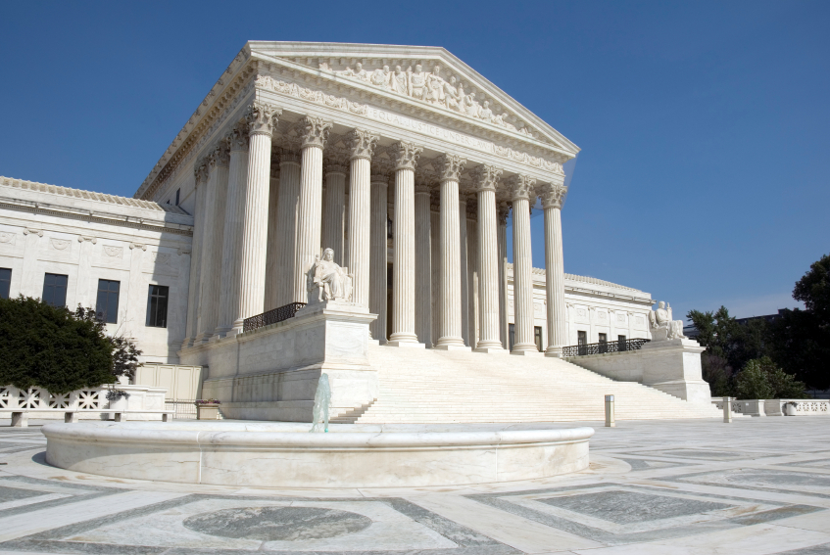
Landmark Court Cases
By: Brendon Burrows

Slide 2
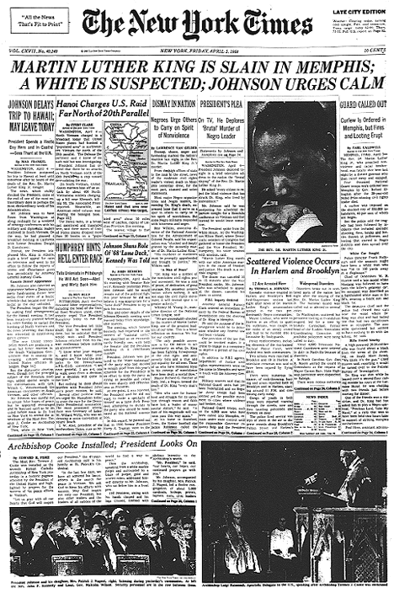
New York times co. v. Sullivan (1964)

Slide 3
Facts of the Case
Decided together with Abernathy v. Sullivan, this case concerns a full-page ad in the New York Times which alleged that the arrest of the Rev. Martin Luther King, Jr. for perjury in Alabama was part of a campaign to destroy King's efforts to integrate public facilities and encourage blacks to vote. L. B. Sullivan, the Montgomery city commissioner, filed a libel action against the newspaper and four black ministers who were listed as endorsers of the ad, claiming that the allegations against the Montgomery police defamed him personally. Under Alabama law, Sullivan did not have to prove that he had been harmed; and a defense claiming that the ad was truthful was unavailable since the ad contained factual errors. Sullivan won a $500,000 judgment.

Slide 4
Constitutional question
Did Alabama's libel law, by not requiring Sullivan to prove that an advertisement personally harmed him and dismissing the same as untruthful due to factual errors, unconstitutionally infringe on the First Amendment's freedom of speech and freedom of press protections?

Slide 5
Implications
It established that the First Amendment protects the publication of all statements, even false ones, about the conduct of public officials except when statements are made with actual malice (with knowledge that they are false or in reckless disregard of their truth or falsity).

Slide 6
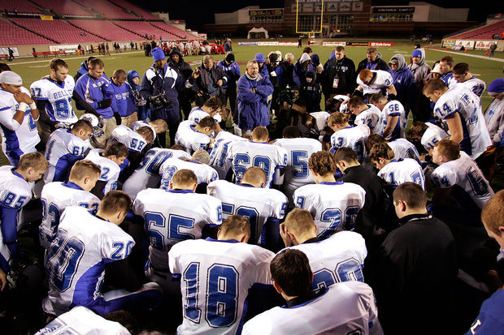
Sante fe independent school district v. newdow (2004)

Slide 7
Facts of the case
Prior to 1995, a student of Santa Fe High School delivered a prayer, described as overtly Christian, over the public address system before each home varsity football game. One Mormon and one Catholic family filed suit challenging this practice and others under the Establishment Clause of the First Amendment. The District Court enjoined the public Santa Fe Independent School District (the District) from implementing its policy as it stood. The District Court entered an order modifying the policy to permit only nonsectarian, nonproselytizing prayer. The Court of Appeals held that, even as modified by the District Court, the football prayer policy was invalid. The District petitioned for a writ of certiorari, claiming its policy did not violate the Establishment Clause because the football game messages were private student speech, not public speech.

Slide 8
Constitutional questions
Does the Santa Fe Independent School District's policy permitting student-led, student-initiated prayer at football games violate the Establishment Clause of the First Amendment?

Slide 9
Implications
It is important because it upheld that the policy allowing the student-led prayer at football games was unconstitutional.
This diminished any potential problems regarding public (not private) prayer that could offend/disturb any who have different religious views or any who disagree.

Slide 10
Sources
http://www.oyez.org/cases

