Slide 1
APUSH Review: Key Terms, People, and Events Specifically Mentioned In The New Curriculum!
Part II: 1865 - Present
Periods 6 - 9 (50% Of The New Curriculum)

Slide 2
Period 6 Overview (1865 - 1898)
Test Structure:
Period 6 is roughly 13% of the curriculum
Essay topics could include:
Comparing and contrasting goals of farmers and industrial workers
Successes/failures of Reconstruction during this time period
Why was 1865 - 1898 chosen for the dates?
1865 = End of the Civil War
1898 = Beginning of the Spanish-American War (US imperialism/overseas expansion)
This time period focuses on the Gilded Age, Social Darwinism, the Growth of Labor Unions, the Populist Party and continued US expansion out West

Slide 3
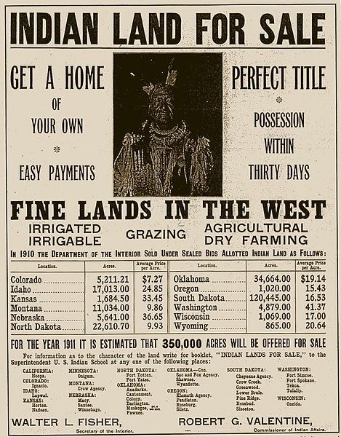
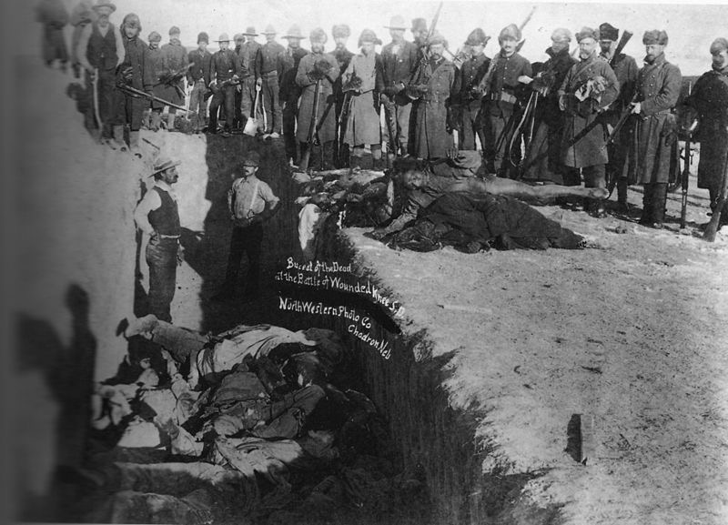
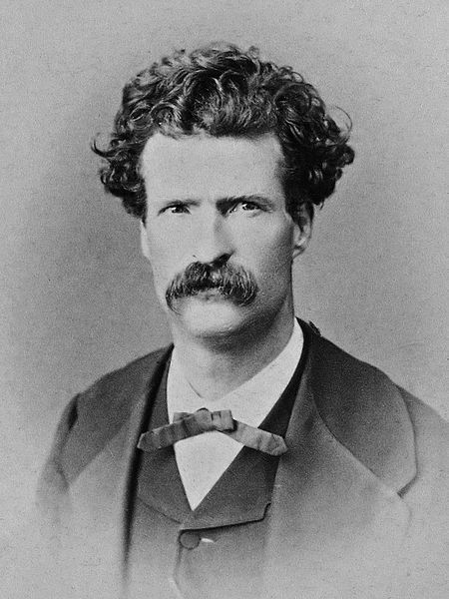
Period 6 Overview (1865 - 1898)
Gilded Age - coined by Mark Twain
On the surface, things appeared as if they were good, but many problems lied underneath
Political debates focused on tariffs, currency, corporate expansion (monopolies and trusts)
Post-Civil War, the US government encouraged westward expansion
Subsidies to railroads, cheap land for Americans
This expansion led to conflicts with Natives, treaties were violated
Near extinction of the buffalo
Relations with Natives?
US used military force (Wounded Knee - 1890)
Pursued a policy of assimilation (Dawes Act - sought to end tribal identities)

Slide 4
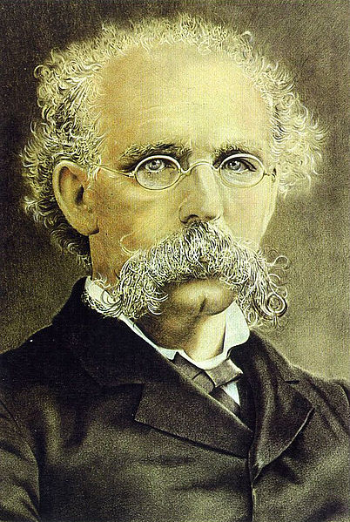
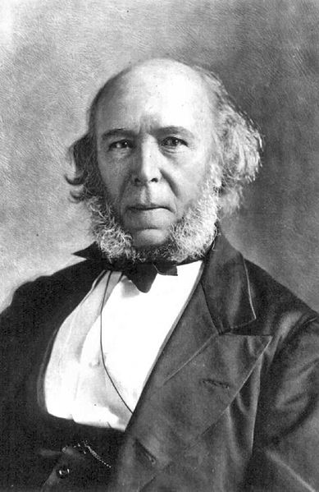
Period 6 Overview (1865 - 1898)
Businesses consolidated their power
Justified through Social Darwinism, Gospel of Wealth
Conflicts emerged between businesses and conservationists over natural resources
Workers organized into local and national unions
Knights of Labor - skilled AND unskilled, AFL - unskilled only
Government often sided with business in labor disputes
The “New South”
Some advocated the South begin to industrialize
However, sharecropping and tenant farming persisted throughout the South

Slide 5
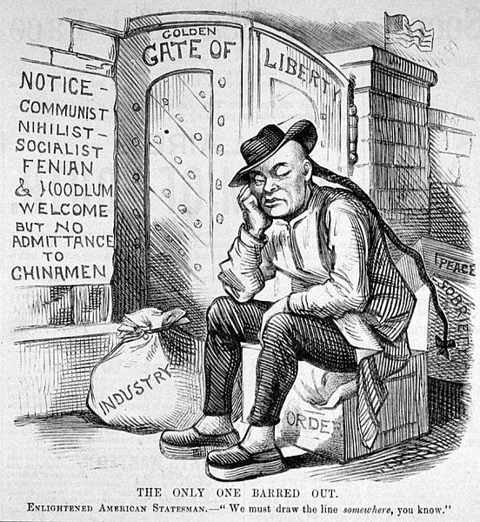
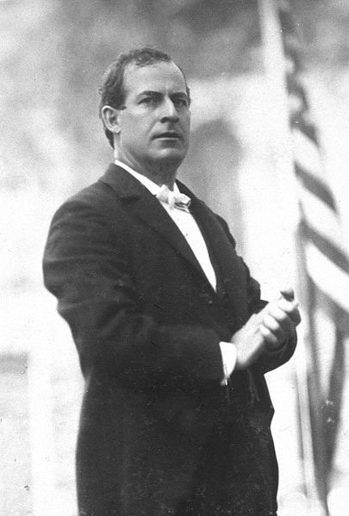
Period 6 Overview (1865 - 1898)
Farmers
Mechanized agriculture hurt many farmers
Created organizations to challenge RRs and corporate control of markets
Populist Party - People’s Party
Advocated political reform and increased government involvement in the economy
Omaha Platform:
Graduated income tax, gov’t control of RRs and telegraphs, Free Silver
Many Populist ideas were adopted during the Progressive Era
Immigration:
Increased from Asia and Southern and Eastern Europe
Led to Nativism - Chinese Exclusion Act
Many Americans hoped to “Americanize” and preserve their cultural identities
Social Gospel - Protestant Church movement that sought to end social issues in cities

Slide 6
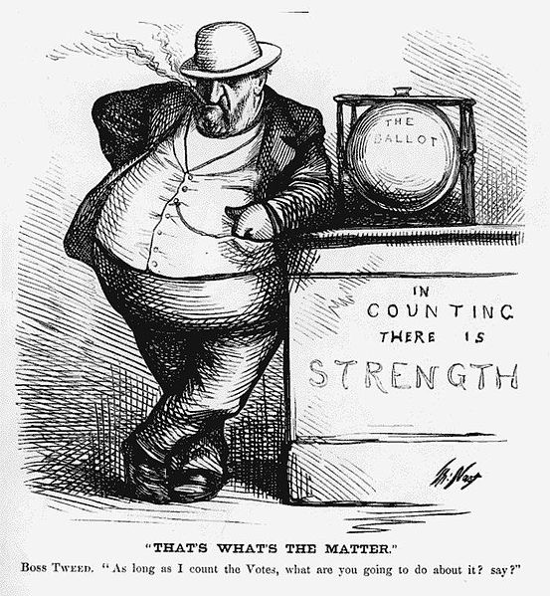
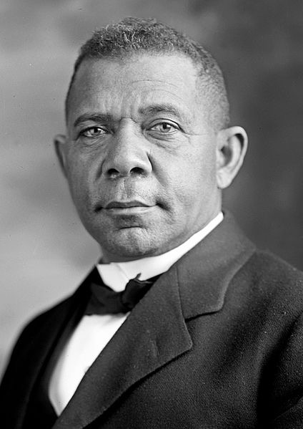
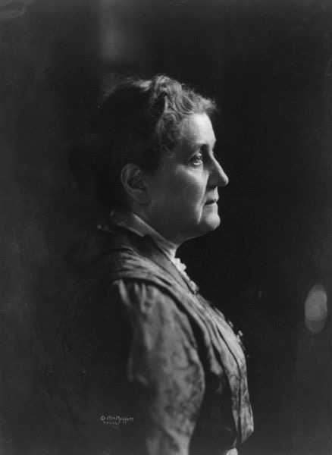
Period 6 Overview (1865 - 1898)
City Life
As cities became more crowded, emergence of:
Political machines - provided services for political support (Boss Tweed and Tammany Hall)
Settlement Houses - helped immigrants and women adapt to American Society (Jane Addams’ Hull House)
Discrimination, violence, and segregation was rampant in the country:
American Protective Association - sought to keep Catholics out of office
Plessy v. Ferguson - upheld Jim Crow laws
Activists that challenged their prescribed “place”
Booker T. Washington - advocated vocational training for African Americans, Ida B. Wells - outspoken critic of lynching

Slide 7
Period 7 Overview (1890 - 1945)
Test Structure:
Period 7 is roughly 17% of the curriculum (LARGEST time period!)
Essay topics could include:
Turning Points in US History for: Spanish-American War, Progressive Era, and Great Depression/New Deal
Change and Continuities for immigrants/African Americans/foreign policy
Why was 1890 - 1945 chosen for the dates?
1890 = “Closing” of the frontier - led to expansion overseas
1945 = End of WWII, shift in US foreign policy
This time period focuses on the US expansion overseas, reform in the Progressive Era, WWI and WWII, as well as the Great Depression and the US’ response to it

Slide 8
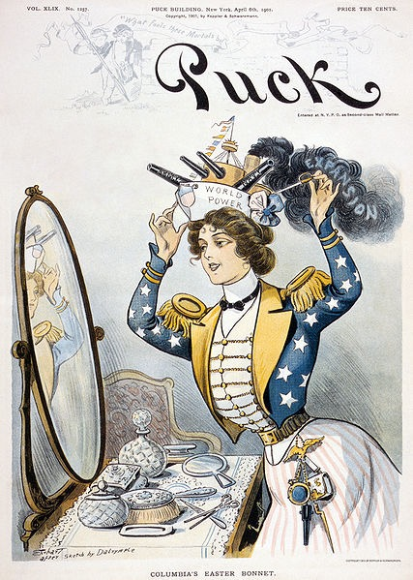
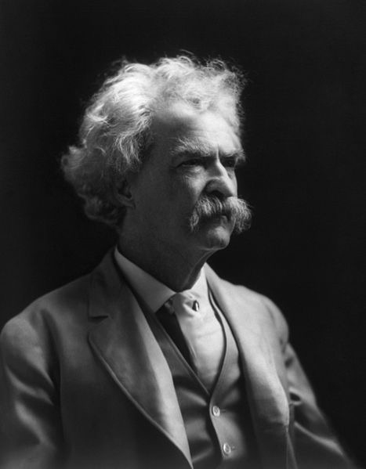
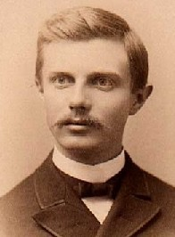
Period 7 Overview (1890 - 1945)
Reasons for overseas expansion (Great Short Answer ?)
Frontier was “closed” - Frederick Jackson Turner
Economic motives - $ for businesses and desire for increased trade
Competition with European imperialists (China)
Racial theories - “White Man’s Burden”
Spanish American War
US defeated Spain in 4 months
Gained Guam, Puerto Rico and the Philippines
Debates between imperialists (Teddy Roosevelt, McKinley) and anti-imperialists (William Jennings Bryan, Anti-imperialist League)
Long insurrection in the Philippines

Slide 9
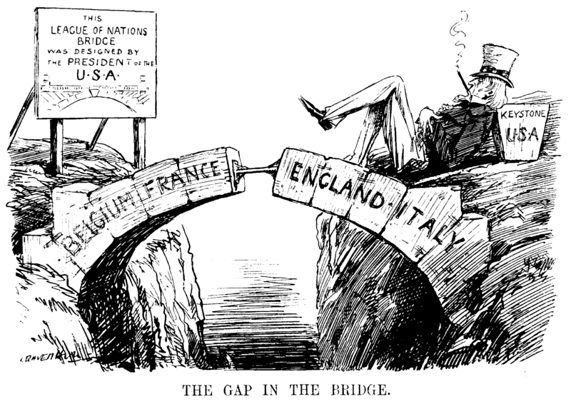
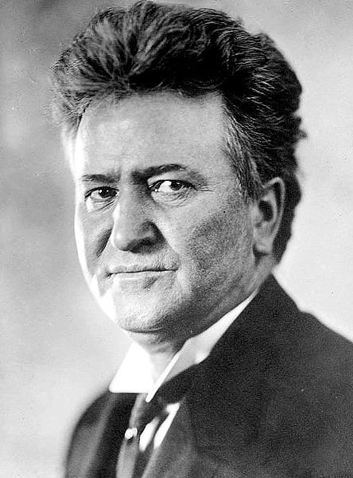
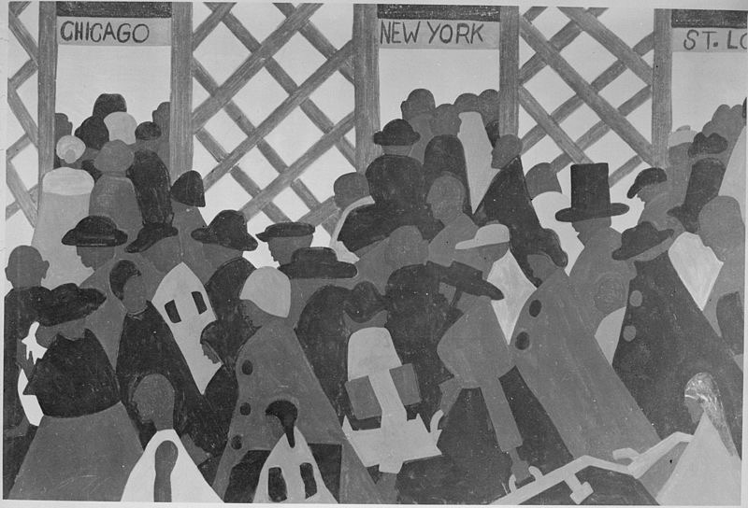
Period 7 Overview (1890 - 1945)
Progressive Era (1890 - 1920)
Advocated government intervention in the economy (Meat Inspection Act, Hepburn Act)
Sought to expand democracy (17th amendment, initiative, referendum, recall)
Progressive tended to be women, middle-class, live in cities
World War I (1914 - 1918)
US initially was neutral, played a limited role - Wilson sought to “Make the world safe for democracy”
US was heavily involved in postwar negotiations - Treaty of Versailles and the League of Nations - influenced by Wilson’s 14 Points
Great Migration:
Mass movement of African Americans from the South to the North during WWIf or economic opportunities

Slide 10
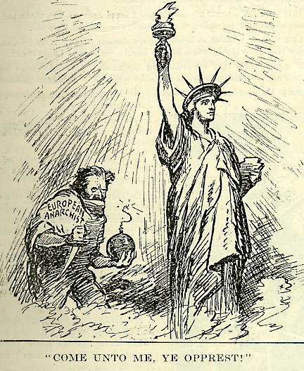
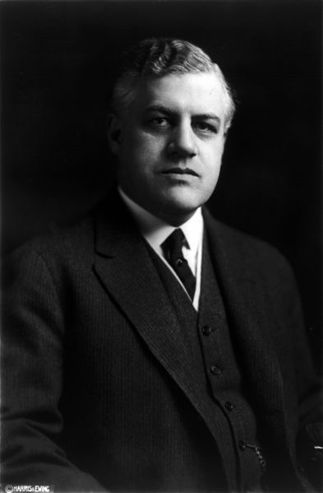
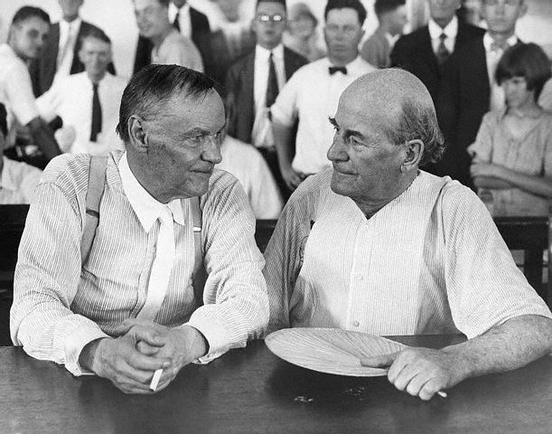
Period 7 Overview (1890 - 1945)
1920s:
Red Scare - 1918 - 1920:
Caused by Russian Revolution, labor unrest
Targeted radicals and immigrants
Quota Acts of 1920s:
Highly restrictive, aimed at “New” immigrants
New technologies:
Improved standards of living (refrigerator), personal mobility (car), better communication systems (radio)
Conflicts:
Tradition v. Innovation
Fundamentalist Christianity v. scientific modernism (Scopes Trial)
Native-born v. new immigrants - quota acts
White v. black (“Red Summer”)
Idealism v. disillusionment - Lost Generation

Slide 11
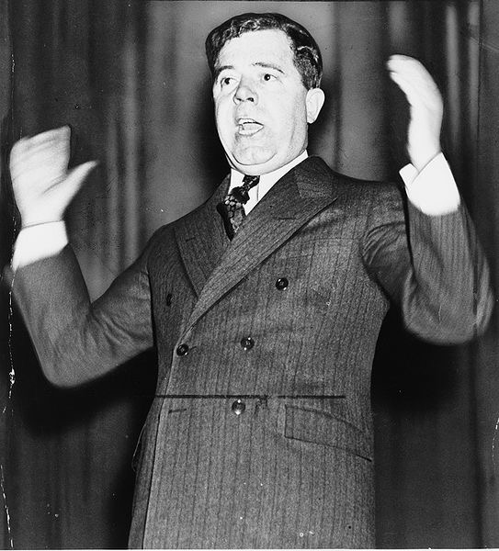
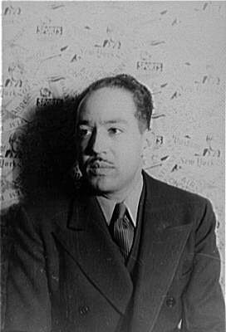
Period 7 Overview (1890 - 1945)
Harlem Renaissance
Celebration of African American culture through writings, music, etc. (Langston Hughes, Zora Neal Hurston)
The New Deal
Response to the Great Depression
Influenced by Progressive ideas
Focused on Relief, Recovery, and Reform
Changed the role of the federal government in the economy (anti-laissez-faire)
Some sought to limit the New Deal (Conservatives, Supreme Court)
Others called for more reforms (Huey Long, Father Charles Townshend)
Impacts of the New Deal?
Many agencies are still around (FDIC, Social Security)
Did not completely overcome the Great Depression
Change in voting - African Americans and unions began to support the Democratic Party

Slide 12
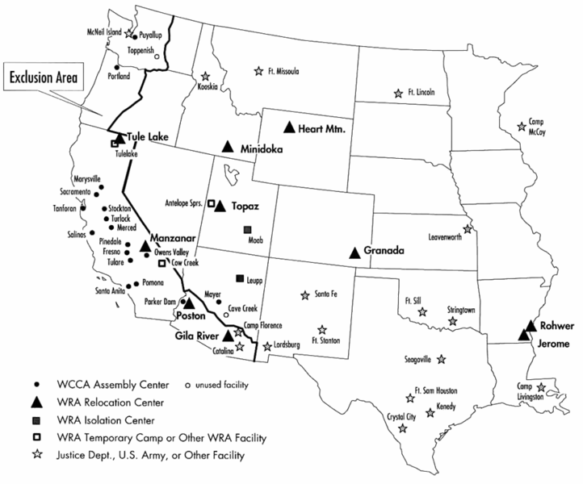
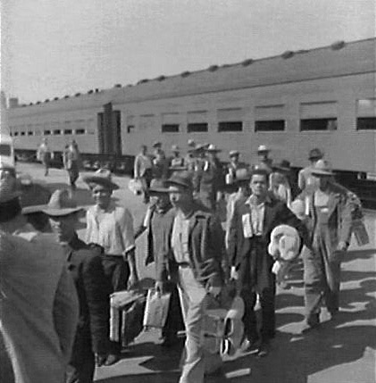
Period 7 Overview (1890 - 1945)
World War II
US was “neutral” until Pearl Harbor
Mass mobilization ended the Depression
Many economic opportunities for women and blacks
Encouraged immigration from Mexico (Bracero program)
Homefront Experiences:
Japanese internment (Executive order, upheld by Supreme Court - good potential M.C. ?)
How did the US and Allies win?
Political and military cooperation (Atlantic Charter)
Industrial production
Advancements in technology and science (Manhattan Project)
US emerged as a superpower - Europe and Asia lay in ruins

Slide 13
Period 8 Overview (1945 - 1980)
Test Structure:
Period 8 is roughly 15% of the curriculum
Essay topics could include:
US foreign policy (compared to other time periods)
Civil Rights (Compared to other time periods)
Why was 1945 - 1980 chosen for the dates?
1945 = End of WWII, shift in US foreign policy
1980 = Election of Ronald Reagan, emergence of a conservative movement
This time period focuses on the Cold War, conflicts such as Korea and Vietnam, Civil Rights, Gay Rights, and Women’s Rights, The Great Society and political scandals and controversies (Watergate and Middle East)

Slide 14
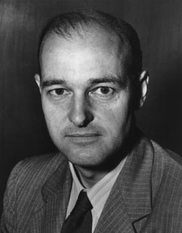
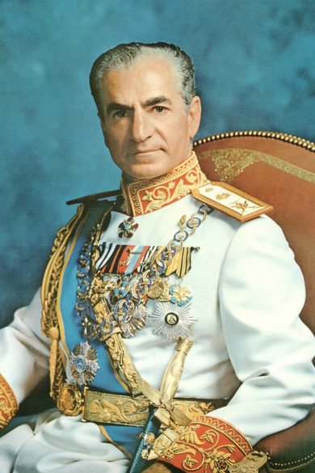
Period 8 Overview (1945 - 1980)
US foreign policy post WWII - Containment
US sought to “contain” the spread of communism
George Kennan
US focused on collective security and economic frameworks that helped non-communist nations
NATO - alliance between US and several European countries - 1st peace-time alliance
Marshall Plan and Truman Doctrine - provided $ to countries in Europe to resist communism
The US sought to support non-communist governments, even if they weren’t the most democratic
Iran, Batista in Cuba, South Vietnam
Tensions between the US and USSR fluctuated between confrontation and détente
Cuban Missile Crisis, SALT Treaties

Slide 15
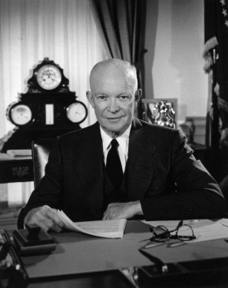
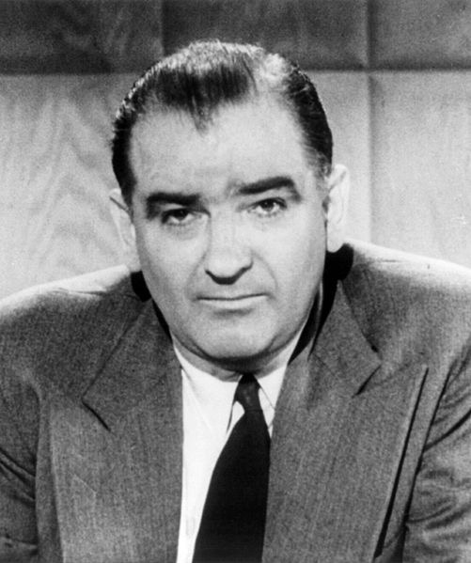
Period 8 Overview (1945 - 1980)
The home front during the Cold War
Debates over liberty vs. order
2nd Red Scare - designed to root out communists
HUAC, Joseph McCarthy, Truman’s Loyalty Oath
Eisenhower’s Farewell Address
Warned of having a large military in peacetime “Military-Industrial Complex”
“Sun Belt”
Southern US that saw an increase in population, emergence of new industries
Protests were common during the Vietnam War, especially as it dragged on
Post-1968 - Tet Offensive
Kent State Massacre

Slide 16
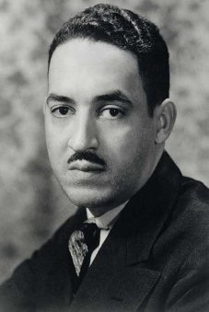
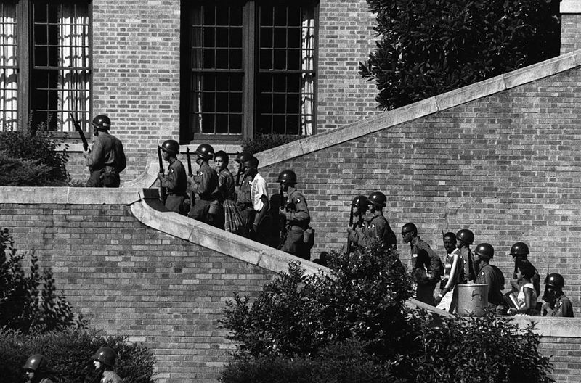
Period 8 Overview (1945 - 1980)
Civil Rights:
All three branches played an important role
Executive - desegregation of military (Truman), Judicial - Brown v. Board (reversed Plessy), Legislative - Civil Rights Act of 1964 - ended segregation
White resistance to desegregation:
Southern Manifesto
Massive Resistance
Little Rock, HS
Activists used many methods to fight segregation:
Legal challenges, direct action, and nonviolent protests
Post-1965 - tensions over philosophies increased

Slide 17
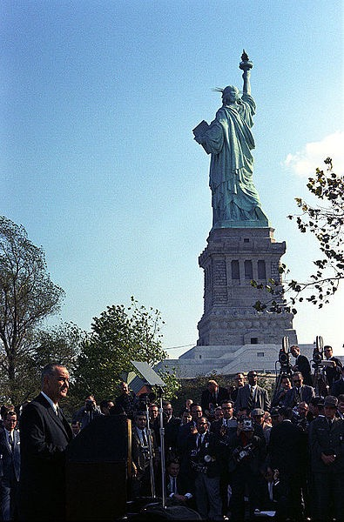
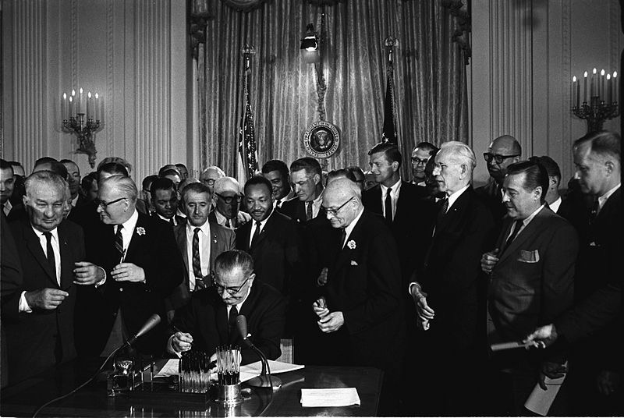
Period 8 Overview (1945 - 1980)
Great Society
Continuation of New Deal programs, implementation of new government programs (Medicare, Medicaid), and promotion of Civil Rights (Civil Rights Act of 1964, Voting Rights Act of 1965)
Height (Zenith) of liberalism - increasing involvement and power of government to fix societal problems
Immigration Act of 1965 - ended the discriminatory quota system from the 1920s, encouraged immigration from Asia and Latin America
Rights for other groups:
Women - Betty Friedan and NOW
Homosexuals - Stonewall riots in NYC - promoted Gay Rights Movement
Latinos - Cesar Chavez

Slide 18
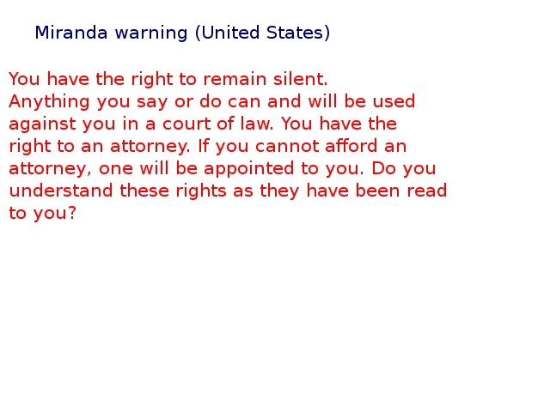
Period 8 Overview (1945 - 1980)
Supreme Court decisions expanded democracy and individual freedoms (Great potential Short Answer)
Griswold v. Connecticut - S.C. struck down laws prohibiting birth control, established “Right to Privacy”
Miranda v. Arizona - increased rights of the accused
Those arrested must be made aware of their constitutional rights (Miranda Rights)
Impact of Great Society and Supreme Court decisions?
Helped motivate the conservative movement

Slide 19
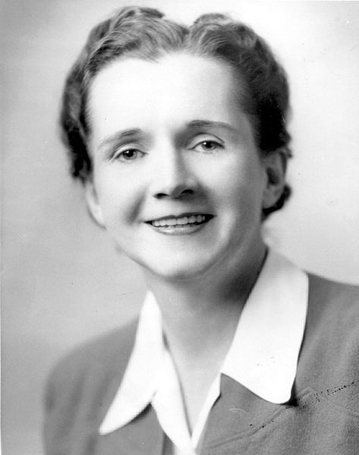
Period 8 Overview (1945 - 1980)
Environmental Concerns (Could be an essay topic dating back to Period 6 or 7, continuing through modern day)
Rachel Carson’s Silent Spring (potential multiple-choice excerpt) — brought awareness to the dangers of pesticides on the Environment
Federal government responded with, among others, the Environmental Protection Agency and the Clean Air Act
Counterculture of the 1960s
Challenged many ideas of their parents’ generation (economic, social, and political)
Helped initiate a sexual revolution

Slide 20
Period 9 Overview (1980 - Present)
Test Structure:
Period 9 is roughly 5% of the curriculum
Essay topics could include:
None exclusively on this period
Why was 1980 - Present chosen for the dates?
1980 = Election of Ronald Reagan, emergence of a conservative movement
Present = Today!
This time period focuses on the end of the Cold War, Ronald Reagan, Conservative movement, and terrorism

Slide 21
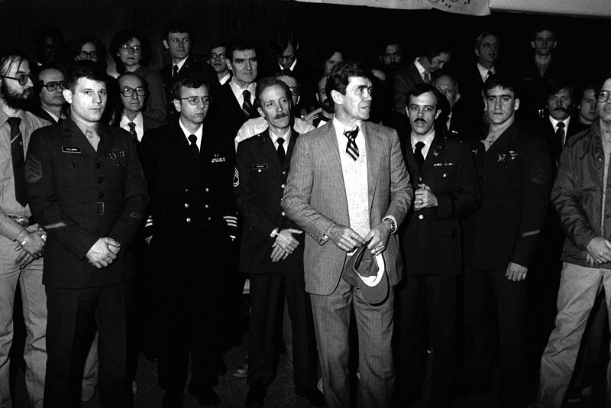
Period 9 Overview (1980 - Present)
What invigorated conservatism?
Economic problems - 1970s inflation
Growth of religious fundamentalism
Public’s loss faith in government’s ability to solve problems
Foreign Policy “Failures”
Iran Hostage Crisis - 1979 - January 1981
Reaction to the US assistance to the deposed Shah of Iran

Slide 22
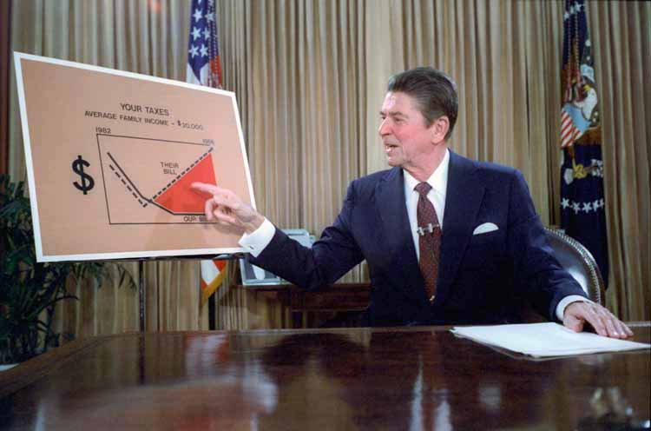
Period 9 Overview (1980 - Present)
What were conservative victories?
Taxation - reduction in taxes
Reaganomics, “trickle-down” economics
Deregulation of many industries - less involvement of the government in industries
Conservatives were not as successful with moral ideals
Abortion remained legal
Denouncing “Big Government”
Even though conservatives favored smaller government, the size of the government grew after 1980
Hard to eliminate popular programs - Medicare, Social Security, etc.

Slide 23
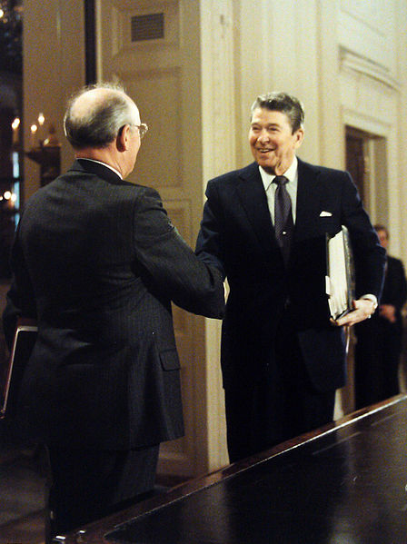
Period 9 Overview (1980 - Present)
Foreign Policy under Reagan
Early in his administration, he rejected detente
Employed “bellicose rhetoric” - “Evil Empire”
Positive relationship developed with Mikhail Gorbachev - arms reductions
Economy post-1980
US saw a decrease in manufacturing and union jobs - outsourcing
Debates over:
Free trade agreements - NAFTA
Size of government safety nets - Social Security Reform

Slide 24
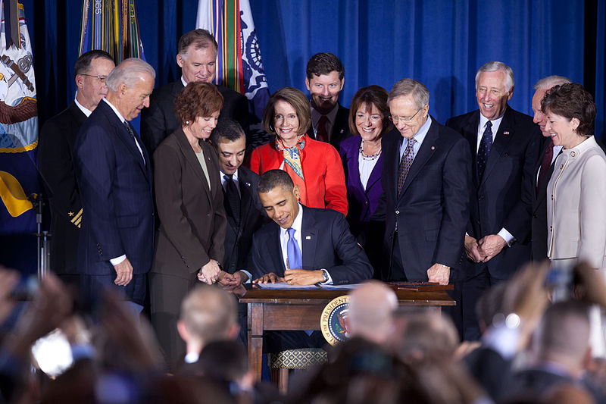
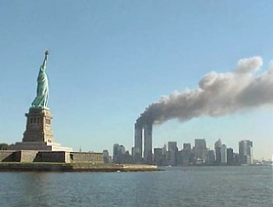
Period 9 Overview (1980 - Present)
US Population Shifts
South and West gained population (“Sun Belt”), immigrants from Latin America and Asia (after 1965 Immigration Act)
Led to many policy debates
Changes for homosexuals:
Don’t Ask, Don’t Tell - banned openly gay individuals from serving in the military (1994), later overturned in 2011
War on Terrorism:
Response to 9/11 attacks
War in Afghanistan
War in Iraq - US entered due to beliefs Iraq had WMDs and connections to terrorism
Impact of War on Terrorism?
Debates over civil liberties vs. government power (Continuity throughout history)
Similar to Sedition Acts in History

