Slide 1
American Imperialism
AP US History
Mrs. Lacks

Slide 2
Essential Question
Why did America join the Imperialist club at the end of the 19th century?
Commercial/Business Interests ($)
Military/Strategic Interests
Social Darwinist Thinking
Religious/Missionary Interests
Closed the US frontier

Slide 3
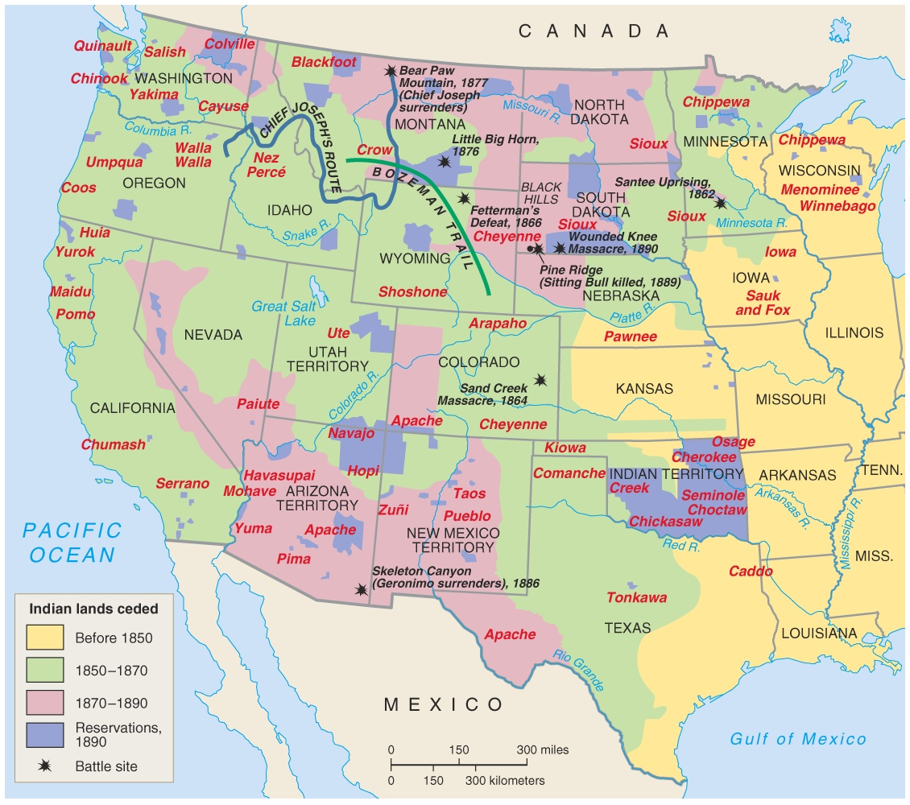
US Frontier, closed by 1890

Slide 4
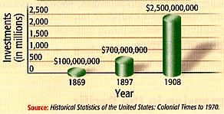
Commercial/ Business Interests
US Foreign Investments (1869 – 1908)

Slide 5
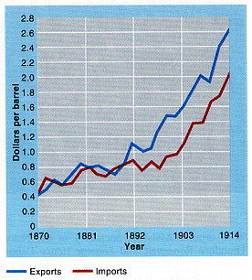
Commercial/ Business Interests

Slide 6
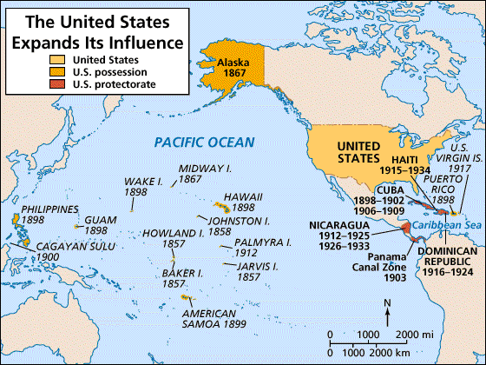
Military/Strategic Interests
Alfred T Mahan wrote The Influence of Sea History: 1660 - 1783

Slide 7
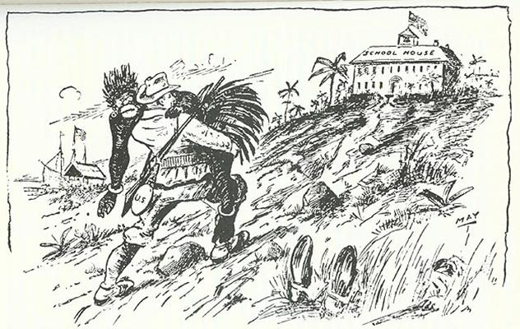
Social Darwinist Thinking

Slide 8
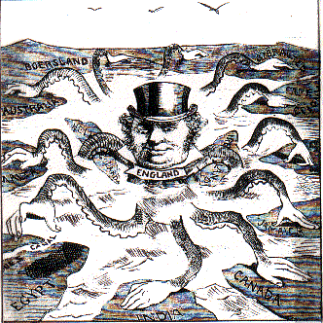
Great Britain, model of imperialist thinking

Slide 9
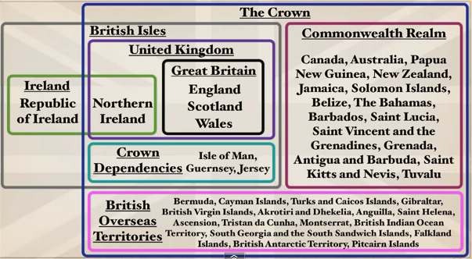
Great Britain, model of imperialist thinking

Slide 10
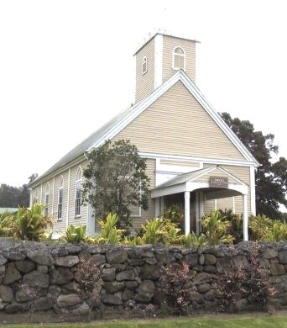
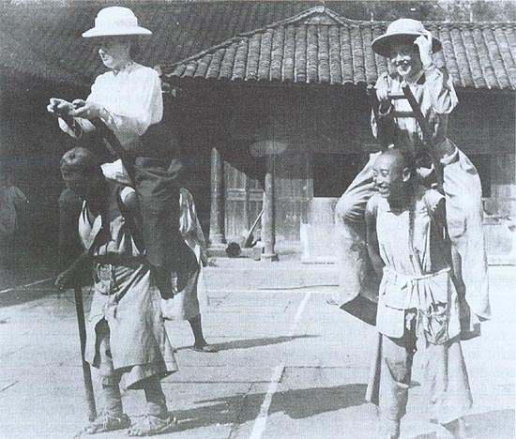
Religious/Missionary Interests
US missionaries in China, 1905
1st Church in Hawaii, 1820s

Slide 11
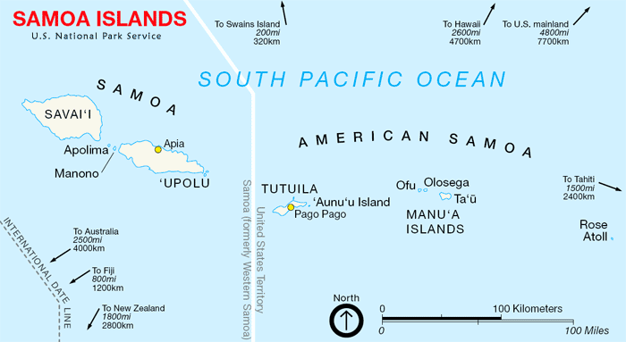
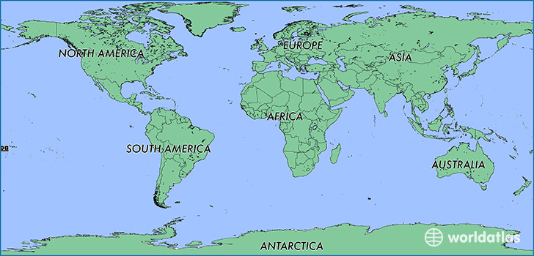
First Act of US Imperialism: Samoa

Slide 12
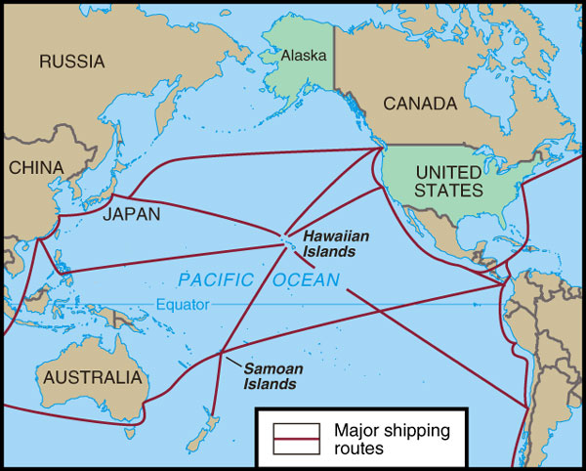
2nd Act: HawaII

Slide 13
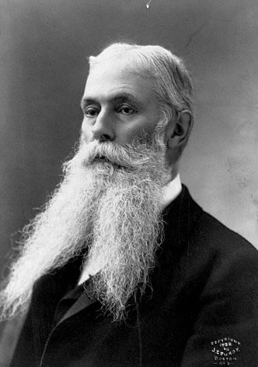
US Business Interests in Hawaii
1893 – American businessmen backed an uprising against Queen Liliuokalani.
Sanford Ballard Dole
proclaims the Republic of Hawaii in 1894 (w himself as President)
1st governor of territorial Hawaii (1900 – 1903)
Notes:
1875 – Reciprocity Treaty (free trade)
1890 – McKinley Tariff (protectionism)
1893 – American businessmen backed an uprising against Queen Liliuokalani.
Sanford Ballard Dole
proclaims the Republic of Hawaii in 1894 (w himself as President)
1st governor of territorial Hawaii (1900 – 1903)

Slide 14
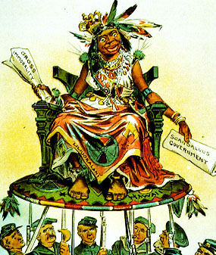
US View of Hawaiians
Hawaii becomes a US Protectorate in 1849 by virtue of economic treaties.

Slide 15
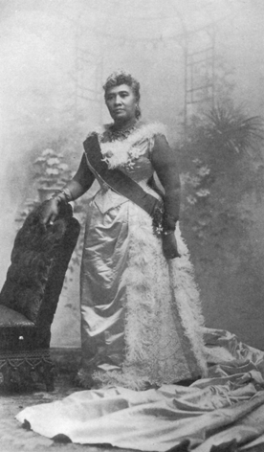
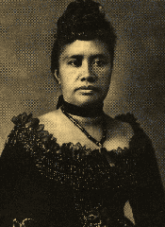
Queen Liliuokalani

Slide 16
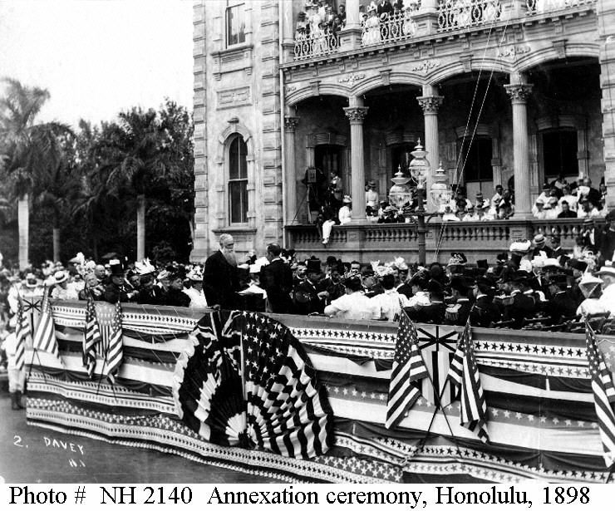
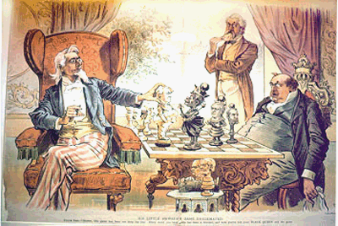
Hawaiian Annexation Ceremony, 1898

Slide 17
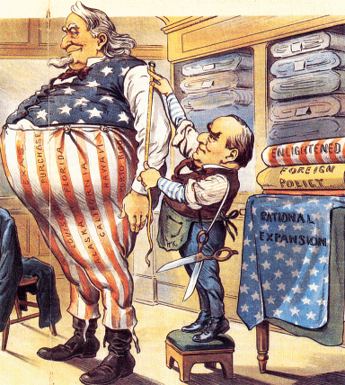
The Imperialist Tailor

Slide 18
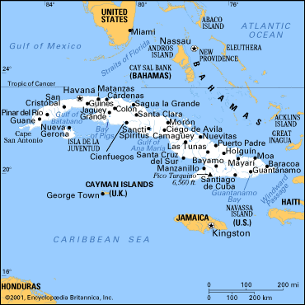
Cuba

Slide 19
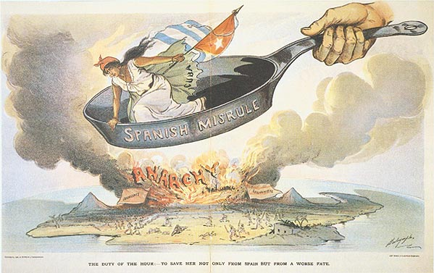
Spanish Misrule in Cuba

Slide 20
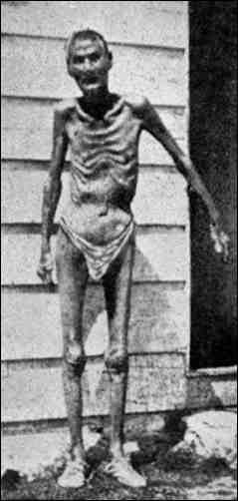
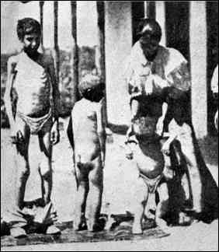
Valeriano Weyler’s “Reconcentration” Policy

Slide 21
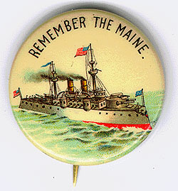
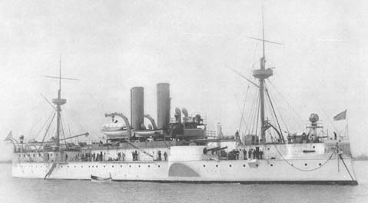
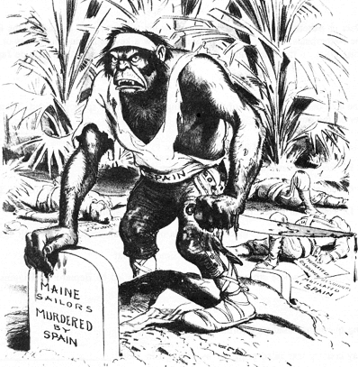
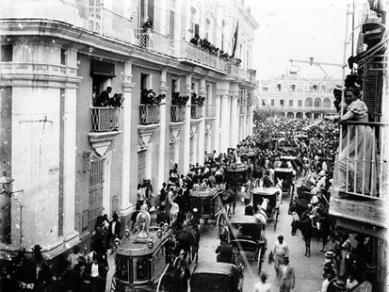
Remember the Maine and to Hell with Spain!
Funeral for Maine victims in Havana

Slide 22
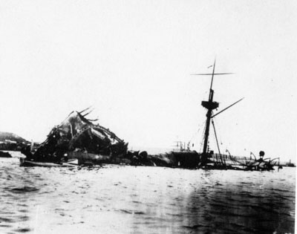

Slide 23
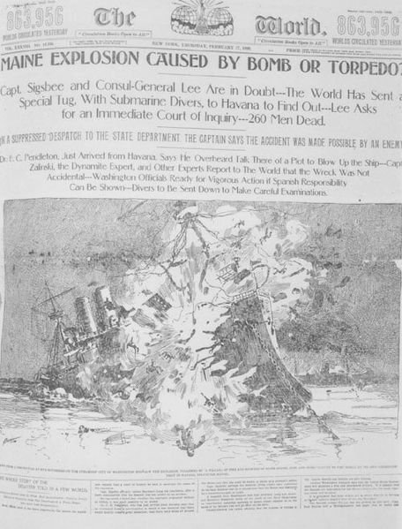
The Spanish-American War (1898): “That Splendid Little War”
US vs. Spain
Pacific Theatre (May – August 1898)
Caribbean Theatre (Feb 1898; June & July 1898)

Slide 24
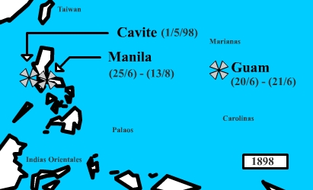
The Pacific Theatre: The Philippines & Guam

Slide 25
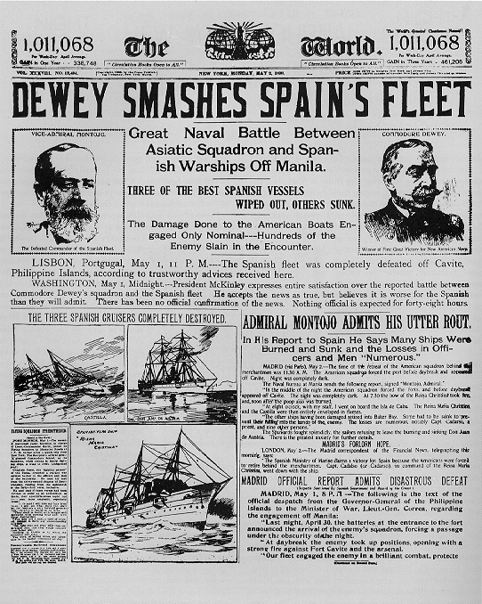
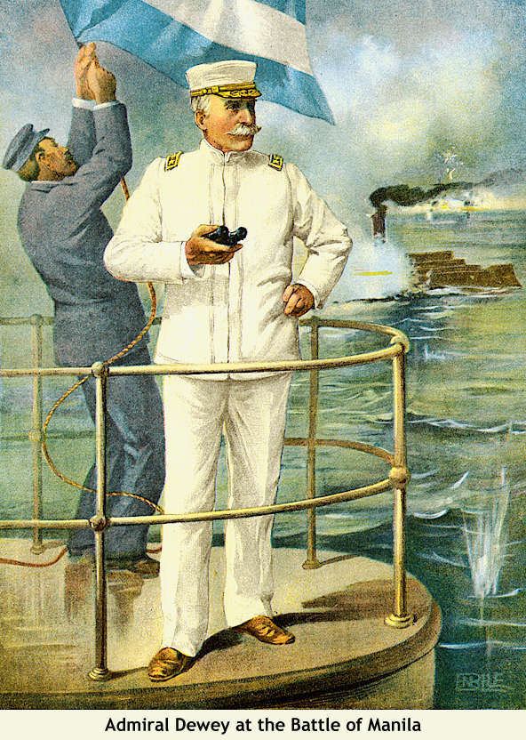
Dewey Captures Manila

Slide 26
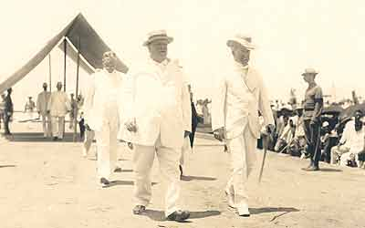
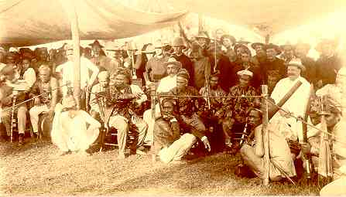
William H Taft, 1st Governor-General of the Philippines

Slide 27
The Caribbean Theatre: Cuba

Slide 28
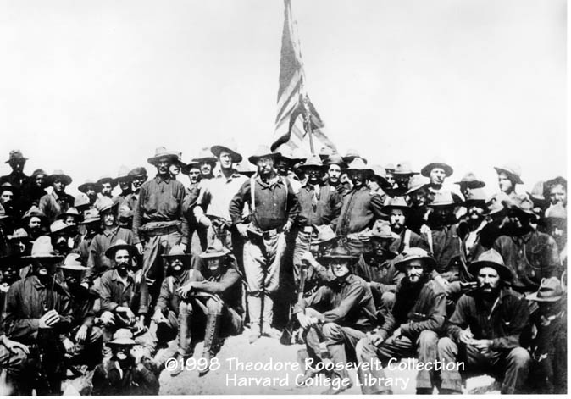
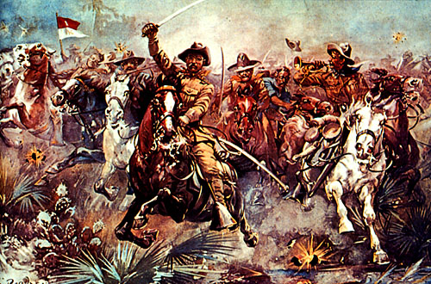
The “Rough Riders”

Slide 29
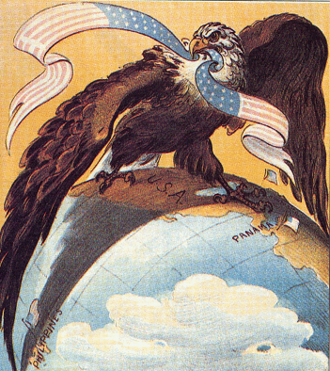
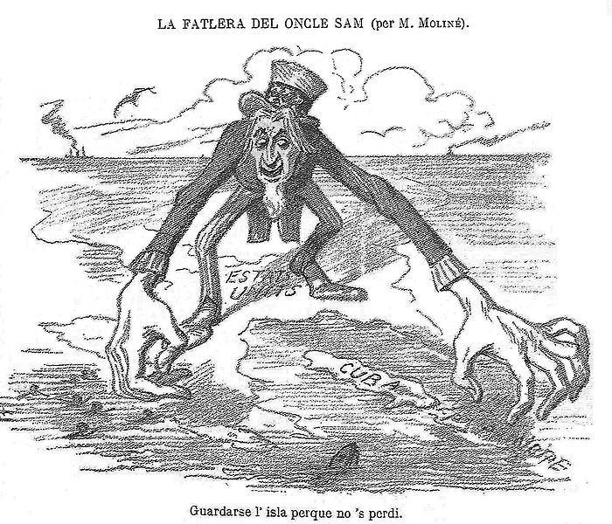
Our Sphere of Influence

Slide 30
Treaty of Paris, 1898
Cuba was freed from Spanish rule.
Spain gave up Puerto Rico and the island of Guam.
The U. S. paid Spain $20 mil. for the Philippines.
The U. S. becomes an imperial power!

Slide 31
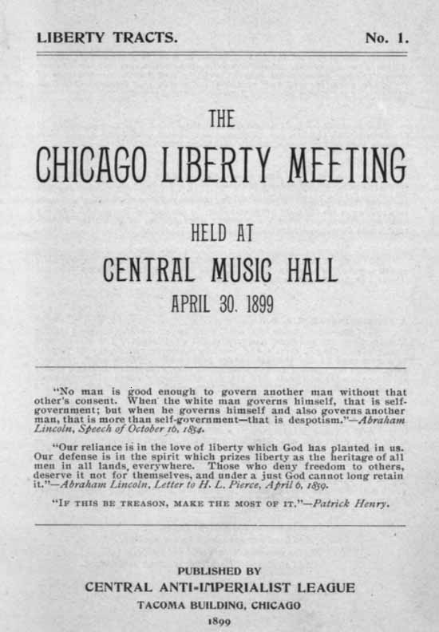
The American Anti-Imperialist League
Founded in 1899.
Mark Twain, Andrew Carnegie, and William Jennings Bryan among the leaders.
Campaigned against the annexation of the Philippines and other acts of imperialism

Slide 32
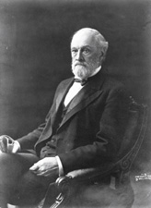
Cuban Independence?
Teller Amendment (1898)
US could not annex Cuba, but military could be there
Platt Amendment (1903)
No foreign alliances
US can intervene politically
No excessive public debt.
must lease Guantanamo Bay to the U.S. for naval and coaling station.
Senator Orville Platt
Notes:
Cuba was not to enter into any agreements with foreign powers that would endanger its independence.
The U.S. could intervene in Cuban affairs if necessary to maintain an efficient, independent govt.
Cuba must lease Guantanamo Bay to the U.S. for naval and coaling station.
Cuba must not build up an excessive public debt.

Slide 33
Dilemma… Did US Citizenship follow the flag?

Slide 34
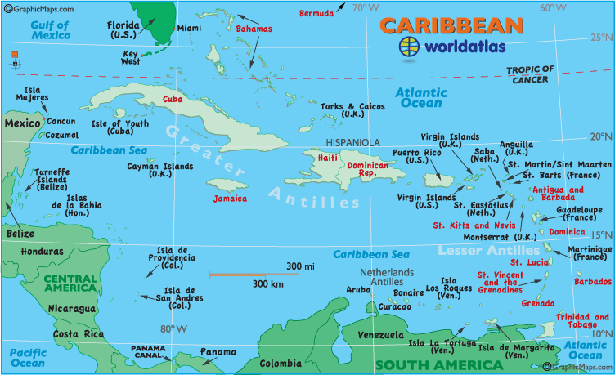
Puerto Rico
1900 - Foraker Act.
PR became an “unincorporated territory.”
Citizens of PR, not of the US.
Import duties on PR goods
1901-1903 → the Insular Cases.
Constitutional rights were not automatically extended to territorial possessions.
Congress had the power to decide these rights.
Import duties laid down by the Foraker Act were legal!

Slide 35
Puerto Rico
1917 – Jones Act
Gave full territorial status to PR.
Removed tariff duties on PR goods coming into the US.
PRs elected their own legislators & governor to enforce local laws.
PRs could NOT vote in US presidential elections.
A resident commissioner was sent to Washington to vote for PR in the House.

Slide 36
Puerto Rico
Today
Jones Act still in effect
However, in 1992, President George H. W. Bush..
Est. that all federal departments, agencies, and officials should treat Puerto Rico administratively as if it were a state
now, many including the FBI, FEMA, TSA, Social Security, and others have presence there
Also has a federal district court, and PR judges have served in that Court and in other federal courts on the mainland regardless of their residency status at the time of their appointment

Slide 37
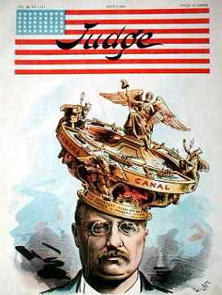
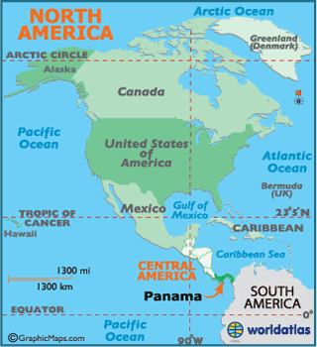
Panama

Slide 38
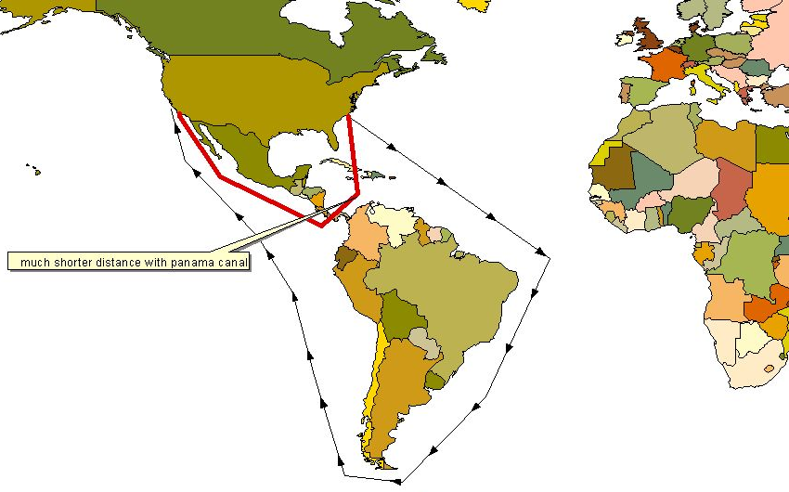
Save 9,000 miles!

Slide 39
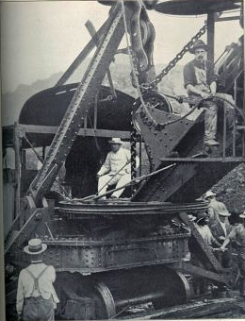
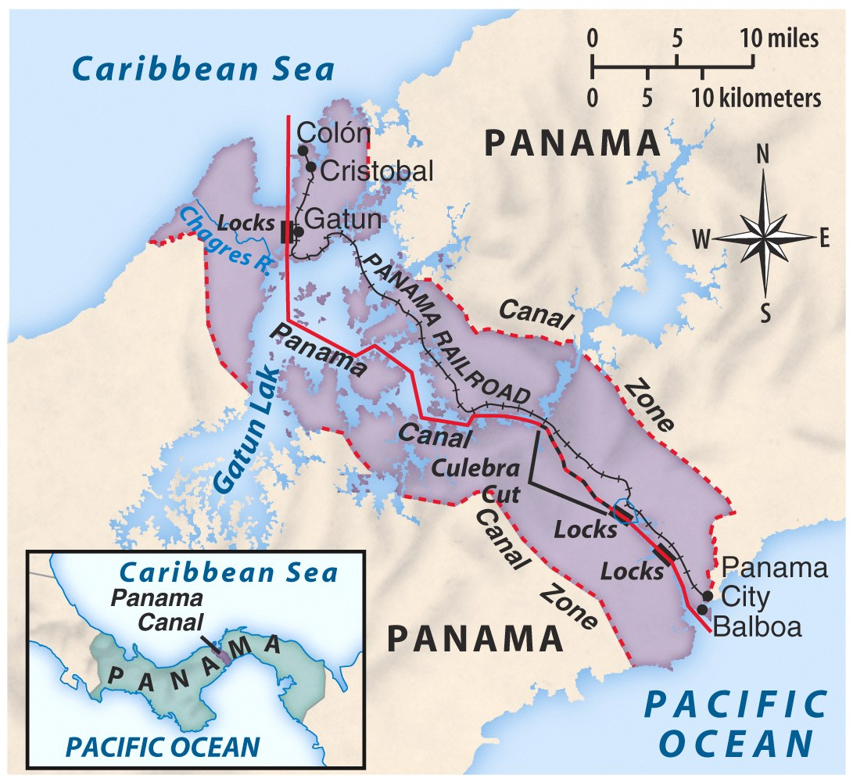
Panama Canal

Slide 40
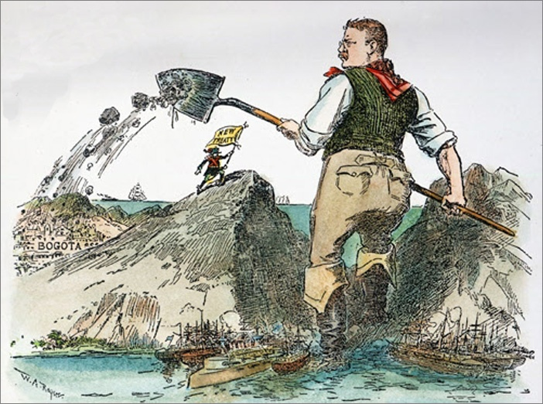
TR, the Imperialist 1903

Slide 41
Travel the Panama Canal…
http://www.youtube.com/watch?feature=iv&v=fA-pnN54uPw&annotation_id=annotation_655031

Slide 42
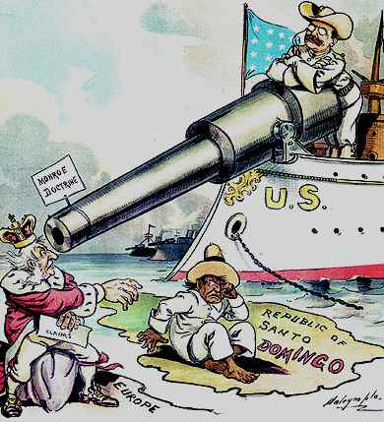
The Roosevelt Corollary
Expansion of Monroe Doctrine
US may intervene in any affairs in the western hemisphere

Slide 43
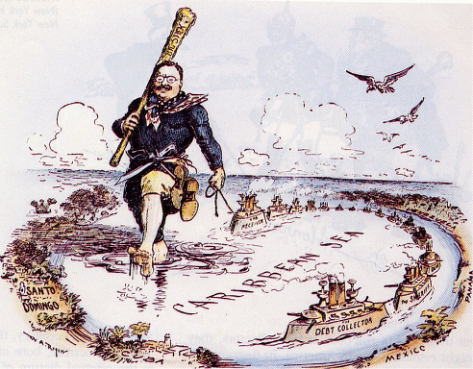
President Roosevelt: Big Stick Diplomacy

Slide 44
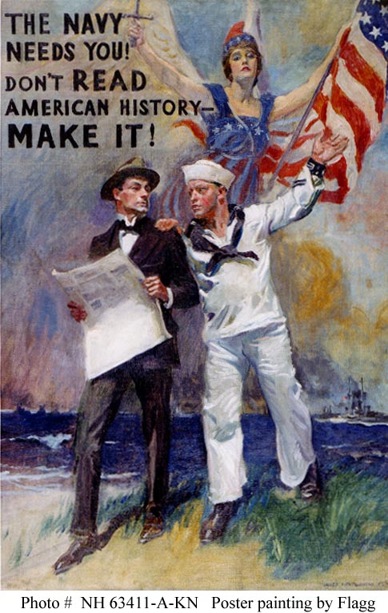
Naval Superpower: Great White Fleet (1907)

Slide 46
Far East Imperialism

Slide 47
China
Open Door Policy (1898)
Secretary of State John Hay
Give all nations equal access to trade in China.

Slide 48
Japan
Commodore Matthew Perry opens up Japan for trade, 1853
The Japanese View of Commodore Perry

Slide 49
Treaty of Kanagawa, 1854
200 years of Japanese isolationism ends

Slide 50
Gentlemen’s Agreement
A Japanese note agreeing to deny passports to laborers entering the U.S.
Japan recognized the U.S. right to exclude Japanese immigrants holding passports issued by other countries.
The U.S. government got the school board of San Francisco to rescind their order to segregate Asians in separate schools.
Why? Nativism in San Francisco

Slide 51
Root-Takahira Agreement: 1908
Japan and US
A pledge to maintain the status quo in the Far East.
Recognition of China’s independence and territorial integrity, and support for continuation of the Open-Door Policy
Maintenance of free trade and equal commercial opportunities
Japan recognizes US control of Hawaii and the Philippines
US recognizes Japanese ability to annex Korea
US concerns?
Japanese naval capabilities (post Russo-Japanese War)
Japanese economic interest in Manchuria

Slide 52
America’s New Role?

Slide 53
The Care of a growing Family

Slide 54
Constable of the World

Slide 55
Treaty Negotiator: Treaty of Portsmouth (1905)
Nobel Prize for Teddy

Slide 56
Additional Info

Slide 57
Taft’s Dollar Diplomacy
Improve financial opportunities for American businesses.
Use private capital to further U. S. interests overseas.
Therefore, the U.S. should create stability and order abroad that would best promote America’s commercial interests.

Slide 58
Mexican Revolution 1910s
Emiliano Zapata
Victoriano Huerta seizes control of Mexico and puts Madero in prison where he was murdered.
Venustiano Carranza, Pancho Villa, Emiliano Zapata, and Alvaro Obregon fought against Huerta.
The U.S. also got involved by occupying Veracruz and Huerta fled the country.
Eventually Carranza would gain power in Mexico.
Porfirio Diaz
Francisco Madero
Venustiano Carranza
Pancho Villa

Slide 59
Wilson’s Moral Diplomacy
The U. S. should be the conscience of the world.
Spread democracy.
Promote peace.
Condemn colonialism.

Slide 60
Searching for Banditos
General John Pershing & Pancho Villa
In 1914

Slide 61
US Global Investments in Latin America, 1914

Slide 62
US Interventions in Latin America, 1898 - 1934

Slide 63
Uncle Sam: One of the Boys?

Slide 64
The Territories
https://www.youtube.com/watch?v=CesHr99ezWE&t=1s

