Slide 1
Roe v. Wade (1973)
Adam Bowen

Slide 2
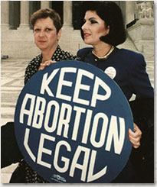
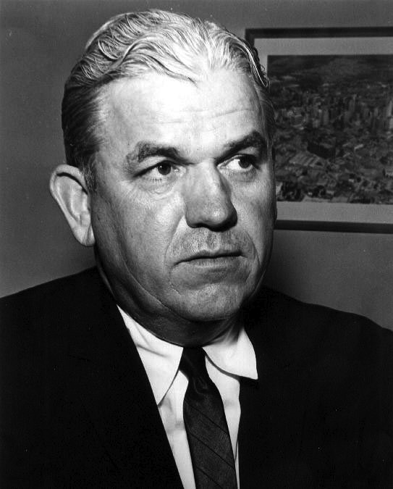
Who is Involved?
Norma McCorvey
Henry Wade

Slide 3
What’s the Story?
Appellant Jane Roe, a pregnant mother who wished to obtain an abortion, sued on behalf of all woman similarly situated in an effort to prevent the enforcement of Texas statutes criminalizing all abortions except those performed to save the life of the mother.

Slide 4
How did they get to the USCC?
Her attorneys alleged that the abortion law in Texas violated her Constitutional Rights and the rights of other women. The defendant was the district attorney of Dallas, Henry Wade. As it was a Constitutional Case claiming state law violated the constitution, the Supreme Court then decided to hear it.

Slide 5
Why is the case so important?
To help find a solution about issues including whether, and to what extent, abortion should be legal, who should decide the legality of abortion, and what methods the Supreme Court should use in constitutional judgement.

Slide 6
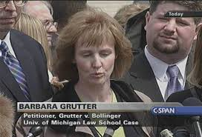
Grutter v. Bollinger (2003)
Barbara Grutter, a white law school applicant challenges a law school’s use of race as a factor in the admissions process.

Slide 7
How’d they get to the Supreme Court
University of Michigan denied Grutter because of her race

Slide 8
Why was it Important?
Schools may consider race as a part of the admissions process as long as it is only one factor in an individualized process.

