Slide 1
Elements of Design: Color
Global Connections Seminar

Slide 2
Color
Color is not essential to a good design.
Black and white and shades of gray can create 'color' that is just as effective as reds, blues, and greens.
However, color is an added dimension that can evoke moods and make powerful statements when used wisely.

Slide 3
Value
Value is present in all design.
It is the lightness or darkness of an object, regardless of color.
Value is relative to the background color and other items on the page.

Slide 4
Use Value to…
Increase/Decrease Contrast
The greater the difference in value between an object and its background, the greater the contrast
Choose the value that creates the amount of contrast and effect that you want for your design.
In the examples, the lighter value recedes into the light background.
The design with the greatest contrast makes the darker object more dominant.

Slide 5
Use Value to…
Create Movement
Objects of the same value create a static design with all objects equal in visual importance.
Introducing varying values gives the page a more dynamic appearance and creates a 'pecking order‘ among the objects.
Some stand out while others recede.
Mix elements of different values to add visual movement to your design or to create a hierarchy of importance.

Slide 6
Use value to…
Lead the Eye
By creating a pattern of dark to light values, even when the objects are equal in shape and size, it leads the eye in the direction of dark to light

Slide 7
Use color to change the effect of value:
Color has the power to override the effects of value.
In a high contrast black & white design, introducing a single, small bit of color will change the focus and balance of the design.
The eye is drawn to that spot of color even if other elements are designed to draw the eye in some other direction or the objects are otherwise equal.

Slide 8
Technical Aspects of Color
Color works differently in print and digital displays

Slide 9
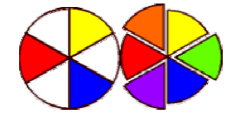
Color Talk
Traditional Colors
RED, YELLOW, and BLUE
Mix two primary colors to get the complementary colors
Traditional complementary colors are ORANGE (Red plus Yellow), GREEN (Yellow plus Blue), and PURPLE (Blue plus Red).

Slide 10
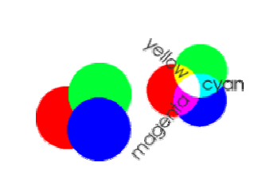
Color Talk
The visible spectrum of light breaks down into three color regions: RED, GREEN, and BLUE.
Add RED, GREEN, and BLUE (RGB) light to create WHITE light. Because you ADD the colors together to get White, we call these the additive primaries.
Subtract one of the colors from the other three and you are left with yet another color.
RGB minus RED leaves CYAN. RGB minus the BLUE leaves YELLOW.
RGB minus GREEN leaves MAGENTA.
These are called the subtractive primaries (CMY)

Slide 11
Color Talk
Your computer monitor emits light so it stands to reason that the computer uses the three color regions of RED, GREEN, and BLUE to reproduce the colors we see.
Working with images destined for the screen or the Web, we designate colors by the amount of RED, GREEN, or BLUE in the color.
A number between 1-255 designates the amount of each color RED, GREEN, or BLUE.

Slide 12
Hues, tints, shades, & saturation
Although we often depict the color wheel with blocks of solid color, it is really millions of colors that blend one into another as we move around the wheel. Similar to this color wheel:

Slide 13
Hues, tints, shades, & saturation
Each of those individual colors is a hue. Red is a hue. Blue is a hue. Purple is a hue.
You can change the saturation of a hue by adding black (shadow) or white (light). The amount of saturation gives us our shades and tints.
Add varying amounts of black to get shades.
Add varying amounts of white to get tints.

Slide 14
Combining/Contrasting Color
http://www.jellocube.com/screendesign/harmonies.swf

Slide 15
Our perception of color

Slide 16
Our perception of color
The right colors can bring a design to life, or destroy an otherwise excellent piece. However, color can't rescue a piece that isn't well-designed in the first place.
Colors fall into three general categories: warm, cool, and neutral.
The way we mix those colors along with attention to value, can add interest, enhance the design concept, or convey specific messages.

Slide 17
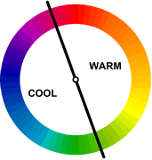
Warm Colors
Warm Colors (exciting): Red, Yellow, Orange (& Black)

Slide 18
Cool Colors
Cool Colors (calming): Blue, Green (& White)

Slide 19
Mixed Cool/Warm Colors
Mixed Cool/Warm Colors: Purple

Slide 20
Natural Colors
Neutral Colors (good for backgrounds): Brown, Tan, Beige, Gray, Silver, Black, White

Slide 21
Color perception
Color is non-verbal communication.
Colors have symbolism and meanings that go beyond ink
the eye and the mind perceive certain colors differently
Sometimes colors create
a physical reaction (red has been shown to raise blood pressure)
a cultural reaction (in the U.S. white is for weddings, in some Eastern cultures, white is the color for mourning and funerals).
Colors follow trends as well. Avocado, a shade of green, is synomous with the 60s and 70s in the minds of some consumers.

Slide 22
Red & Pink: Love & War
Red is hot.
It's a strong color that conjures up a range of seemingly conflicting emotions from passionate love to violence and warfare.
Red is Cupid and the devil.
Use red to grab attention and to get people to take action.

Slide 23
Red & Pink: Love & War
Red
Power (red carpet)
speed (combined with confidence or a dash of danger)
happiness and prosperity; attracts good luck (China)
worn by brides in the East
In combination with green, red is a Christmas color — a joyful season. In some cultures, red denotes purity, joy, and celebration
Pink is a softer, less violent red.
sweet side of red (both colors denote love but while red is hot passion, pink is romantic and charming)
Use pink to convey playfulness (hot pink flamingoes) and tenderness (pastel pinks)

Slide 24
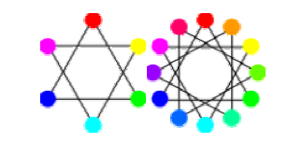
Red goes with…
Harmonizing (analogous) colors:
Complimentary Colors:
Opposite Color:

Slide 25
Red Combinations

Slide 26
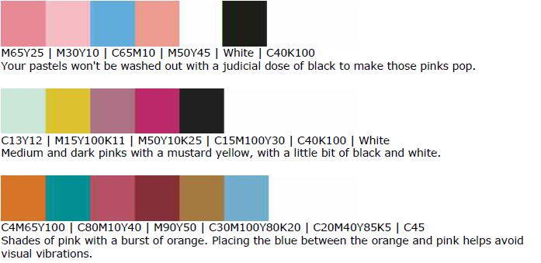

Slide 27
Yellow & Gold: Hope & Happiness
Yellow is sunshine
On the one hand it denotes happiness and joy but on the other hand it's the color of cowardice and deceit
Use the color to
lift spirits and project optimism (yellow ribbons for loved ones deployed)
welcome home loved ones
perk up a more subdued palette of blues and grays
carry out a healthy, summery, citrus theme.

Slide 28
Yellow & Gold: Hope & Happiness
Because of the high visibility of bright yellow, it is often used for hazard signs and some emergency vehicles.
A cousin to yellow (and orange and brown) is gold. While green may be the color of money (U.S. money, that is) gold is the color of riches. While 'all that glitters is not gold' the color gold still suggests grandeur, and perhaps on the downside, the excesses of the rich. Glittery gold denotes richness from money while an earthy, orange gold can suggest more emotional riches from family and friends

Slide 29
Yellow & Gold: Hope & Happiness
Harmonizing colors:
Complimentary Colors:
Opposite Color:

Slide 30
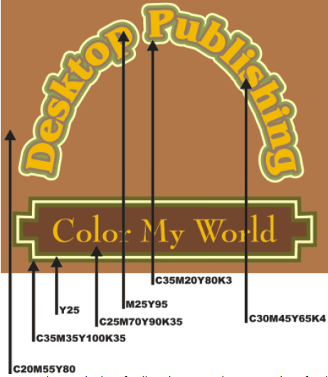
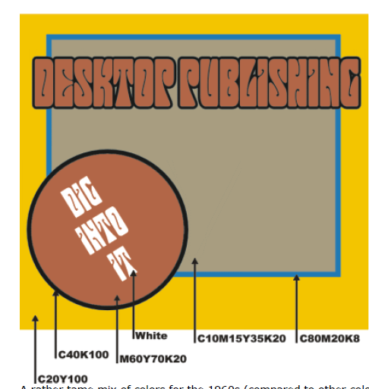
Victorian Colors
1960s Colors (slightly subdued for mellow effect)

Slide 31
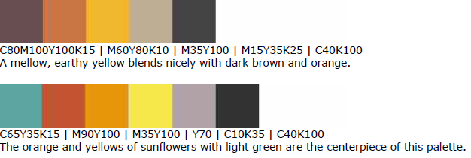
Yellow Combinations

Slide 32
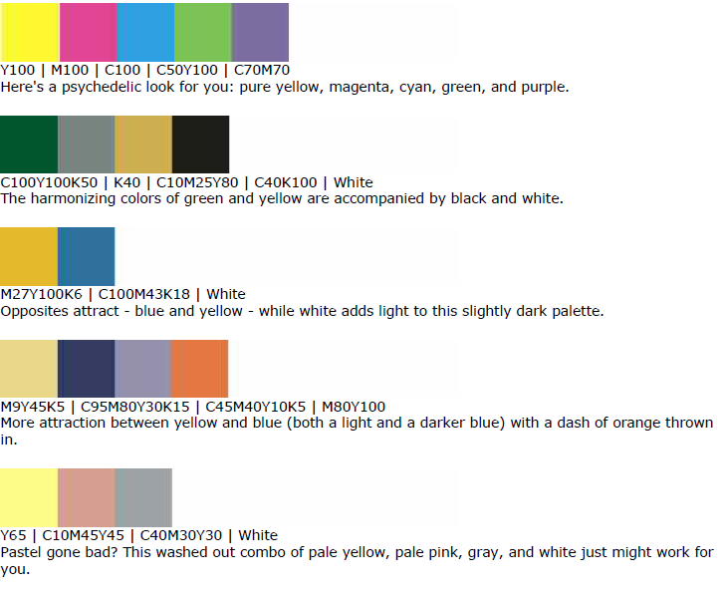

Slide 33
Orange
Orange is vibrant, denotes energy, warmth
Less intensity than red, calmed cheerfulness of yellow
Use orange to
Stimulate emotions, even appetite
Get attention without screaming
Be friendly (like peaches)
Promote good health (Vitamin C)
Get people thinking/talking (sociable)

Slide 34
Orange
Harmonizing colors:
Complimentary Colors:
Opposite Color:

Slide 35
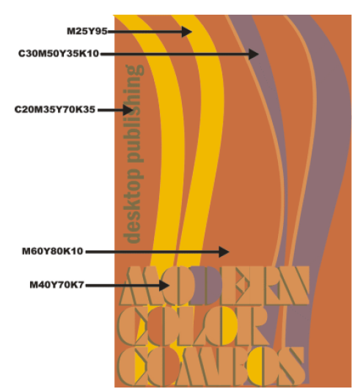

Slide 36
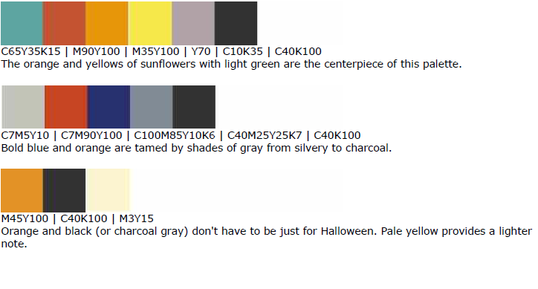
Orange Combinations

Slide 37
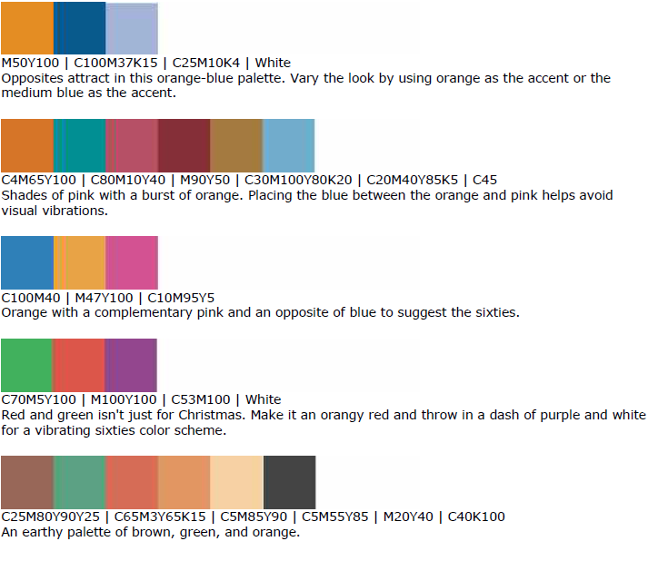

Slide 38
Blue
Blue is calming
Significant in many religious beliefs, blue brings peace and keeps evil away
Often used by corporations
Use blue to
Show superiority (Navy)
Bring confidence without being sinister
Show intelligence, stability, unity, conservatism
Light blue + dark blue = trust & truthfulness (banking)
Blue + green = nature, water
Cools down reds and yellows

Slide 39
Blue
Harmonizing colors:
Complimentary Colors:
Opposite Color:

Slide 40
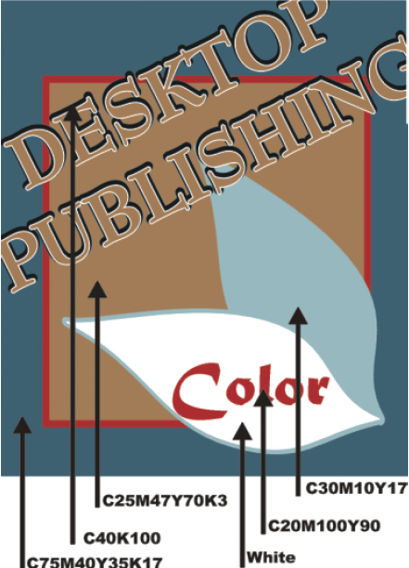
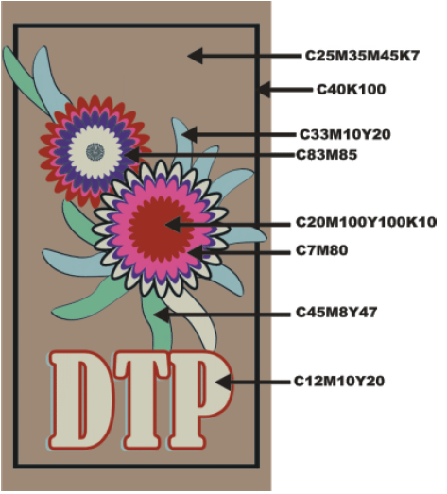
Atomic Age Colors

Slide 41
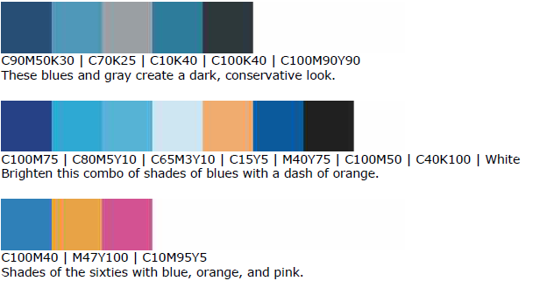
Blue Combinations

Slide 42
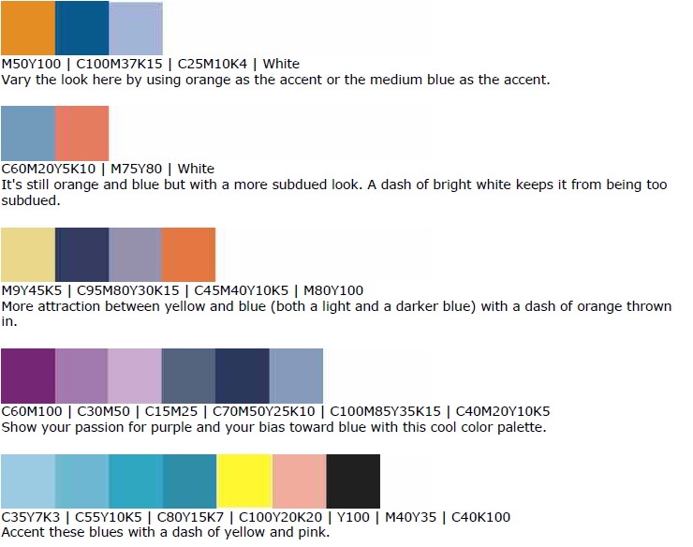

Slide 43
Green and Teal
Green is life
Teal reveals liveliness
Use green to
Show abundance, renewal, environment
Create jealousy or envy
Unveil inexperience
Denote balance, harmony, and stability
Convey quiet contemplation

Slide 44
Green
Harmonizing colors:
Complimentary Colors:
Opposite Color:

Slide 45
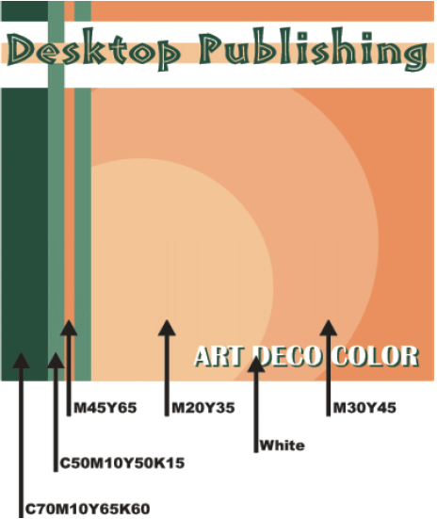
Art Deco Colors

Slide 46
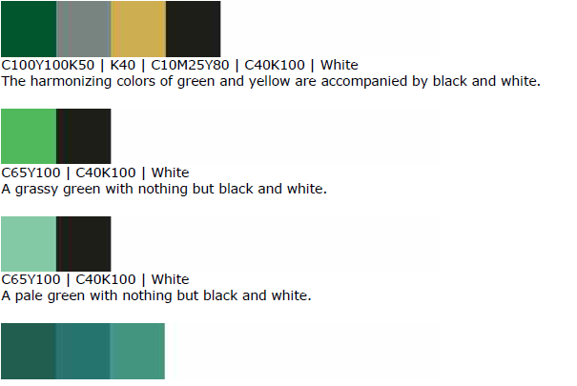
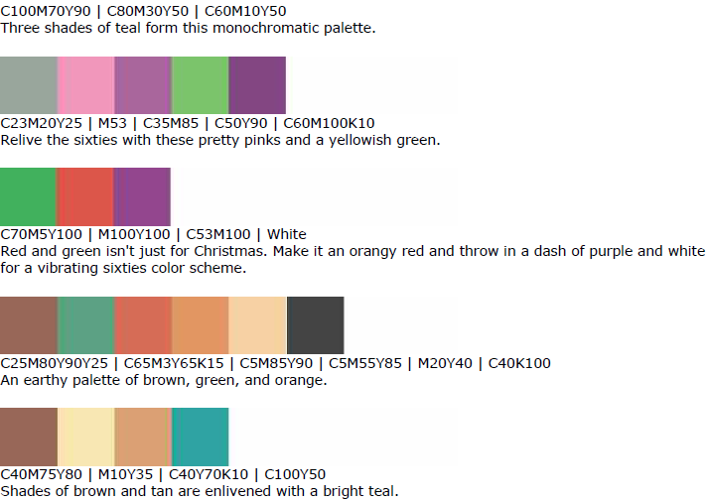

Slide 47
Purple & Lavender
Purple is royalty, nobility, and spirituality
Deep/bright purple suggests riches
Lighter purples are more romantic and delicate
Associated with creativity & moodiness
Eggplant + neutral tans = earthy, conservative, mysterious
Sacred in nature (many purple flowers) suggest uniqueness, refinement, intrigue

Slide 48
Purple
Harmonizing colors:
Complimentary Colors:
Opposite Color:

Slide 49
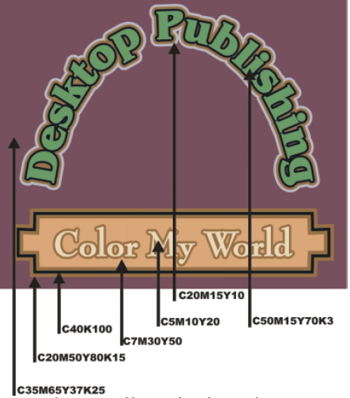
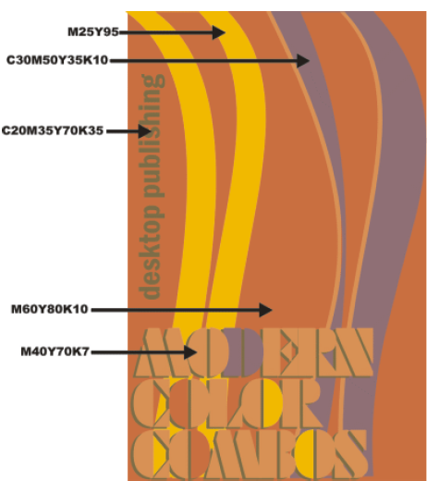

Slide 50
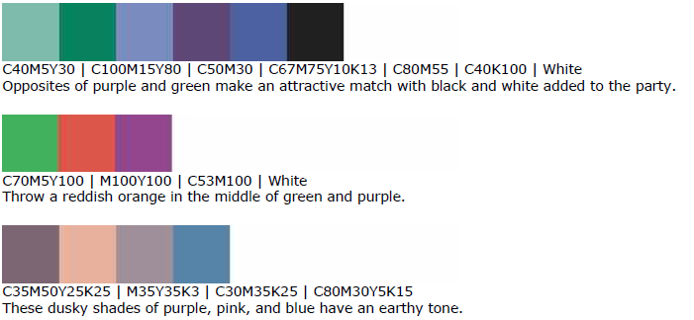
Purple Combinations

Slide 51
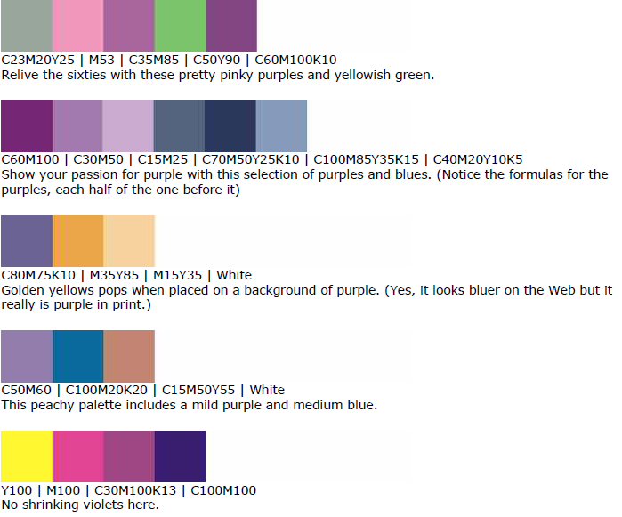

Slide 52
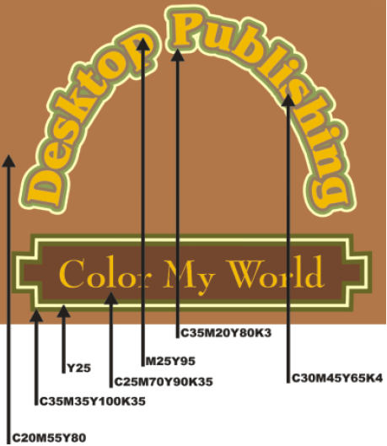
Brown (neutrals)
Brown is natural, down to earth
Often used as an accent color
Use brown to convey
Wholesomeness
Richness
Simplicity
Dependability
Friendliness

Slide 53
Brown Combinations

Slide 54
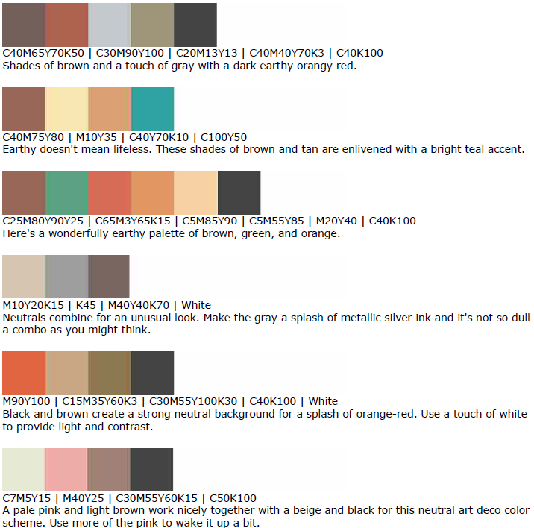

Slide 55
Gray and Silver
Gray is neutral, balanced
Usually cool and collected, rarely evoking emotion
Can also be seen as cloudy or moody
Dark, charcoal gray – strength, mystery of black
Silver – lively, playful, sleek, elegant

Slide 56
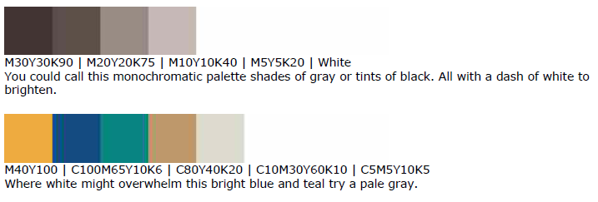
Gray Color Combinations

Slide 57
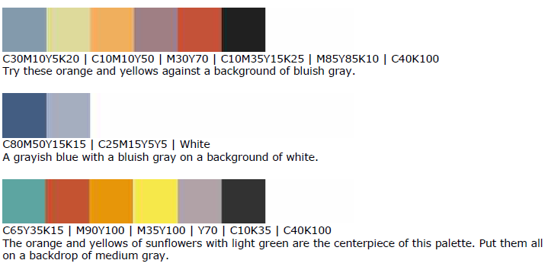
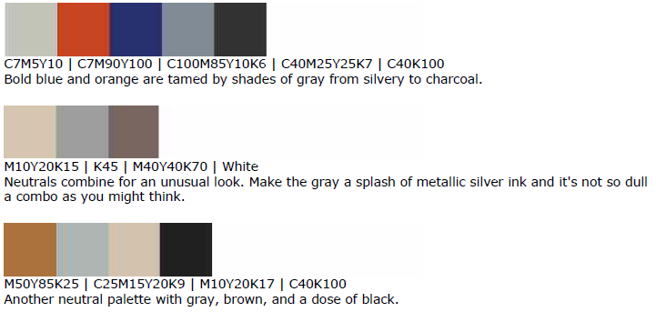

Slide 58
Dark & Light
Black and white are opposites, but share neutrality
Black is conservative (goes with every color except very dark)
Black is… serious, conventional, mysterious, sexy, sophisticated, both positive and negative
In the West, it is the color of mourning
Among youth, it is seen as rebellious
Makes lighter colors pop out

Slide 59
Dark & Light
White is purity, cleanliness, innocent
Also goes with any color
In West, color for brides; In East, color for funerals
Often associated with hospitals, esp doctors, nurses, and dentists
Light beiges and creams carry the same attributes as white, but are less blinding, more subdued

Slide 60
